Slide 1

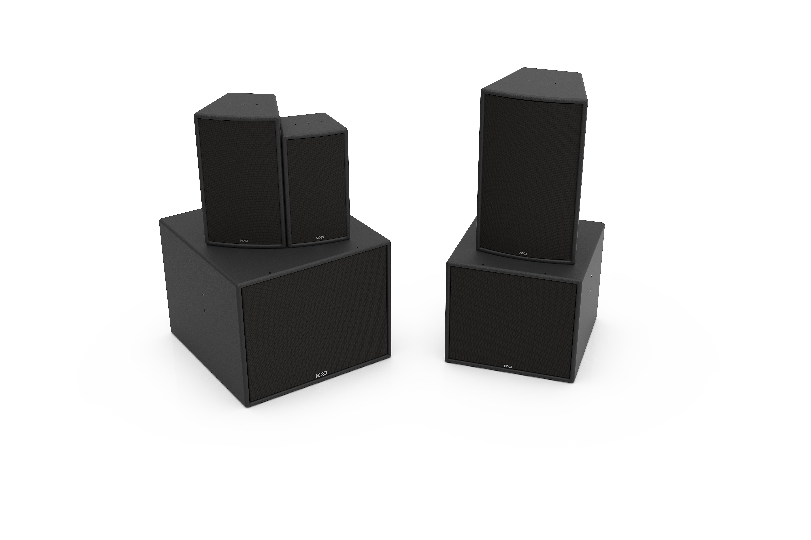
Affordable quality with no compromise

Slide 2
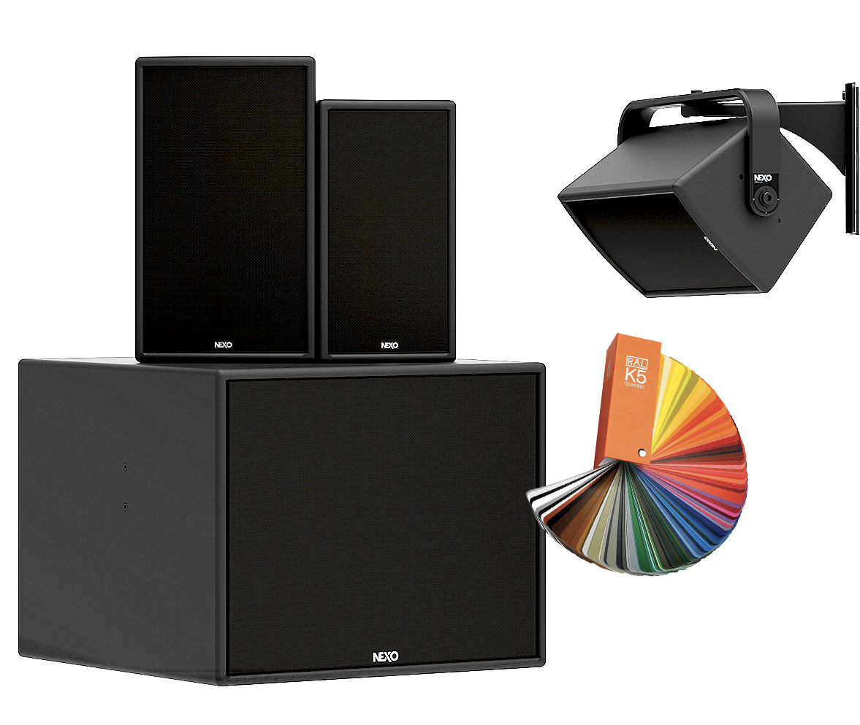



NEXO Performance
for critical cost
ePS6, ePS8, ePS10 Main cabinets
Dedicated eLS400, eLS600 subs
130dB Peak SLP (ePS10)
Variable HF directivity
Universal Mountings and accessories
Screw Connectors behind IP cover

Slide 3




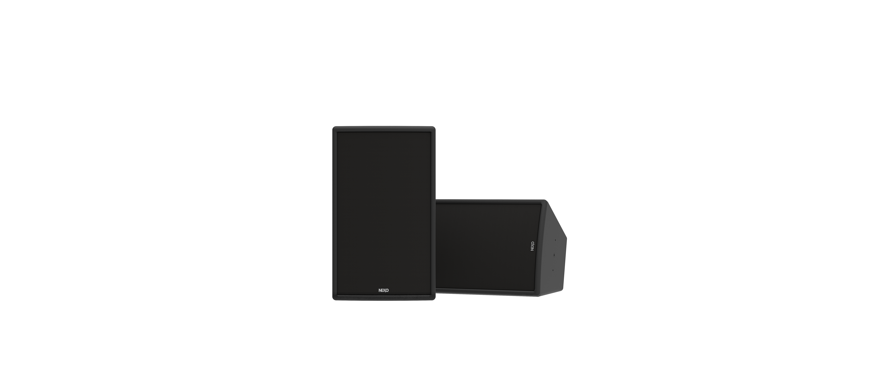
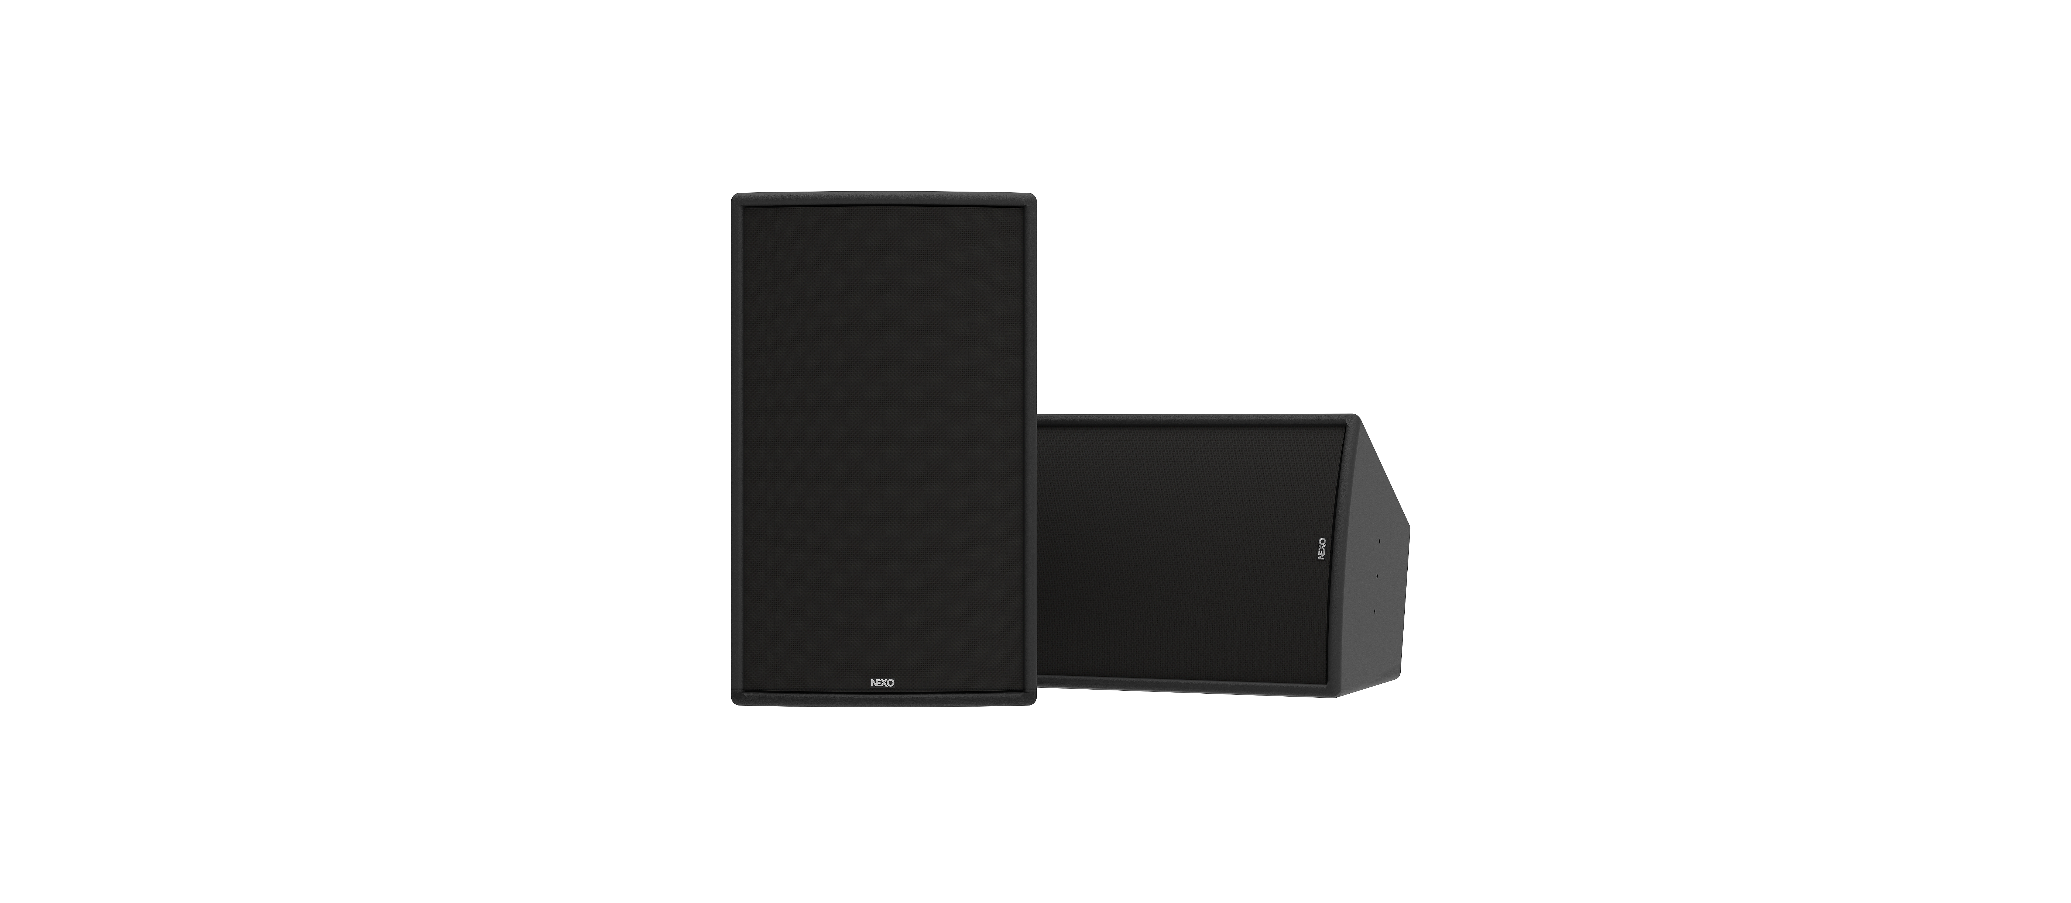
Built on the legendary
NEXO PS platform
7.1kg
8.1kg
14.8kg
367 x 200 x 182 mm
90 Hz – 20 kHz
125dB
425 x 252 x 227 mm
80 Hz – 20 kHz
128dB
533 x 318 x 283 mm
70 Hz – 20 kHz
130dB

Slide 4


Companion Sub
12” Long-Excursion Driver
45Hz-150kHz
130dB Peak
Crossover Fqy : 45- 85 Hz, 45-120 Hz,
45-150 Hz
14.5kg

Slide 5
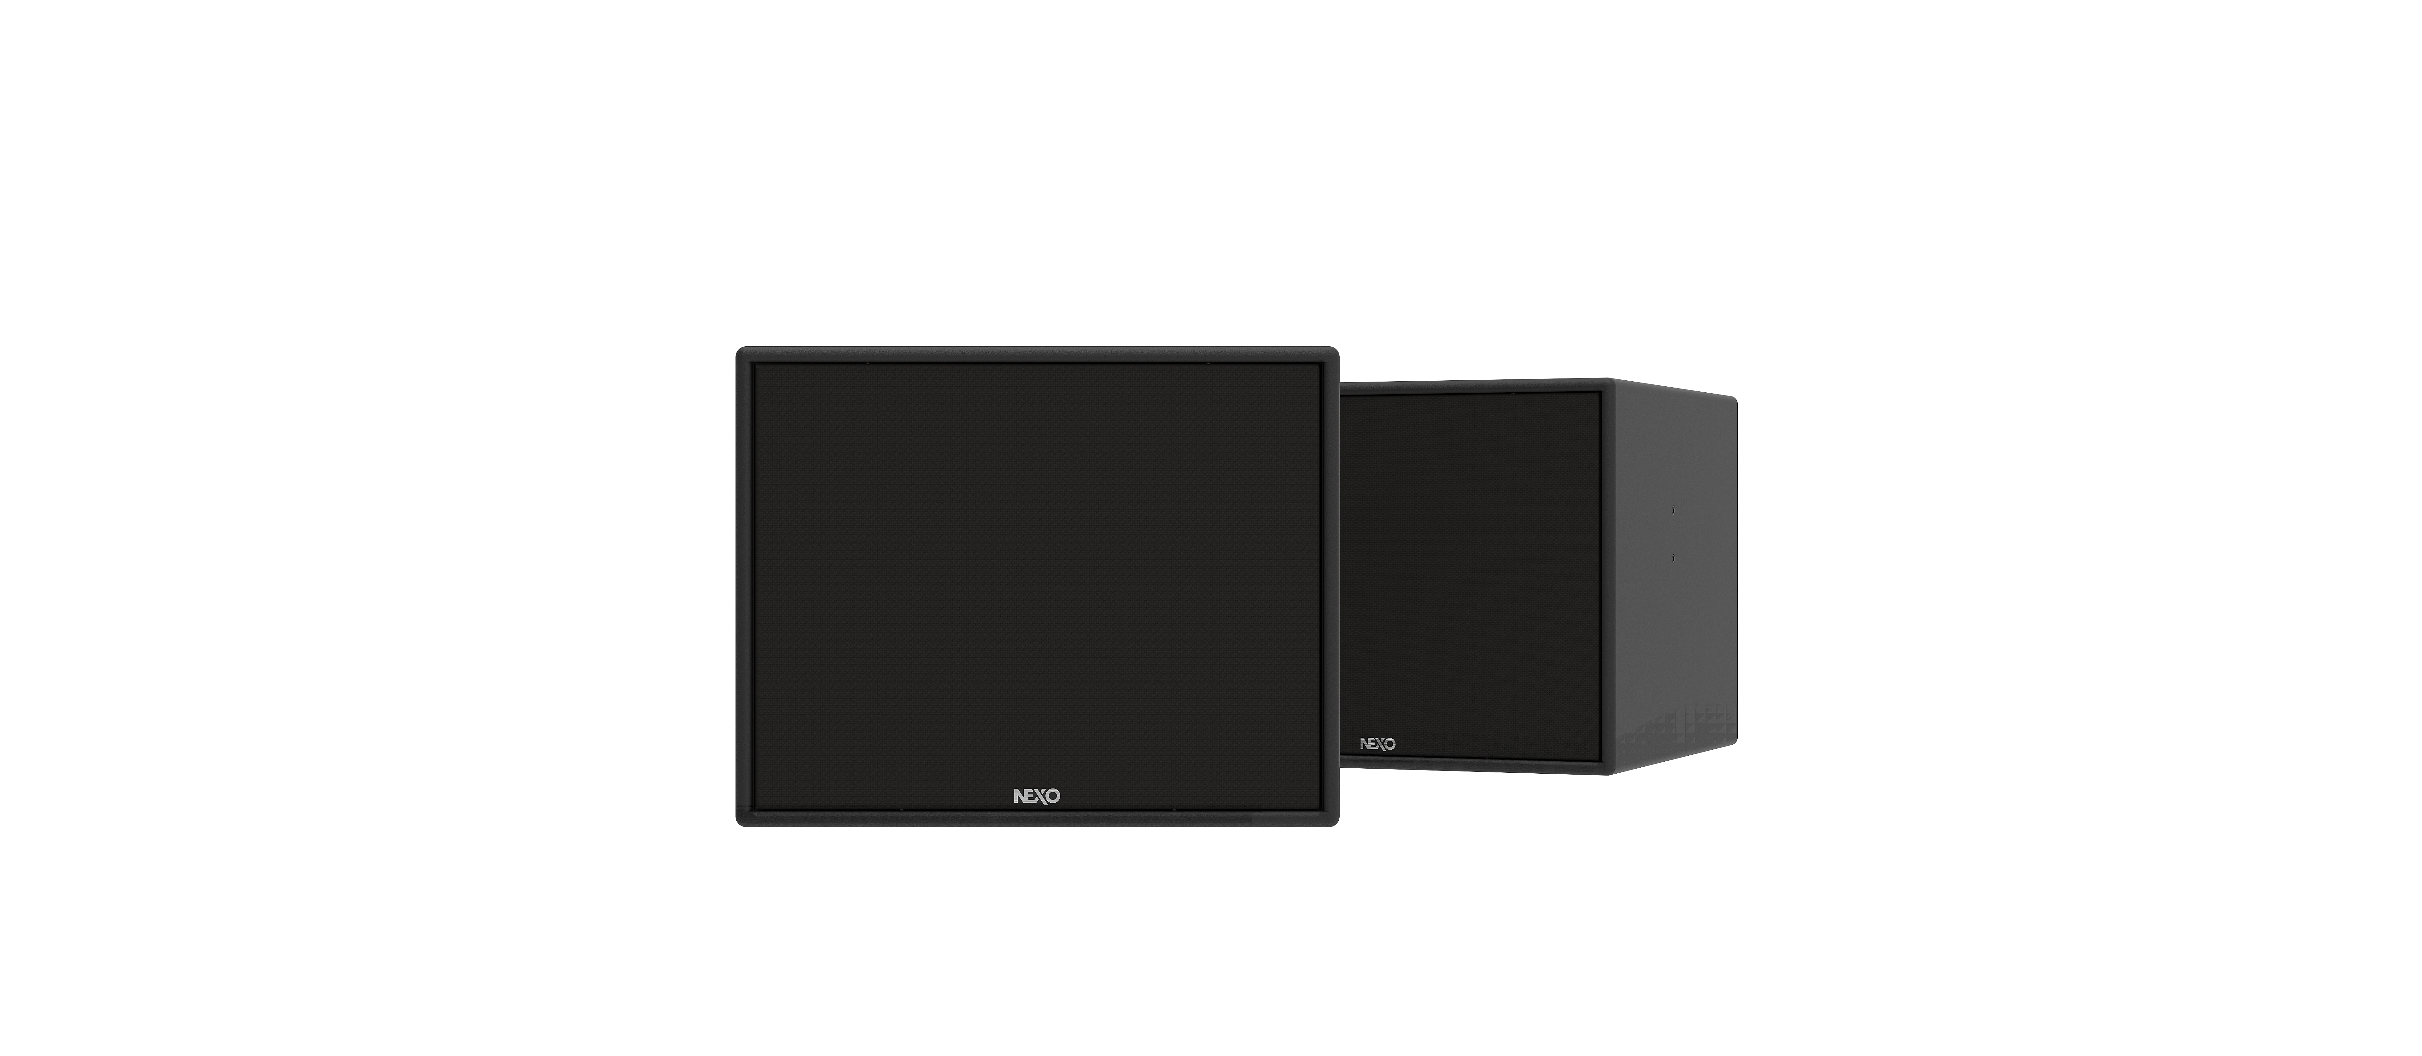

Companion Sub
15” Long-Excursion Driver
45Hz-150kHz
136dB Peak
Crossover Fqy : 45- 85 Hz, 40-120 Hz,
40-150 Hz
26.3kg

Slide 6
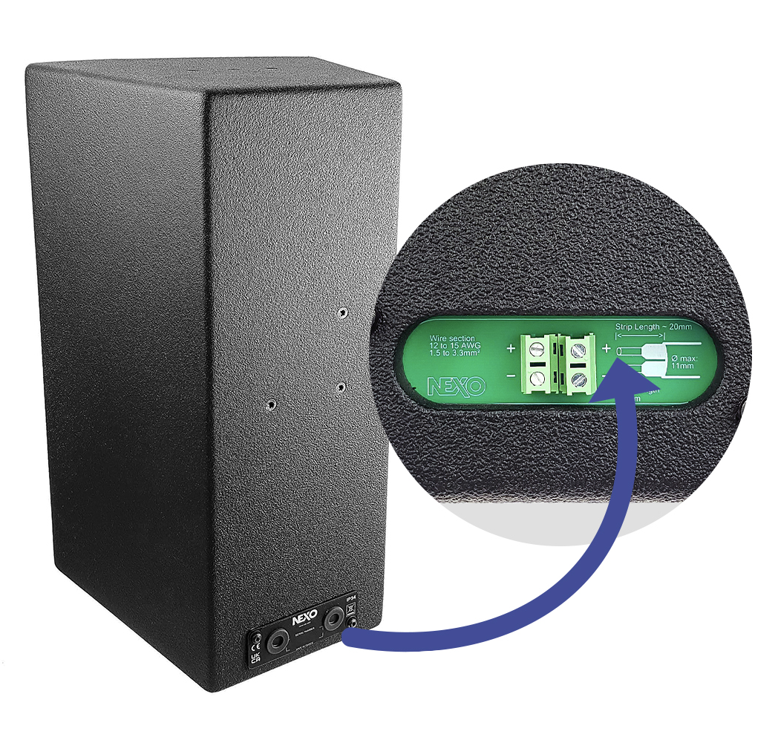
Connectivity
All three main cabinets and both subs are minimally fitted with a hard-wired strip for connection, offering generic 2 x 7 mm pitch IN/OUT screw connectors.
The included IP cover protects the connectors from moisture in outdoor applications.

Slide 7
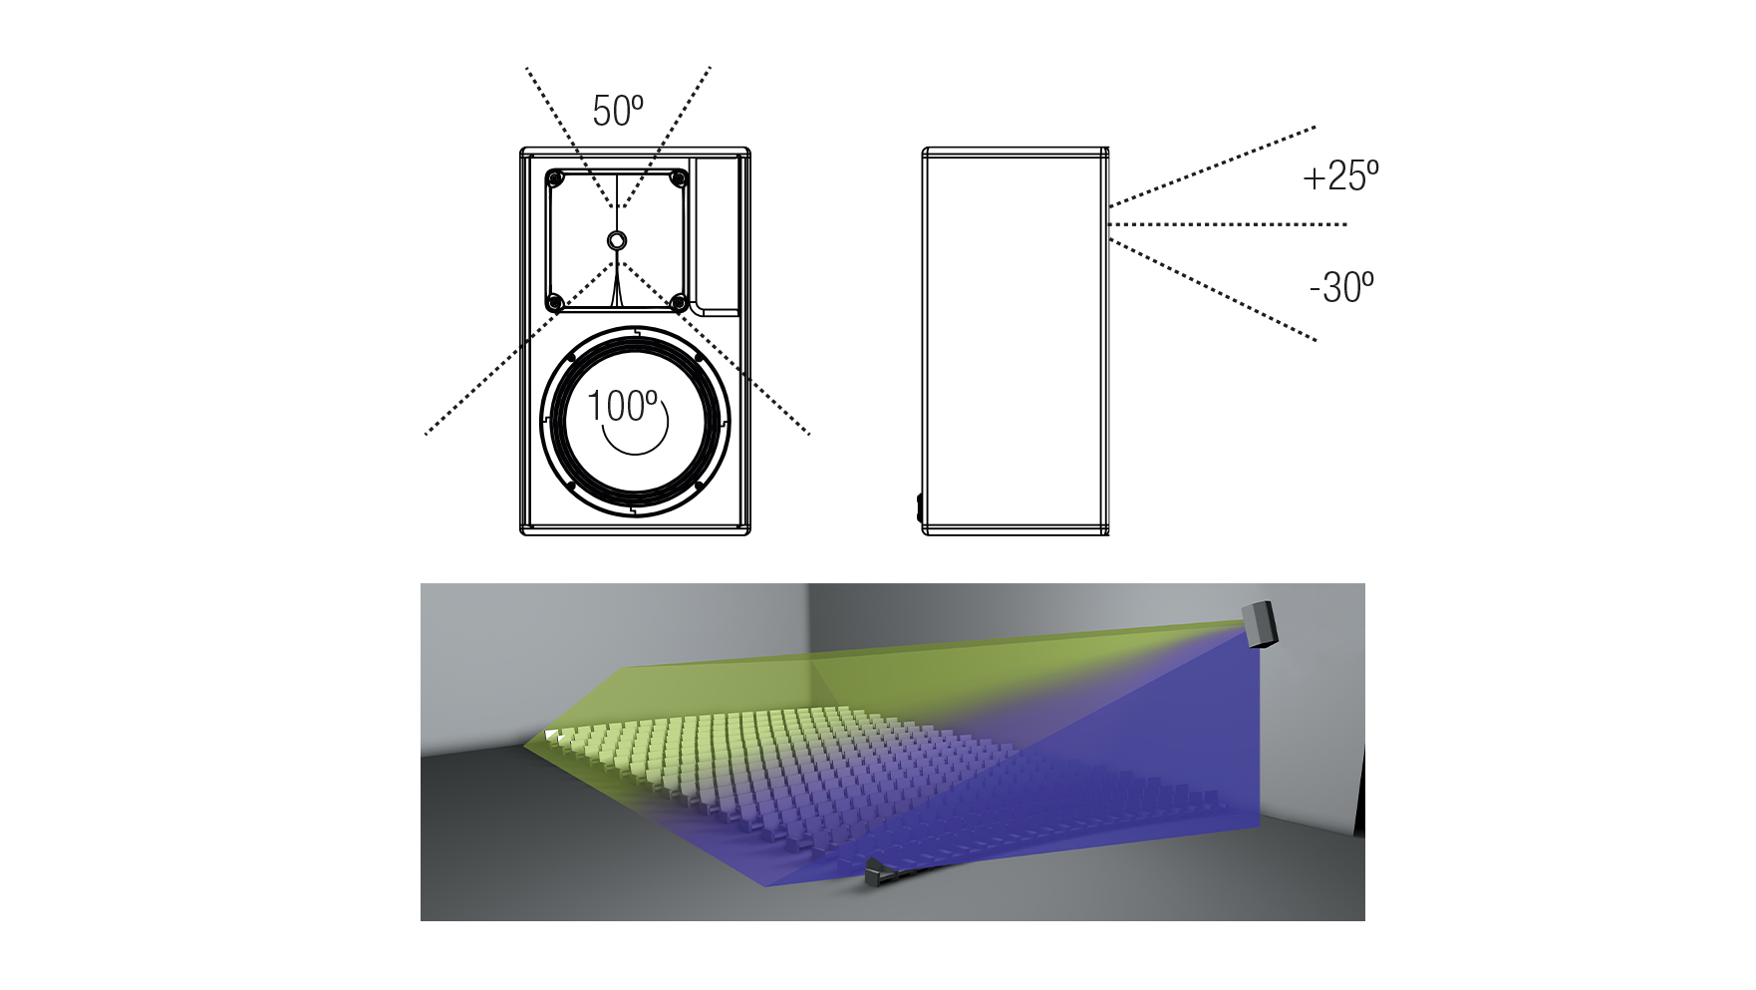
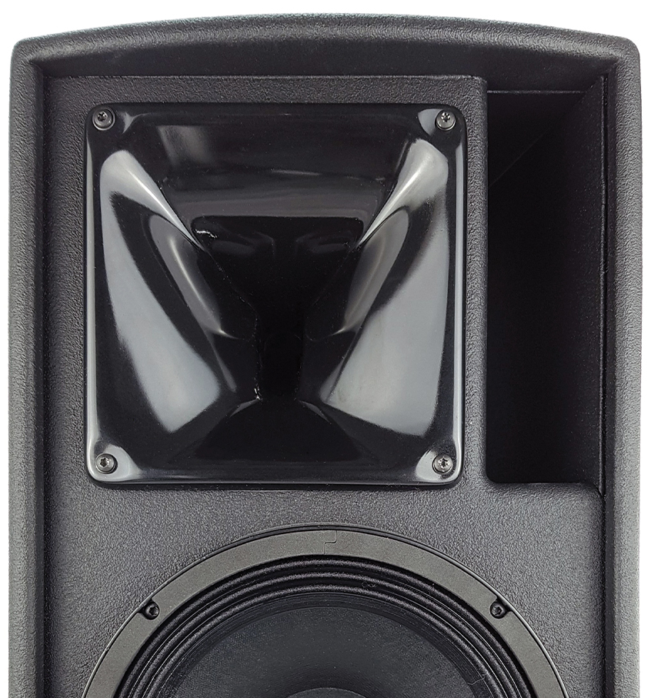
Variable HF directivity for
perfect venue coverage
A satisfactory audience experience often necessitates compromise between the wide, short throw coverage required by listeners closest to the stage, and the narrow, long throw coverage required by those at the back of the venue.
The asymmetrical horns in ePS speakers are engineered such that vertical coverage is narrower above horn axis than below. Easy for the user to rotate, it ensures optimum directivity for any fixed installation.

Slide 8
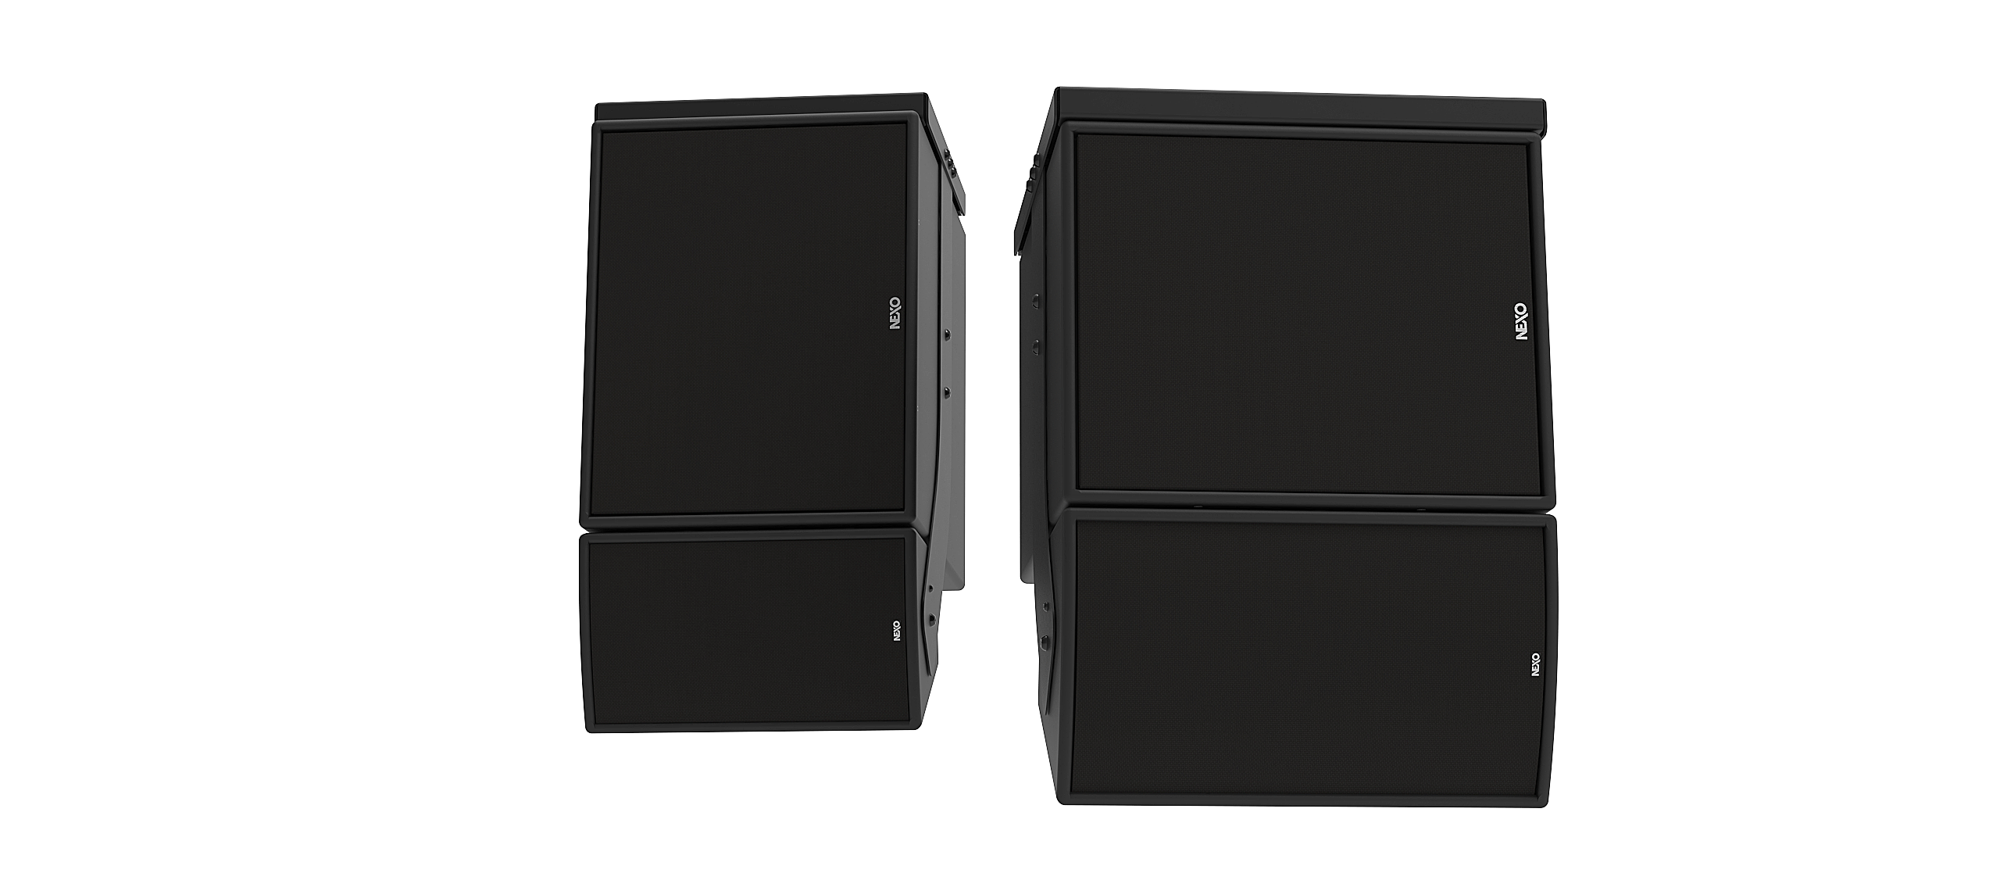
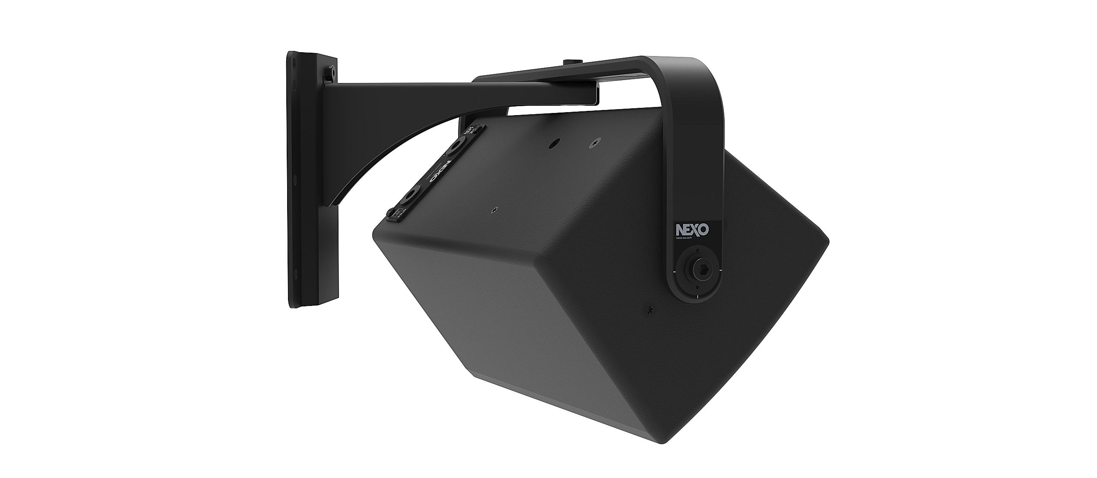
Ready for any
environment
Flexible mounting options and custom RAL colour finishes ensure that ePS loudspeakers fit seamlessly into their surroundings, delivering consistent venue coverage with a minimal visual impact.
The 1 x 12-inch driver-equipped eLS400 is the ePS6 and ePS8, while the eLS600 partners the ePS8 designed to partner and ePS10. Custom accessories exist to hang ePS cabinets below the subwoofers to create a small footprint wideband system.

Slide 9
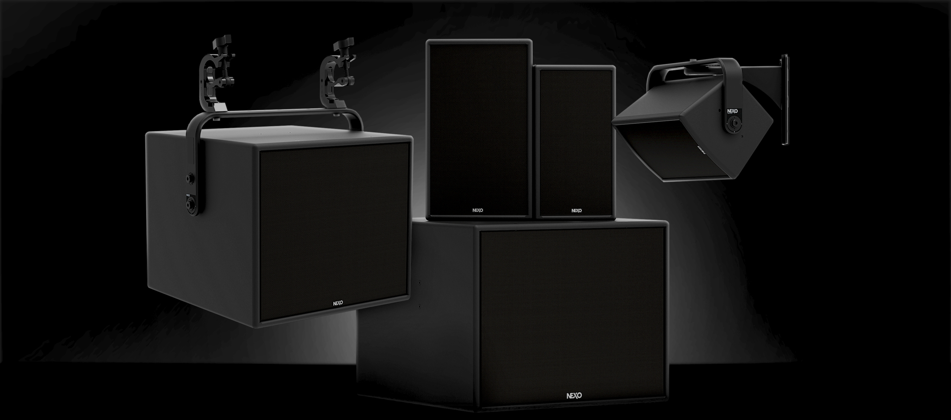


Slide 10

STADIA & ARENAS - Sound Solutions
Parc d’Activité du Pré de la Dame Jeanne, B.P. 5
60128 Plailly
France
Tel: +33 (0) 3 44 99 00 70
Email: info@nexo.fr
nexo-sa.com

