Slide 1
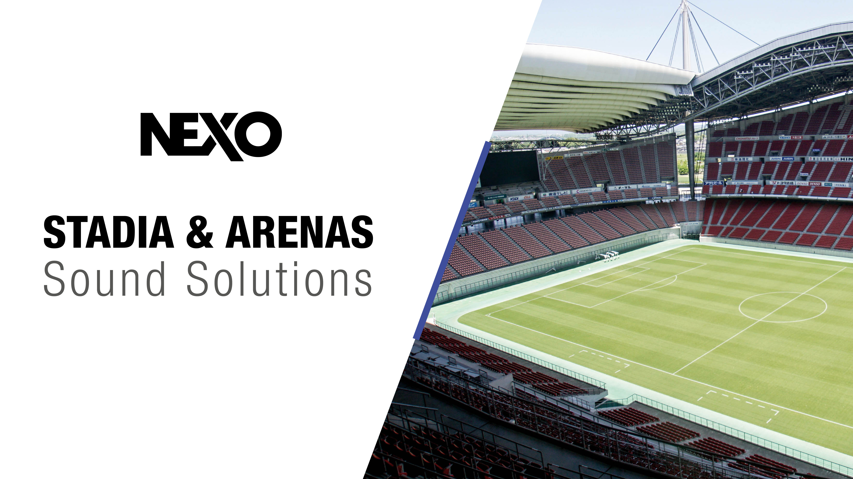

Slide 2
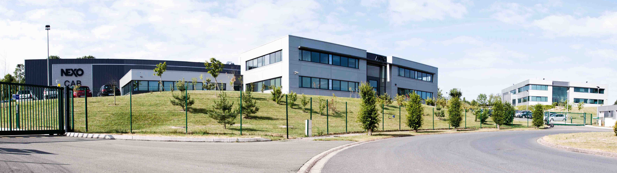
STADIA & ARENAS - Sound Solutions
The home of
Precision Sound.
NEXO has been designing ground-breaking sound reinforcement solutions at its French headquarters since 1979.
The company’s pioneering technology, innovative designs and sonic excellence have enhanced live events and venue sound across the globe for decades, gaining the respect and trust of sound professionals everywhere.

Slide 3
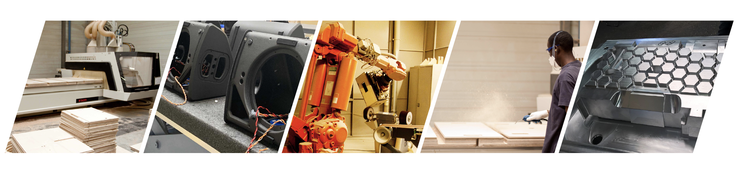
STADIA & ARENAS - Sound Solutions
Advanced manufacturing processes
Each and every one of NEXO’s loudspeaker cabinets is designed and manufactured in France. Since 2007, the company’s headquarters have been located in modern purpose-built facilities, just 30 km north of Paris and close to Charles de Gaulle International Airport. NEXO has also a manufacturing plant in Saint-Pierre-de-Côle.
Highly-automated
manufacturing plant
2 optimized production lines
5000 Sqm/each
Rigorous processes /
Quality management system

Slide 4
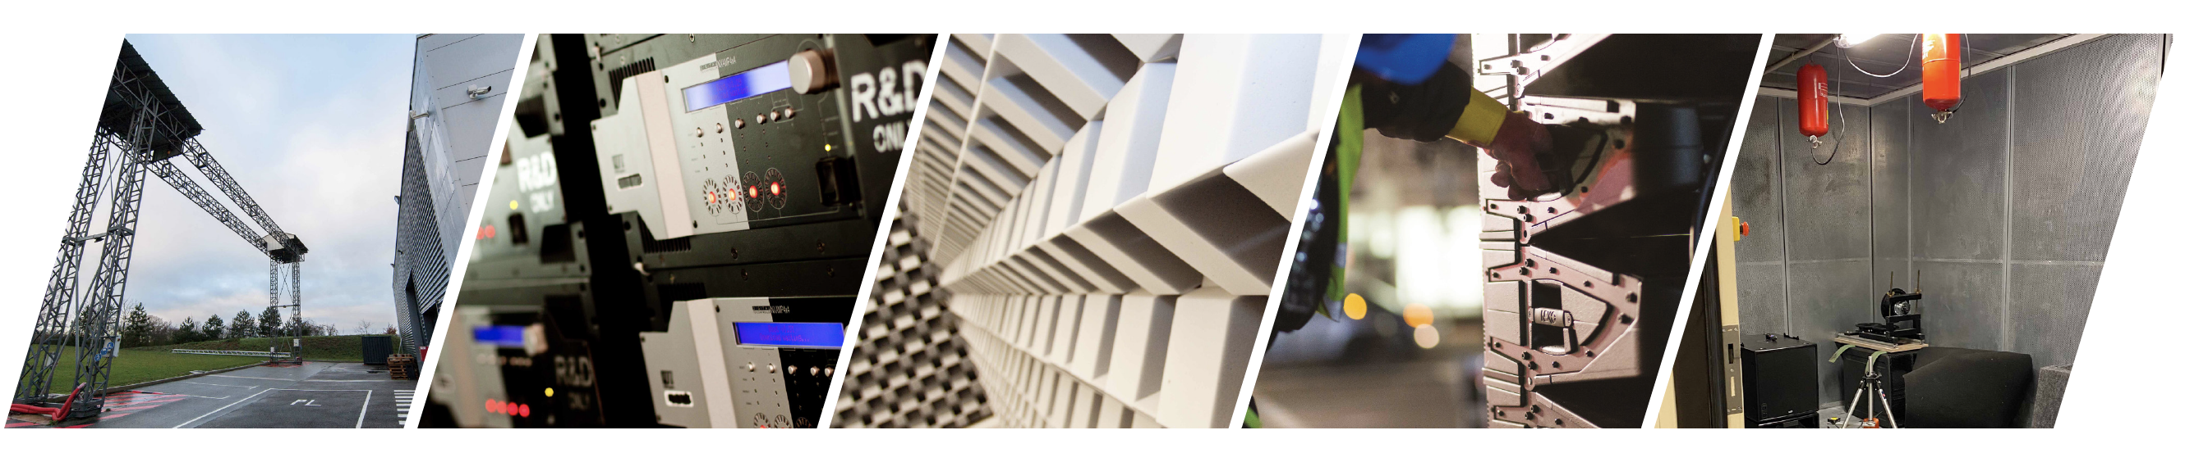
STADIA & ARENAS - Sound Solutions
Modern purpose-built facilities
Each new system begins with sophisticated computer simulations, executed by specialised proprietary software. The entire electro-acoustic signal chain is thoroughly modelled and product performance rigorously evaluated to maximise system performance.
R&D centre : 2000m2 dedicated
State of the art facilities
Anechoic chamber : 12m x 8m x 6.5m, this chamber allows the R&D team to measure down to 28Hz.
Passionate, rigorous and high level engineers

Slide 5
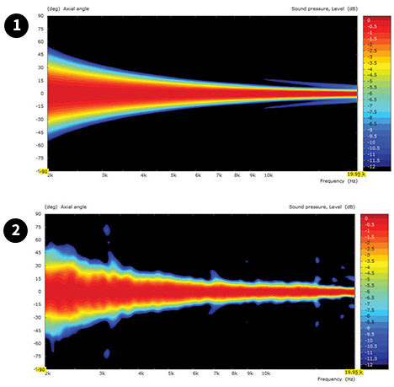
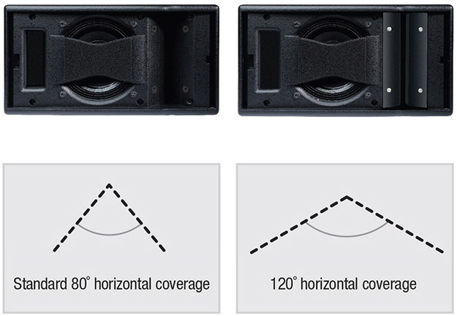
STADIA & ARENAS - Sound Solutions
Thinking. Inside the box.
What separates NEXO from its competition is its innovative, integrated systems approach to loudspeaker research and development. The company’s R&D mission to innovate is acknowledged in the form of numerous patents, some of which are included here.
THE HRW HYPERBOLIC
REFLECTOR WAVEGUIDE
THE CDD CONFIGURABLE
DIRECTIVITY DEVICE
&
THE PDD PHASE
DIRECTIVITY DEVICE
Conventional speakers cannot be coupled in the high frequency range if not generating a continuous wavefront along the height or the width of the enclosure.
HRW waveguide converts the spherical wave front generated by a high frequency compression driver into a flat or convex wavefront by means of an acoustic reflector.
It allows speaker cabinet acoustical coupling without interference up to 20 kHz, with inter-cabinet angle sequences ranging from 0° up to 30° or more.
Used in GEO M Series, GEO S1210 and S1230, STM M28 and M46 cabinets.
CDD flanges are superposed to a horn or a waveguide to modify its dispersion characteristics.
The same speaker cabinet reference can therefore produce a wide range of directivity features, from 80° or (narrow coverage needed at long distances) less to 120° or more (wider coverage needed at short distances).
PDD : Coupled direct radiation drivers will interfere when the distance between them exceeds half a wavelength, which sets a strong constraint on cross-over frequency to high frequency drivers (these are very likely to distort below 1 kHz). The Phase Directivity device splits the radiating surface of the driver in 2, thus dividing by 2 the acoustic distance between coupled devices.
Used in GEO M Series, GEO S1210 and S1230, STM M28 cabinets.

Slide 6
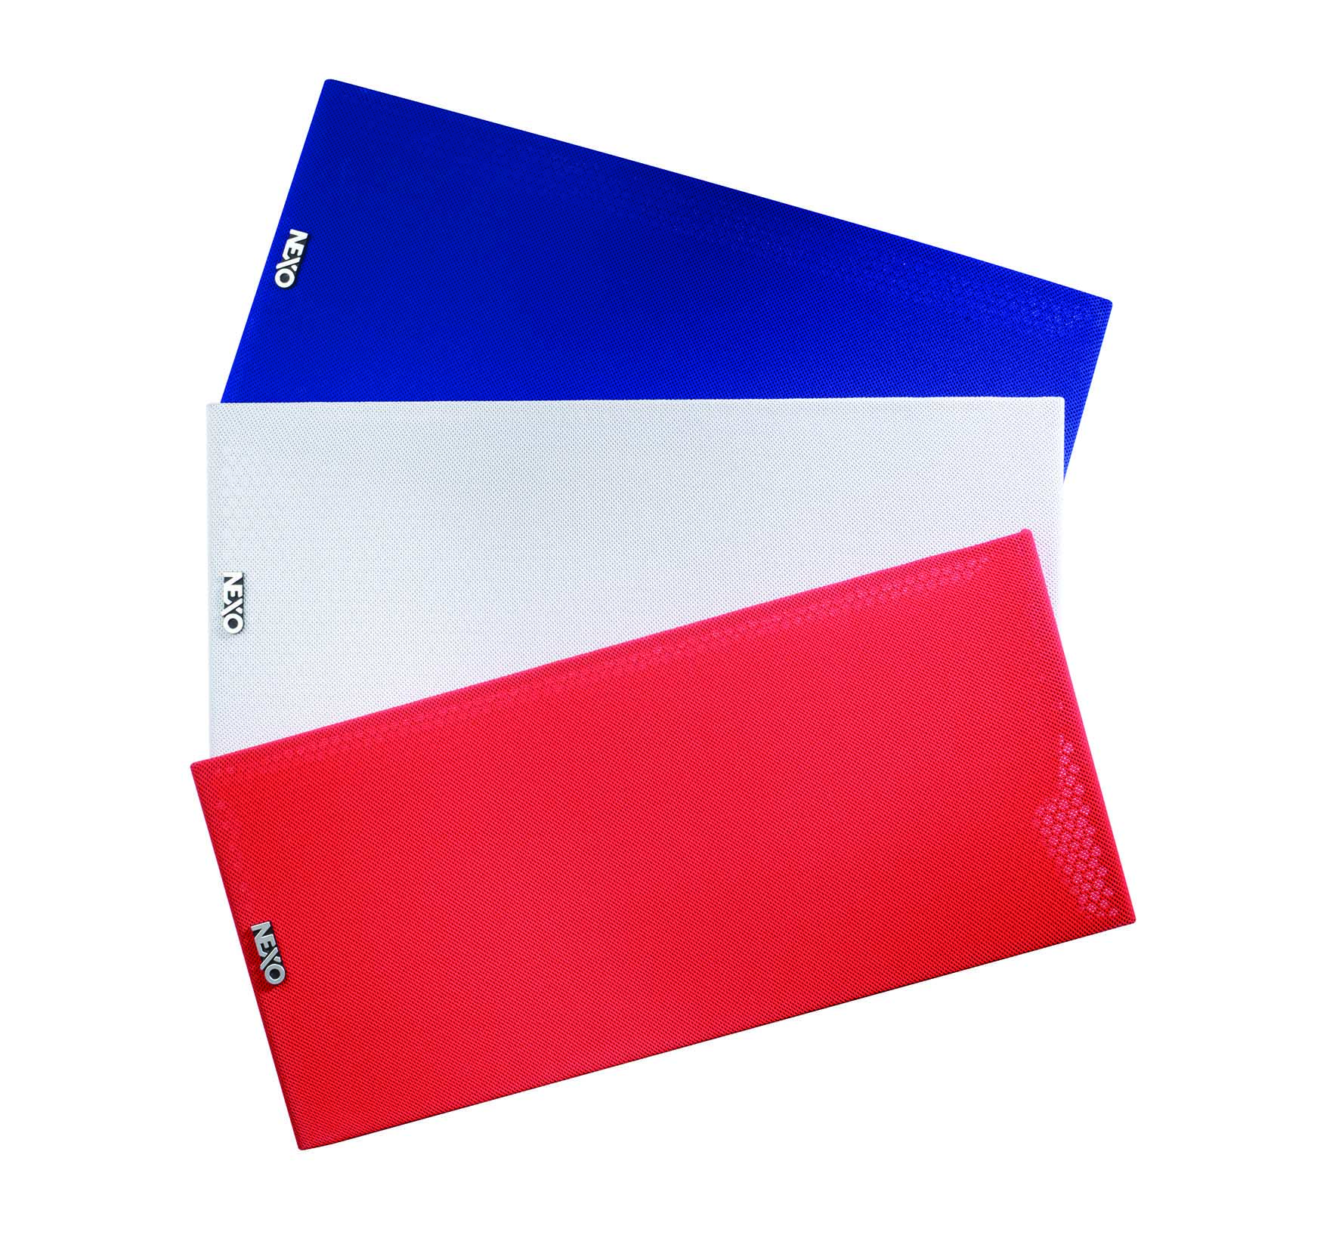
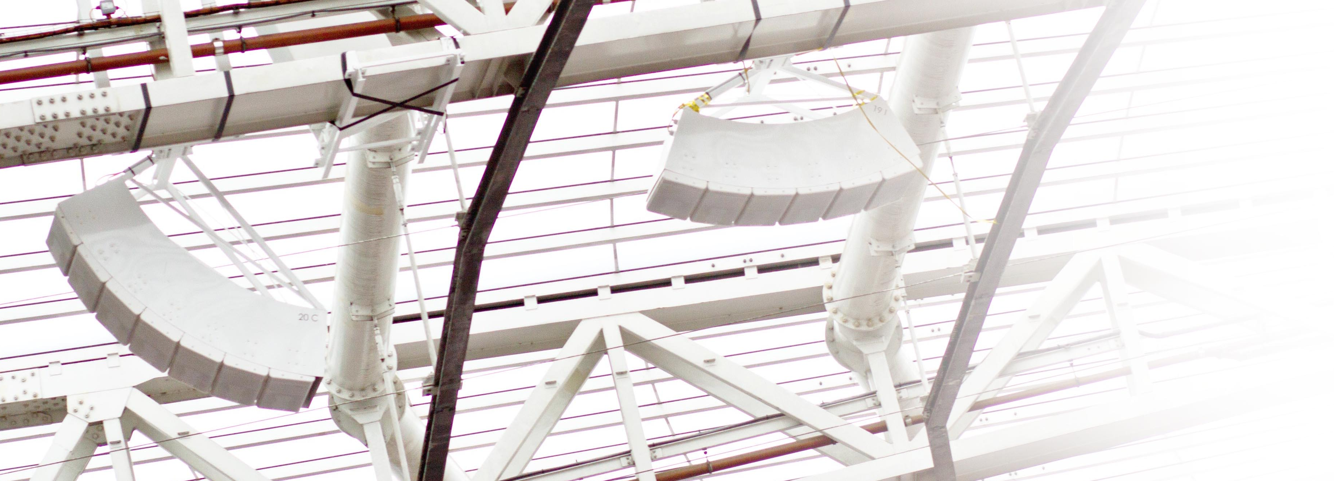
STADIA & ARENAS - Sound Solutions
Custom solutions
Our installation versions cabinets and accessories can be specified in black, white or any RAL colour for projects that require the greatest degree of customization.
For sports & arenas, the RAL colour option is usually required to match the steel beams of a roof for example, assuring a low visual impact.

Slide 7
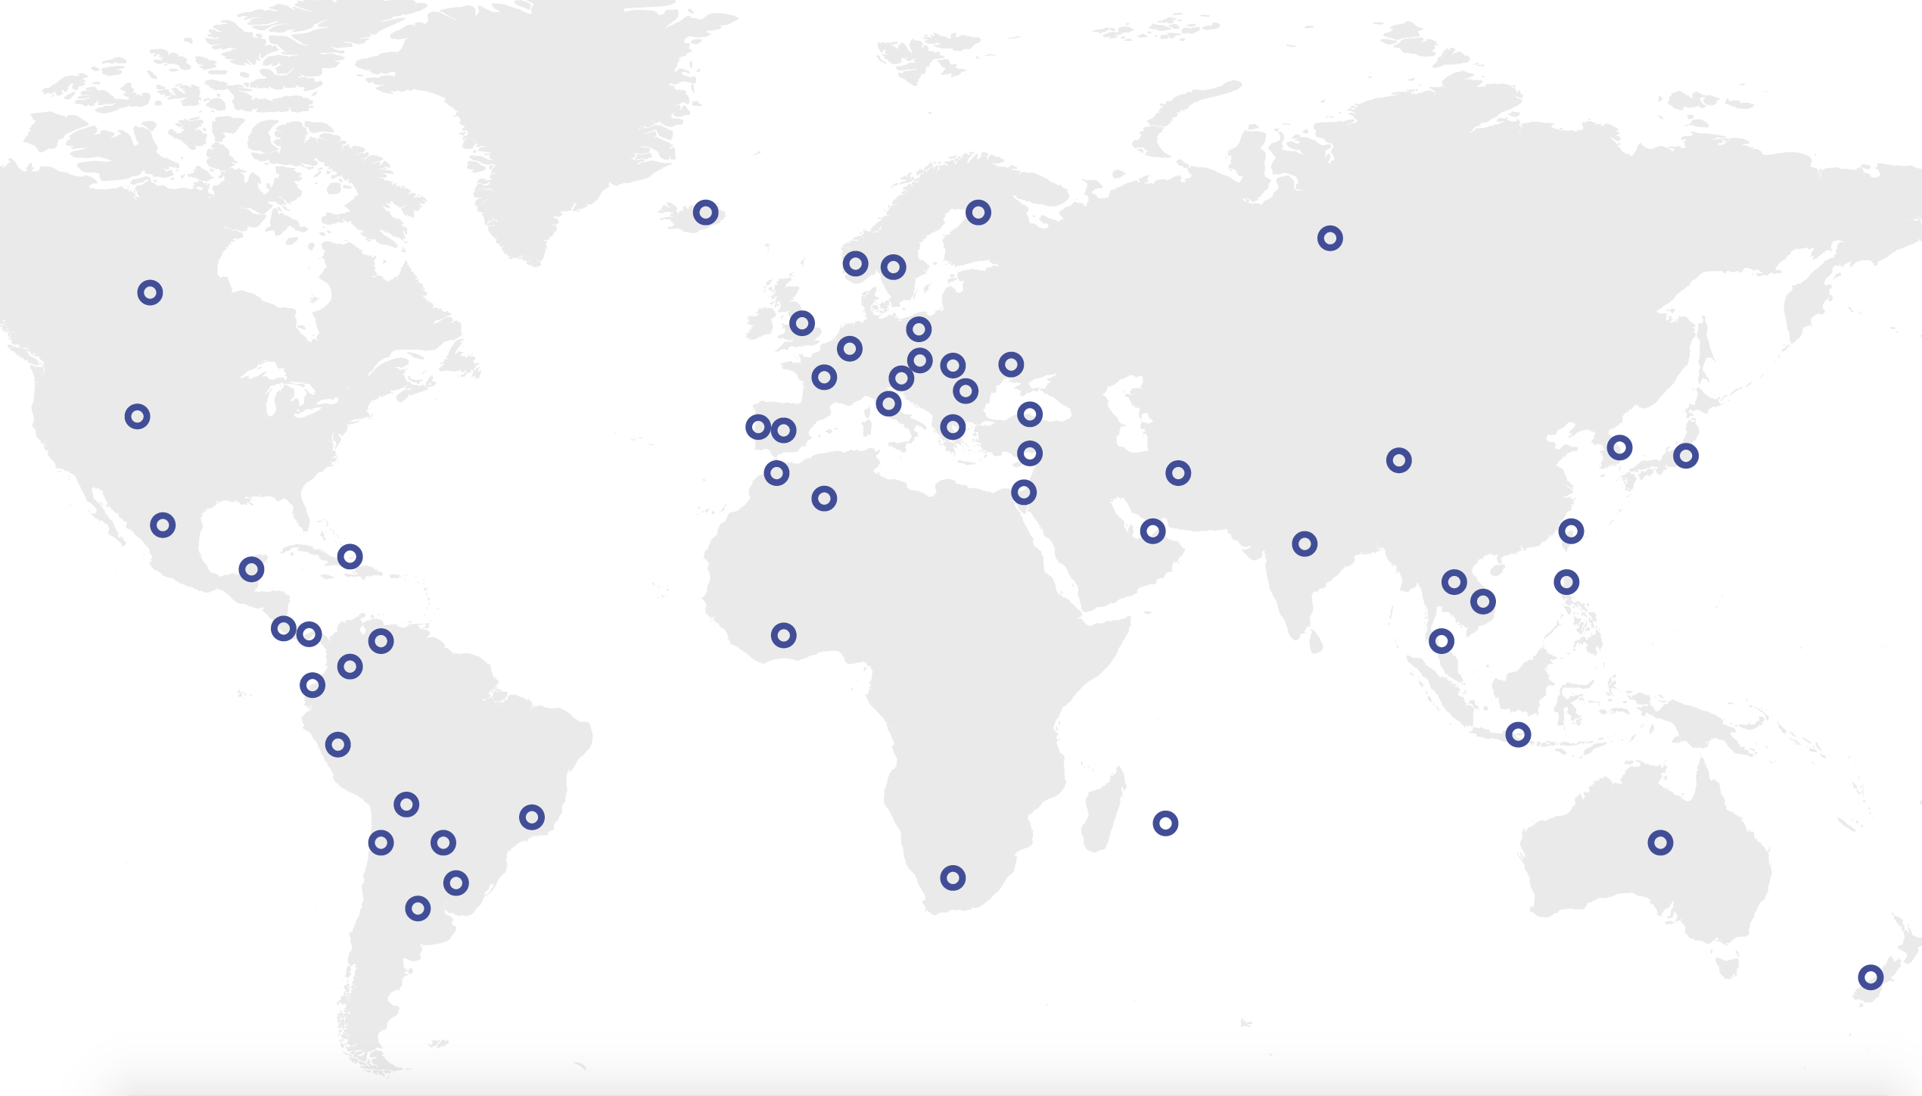
STADIA & ARENAS - Sound Solutions
A global sales & support network
NEXO systems are distributed by a network of 50 independent distributors worldwide, each chosen carefully for their expertise and provision of high-level technical and customer support.

Slide 8
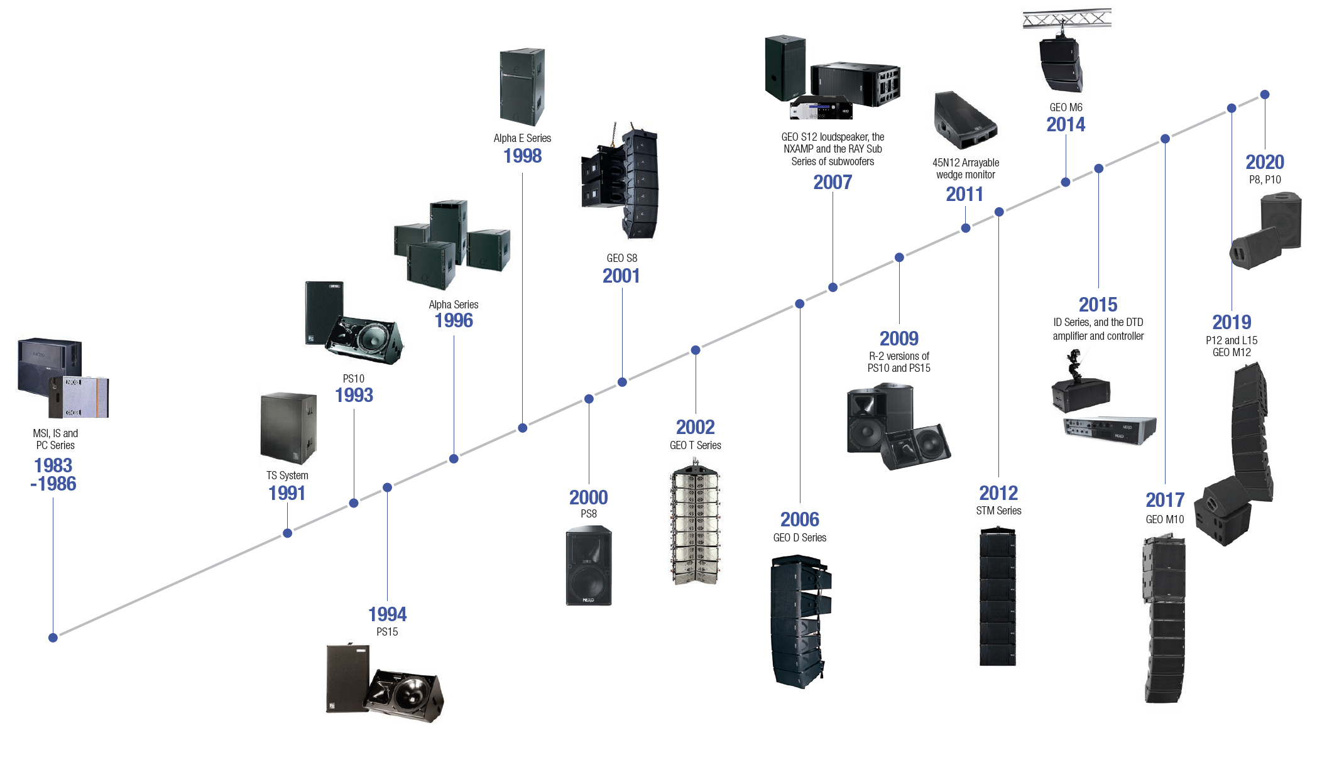
STADIA & ARENAS - Sound Solutions
Product Legacy
and Timeline.

Slide 9
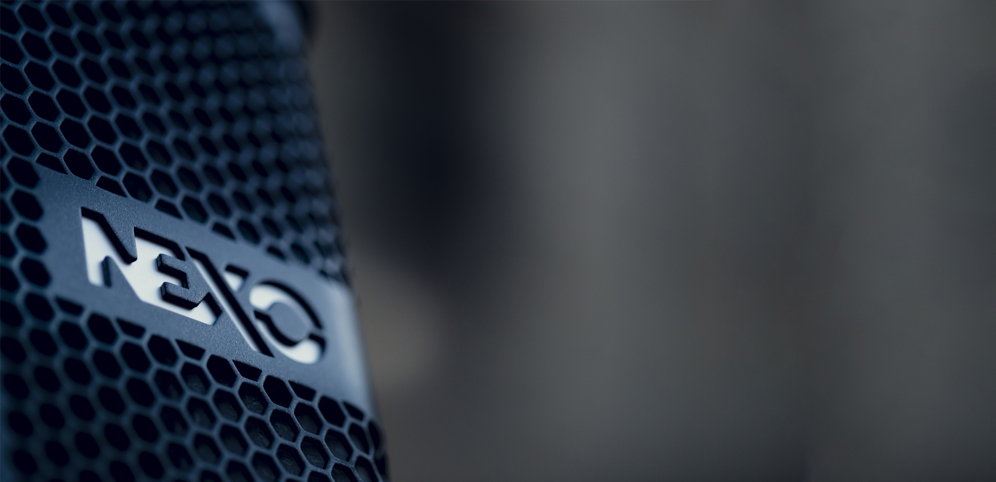




STADIA & ARENAS - Sound Solutions
Quality & Certifications
In order to meet our customers’ requirements and enhance their satisfaction, NEXO is continually identifying the best options necessary to set an exceptional standard of products and services. The high quality of our products and services is endorsed through certification and a commitment to recognised methodical processes.
EC Declaration of Conformity
IP 54 Rating
ISO 9001
TÜV Certification

Slide 10
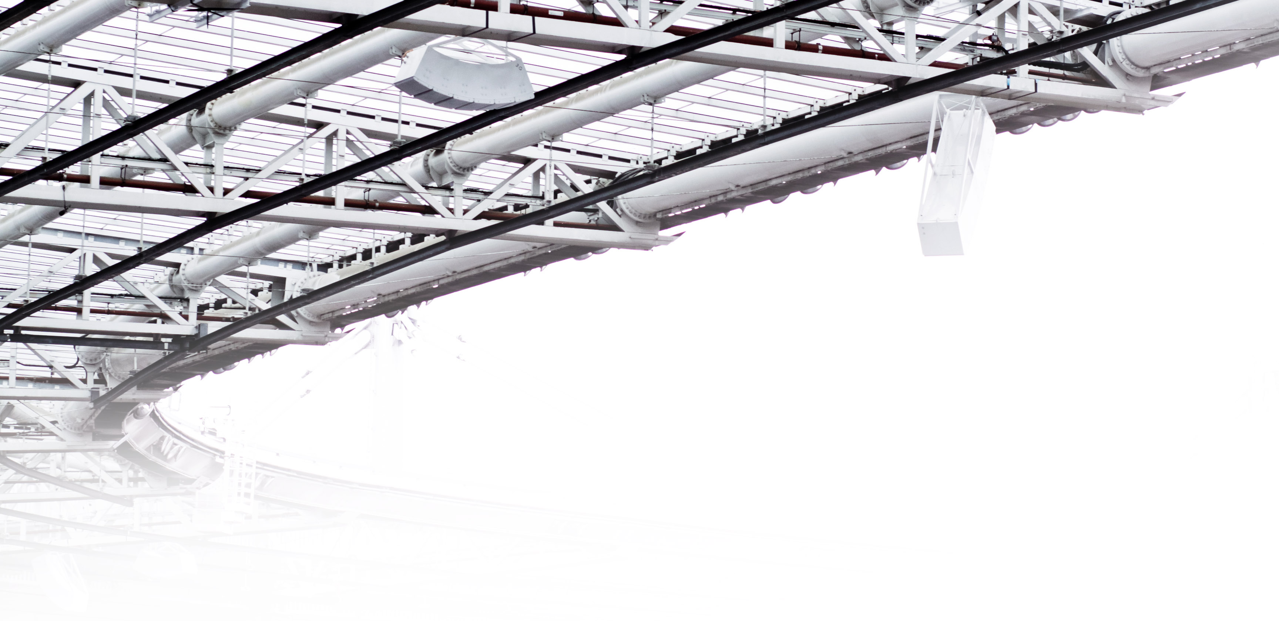

STADIA & ARENAS - Sound Solutions
Our GEO S12 and GEO S12-ST loudspeakers have successfully passed the test procedures and complied with the rigorous requirements to be certified as EN54-24 products.
The EN54 gives common requirements for the construction of voice alarm loudspeakers and their performance under different climatic conditions.
In case of emergency, loudspeakers must provide intelligible warning and evacuation instructions to the public in a in a short time-frame.

Slide 11
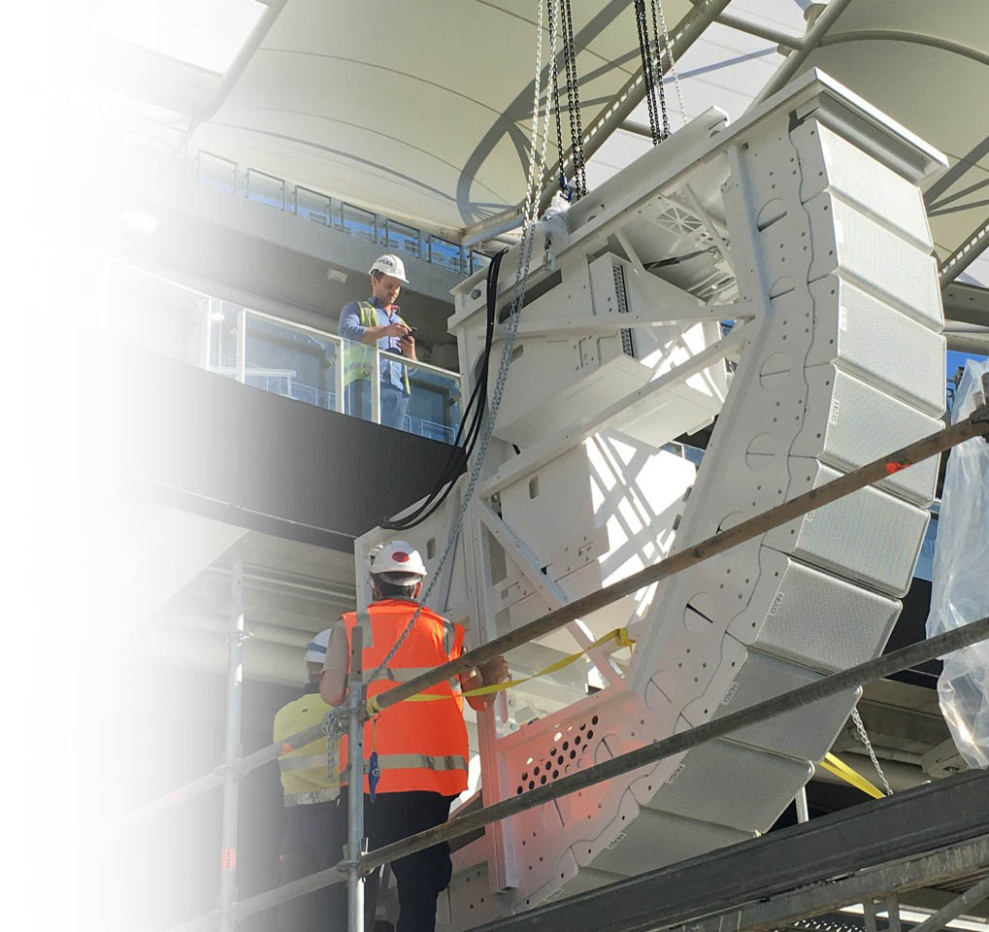
STADIA & ARENAS - Sound Solutions
Dedicated Support
At NEXO, we believe in supporting the consultant,
not in trying to be one!
Before
System Design
Training
Demos
During
Installation Support
Acoustic report
Assistance
After
Hotline
Feedback
Technical Docs
Technical@nexo.fr

Slide 12
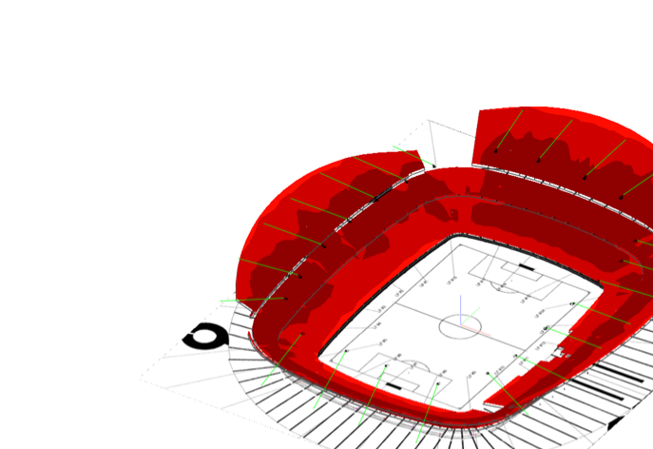


STADIA & ARENAS - Sound Solutions
System design
Perfect coverage made easy.
NEXO is able to provide full sound system design support, offering our extensive experience and powerful modelling tools to augment the resources of consultancies and integrators, or even to provide complete venue designs on their behalf.
At the heart of our design process is NS-1, NEXO’s powerful system configuration and simulation tool which ensures uniform SPL coverage of any NEXO system in any venue.
Download NS-1 on NEXO website
nexo-sa.com

Slide 13
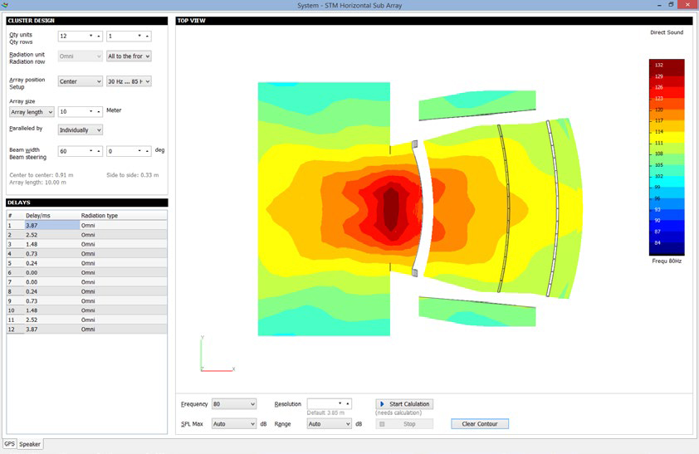
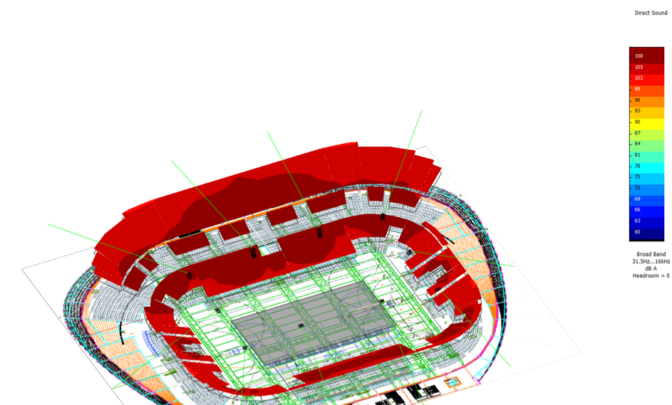
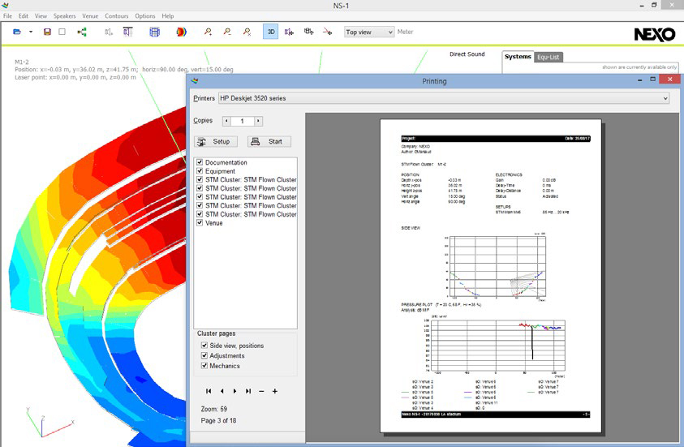
STADIA & ARENAS - Sound Solutions
Complex calculations
NEXO enjoys close collaboration with the world’s leading experts in electro-acoustic simulation programming. NS-1 models the radiating behaviour of the speakers by spatially sampling them into a large number of monopoles and dipoles. In every mesh point of the venue’s surfaces, the contribution of each one of the speaker monopoles is calculated for the frequency band of your choice. The simulation results are mapped to the surfaces, giving a 3D representation of the SPL coverage.
Sub design screenshot
Report editing screenshot

Slide 14
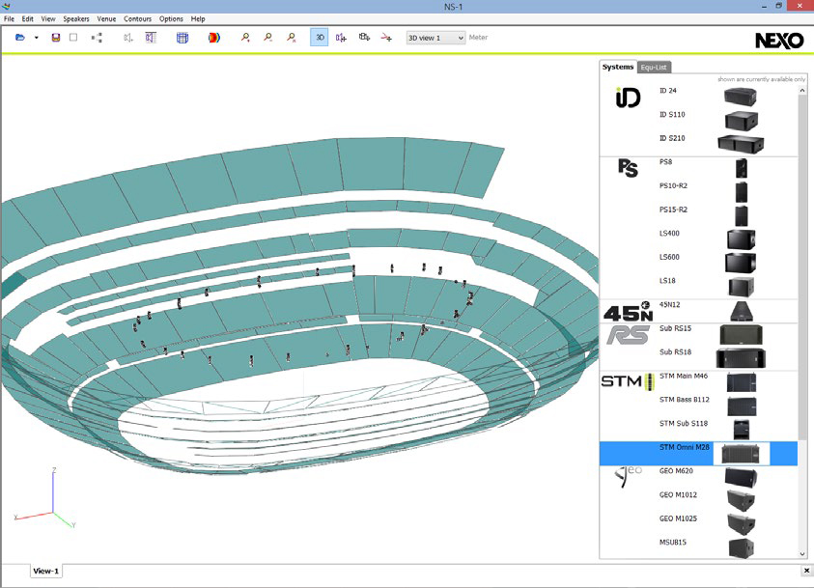
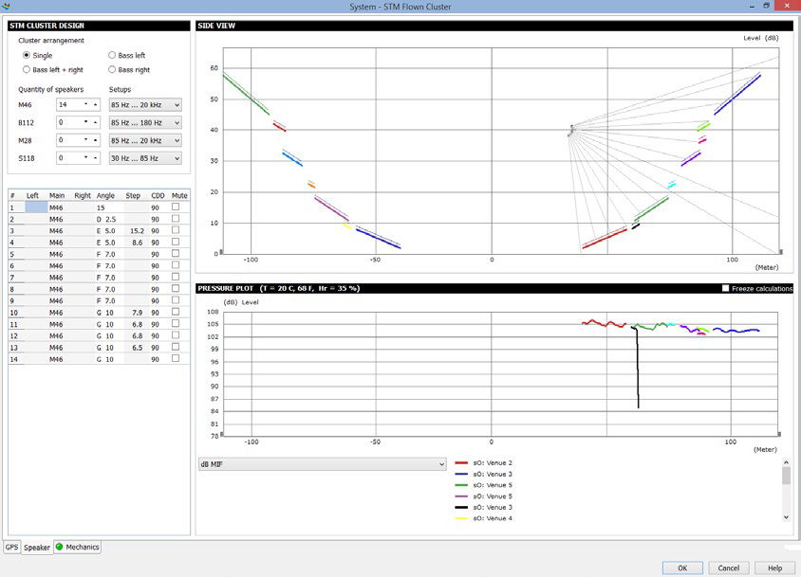
STADIA & ARENAS - Sound Solutions
All NEXO speakers on tap
Once the geometry is defined, loudspeakers can simply be dragged and dropped into the project, and configured into flown or stacked clusters.
Surfaces
Sound pressure can be received differently on the venue surfaces. Venue items can be:
Simple surfaces
Standing-up or seated audience areas
No audience areas, simply taken into account as obstacles
Hidden to calculation.
Line-source calculations
NS-1 helps you to find the perfect series of angles for your clusters, by calculating acoustic pressure on the surfaces. Results can be displayed using NEXO’s meaningful dB MIF, or other metrics of your choice.
Direct sound and time coherency
NS-1 performs direct sound calculations on your geometry. They allow you to tend towards the best speaker ratio, gains and positions to match your target coverage.
Furthermore, NS-1 makes it easy to align the delays of the speakers thanks to time-coherency calculations.

Slide 15
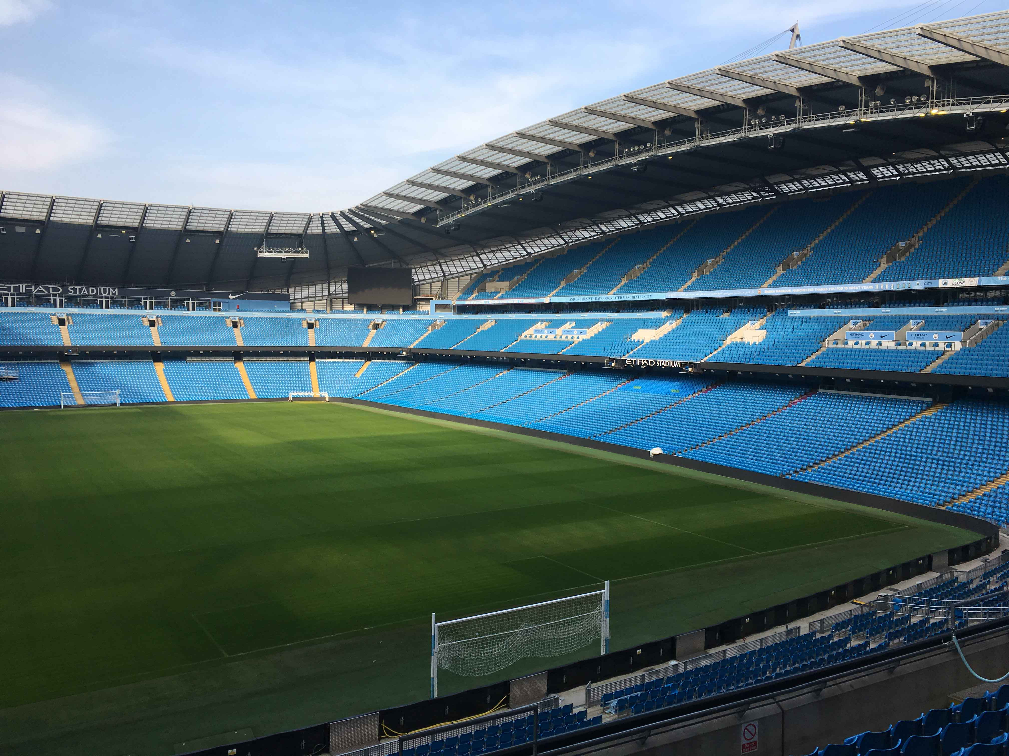
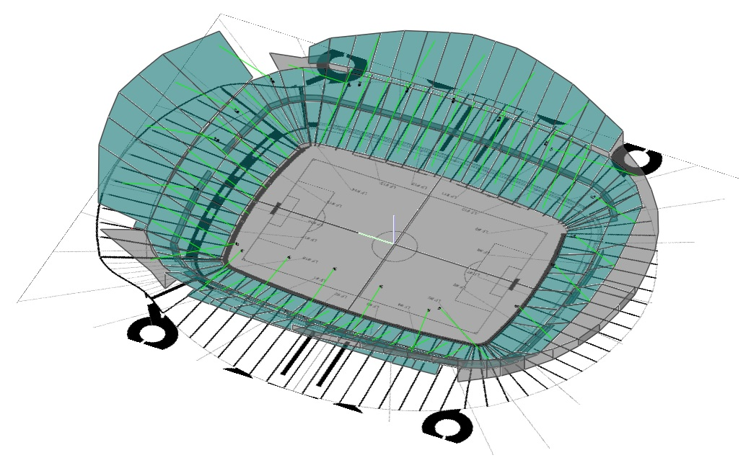
STADIA & ARENAS - Sound Solutions
System Design : Etihad Stadium
Manchester, United-Kingdom

Slide 16
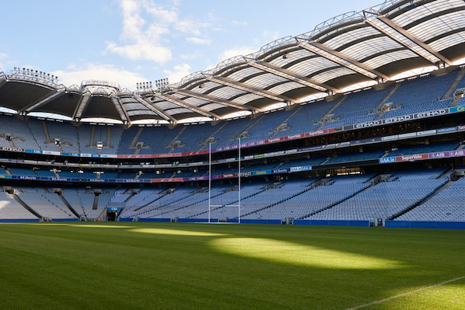
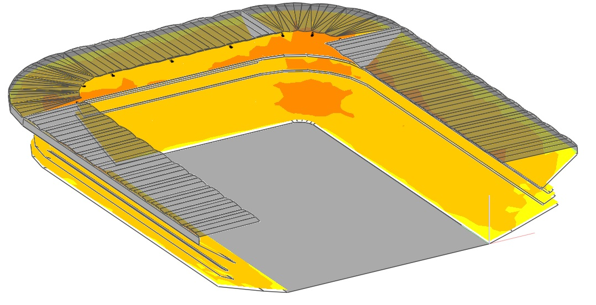
STADIA & ARENAS - Sound Solutions
System Design : Croke Park
Dublin, Ireland

Slide 17
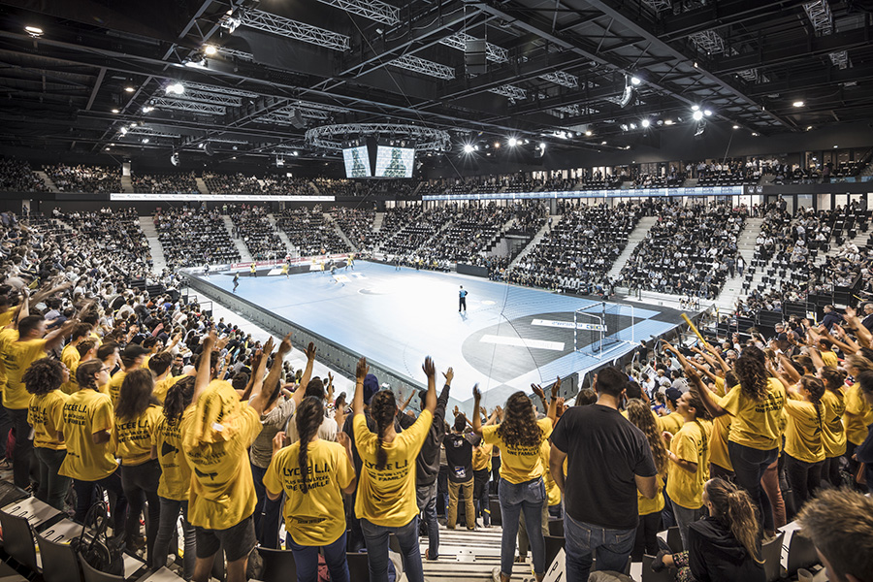
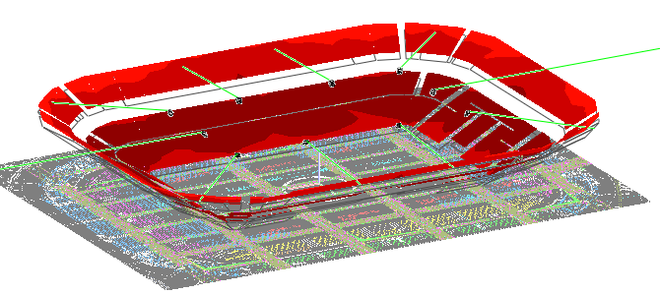
STADIA & ARENAS - Sound Solutions
System Design : Arena du Pays d’Aix
Aix en Provence, France

Slide 18
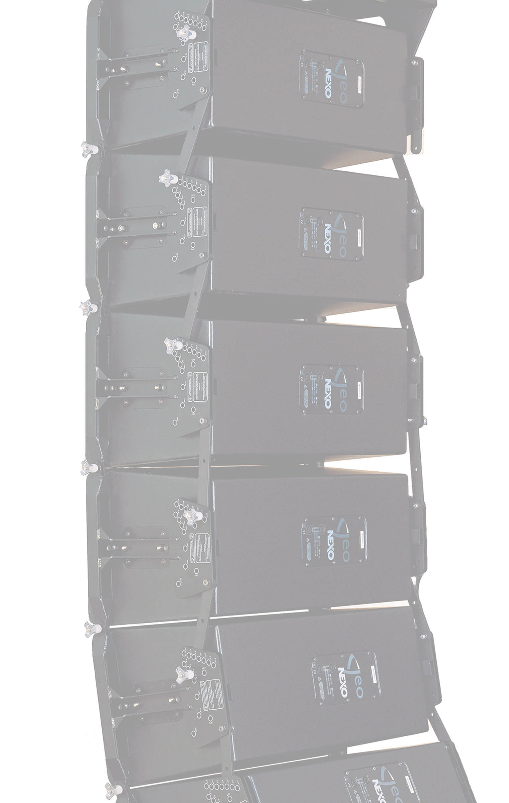
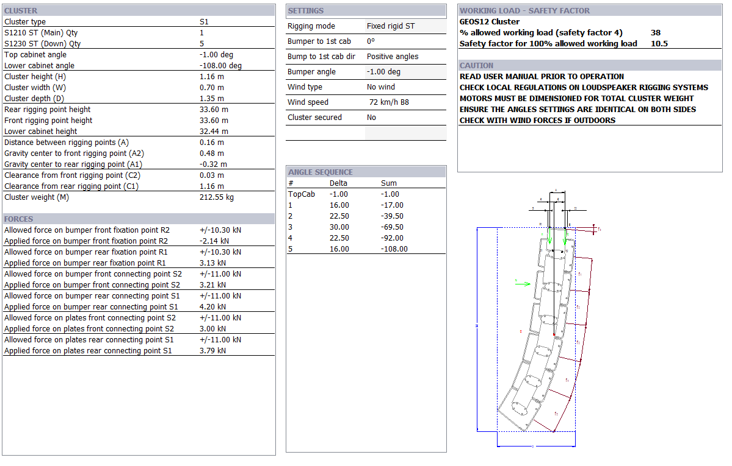
STADIA & ARENAS - Sound Solutions
Mechanics
Fly safe
For NEXO, safety is the number one priority.
Capable of so much more than acoustic predictions, NS-1 also calculates the working load of the flown clusters, and gives you the green light.
NS-1’s mechanical database is always double-checked by an independent expert. The advanced algorithm takes into account the hanging points, the bumper type and, most importantly, the angles between the speakers, providing an accurate result that is certified according to Eurocode 3 “Design of Steel Structure” by TÜV, the world leading certification company.

Slide 19
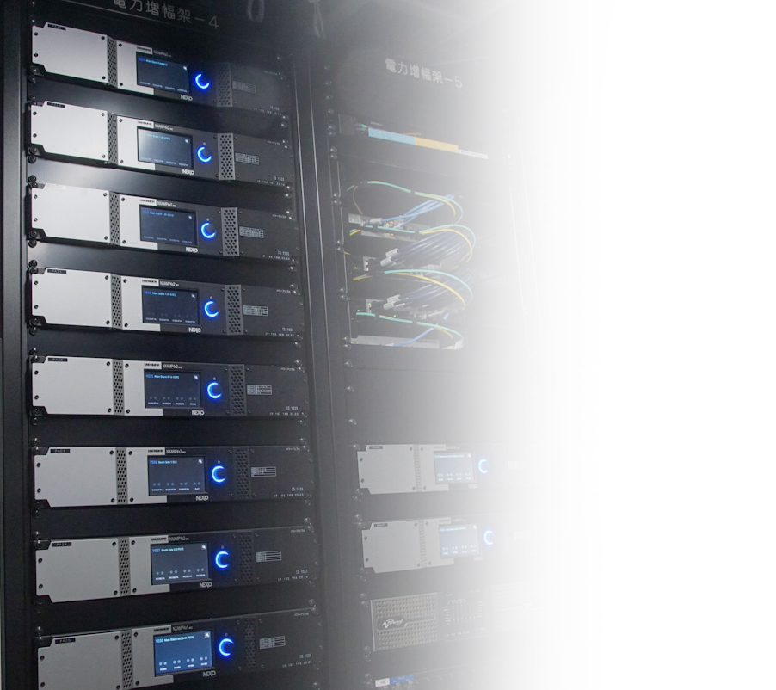
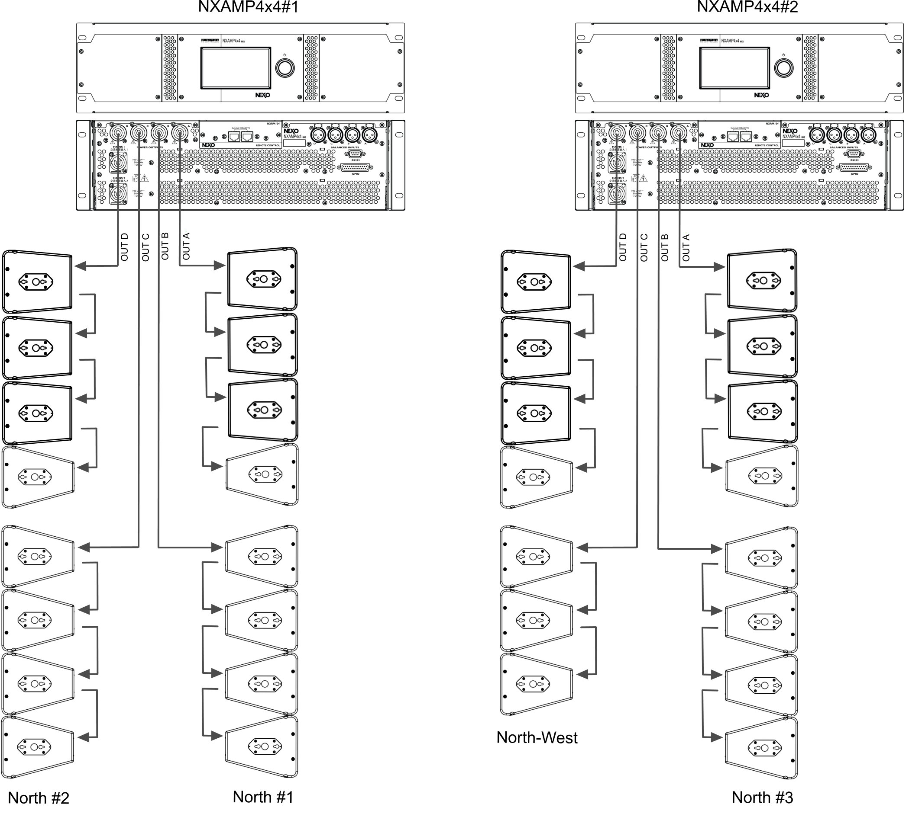
STADIA & ARENAS - Sound Solutions
Amplification NXAMPs
Formidable power. Precision control. Flexible networking.
Available in 4 X 1300 Watts, 4 X 2500 Watts and 4 X 4500 Watts versions, the NXAMPMK2 combines advanced signal processing with four state-of-the-art Class D amplifiers to create a flexible, light-weight powering and control solution for NEXO loudspeaker systems.
Block diagrams example
NXAMPs > GEO S12 systems

Slide 20
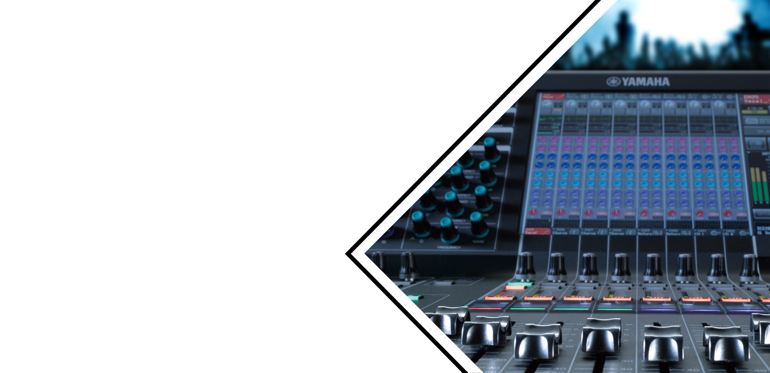
STADIA & ARENAS - Sound Solutions
Perfect partners in
sound reinforcement
Yamaha has been building digital mixing consoles for almost as long, pioneering the development of digital mixing and leading the field ever since.
So when NEXO became a wholly owned strategic business unit of the Yamaha Corporation, the fuse was lit on a series of commercial and technical collaborations that today deliver a coherent, joined-up approach to sound system design and configuration. At the heart of this collaboration lies the shared philosophy that the audience experience should be optimised through the development of transparent and consistently controllable sound systems.
Yamaha’s CL Series digital audio mixing consoles deliver unprecedented levels of flexibility, reliability and audio quality to both live and installed audio applications, integrating seamlessly with NEXO sound reinforcement systems.

Slide 21
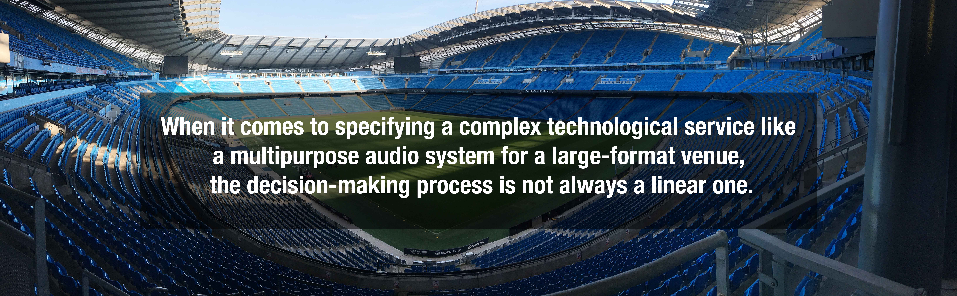
STADIA & ARENAS - Sound Solutions
Researching information for solutions to fulfil the requirement is where that process starts to become complex.
Sound system set-ups for concert events, even very large ones, are founded on entirely different design criteria to those suited to a sports space which essentially operates ‘in the round’ rather than with a left/right stereo image. Choose your partners carefully, rather than being influenced by the “stardust” of which world-class bands used the loudspeaker systems last year!
To streamline the interrogation, here follows a few vital criteria which will advance your understanding ⇢

Slide 22
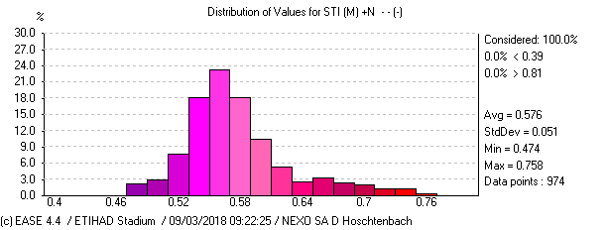
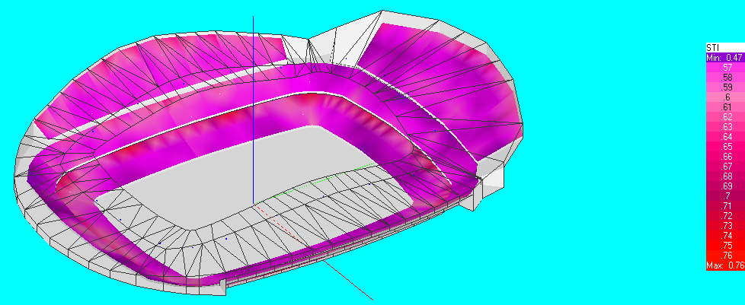
STADIA & ARENAS - Sound Solutions
Intelligibility
This is simply explained as the measure of how well the average listener can distinguish and understand sounds. You might think this is a subjective element, but in reality, there is a worldwide measurement standard (STIPA, giving an actual STI or Speech Transmission Index figure) by which to judge systems and successful installations.
VITAL CRITERIA

Slide 23
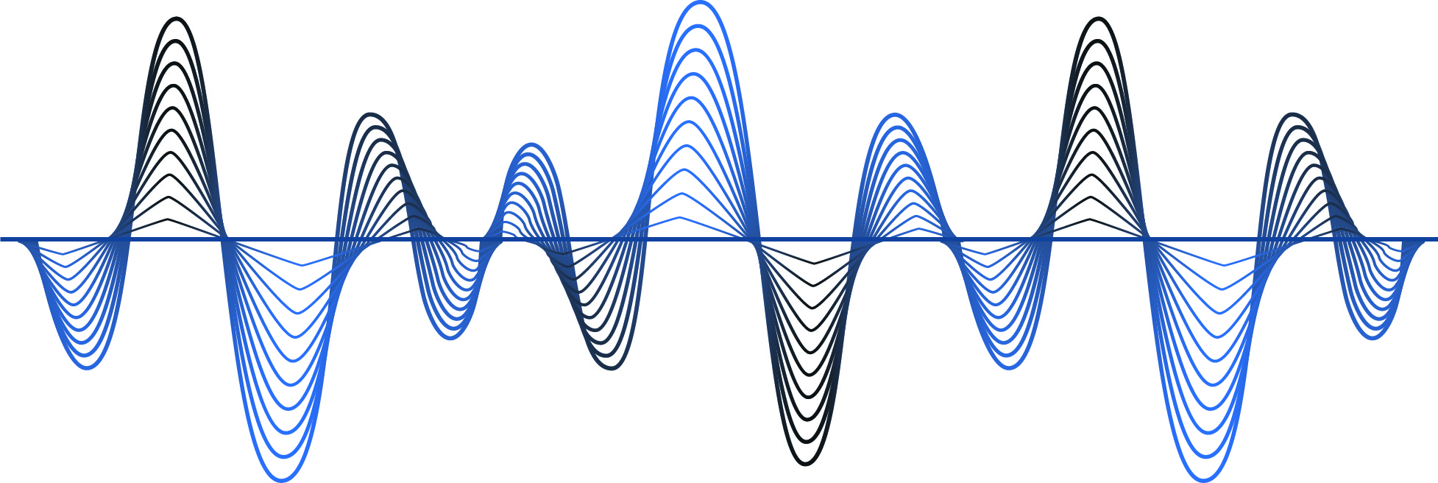
STADIA & ARENAS - Sound Solutions
Loudness
We all think we know what ‘loud’ means, measured in the audio business as decibels of sound pressure level (SPL), but sound is perceived by the human ear relative to other sounds. To have a ‘loud enough’ system depends on the level of ambient noise in your venue – some football crowds are more raucous than others! Loudness has a cost, so it’s important to have a good sound designer to find the right balance of quality to suit budget.
VITAL CRITERIA

Slide 24
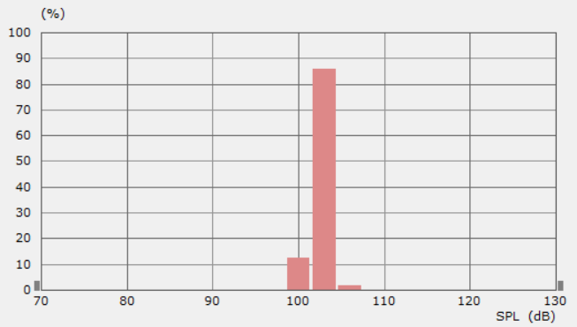
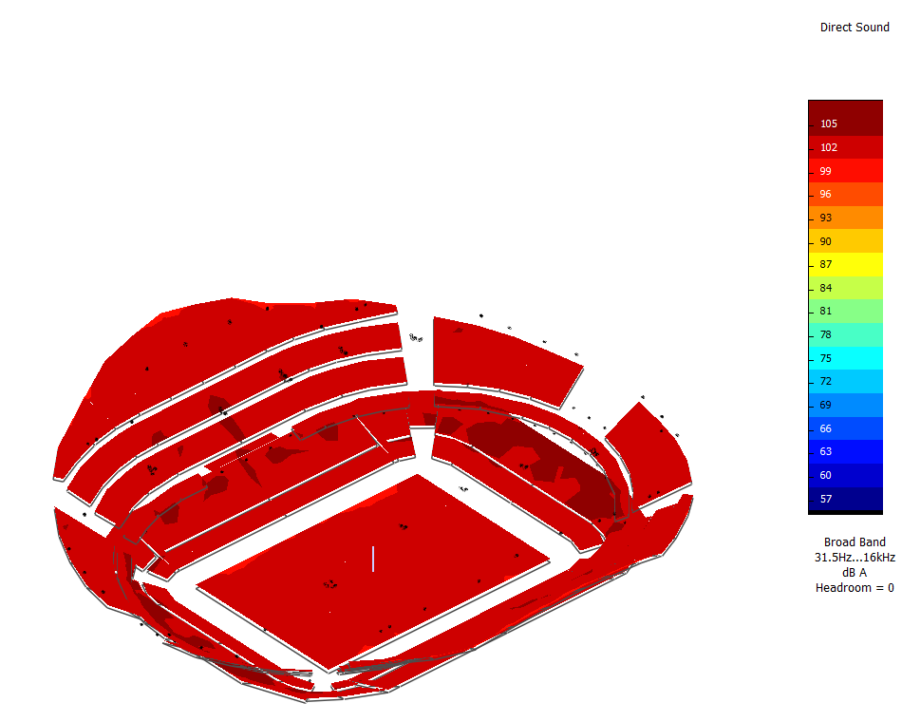
STADIA & ARENAS - Sound Solutions
Coverage
The system can sound great to people in the expensive seats, but what about the others. A high-quality sound system promises to deliver the same results to every seat in the house with no dead spots. The supplier should be able to model their proposals with computer simulation software. There are different ways of achieving coverage, but it is important that your designer, integrator and manufacturer have experience with large-format venues. Showy systems put together for touring concerts have very little in common with purpose-designed installed infrastructures, which deliver built-in flexibility for zoning, announcements and evacuation protocols.
VITAL CRITERIA

Slide 25
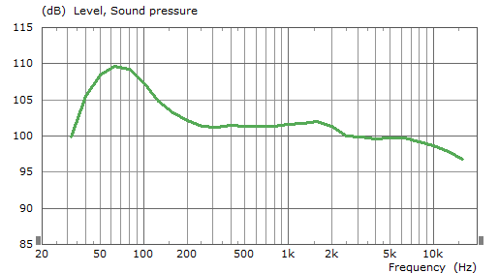
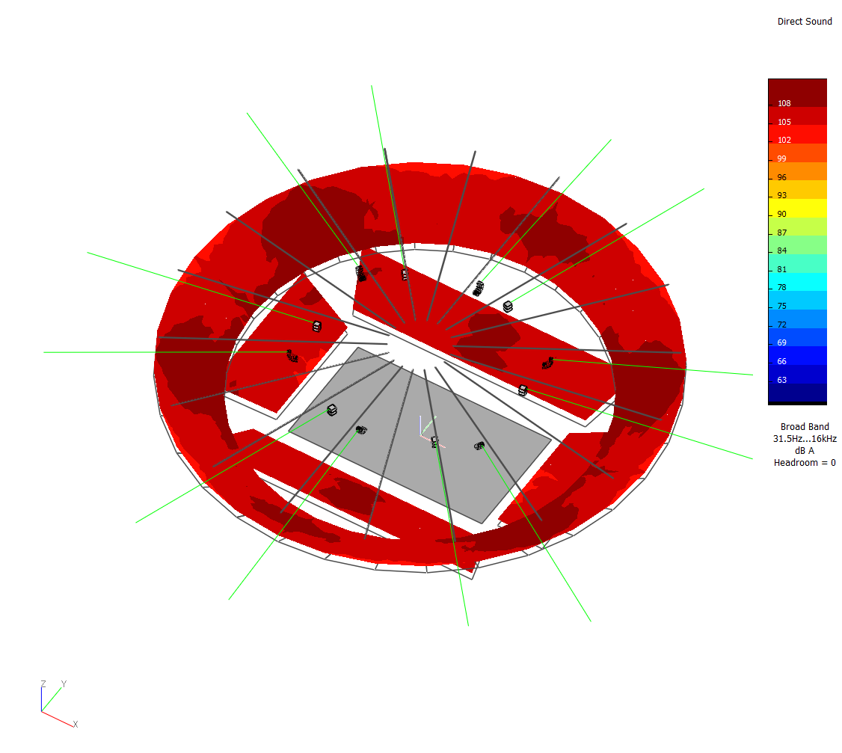
STADIA & ARENAS - Sound Solutions
Frequency
Some sound systems have dynamic ranges better suited for powerful music, others for intelligible speech. In a large-format sporting environment, with tightly regulated safety procedures, the sound system’s frequency response needs to be optimised for speech as well as music. This is the challenge for products as well as sound designers, and it requires a lot of practical expertise.
VITAL CRITERIA

Slide 26
STADIA & ARENAS - Sound Solutions
High-profile contracts, Worldwide.
Representation places
Stade de France (Paris-France) // Stade Roland-Garros (Paris-France) // Wimbledon (London-UK) //
Etihad Stadium (Manchester-UK) // O2 Arena (Prague-Czech Republic) // Optus Stadium (Perth-Australia) // Standard de Liège Stadium (Liège-Belgium) // Croke Park Stadium (Dublin-Ireland)…and more.

Slide 27
STADIA & ARENAS - Sound Solutions
Optus Stadium
Perth, Australia
Nearly 500 NEXO loudspeaker cabinets, line array and point-source, have been installed, in a state-of-the-art AV system, delivered by Australia’s number one AV systems integrator, Rutledge AV. A 3-year design process included extensive evaluation of loudspeaker systems, with Group Technologies finally winning the contract with its NEXO solution.
Equipment list
216 x GEO S12
54 x LS18
200 x ID24
NXAMP4x1 / 4x4
Capacity : 65,000

Slide 28
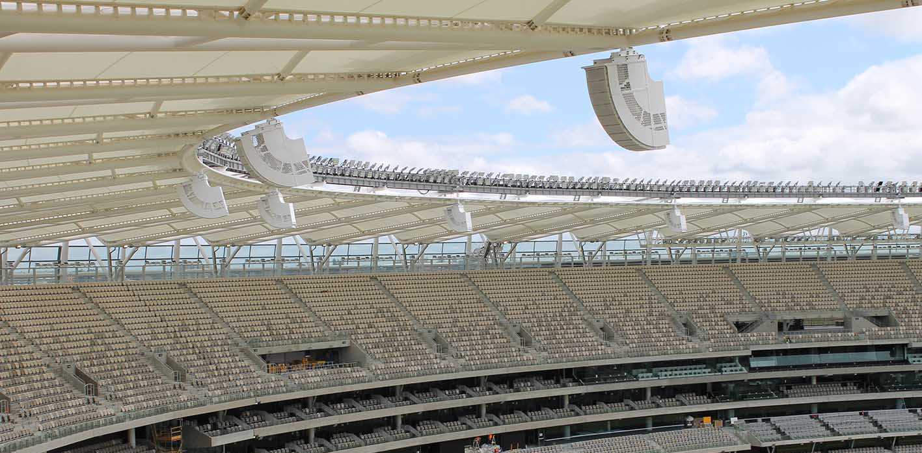
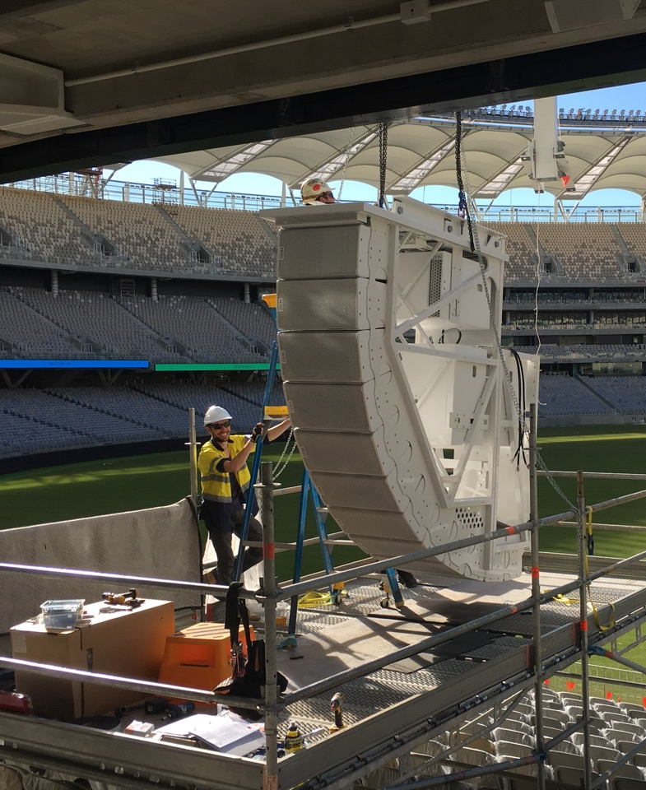
STADIA & ARENAS - Sound Solutions
Optus Stadium Perth, Australia
Rutledge AV was challenged to create a PA system that would deliver an ambitious 0.6 STi or above for the entire stadium seating area, referred to as the Main Bowl PA.
Additionally, a nominal SPL of 102dB (±3dB) for all the 60,000-seated visitors was stipulated.
“From the outset, NEXO was the clear winner for a variety of factors and, over the course of the project, the manufacturer proved themselves as great partners providing support whenever we required it” - Elijah Steele, Rutledge Project Manager

Slide 29
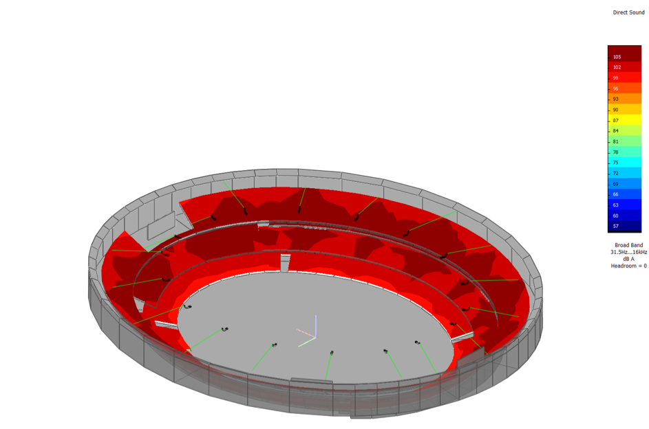
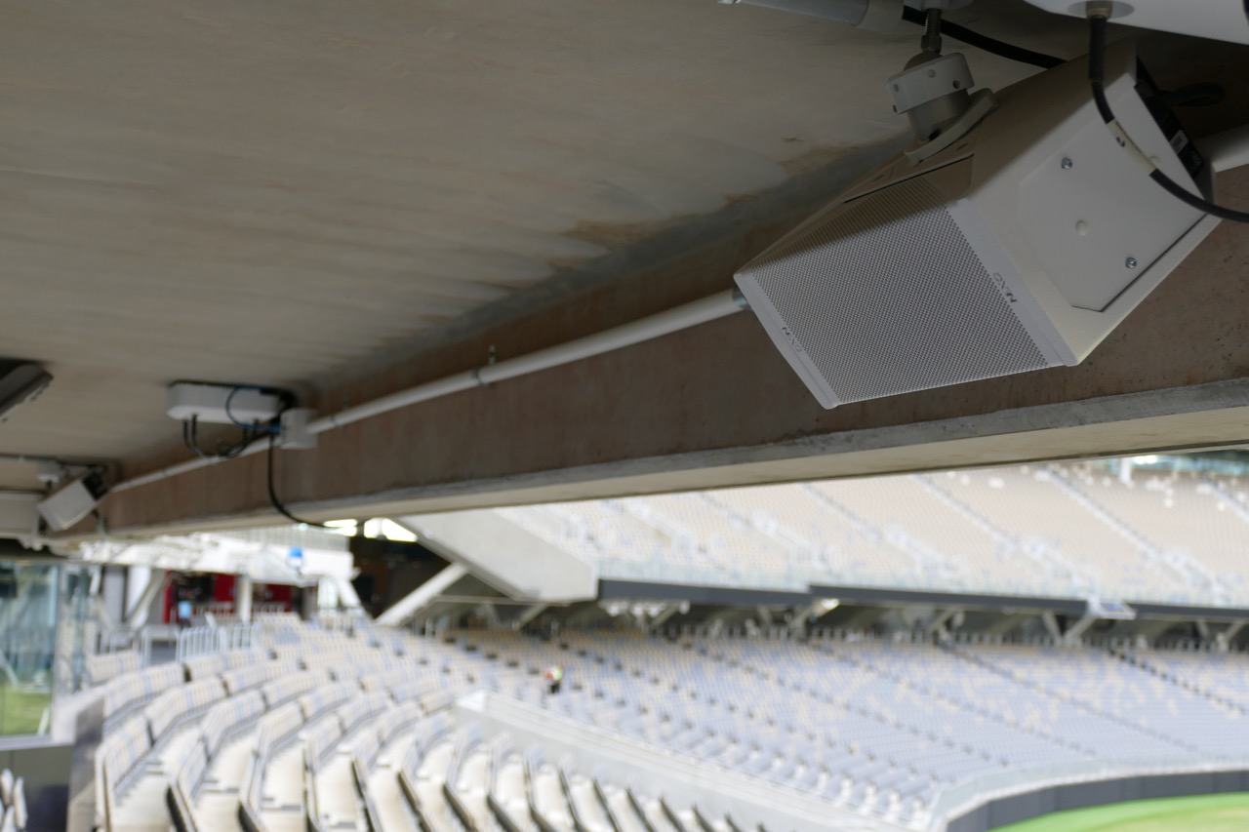
STADIA & ARENAS - Sound Solutions
Optus Stadium Perth, Australia
Eighteen arrays, each combining 12x GEO S12 elements together with 3x LS18 sub bass cabinets, were installed to provide the bulk of the stadium’s SPL punch.
Largely dictated by simulations using NEXO’s NS-1 software, the special GEO S1210 and S1230 modules provide long-throw capabilities to ensure even coverage down to the L1 seating areas. Vertical and horizontal control is further enhanced by the incorporation of the GEO S12’s Hyperbolic Reflective Wavesource, while a Directivity Phase Device extends coherency below normal LF-HF coupling limits. The presence of three additional LS18 sub bass units within each array extends the LF response to 32Hz at –6dB.
To attain an STi of 0.6 for the under-balcony seating areas on L1, L3 and L4, a further 200x NEXO ID24 cabinets have been installed. Each delayed ID24 incorporates dual 4-inch drivers in a dipole arrangement, providing coverage in those spaces out of the full GEO S12 range. “These deceptively powerful boxes allowed us to fulfil the 100dB SPL handling in what we term the shadow areas, while their compact footprint provides discretion,” explains Steele.

Slide 30
STADIA & ARENAS - Sound Solutions
Stade de France
Paris, France
The Stade de France in St Denis, Paris, is France’s iconic national stadium, with seating capacity for 80,000 beneath its immense floating roof. Built as the principal venue for the 1998 World Cup, hosted and won by France, the stadium has enjoyed a lifelong relationship with local audio equipment manufacturer NEXO, with nearly 300 of its high-output loudspeakers installed.
Equipment list
300 x GEO S12
30 x RS18
40 x NXAMPs
Capacity : 80,000

Slide 31
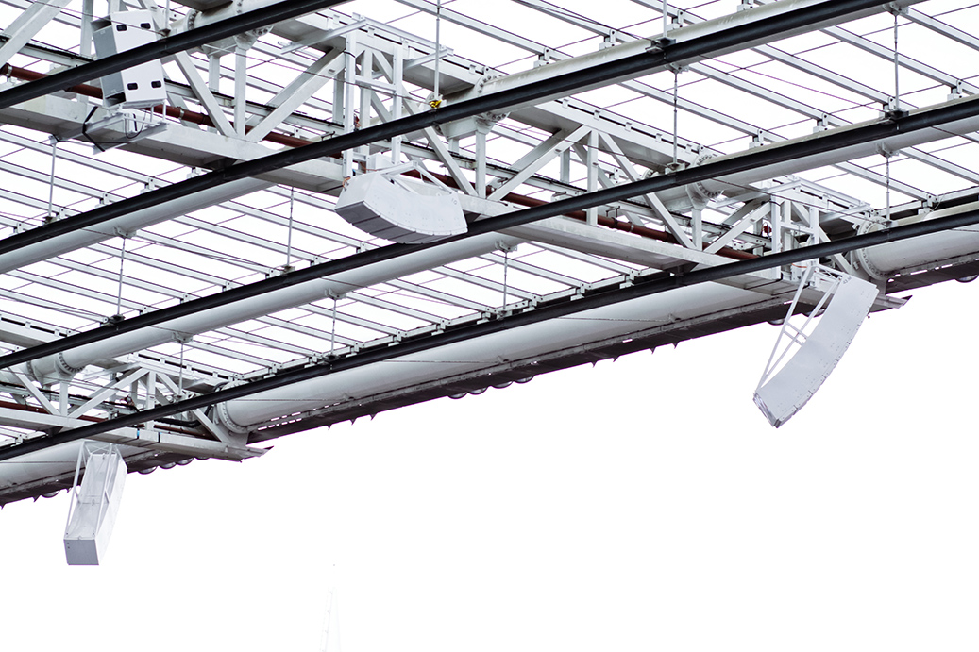
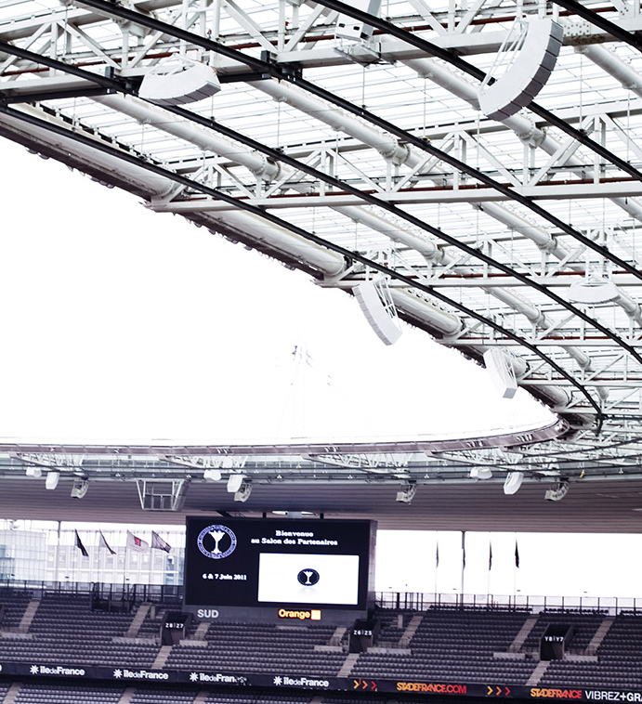
STADIA & ARENAS - Sound Solutions
Stade de France Paris, France
Put together with NEXO’s NS1 programme and EASE, the integrator’s design featured nearly 300x GEO S12 loudspeaker cabinets, specially enhanced for this project, and nearly 30x RS18s, the first time NEXO has delivered these sub-bass units into a sports stadium install.
Split to cover the upper and lower parts of the stadium, the system uses 40 clusters of NEXO cabinets for the stands; flown from the roof, 7x S12s are directed at the upper levels, while a separate array of 6x S12s faces directly down towards the lower levels. Another 32 cabinets of S12 are used for fill at ground level. RS18s are flown, 27 in total. Any loudspeaker in any cabinet can be changed in 30 minutes, supplementing the protection afforded by the NEXO NXAMPs.

Slide 32
STADIA & ARENAS - Sound Solutions
Toyota Stadium
Toyota City, Japan
The Toyota Stadium in Aichi Prefecture is one of the largest football stadiums in Japan, and is also used for rugby. A major upgrade of its sound system was undertaken in preparation for the 2019 World Cup, equipping it with a world-class installation of NEXO loudspeakers and amplifiers, and Yamaha electronics.
Equipment list
GEO S12
PS15
PS10
NXAMPMKII
Yamaha CL5 console
MSP5 STUDIO
Rio3224-D2 / Rio1608-D2
SWX2300-16G / 24G
YSFP-G-SXA / LX
SWP1-8MMF
Capacity : 45,000

Slide 33
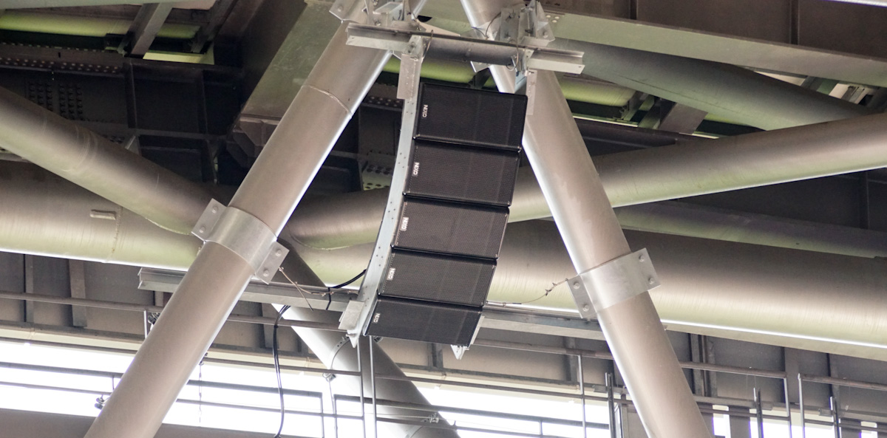
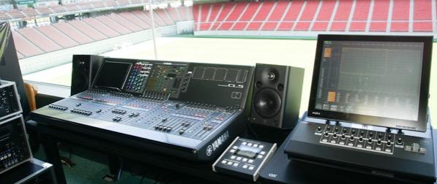
STADIA & ARENAS - Sound Solutions
Toyota Stadium Toyota City, Japan
All the NEXO equipment, line array and point source loudspeakers, have been supplied by Yamaha Sound Systems, which has also delivered a Yamaha CL5 digital console as the main mixer in the Toyota Stadium operation room. With NEXO’s new NXAMP4x2Mk2 Series amplifiers spread out amongst different amp rooms in the four corners of the stadium, there is significant distance between ops room and amp rooms. The Dante network has been converted to optical fibre for transmission.
The loudspeakers in the new system, primarily featuring NEXO’s high-spec GEO S12-ST line array modules, are discreetly installed amongst the steel beams of the stadium structure, ensuring ultra-low visibility. They are used for music at half-time, for the stadium DJ, for venue announcements and to play sound to accompany the big LED screen. It is also used to amplify the pitchside interviews, so speech clarity was an absolute priority for the designers, as well as high SPL to provide the volume needed to handle loud cheering and applause.
“The NEXO speakers have higher efficiency than the previous ones, so we can output louder sound than before. Something that is important in this kind of facility is durability. Speakers in this kind of facility often break due to exposure to wind and rain. With the new NEXO system, we are able to achieve theatre-class high sound quality even in severe conditions.” - Yoshiteru Mimura, President of M&H Laboratory Co. Ltd

Slide 34

STADIA & ARENAS - Sound Solutions
Parc d’Activité du Pré de la Dame Jeanne, B.P. 5
60128 Plailly
France
Tel: +33 (0) 3 44 99 00 70
Email: info@nexo.fr
nexo-sa.com

