Slide 1


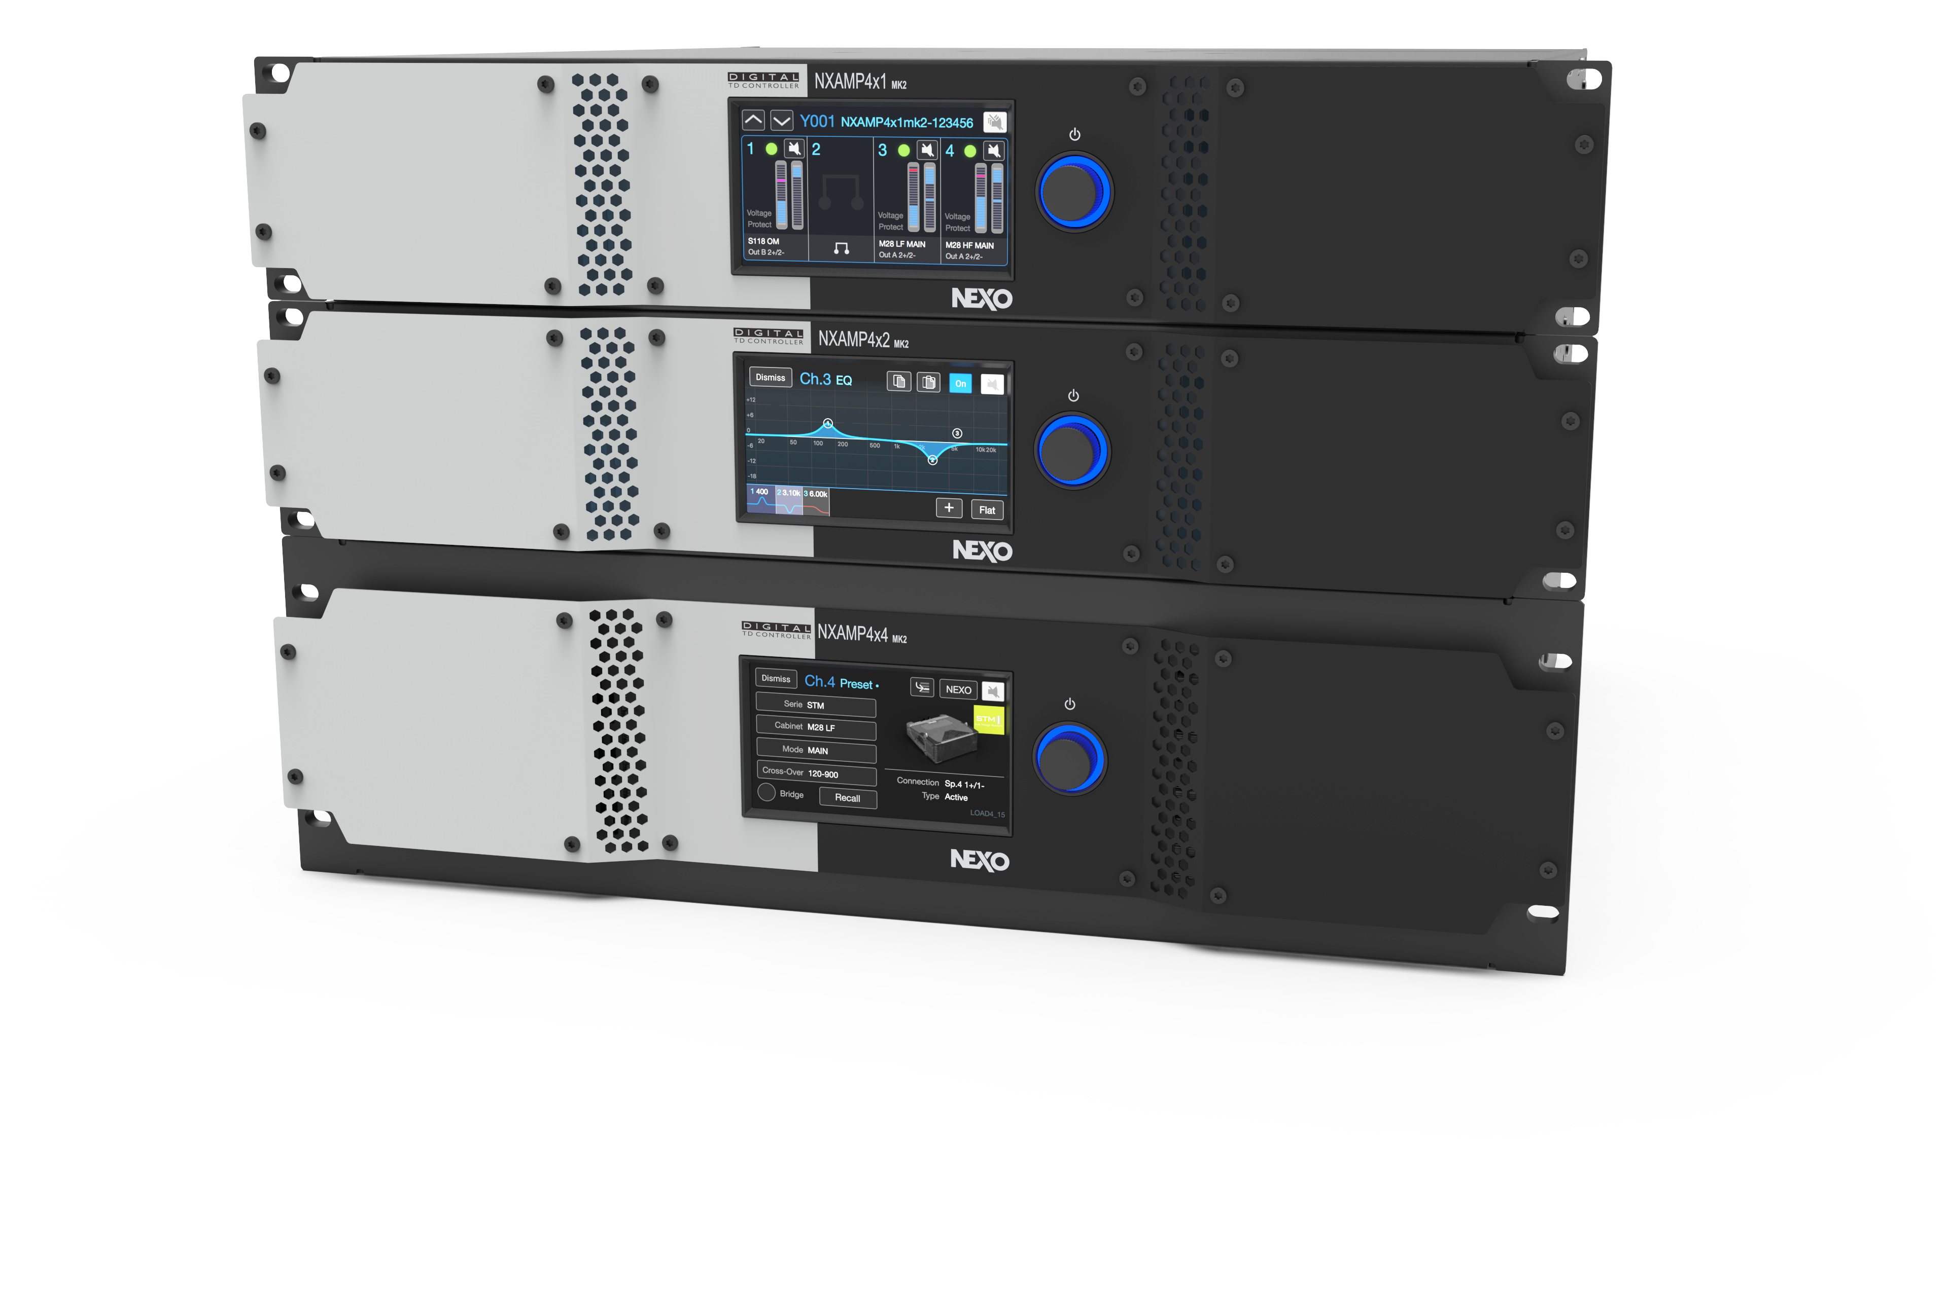


Slide 2


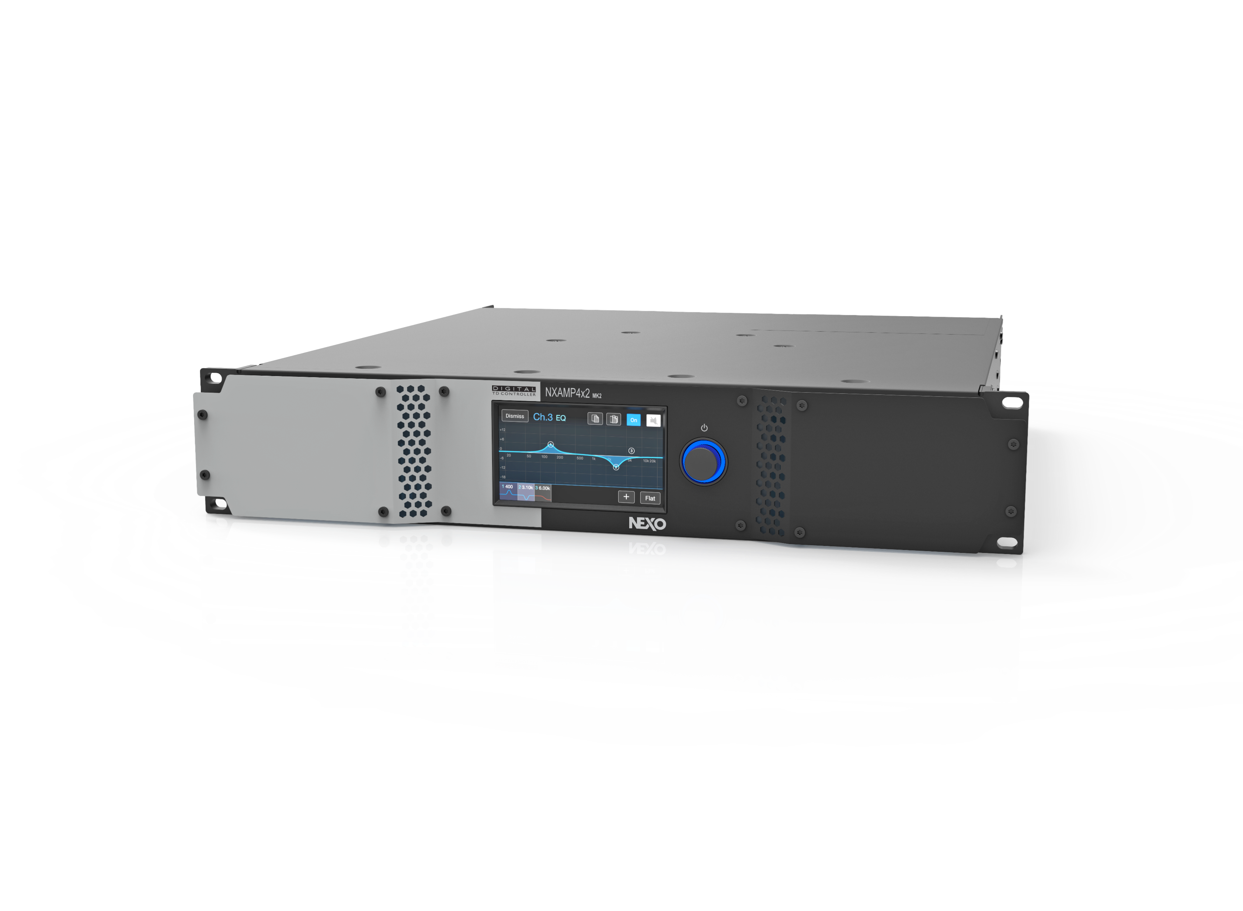


Introdución
Disponible en 4 x 1300 Vatios, 4 x 2500 Vatios y 4 x 4500 Vatios
NXAMP4X1MK2
NXAMP4X2MK2
NXAMP4X4MK2
Amplificadores de 4 canales en Clase D con la última tecnología.
Pantalla LCD táctil de gran tamañoy a color
Nuevo nivel de calidad sonora

Slide 3

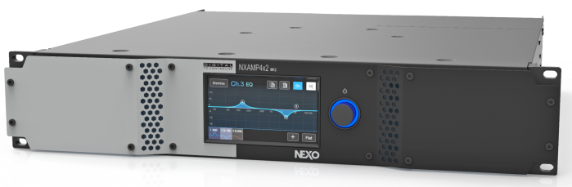
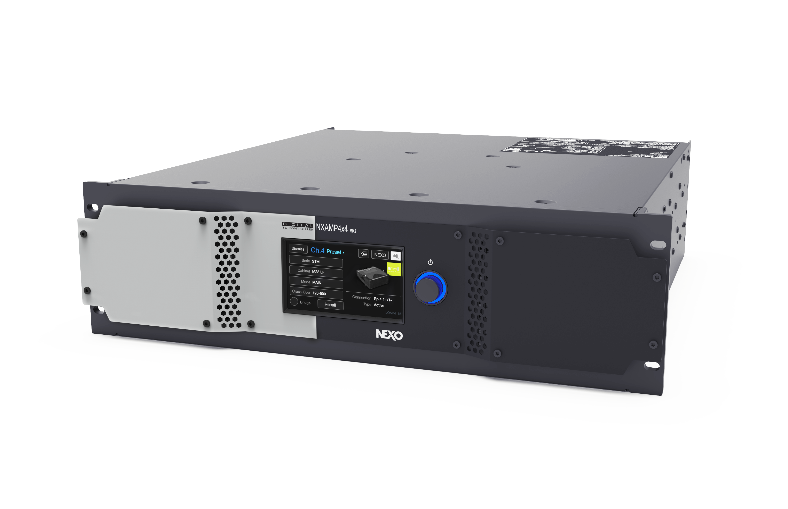
Potencia de salida
Máxima potencia de salida 4 canales (8 Ω/canal) | 4x 600 W
Máxima potencia de salida 4 canales (4 Ω/canal) | 4x 900 W
Máxima potencia de salida 4 canales (2 Ω/canal) | 4x 1.300 W
Máxima potencia de salida 2 canales en bridge (8 Ω/canal) | 2x 1.800 W
Máxima potencia de salida 2 canales en bridge (4 Ω/canal) | 2x 2.600 W
NXAMP4x1MK2
Máxima potencia de salida 4 canales (8 Ω/canal) | 4x 1.200 W
Máxima potencia de salida 4 canales (4 Ω/canal) | 4x 1.900 W
Máxima potencia de salida 4 canales (2 Ω/canal) | 4x 2.500 W
Máxima potencia de salida 2 canales en bridge (8 Ω/canal) | 2x 3.800 W
Máxima potencia de salida 2 canales en bridge (4 Ω/canal) | 2x 5.000 W
NXAMP4x2MK2
Máxima potencia de salida 4 canales (8 Ω/canal) | 4x 1.900 W
Máxima potencia de salida 4 canales (4 Ω/canal) | 4x 3.300 W
Máxima potencia de salida 4 canales (2 Ω/canal) | 4x 4.500 W
Máxima potencia de salida 2 canales en bridge (8 Ω/canal) | 2x 6.600 W
Máxima potencia de salida 2 canales en bridge (4 Ω/canal) | 2x 9.000 W
NXAMP4x4MK2

Slide 4
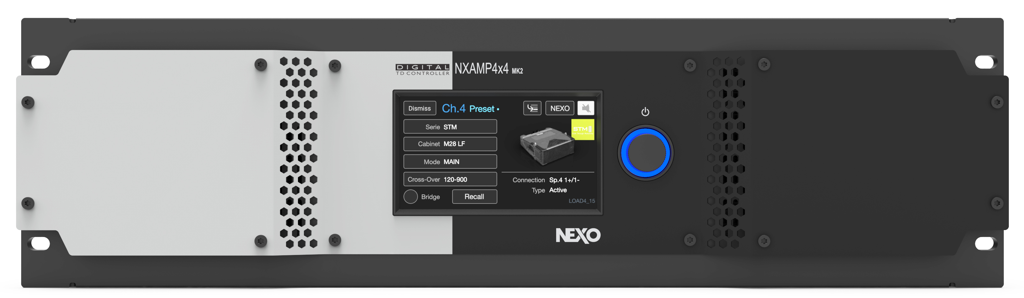
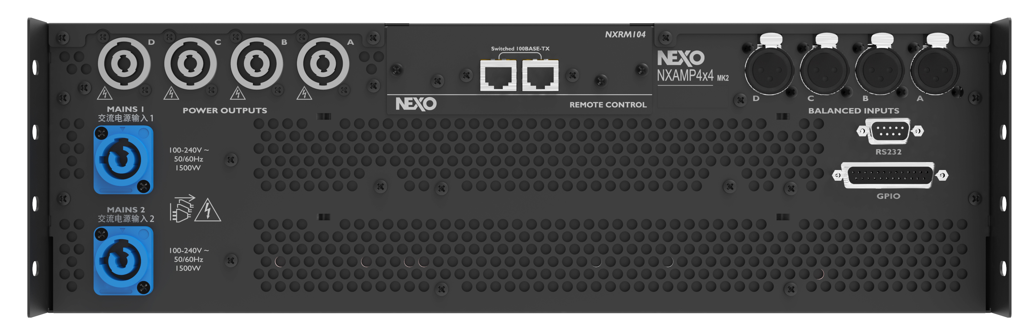

Características
Amplificador de 4 canales
Procesamiento con chips LSI propios para una excelente calidad de sonido
4 entradas analógicas de alta calidad
Fuente de poder universal (100-240 Volts)
con tecnolgía PFC
4 entradas digitales opcionales (en ranura de expansión) AES/EBU, Ethersound, Dante o AES67
El panel posterior incluye:
puerto serial RS232 y puertos GPIO

Slide 5
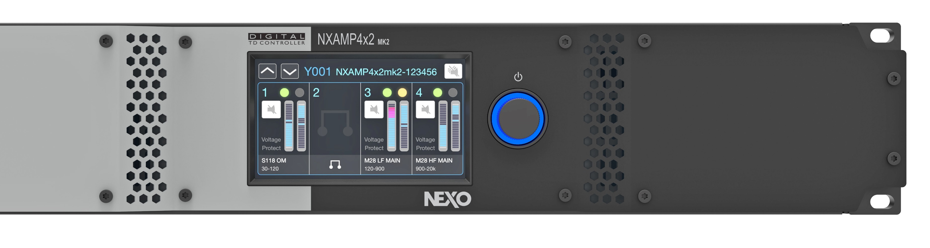
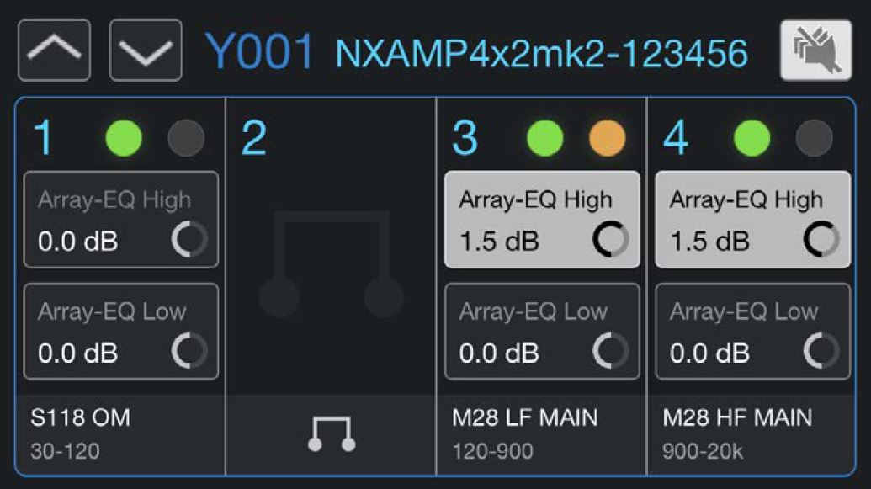
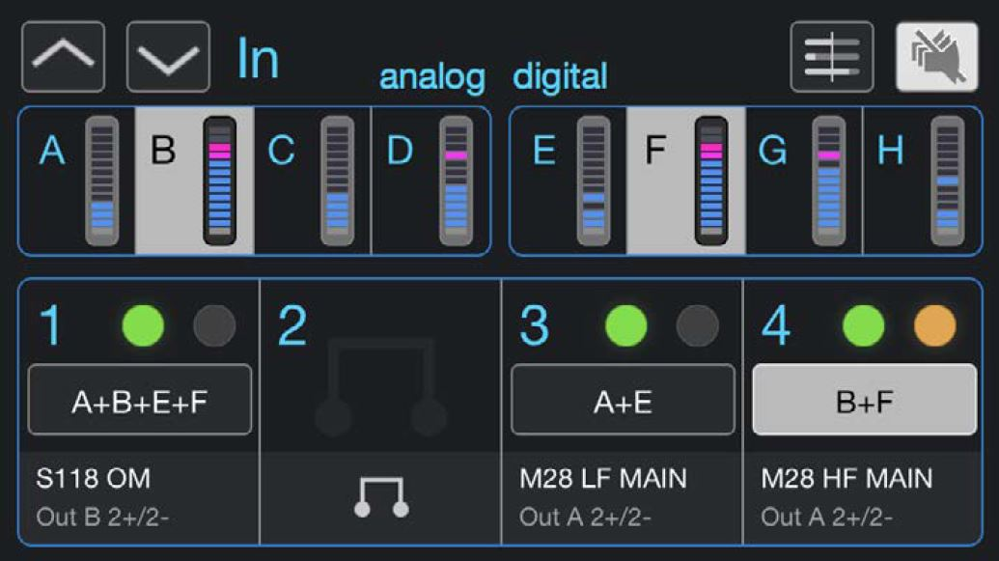
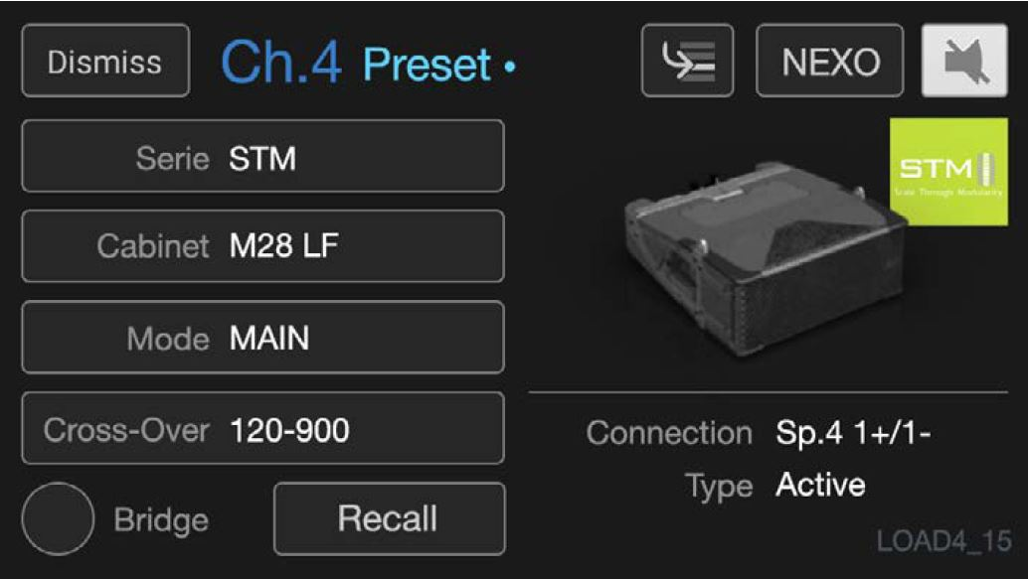
Fingertrip control
4.3 Inches
LCD
Tactile Display
Access to all critical functions :
EQ Detail, User EQ, Scene, Volume/Gain etc…
Array EQ
Inputs
Setup
Better compensation of ground, stacking and line-array effect, on Low and High frequencies
The inputs view displays input levels and offers input alignement options.
NEXO or Custom Setup can be edited on one or several channels.

Slide 6
Fingertrip control
Pantalla LCD táctil
4.3 Pulgadas
Access to all critical functions :
EQ Detail, User EQ, Scene, Volume/Gain etc…
Array EQ
Inputs
Setup
Better compensation of ground, stacking and line-array effect, on Low and High frequencies
The inputs view displays input levels and offers input alignement options.
NEXO or Custom Setup can be edited on one or several channels.

Slide 7


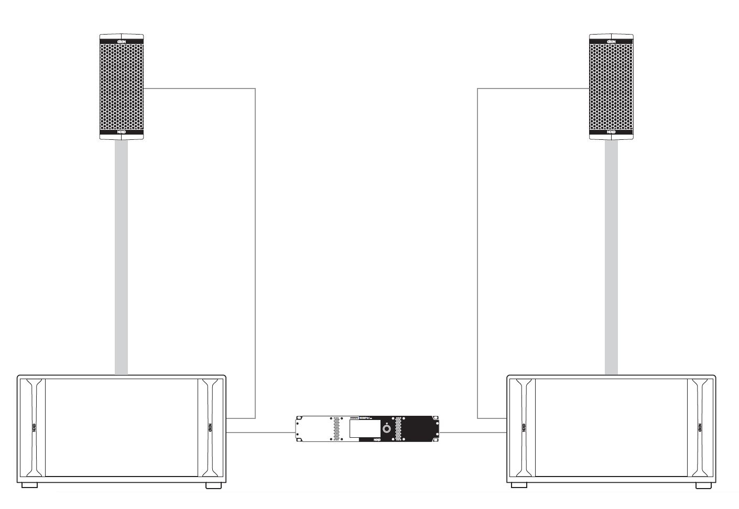
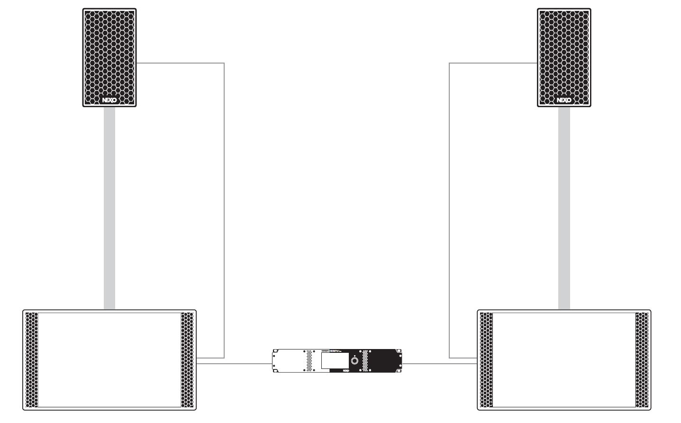
Recommended Systems
NXAMP4X1MK2
NXAMP4X1MK2 powering 1x ID24 and 1x IDS110 sub per side
NXAMP4X1MK2 powering 1x PS8 and 1x LS400 sub per side

Slide 8

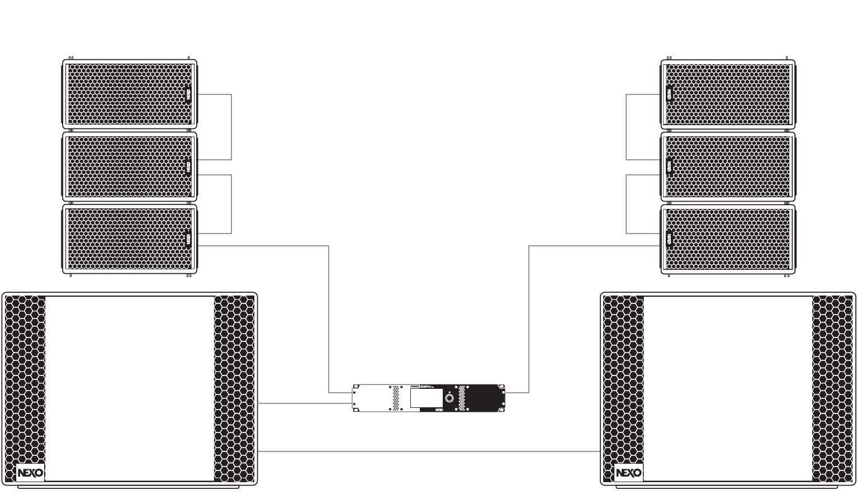
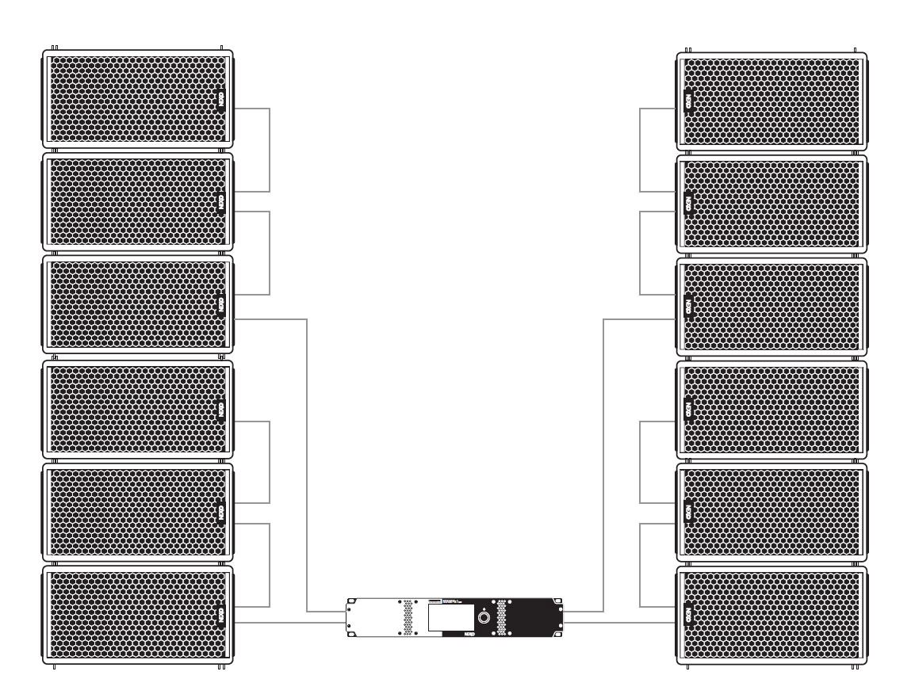
Recommended Systems
NXAMP4X1MK2
NXAMP4X1MK2 powering 3x GEO M6 per side and 2x LS18 in mono bridge
NXAMP4X1MK2 powering 6x GEO M6 per side

Slide 9

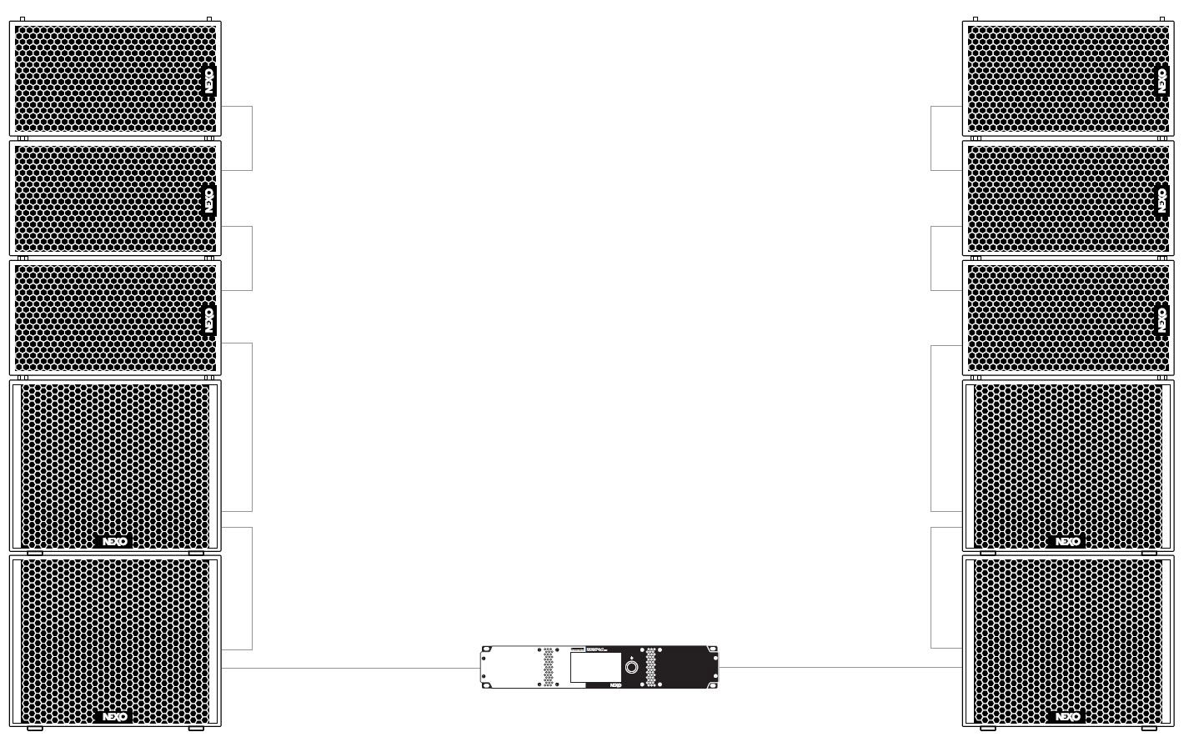
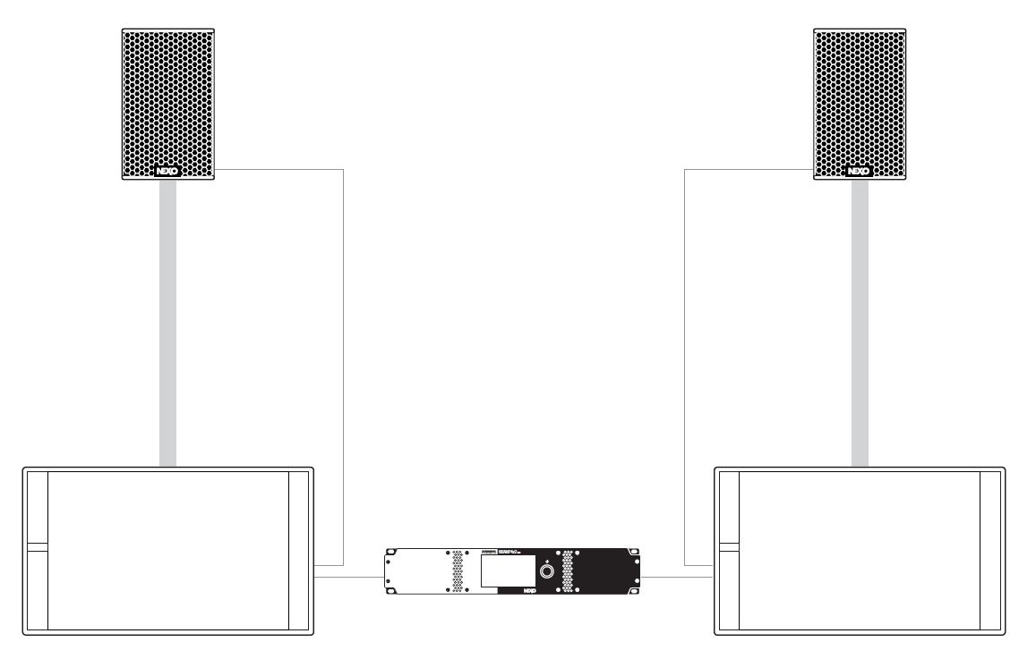
Recommended Systems
NXAMPX2MK2
NXAMP4X2MK2 powering 1x PS10R2 and 1x LS600 sub per side
NXAMP4X2MK2 powering 3x GEO M10 and 2x MSUB15 per side

Slide 10
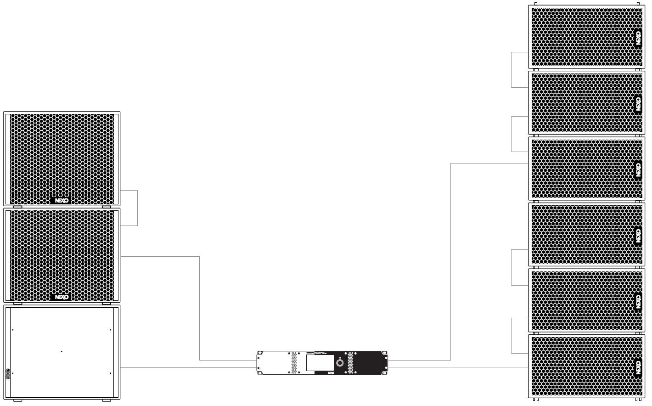
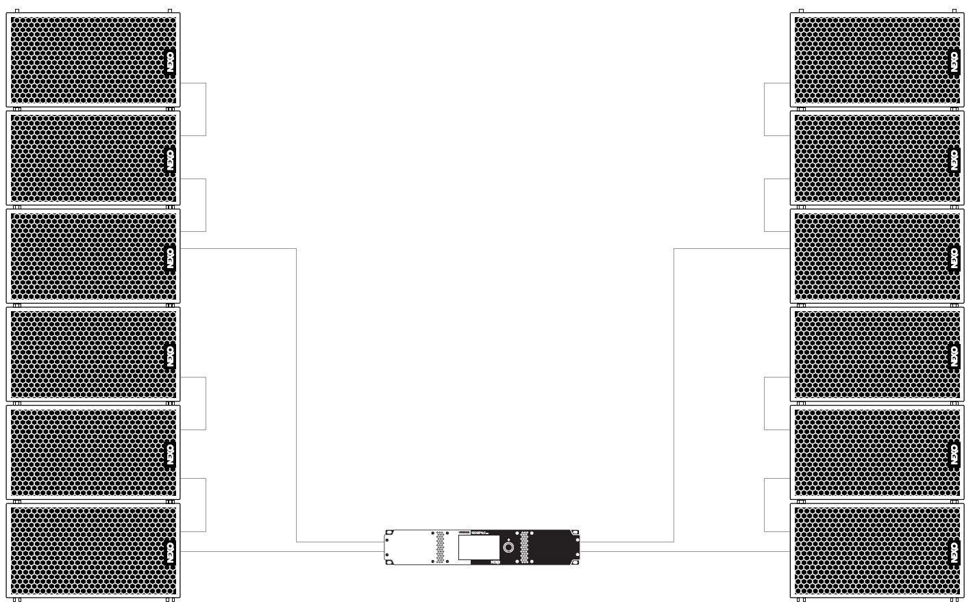
Recommended Systems
NXAMP4X2MK2
NXAMP4X2MK2 powering 3x MSUB15 (one in cardio mode) and 6x GEO M10
NXAMP4X2MK2 powering 6x GEO M10 per side

Slide 11


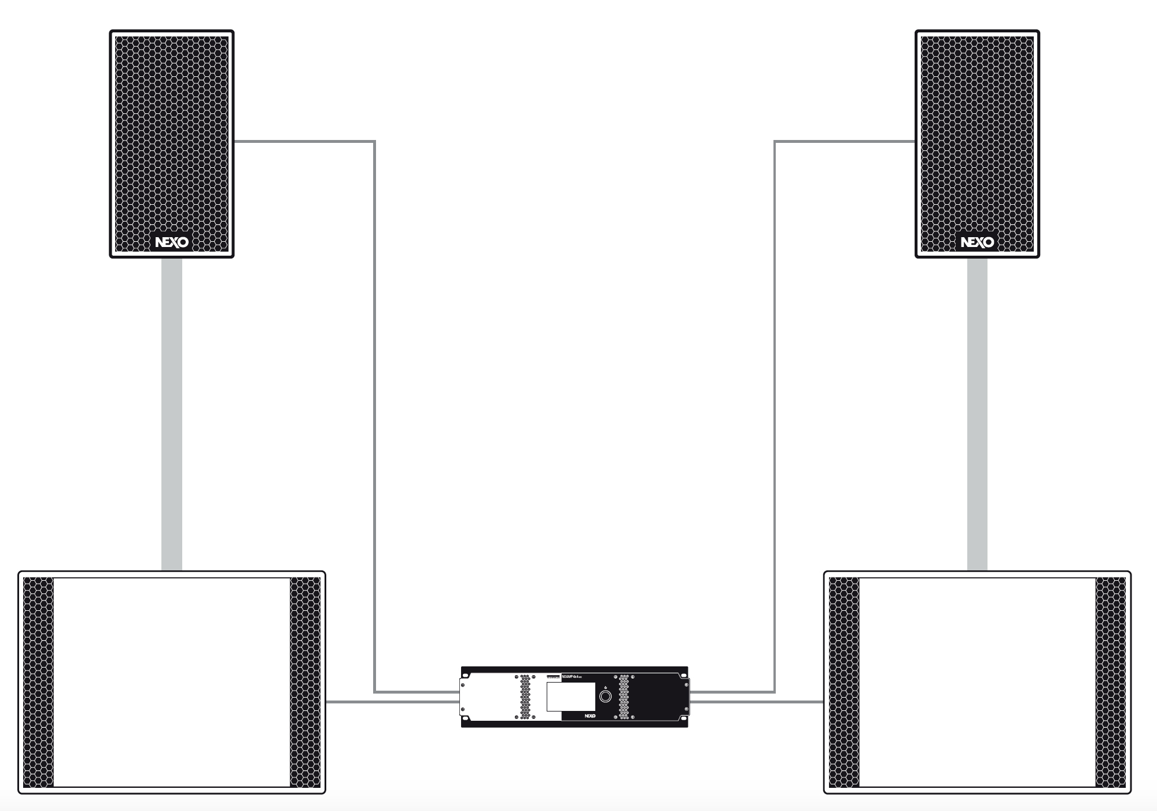
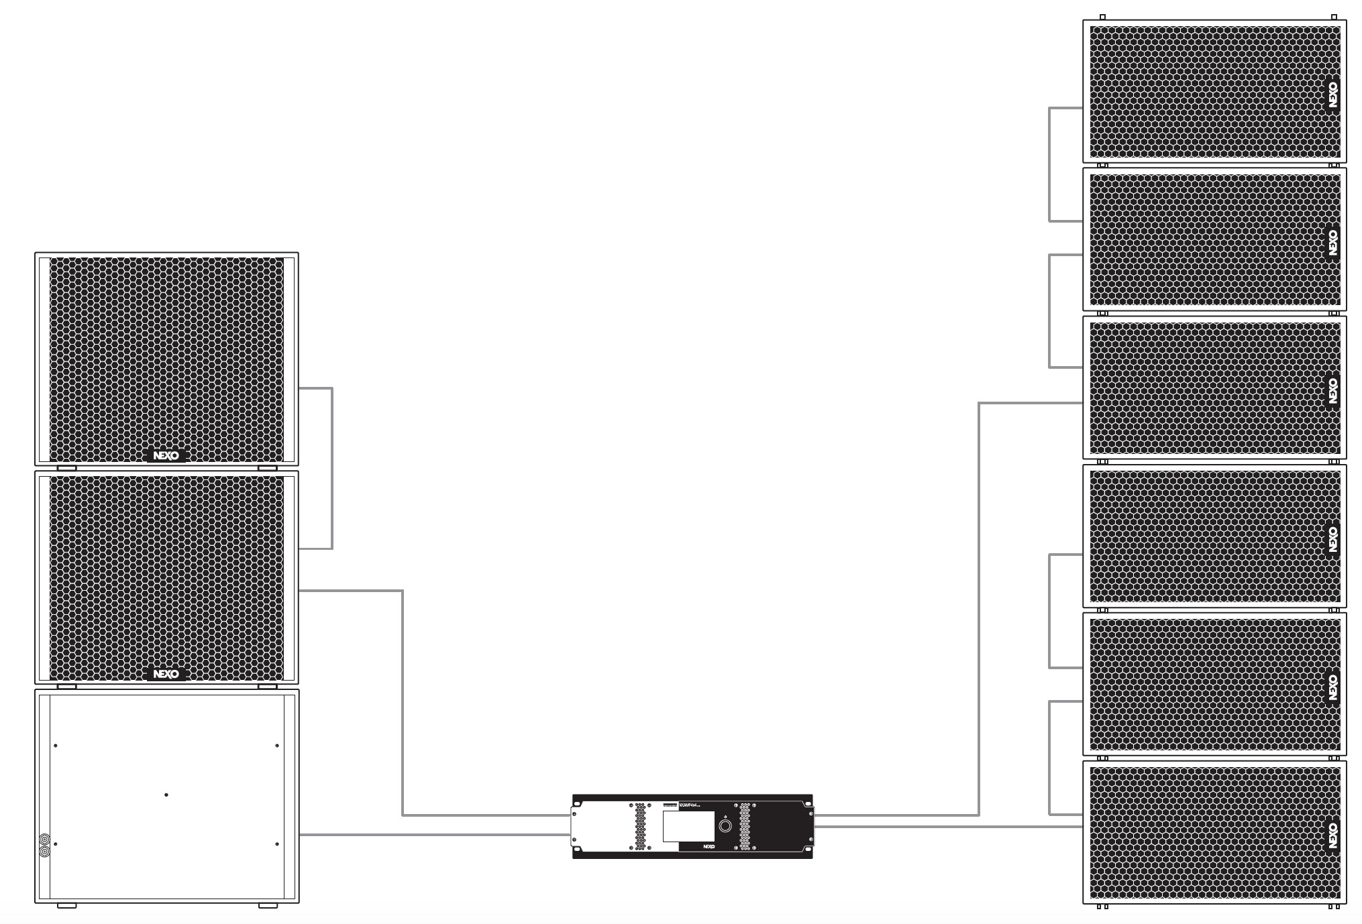
Recommended Systems
NXAMP4X4MK2
NXAMP4X4MK2 powering 2 X PS15 + 2 X LS18 per side
NXAMP4X4MK2 powering 3 X MSUB18 (one in cardio mode) and 6 X GEO M12

Slide 12
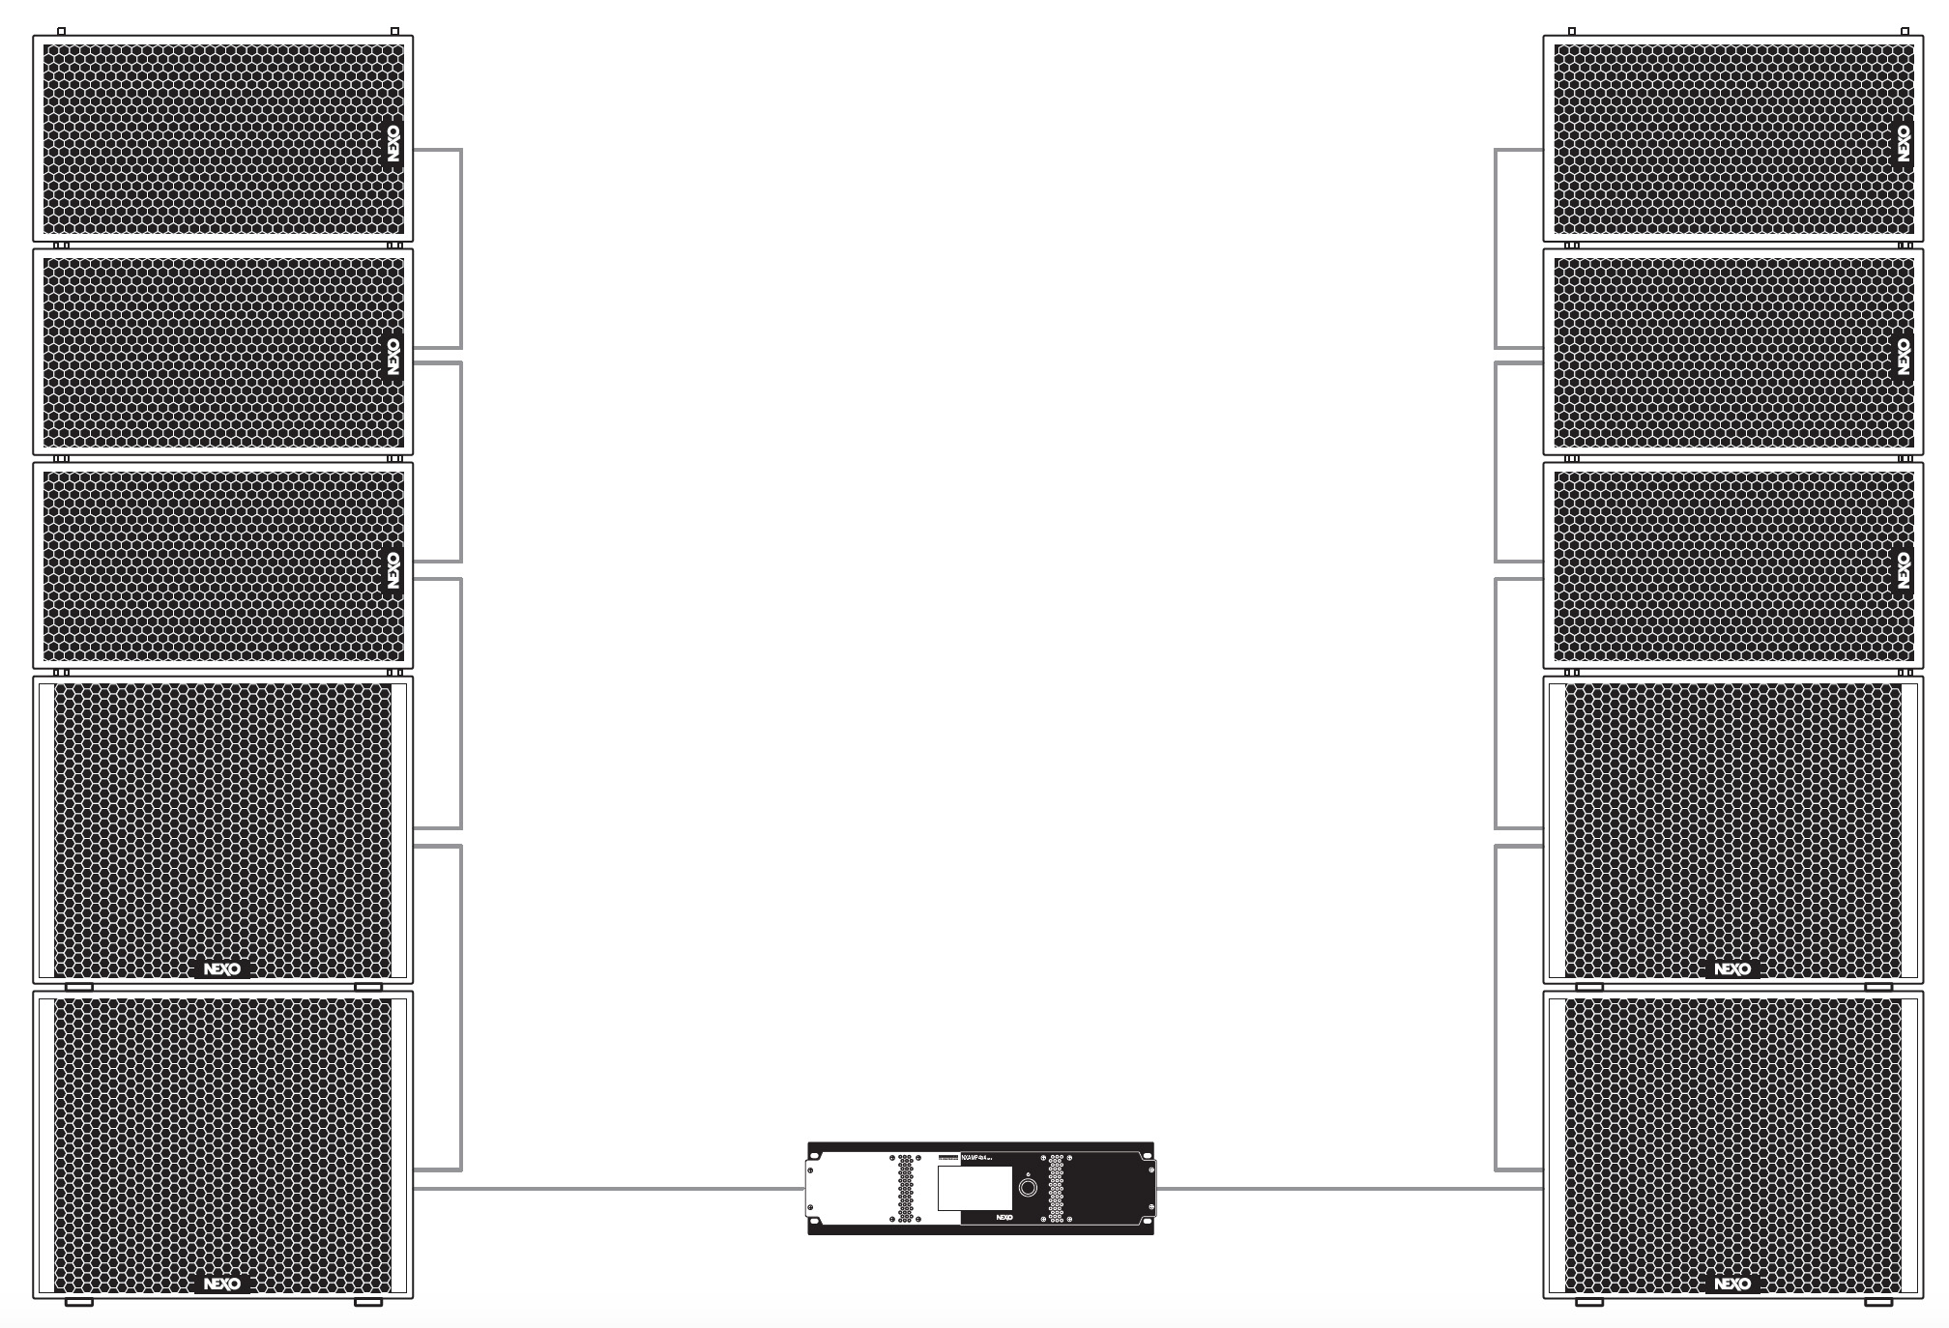
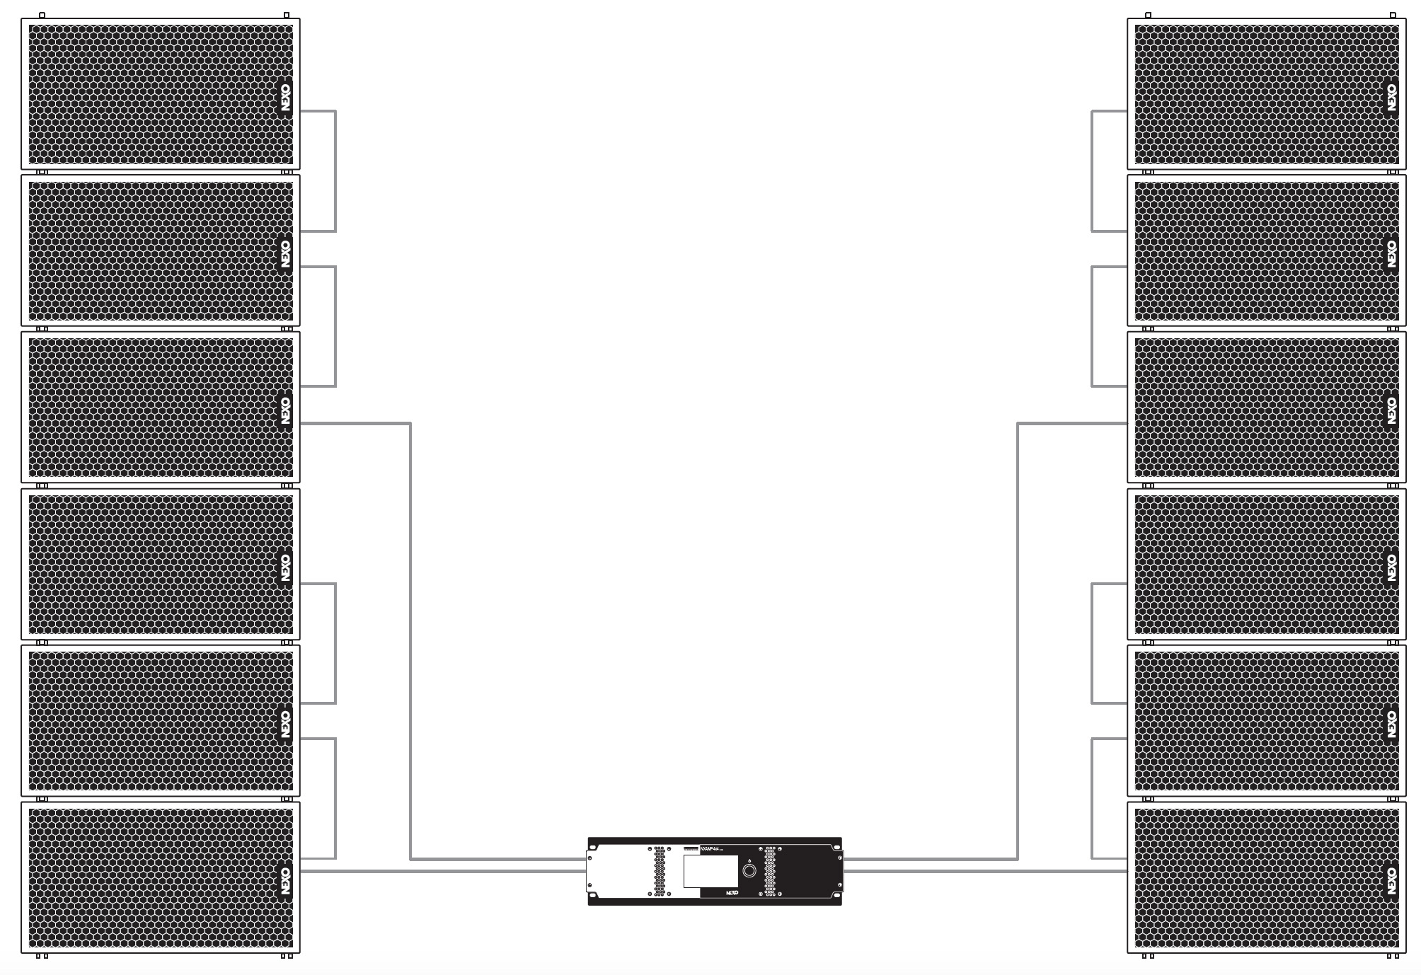
Recommended Systems
NXAMP4X4MK2
NXAMP4X4MK2 powering 3 X GEO M12 and 2 X MSUB18 per side
NXAMP4X4MK2 powering 6 X GEO M12 per side

Slide 13



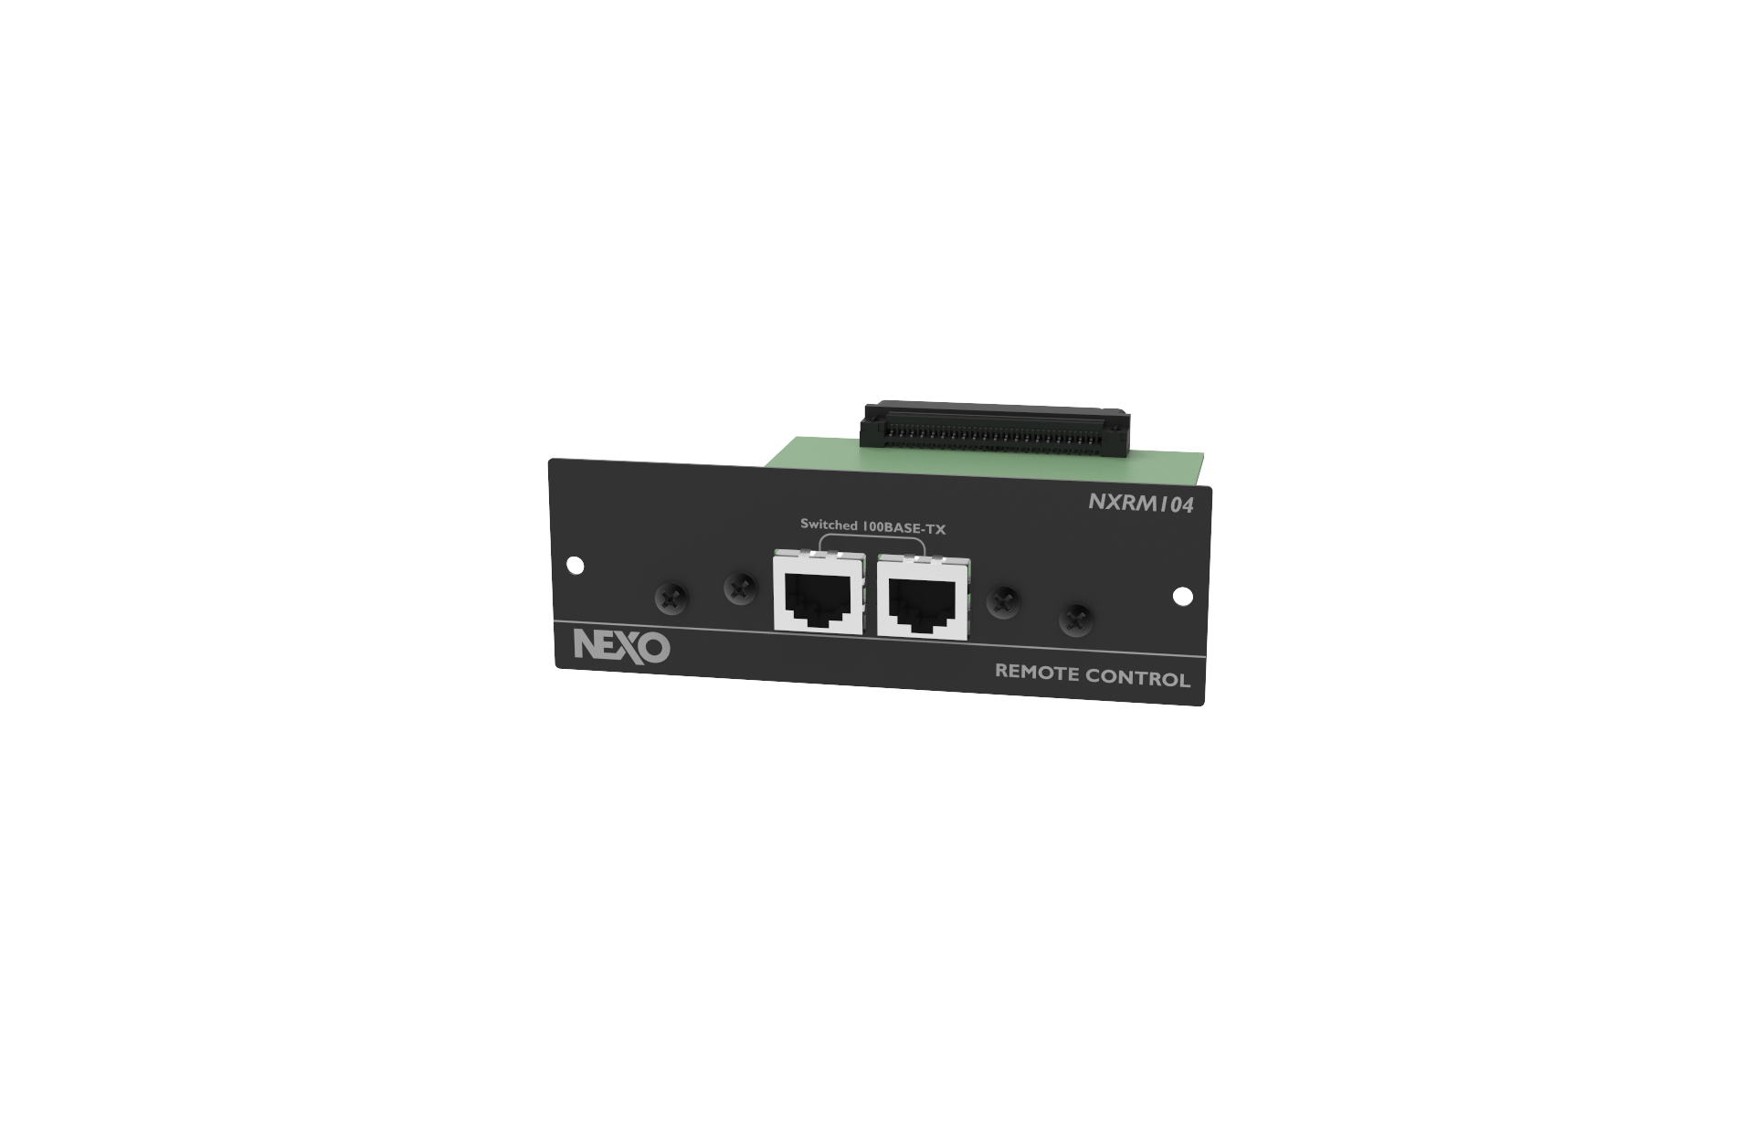
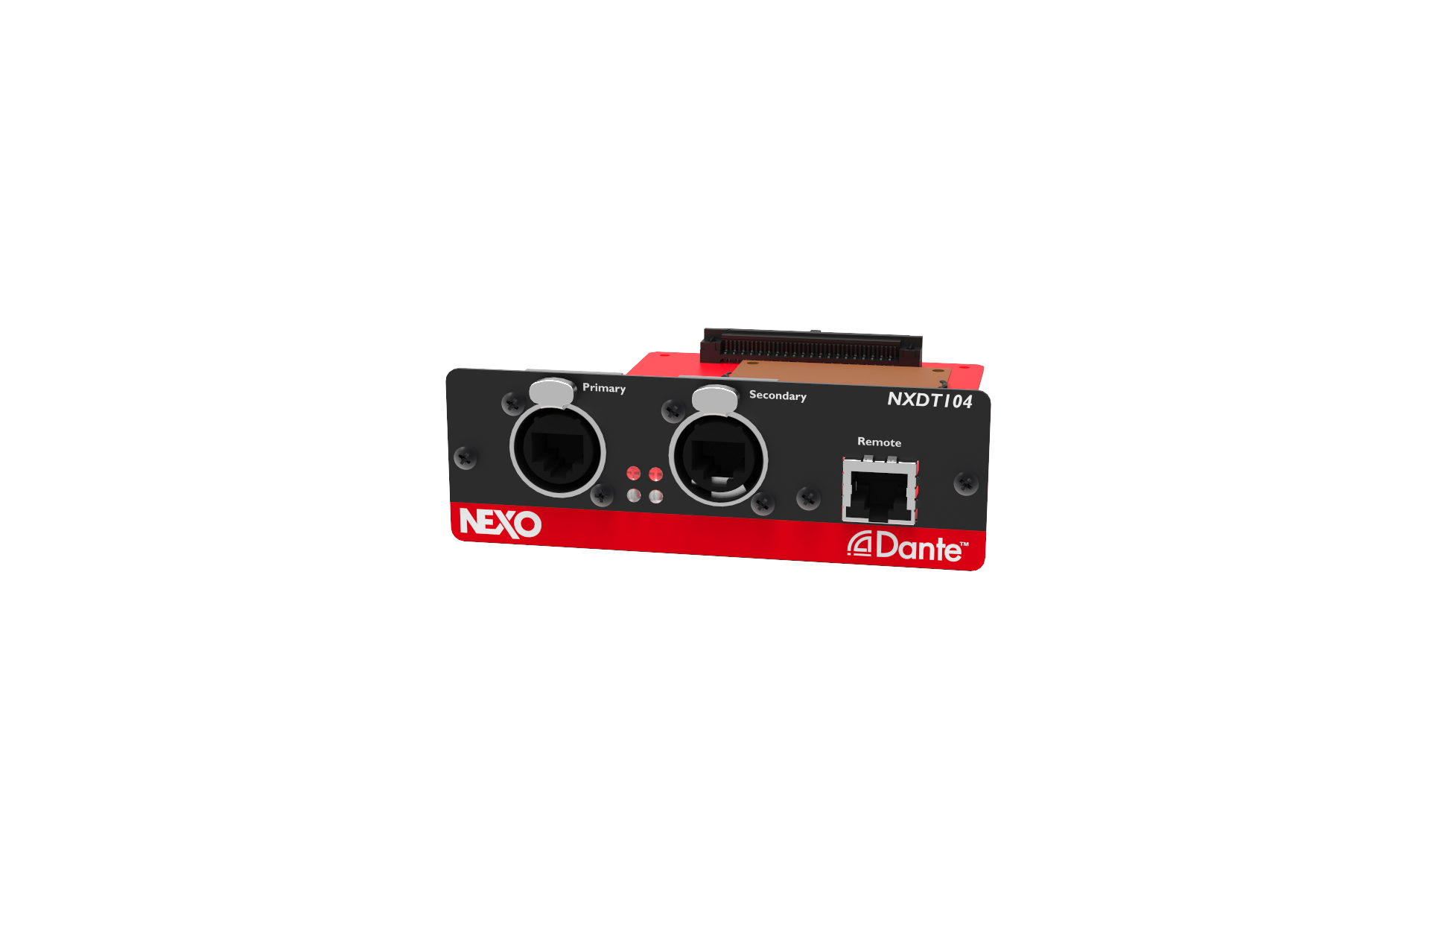
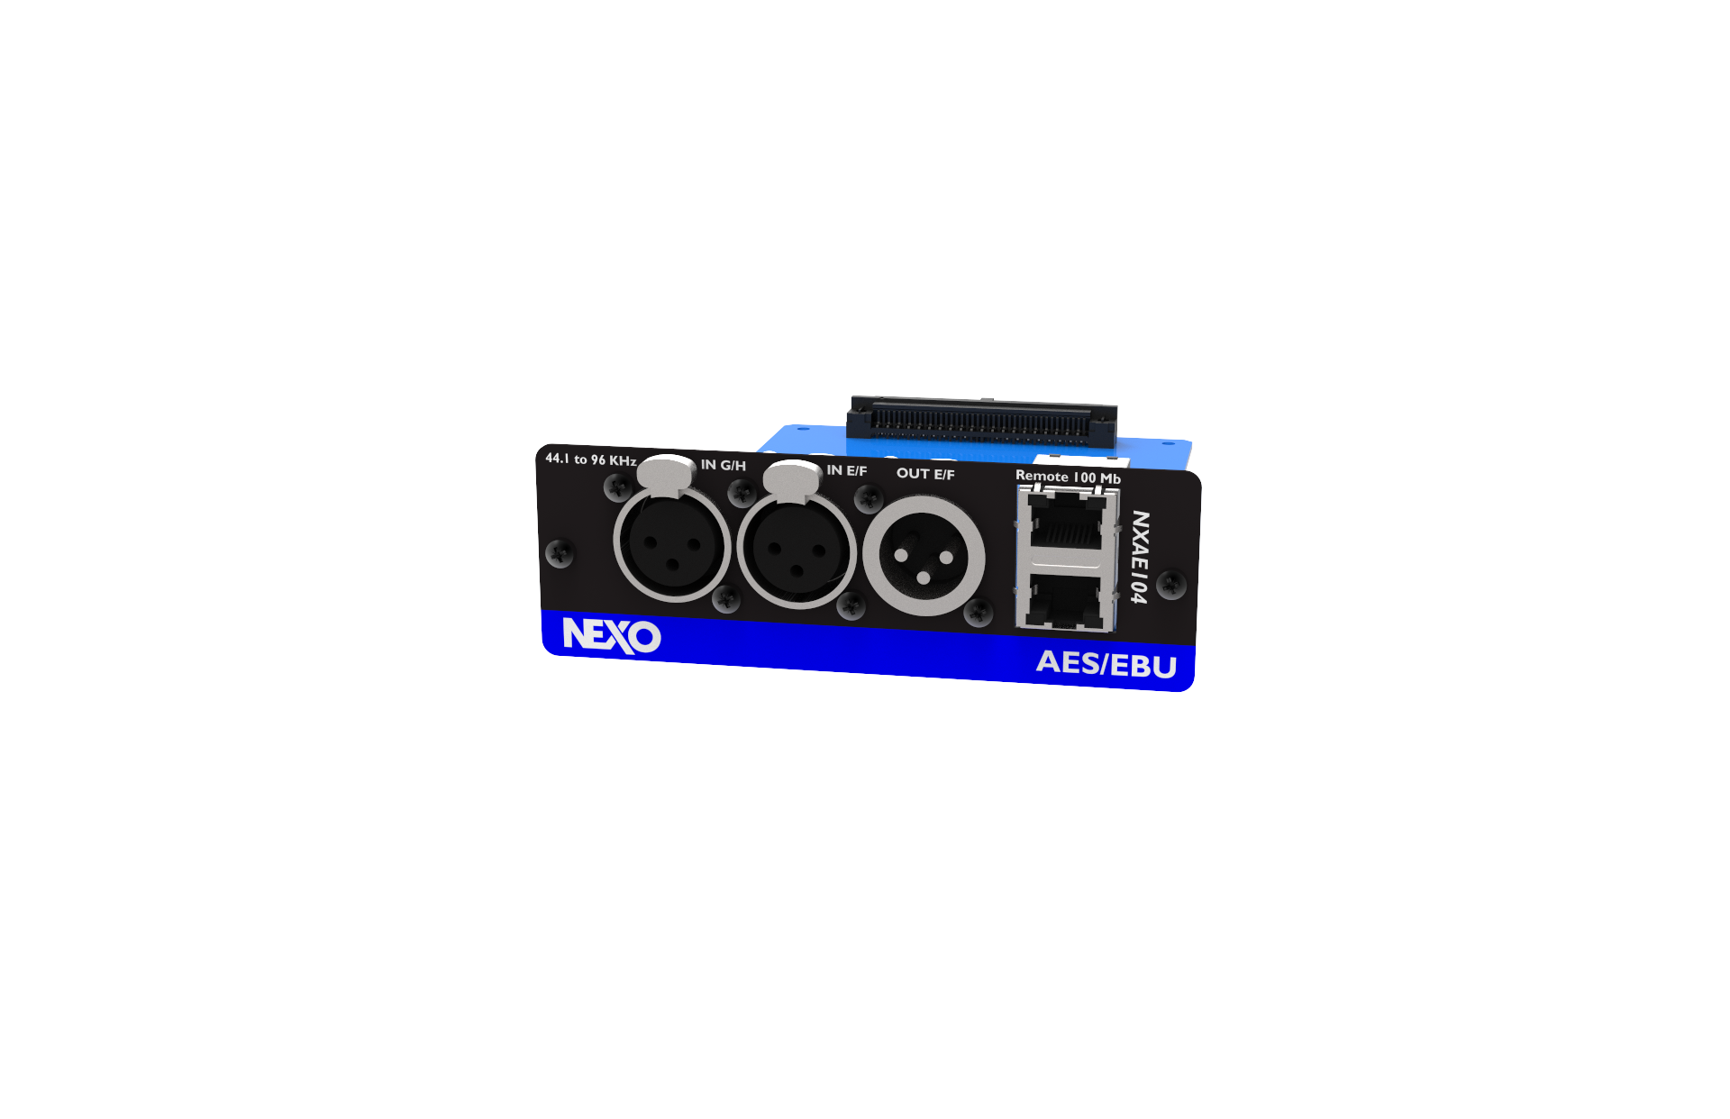
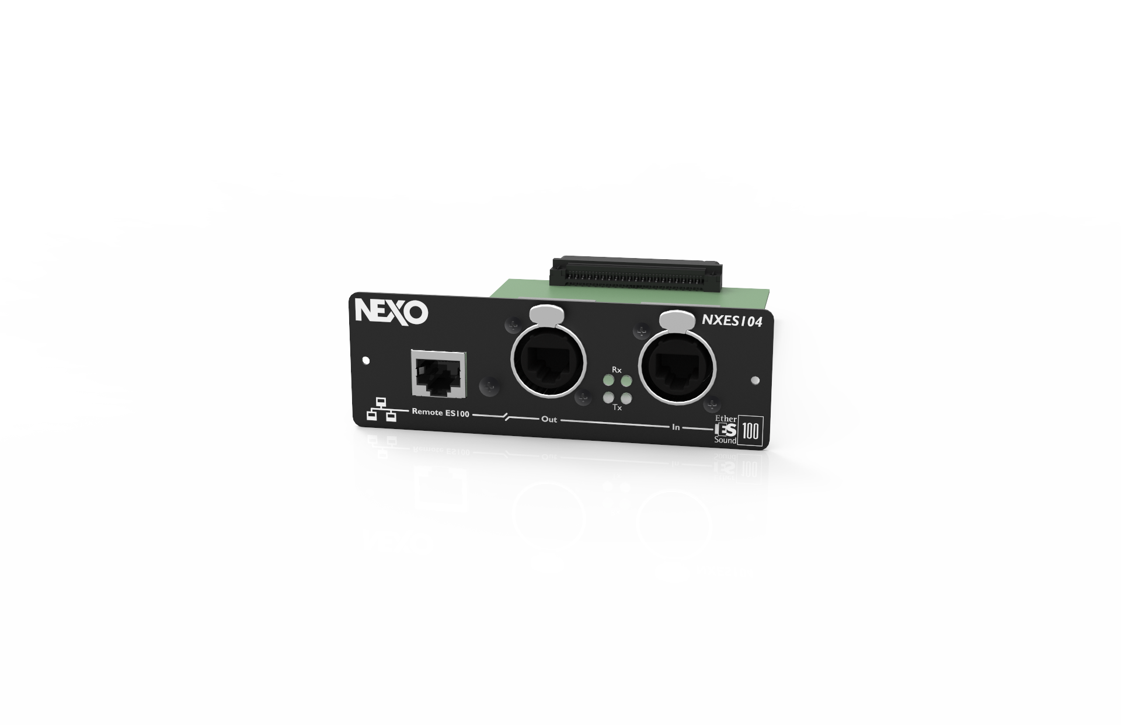
Network Cards
Remote Control
Optional*
Extracts 4 audio streams
from the 2 x 64 channels of an ES100
In Out ports (easy daisy-changing)
Supplied as standard
2x RJ45 ports for remote control
Optional*
Receives 4 audio streams (Dante or AES67) + Remote control
(via LAN using TCP/IP commands)
Unique 3-port design can be used as :
-3 port gigabit switch
-2 Dante redundant ports + optional 3rd port
Optional*
Receives 4 audio channels
2x AES/EBU stereo XLR inputs
2x switched RJ45 ports for remote control

Slide 14

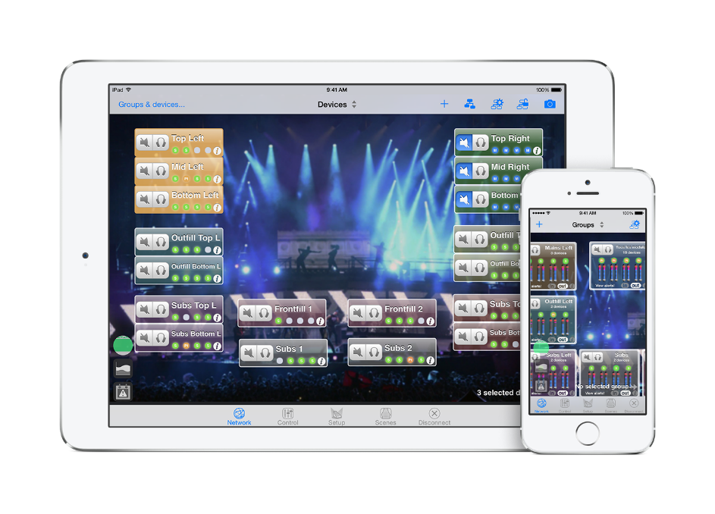
Total system management control
SYSTEM MANAGEMENT SOFTWARE
For macOS^{tm} and iOS^{tm} devices
A large number of NXAMPMK2s can be conveniently controlled via a wired or WiFi network from a Mac or iOS device using NEXO’s system management software NeMo.

Slide 15
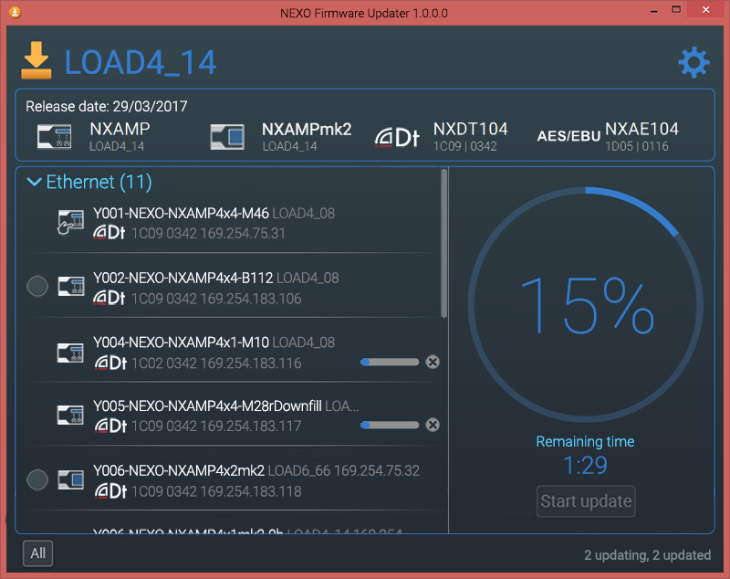
Firmware updates
Can be installed via the RJ45 port (Remote Control Card)
Windows and Mac
Dedicated Firmware Update screen in the user interface

Slide 16
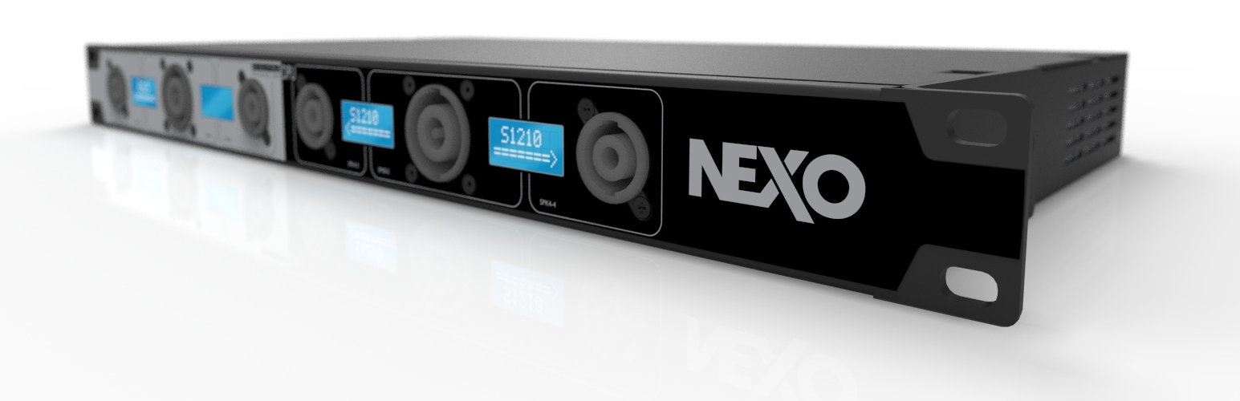
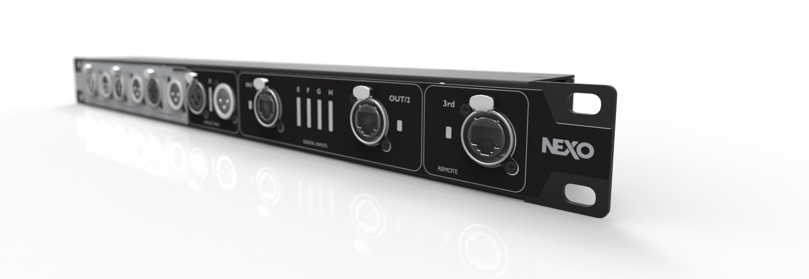
Accessories
DPU
DMU

Slide 17


