Slide 1
COMPANY PROFILE
www.nexo-sa.com
© COPYRIGHT NEXO- 2015
©copyright NEXO-2019

Slide 2
WHAT WE DO
Design and manufacture of loudspeaker systems for high-end sound reinforcement.
www.nexo-sa.com
© COPYRIGHT NEXO- 2015
©copyright NEXO-2019
Notes:
NEXO is one of the world leading sound reinforcement loudspeaker manufacturers highly recognized for the precision quality of its systems.

Slide 3
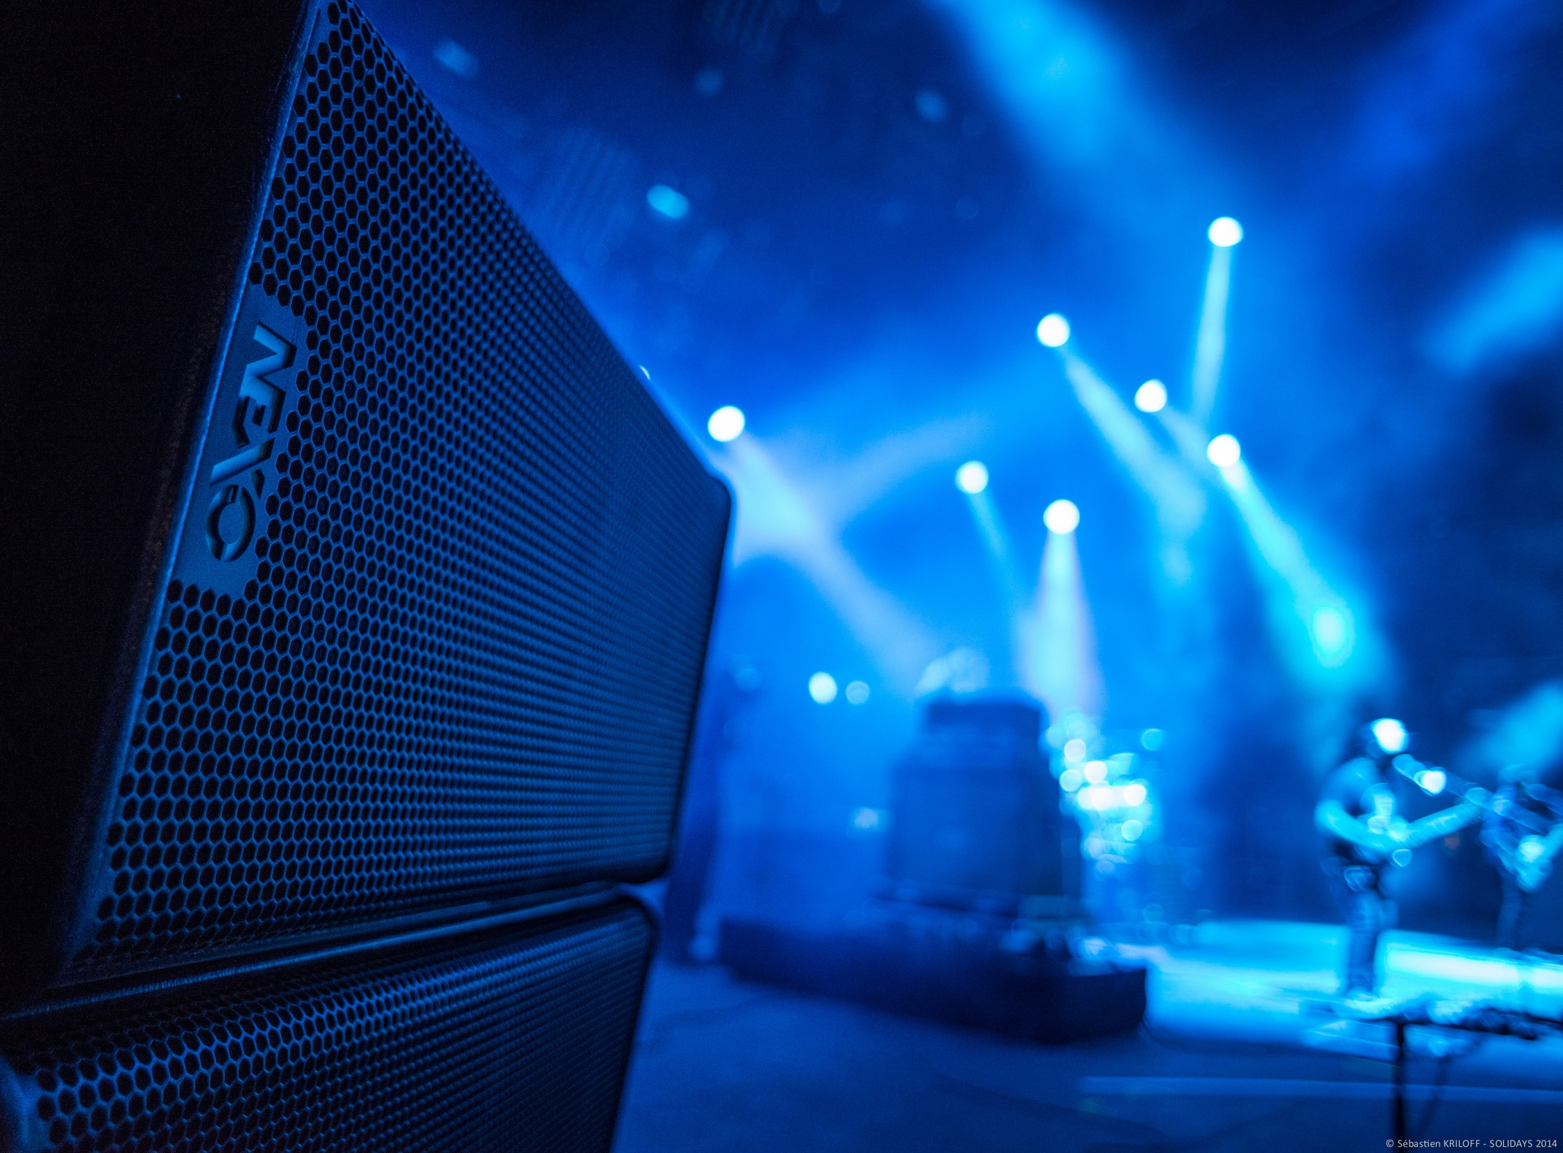
Design and manufacture of loudspeaker systems for precision sound reinforcement
Company Name : NEXO
Headquarters : Plailly - France
Year of Foundation : 1979
Annual Sales (Consolidated): 27 123 000 €
Employees (Consolidated) : 100
Shareholder : Yamaha Corporation (99,87%)
As of March 31st, 2019
www.nexo-sa.com
© COPYRIGHT NEXO- 2015
©copyright NEXO-2019
Notes:
HEADQUARTERS located at Plailly – 30.000 SQM (320.000 ft2) 10 mns away from Paris CDG International airport
YEAR OF FUNDATION :the company was founded in 1979 by Eric Vincenot and Michael Johnson and, since 2008, is a wholly owned strategic business unit of Yamaha Corporation. NEXO’s history is punctuated by many landmark moments and technical breakthroughs in sound reinforcement technology. In 1993, NEXO’s first PS Series product was launched, with performance that dramatically exceeded what might be expected from a compact loudspeaker at the time. The PS went on to become one of the most successful sound reinforcement speakers of all time and, in 2009, the bar was raised yet further with the launch of the uprated PS-R2 Series. Soon after, NEXO won the contract to equip the prestigious Stade de France national sporting stadium, venue of the world Cup Final in 1998, with its ground-breaking Alpha system. And early in the new century, NEXO unveiled its revolutionary GEO technology which immediately set new standards for coherence, accuracy and consistent SPL coverage in arrayable loudspeaker systems. This tradition of innovation continues today. Through the application of convergence-inspired design, NEXO seeks not only to enhance the audience experience through the development of increasingly more transparent and consistently controllable sound systems, but also to serve the wider public through the improved directivity of our systems.

Slide 4
R&D
NEXO HEADQUARTERS – Plailly - FRANCE
Budget > 6% of turnover
Passionate, rigorous and high level engineers
State of the art facilities
www.nexo-sa.com
© COPYRIGHT NEXO- 2015
©copyright NEXO-2019
Notes:
R&D : What separates NEXO from the competition is an innovative, integrated systems approach to loudspeaker research and development. Each new product/system begins with sophisticated computer simulations, executed by our highly specialized proprietary software. After the design specification stage, the entire electro-acoustic signal chain is thoroughly modelled and product performance rigorously evaluated to maximize system performance in an incredibly short time frame.

Slide 5
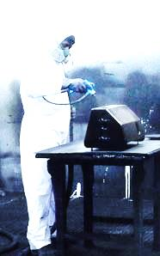
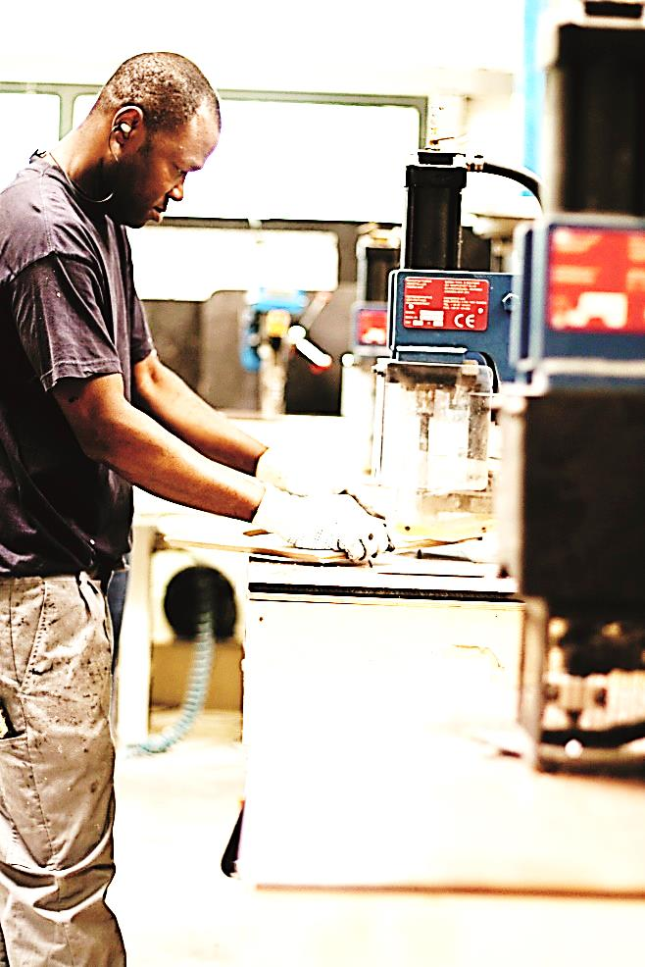
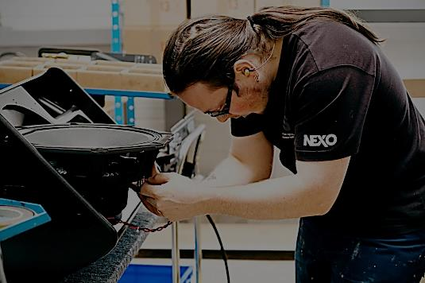
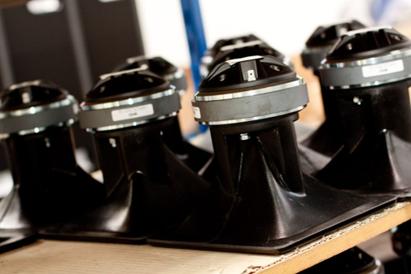
PRODUCTION
NEXO HEADQUARTERS – Plailly - FRANCE
MADE IN FRANCE : 2 HIGHLY OPTIMIZED PRODUCTION LINES . 5000 SQM/EACH
20 000 UNITS PER YEAR
RIGOROUS PROCESSES /
QUALITY MANAGEMENT SYSTEM
www.nexo-sa.com
© COPYRIGHT NEXO- 2015
©copyright NEXO-2019
Notes:
Paris headquarters also comprise a high technology manufacturing plant, fully equipped to build systems to the exacting standards we demand. Another production site is located in the center of France and is mainly specialized for the polyurethane injection of our cabinets.
All production processes are designed by our quality assurance department.

Slide 6
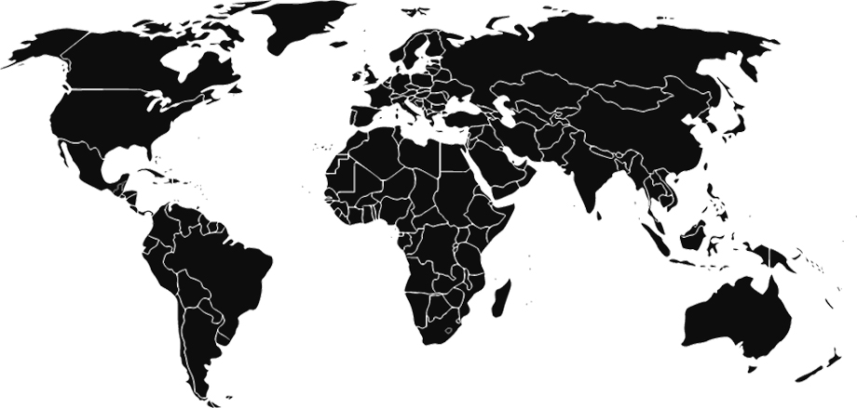
SALES GLOBAL NETWORK
(NORTH AMERICA)
(JAPAN)
(TAIWAN)
(INDIA)
(INDONESIA)
(SINGAPORE)
(BRAZIL)
(TURKEY)
(Middle East
Africa C.I.S)
Importers
Notes:
Since its fundation, Nexo expanded its sales from France to Western Europe and then to almost very country on the planet. Today, 85% of the turnover is export sales thanks to our selected slate-of-the-art importers and dealers.
Today, the synergy with Yamaha go much beyond the product development strategy. It is also relating to the distribution in some key areas. Yamaha Corporation of America is in charge of Nexo’s distribution in the north-american market (USA + Canada); same as for the Yamaha marketing subisidiaries in Japan and Singapore.

Slide 7
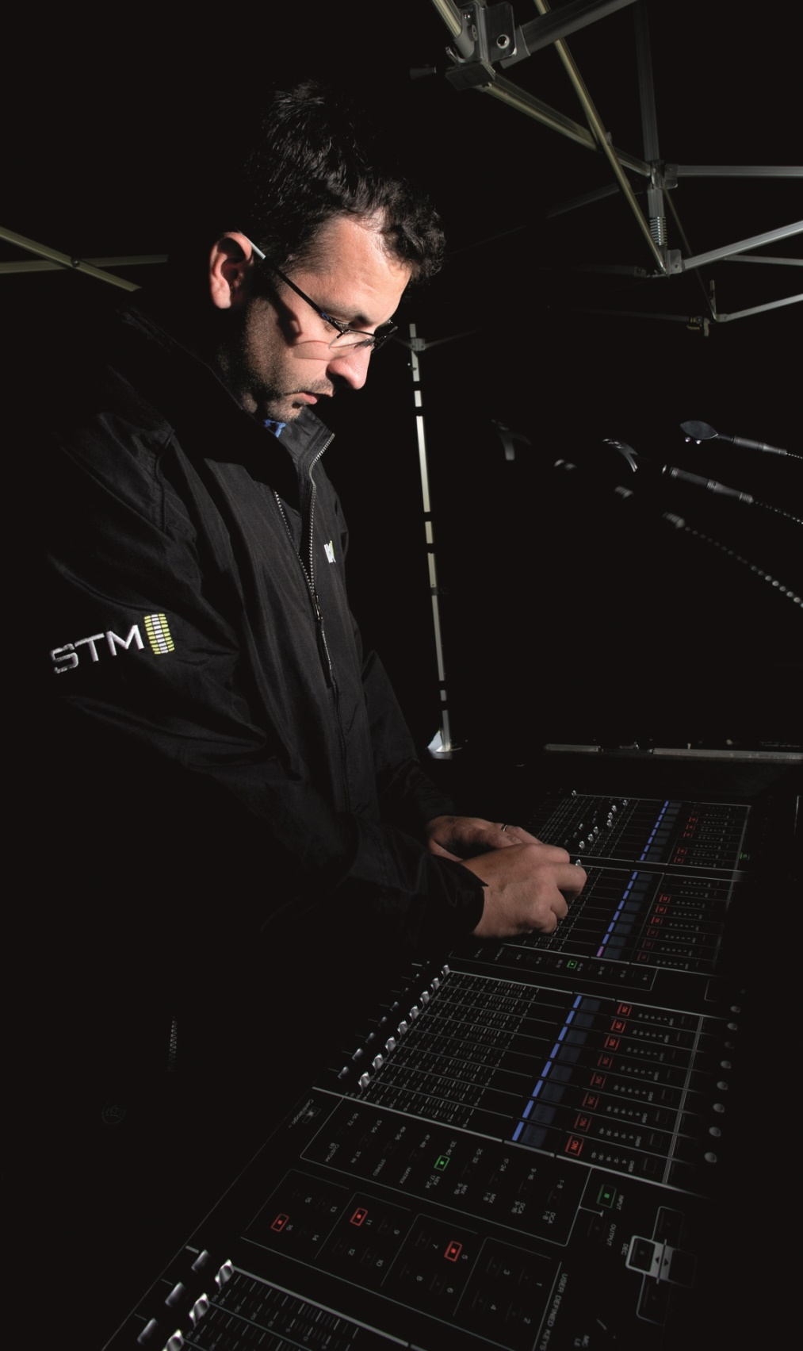
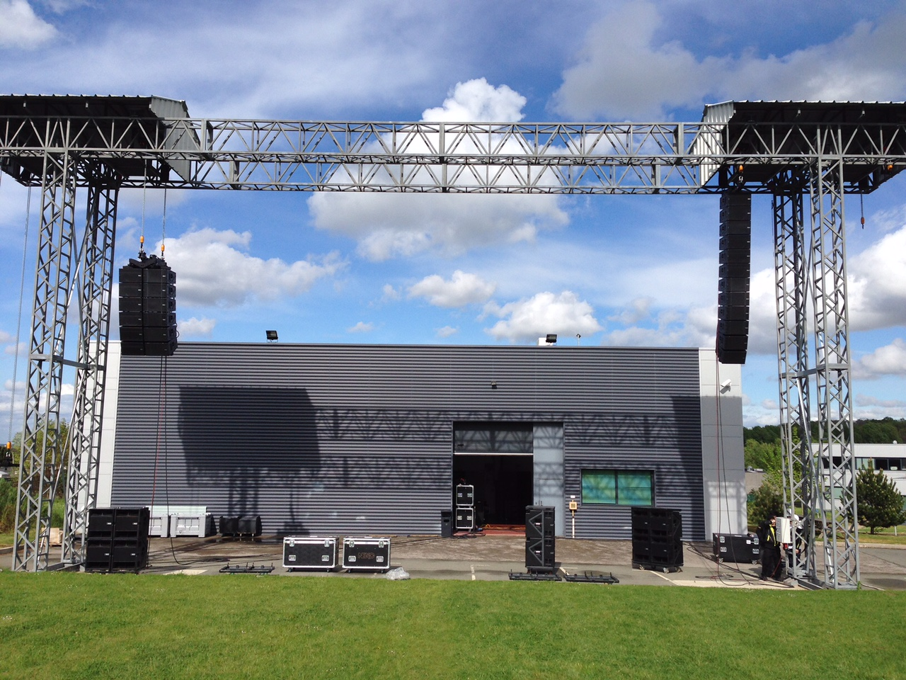
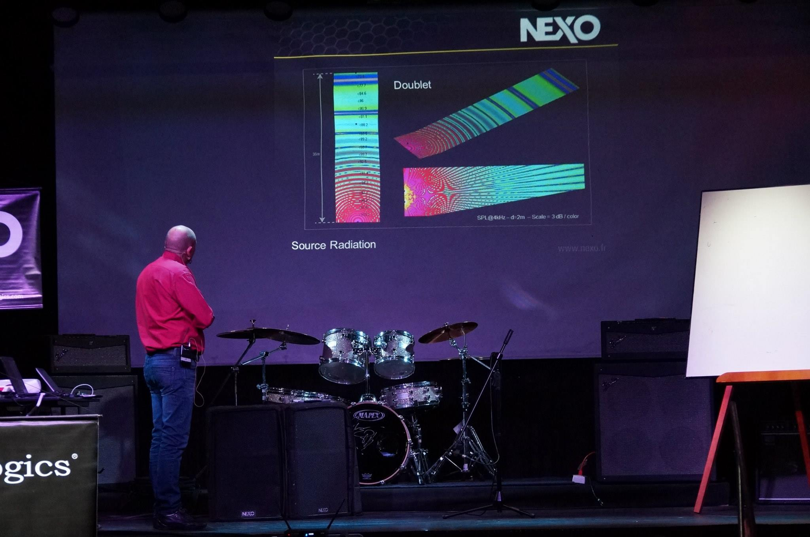
ENGINEERING SUPPORT
PRE & POST SALES SUPPORT
CASE STUDY FILES
TECHNICAL DOCUMENTATION
LIVE DEMOS
ON-HAND TRAININGS
HOT-LINE / HOT-FLIGHTS
CONSTANT FEEDBACK FROM END USERS
www.nexo-sa.com
©copyright NEXO-2018
© COPYRIGHT NEXO- 2015

Slide 8
Design and manufacture of loudspeaker systems for precision sound reinforcement
WHICH APPLICATIONS
www.nexo-sa.com
© COPYRIGHT NEXO- 2015
©copyright NEXO-2019
Notes:
Since 1979, NEXO systems have been installed and utilized in some of the world’s most prestigious venues and events. Let us see some examples :

Slide 9
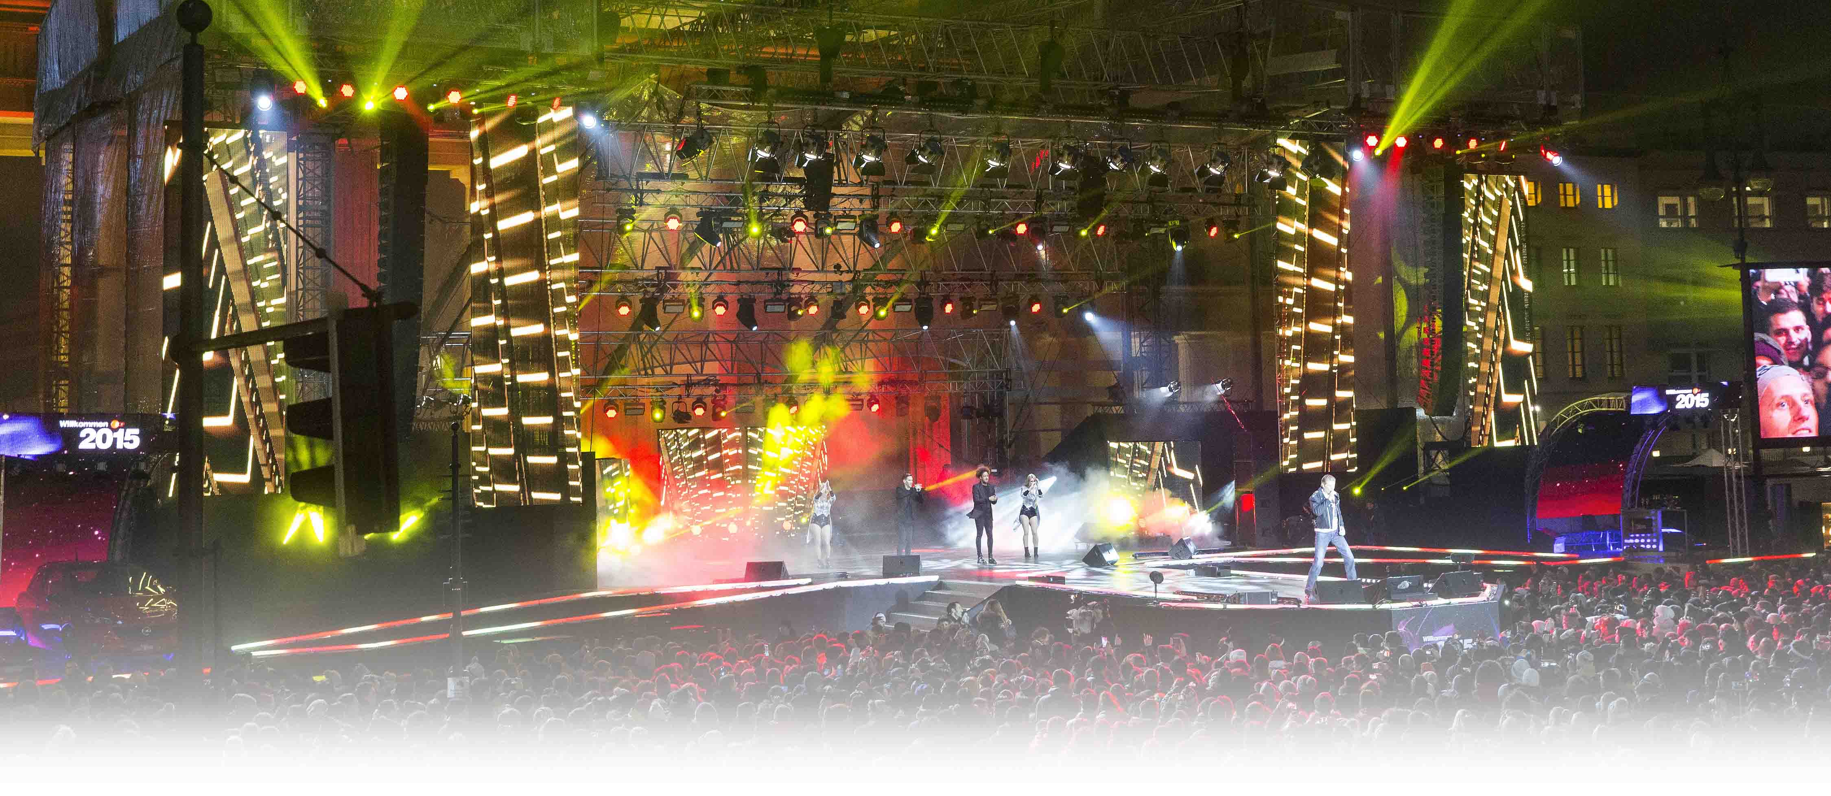
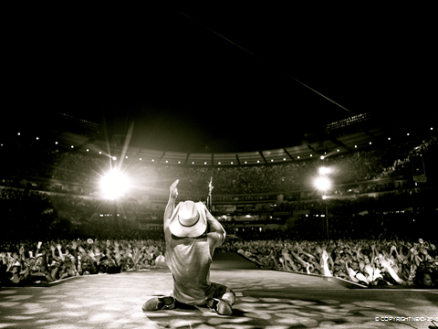
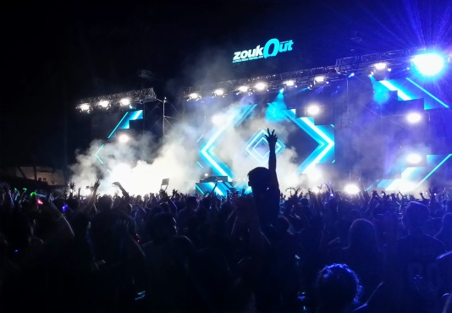
LARGE EVENTS
Silverster Party – New Year’s Eve
Berlin, Germany
LARGE EVENTS
Kenny Chesney US Tour
Pittsburgh, USA
ZookOut
Singapore

Slide 10
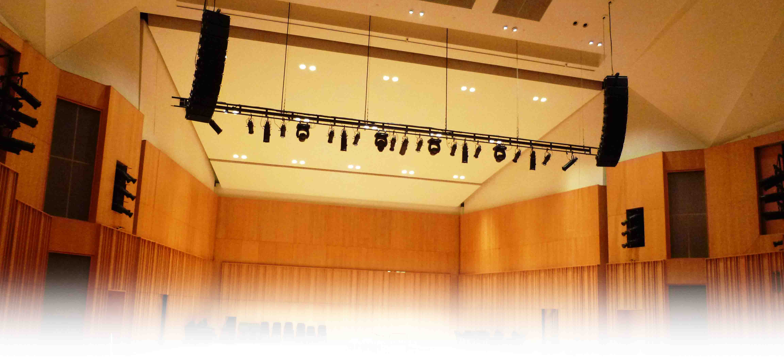
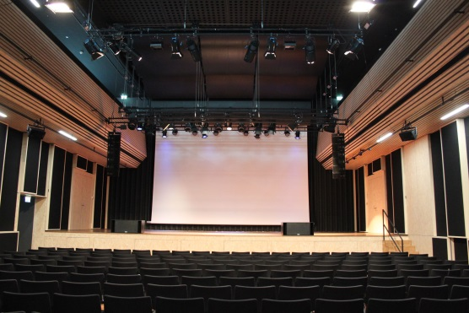
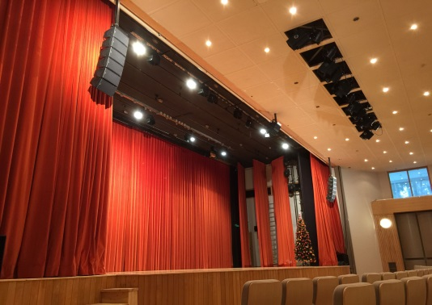
The Republic Cultural Centre
Singapore
THEATERS
HEMU University of Music Lausanne
Lausanne, Switzerland
Bled Festival Hall
Bled, Slovenia

Slide 11
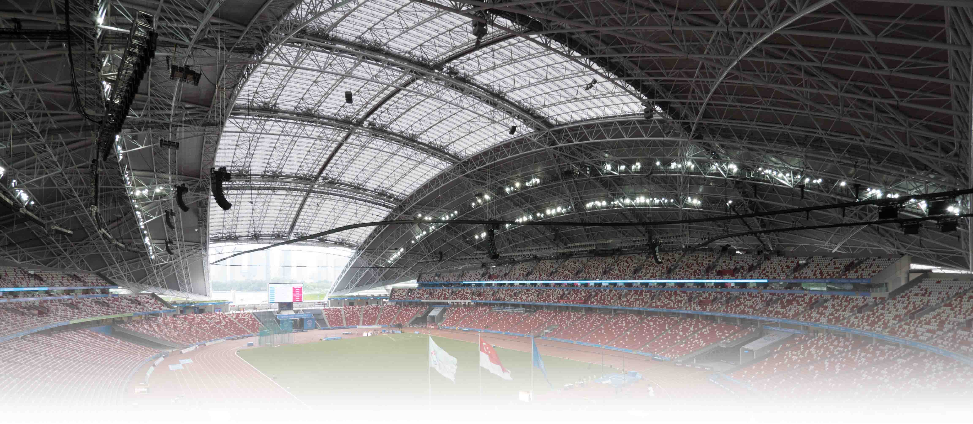
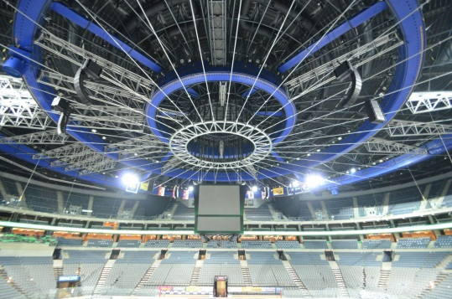
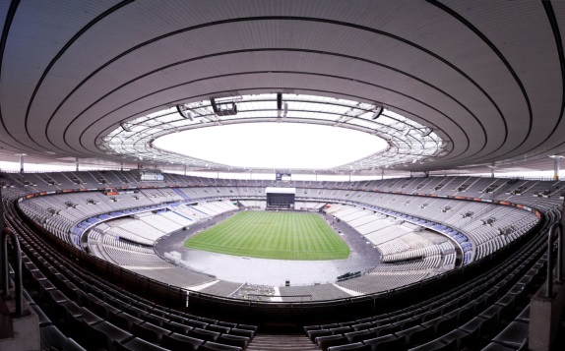
South East Asian Games
Singapore
SPORTS VENUES
O2 Arena
Prague, Czech Republic
Stade de France
Saint Denis, France

Slide 12
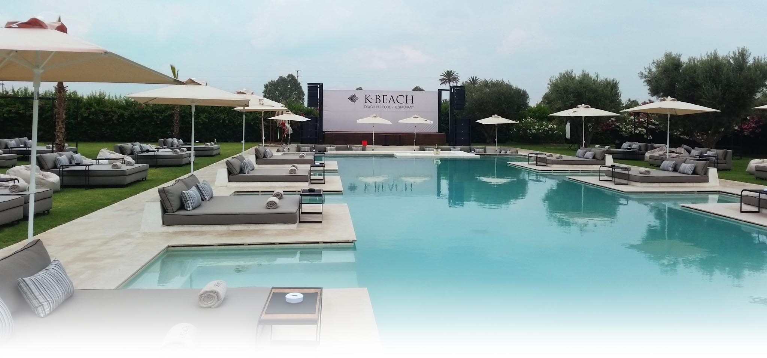
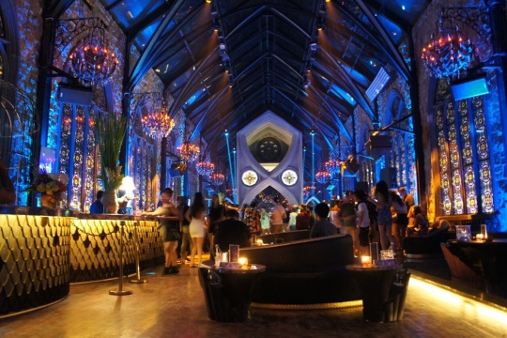
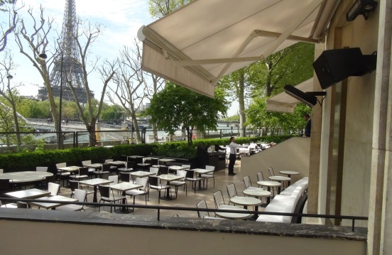
K-Beach
Marrakech, Morocco
CLUBS & BARS
Mirror – Lounge & Club
Bali, Indonesia
Palais de Tokyo
Paris, France

Slide 13
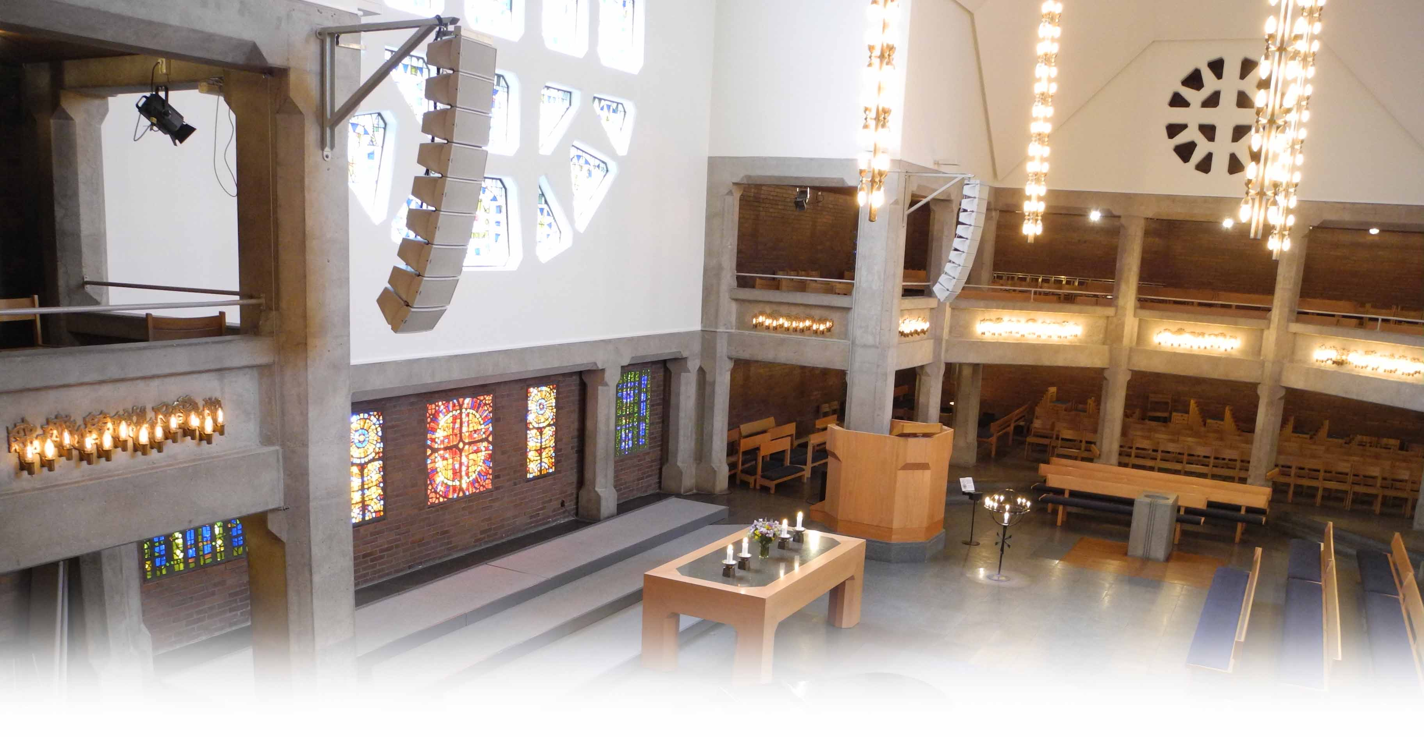
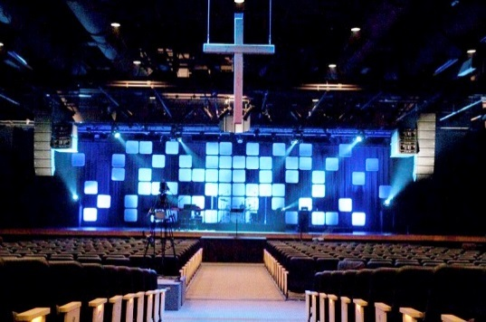
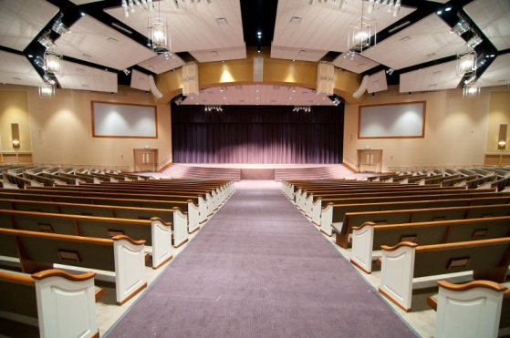
Bethlehem Church
Gothenburg, Sweden
HOUSES OF WORSHIP
Christ The King Church
Bellingham, USA
Northwest Campus of Eastern Star Church
Indianapolis, USA

Slide 14
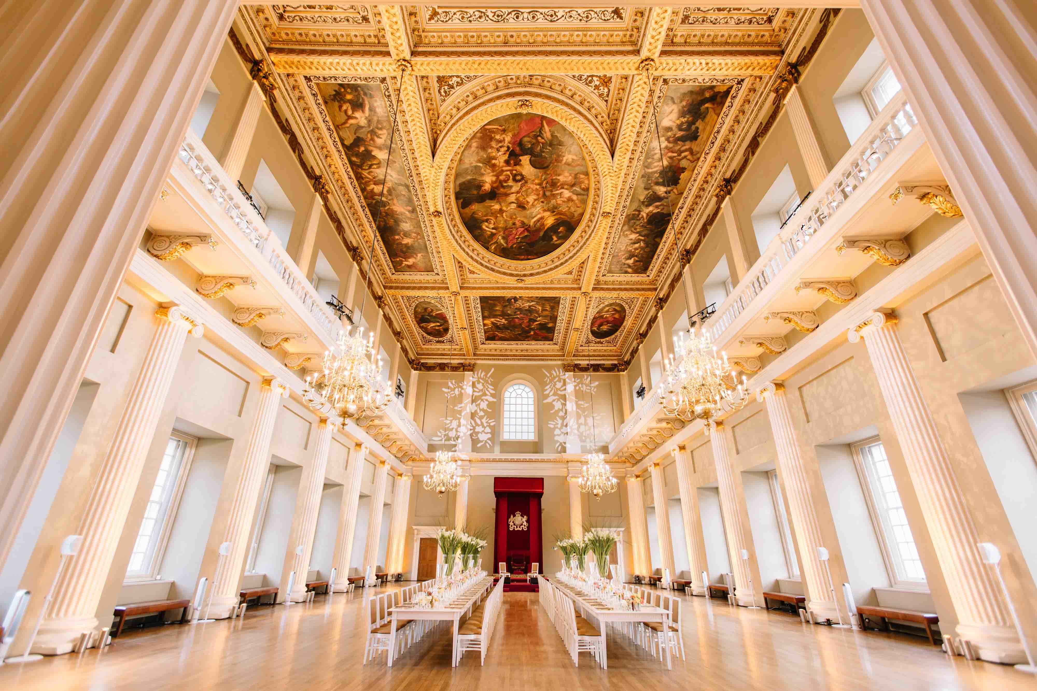
CONFERENCE HALLS
Banqueting House
London, UK

Slide 15
WHICH SYSTEMS
www.nexo-sa.com
© COPYRIGHT NEXO- 2015
©copyright NEXO-2019

Slide 16
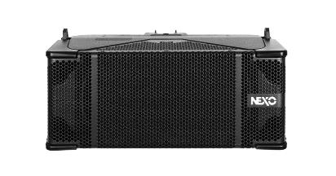
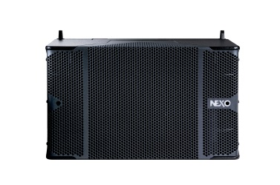
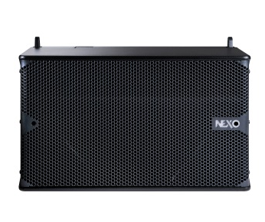
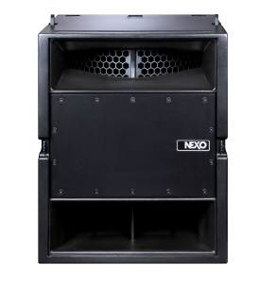
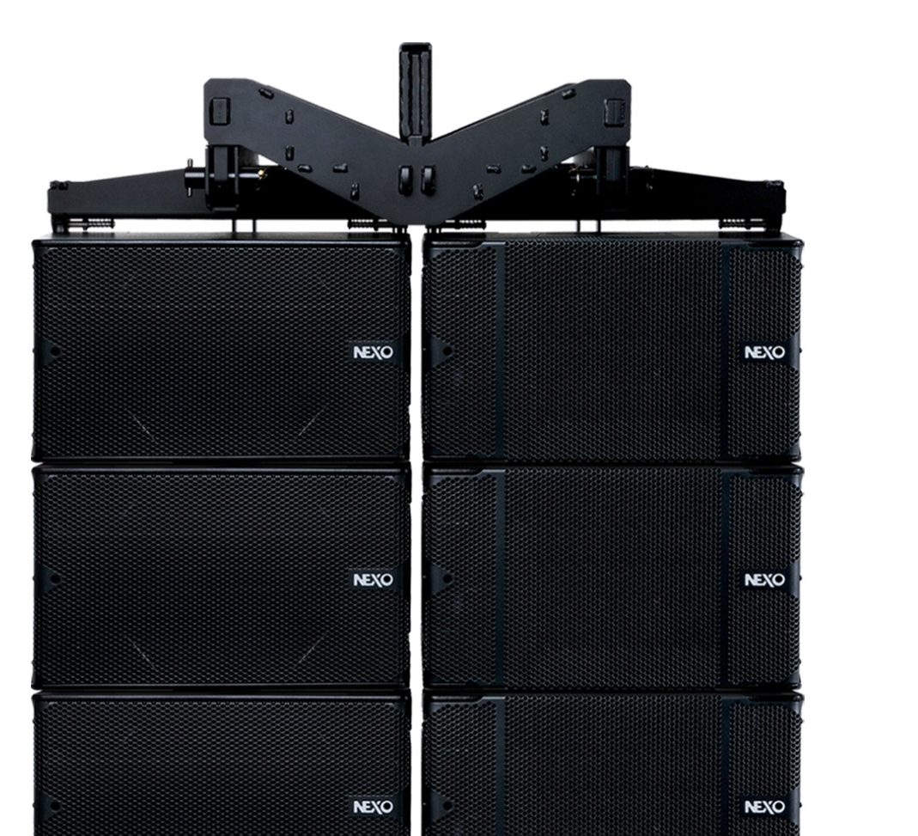
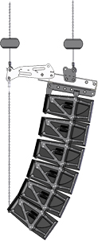
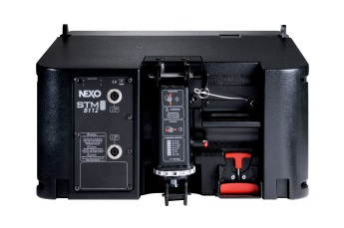
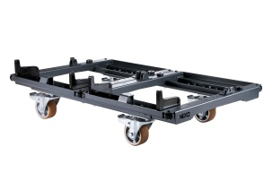
Four core modules
STM M28
Omni-purpose module
STM M46
Main module
STM B112
Bass module
STM S118
Sub module
Quick & Easy rigging
PistonRigTM
Bumper
Dolly - Wheelboard
Notes:
Our high end LegoTM

Slide 17
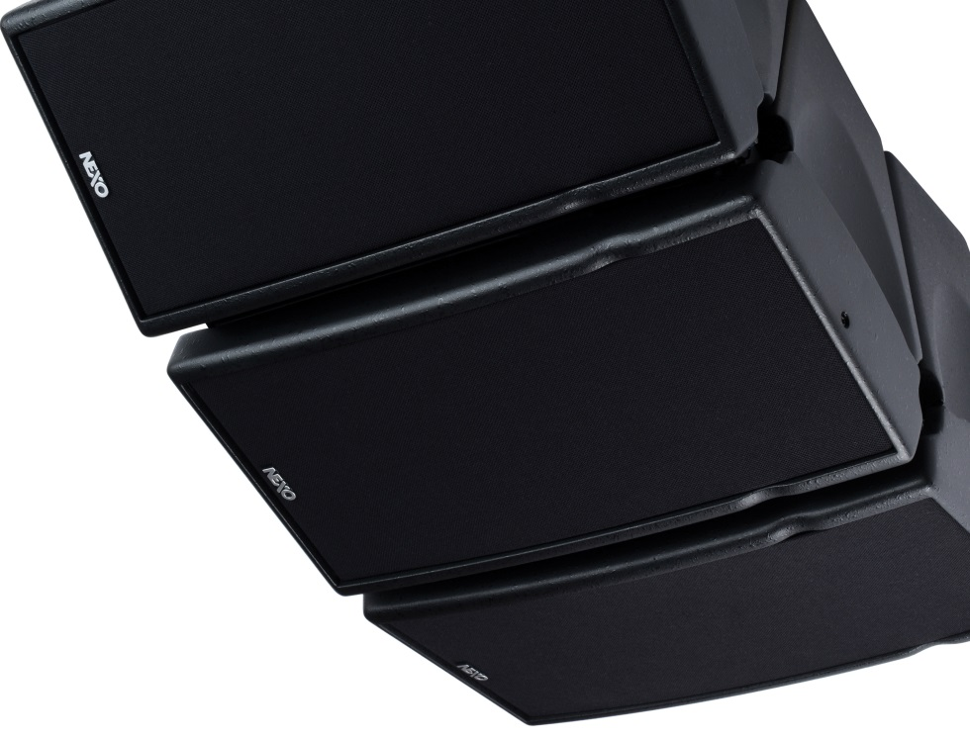
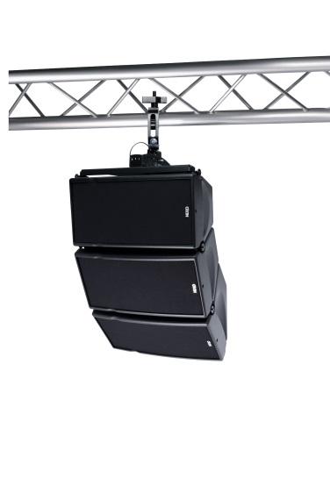
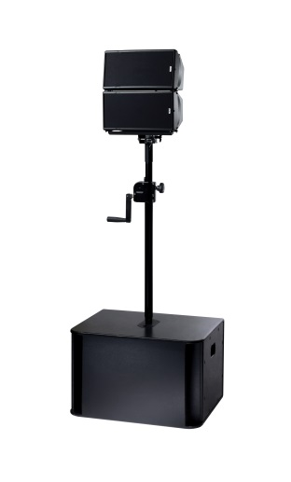
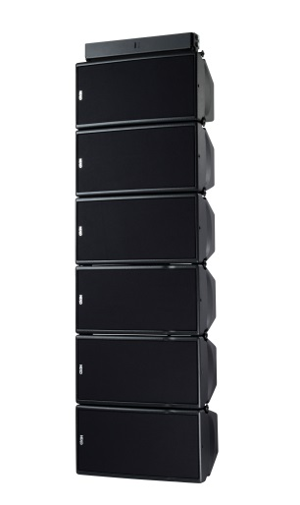
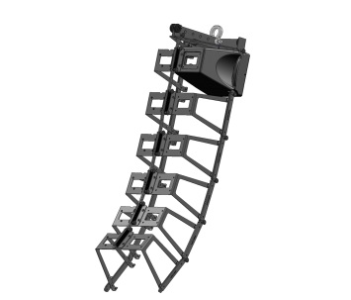
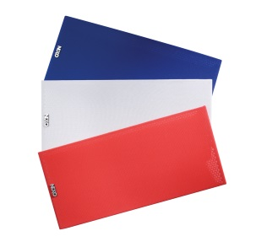
THE COMPACT SOUND SYSTEM THAT FITS INTO ANY ENVIRONMENT
Theatres
Conference halls
Live events
Corporate A/V
NEXO Skeleton Rigging System
Customized RAL Colours
Notes:
Powerful, flexible and compact, NEXO GEO M6 delivers uncompromised full-range sound in a wide variety of fixed installations and mobile applications.
The visual impact of GEO M6 is subtle, thanks to compact design, an elegant internal rigging system and custom colour options. Comprising two identically-sized cabinets – the GEO M620 main and GEO M6B bass extension – and complemented by a comprehensive range of mounting accessories, GEO M6 offers installation contractors and sound rental companies a dependable, TÜV-certified system with an important difference: legendary NEXO performance.
Systems can be flown, groundstacked or pole-mounted on subs. Lightweight polyurethane composite cabinets measure just 191mm high x 373mm wide x 260mm deep. Cabinets, fabric grilles and accessories can be specified in any RAL colour.
The versatility of the GEO M6 system extends to a highly cost-effective amplification solution. A single NXAMP – the smallest of NEXO’s powered TDControllers – can power up to 12x GEO M6 cabinets. And with ‘channel-by-channel’ preset selection for all NEXO cabinets and linear phase on all set-ups, it’s easy to integrate subbass cabinets such as the NEXO LS600 into a single amplifier solution.
Larger networks of NXAMPs can be monitored using the NEXO’s NeMo Remote Monitoring App, available free for iPad® and iPhone®.

Slide 18
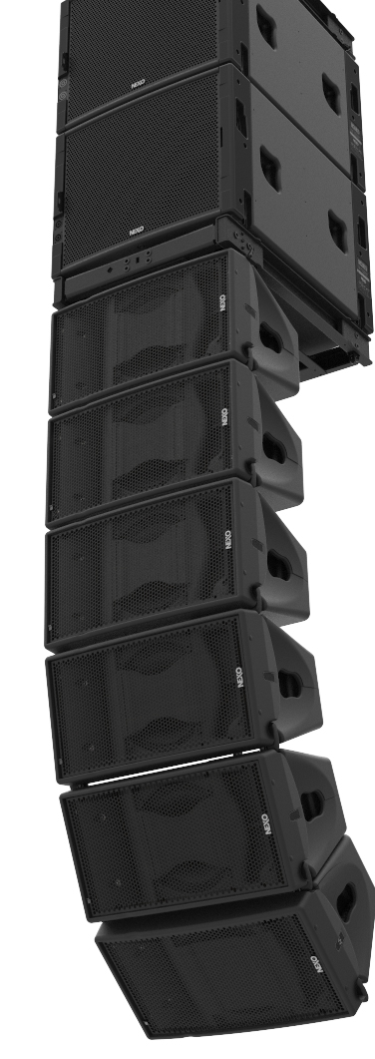
THE WORLD'S MOST ADVANCED COMPACT LINE ARRAY
Install or touring versions
TÜV-compliant integral rigging system with no “loose parts”.
Twice as powerful as the GEO M6, making it ideal for :
Theatres/
Conferences
Public Spaces
Live Events/
Live Music
…with larger audiences.
Notes:
OVERVIEW
Favouring innovative new thinking over conventional line array wisdom, GEO M10 partners a 1.4″ titanium diaphragm HF driver with a single, Neodymium-magnet 10” driver and delivers an unprecendented ratio of LF response to cabinet size, outperforming many larger, dual-driver designs. And with a maximum SPL of 131dB, GEO M10 is twice as powerful as its sister-system, the GEO M6, making it ideal for speech and music events with larger audiences.
MODULES
Two versions of the GEO M10 (offering 12.5° and 25° of vertical dispersion) can be configured manually, without tools, for 80° or 120° horizontal dispersion, and are complemented by the dedicated MSUB15. Extending system response down to 40Hz, the sub can be configured in Omni or Cardioid modes in flown arrays or groundstacks, using a versatile bumper. GEO M10 and MSUB15 are available in Touring and Installation versions. Cabinets are available in black, white and custom RAL colours.

Slide 19
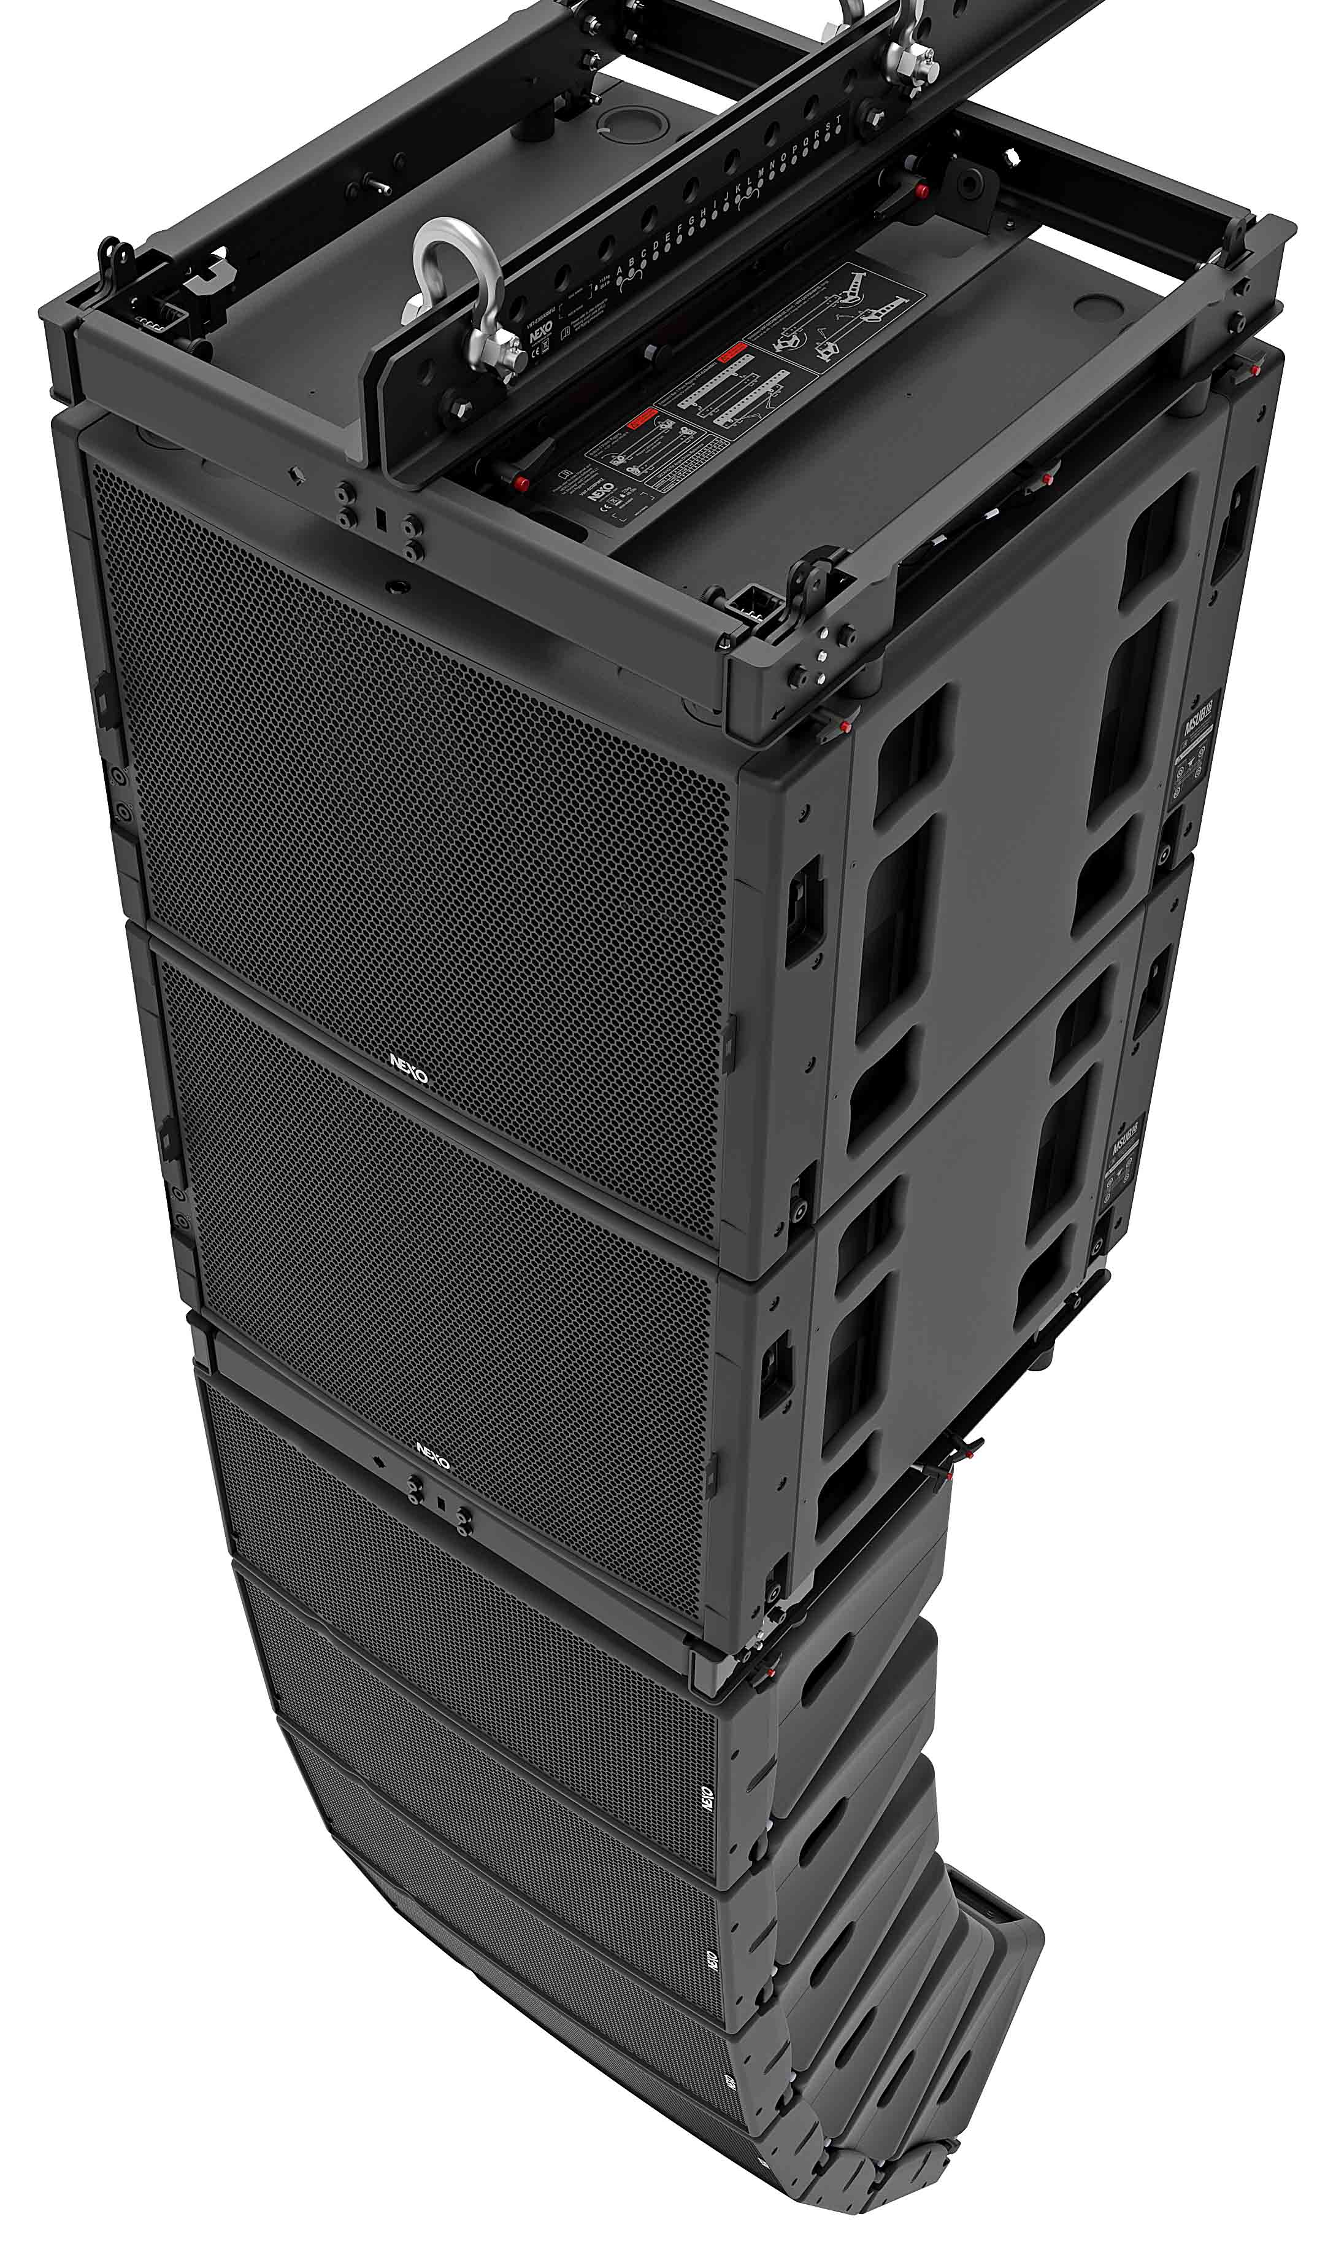
Taking line array performance to a whole new level
Powerful
2 way active or passive
Latest NEXO patented technologies
Integrated rigging hardware
Versatile accessories
Notes:
OVERVIEW
Favouring innovative new thinking over conventional line array wisdom, GEO M10 partners a 1.4″ titanium diaphragm HF driver with a single, Neodymium-magnet 10” driver and delivers an unprecendented ratio of LF response to cabinet size, outperforming many larger, dual-driver designs. And with a maximum SPL of 131dB, GEO M10 is twice as powerful as its sister-system, the GEO M6, making it ideal for speech and music events with larger audiences.
MODULES
Two versions of the GEO M10 (offering 12.5° and 25° of vertical dispersion) can be configured manually, without tools, for 80° or 120° horizontal dispersion, and are complemented by the dedicated MSUB15. Extending system response down to 40Hz, the sub can be configured in Omni or Cardioid modes in flown arrays or groundstacks, using a versatile bumper. GEO M10 and MSUB15 are available in Touring and Installation versions. Cabinets are available in black, white and custom RAL colours.

Slide 20
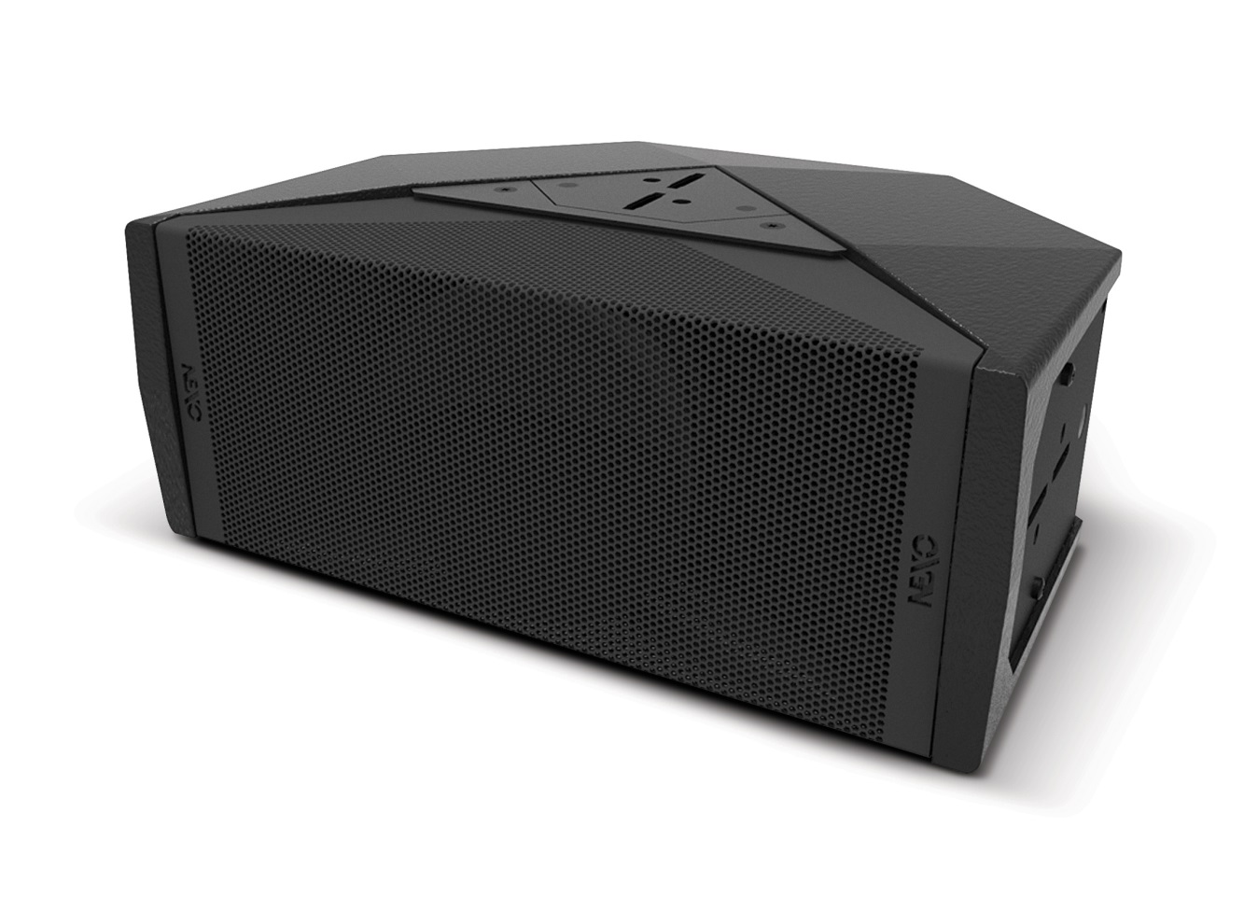
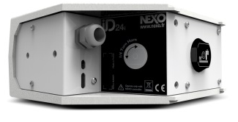
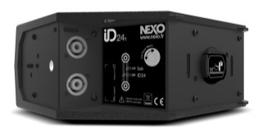
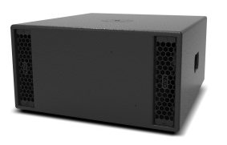
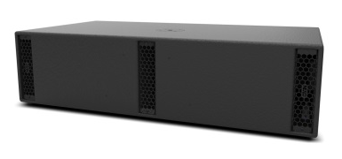
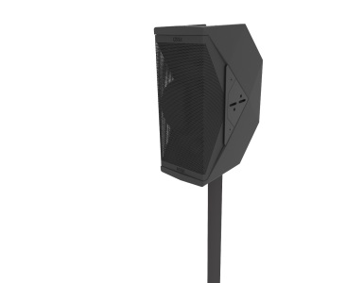
COMPACT SOUND
REINFORCEMENT SYSTEM.
ID24i
(Install)
ID24t
(Touring)
ID Series subs :
Application-focused design.
ID S110
1x10" sub
ID S210
2x10"sub
Notes:
With a unique user-rotatable horn that lets users quickly select between 120° x 30° or 30° x 120° HF coverage, ID24 brings unparalleled flexibility to the world of compact speakers with a cabinet that delivers trademark NEXO sound and performance, whether mounted horizontally or vertically.
Measuring just 309mm wide, 132mm high and 233mm front to back, the ID24 uses twin 4 inch drivers in a V formation, and is ideal as a full-range speaker, or as a dedicated ‘sound beaming’ unit in difficult spaces. Mounted horizontally or vertically, ID24 delivers superior performance in all scenarios.
ID24 is available in install (ID24i) and touring (ID24t) versions, plus an ‘A La Carte’ variant with enables specifiers to choose from a range of colour, mounting, connectivity and HF dispersion options to configure the perfect speaker for the given application.
Compatible with a huge range of NEXO and third party touring and installation hardware, the ID Series also encompasses two dedicated low-profile subs.

Slide 21
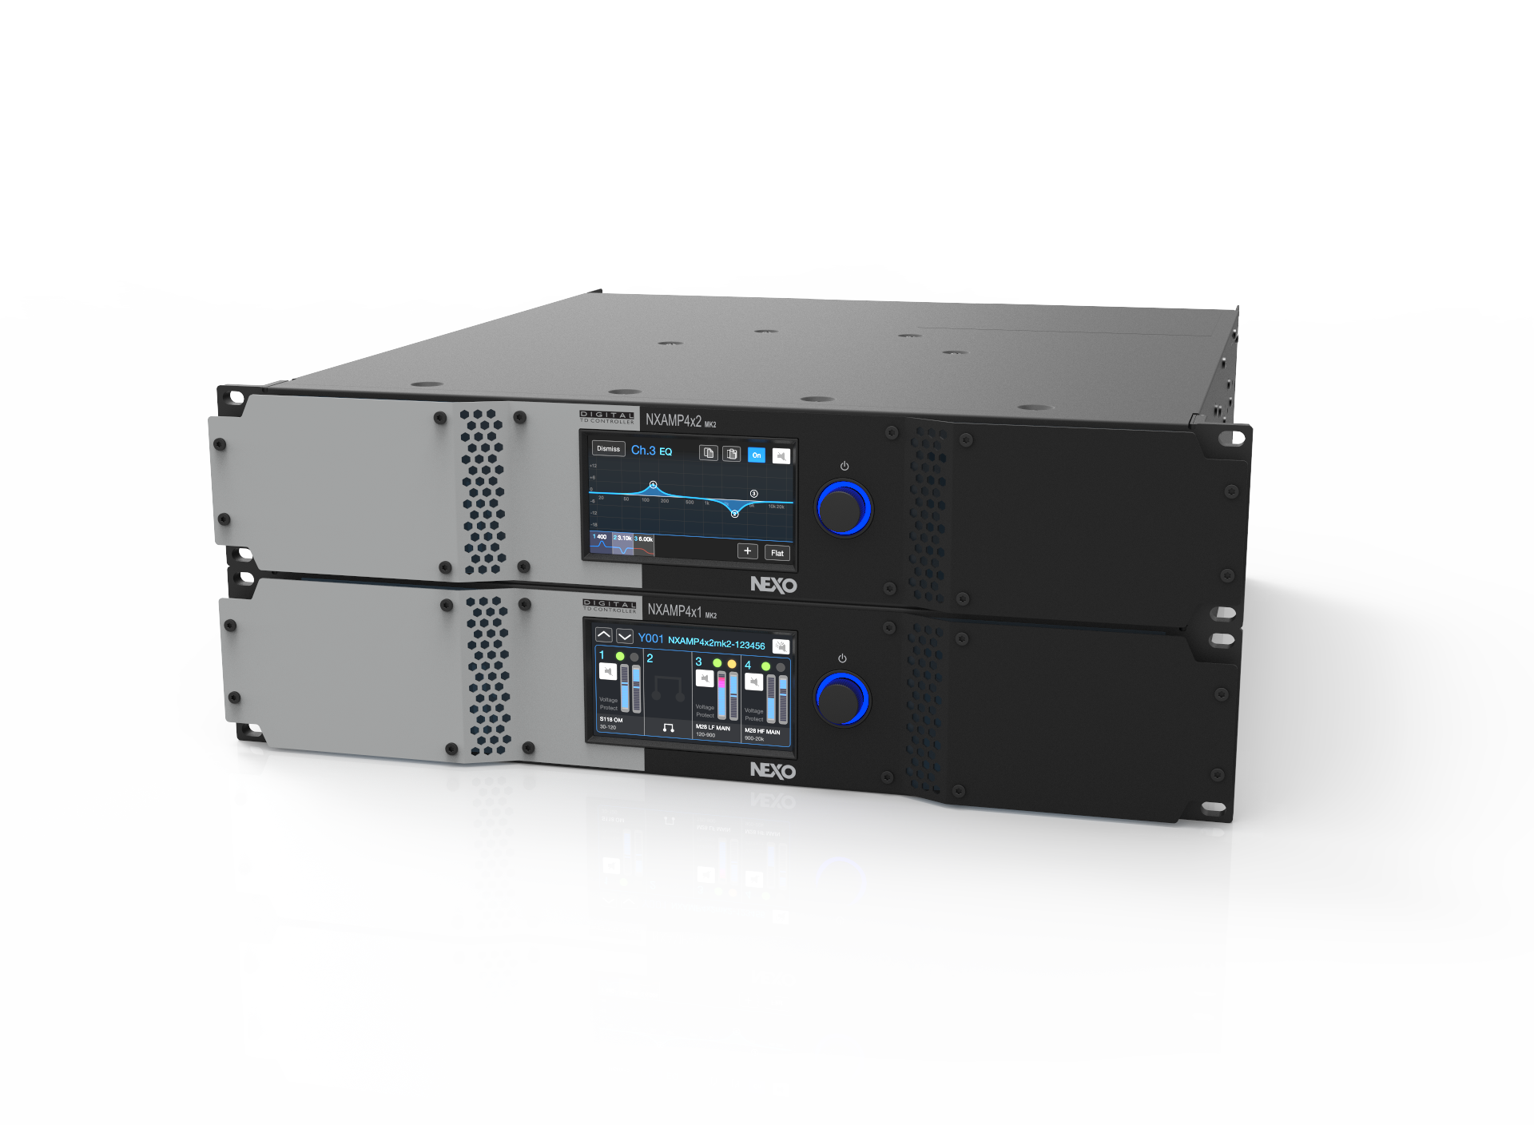
Power, Purity
& Precision

