Slide 1


Slide 2
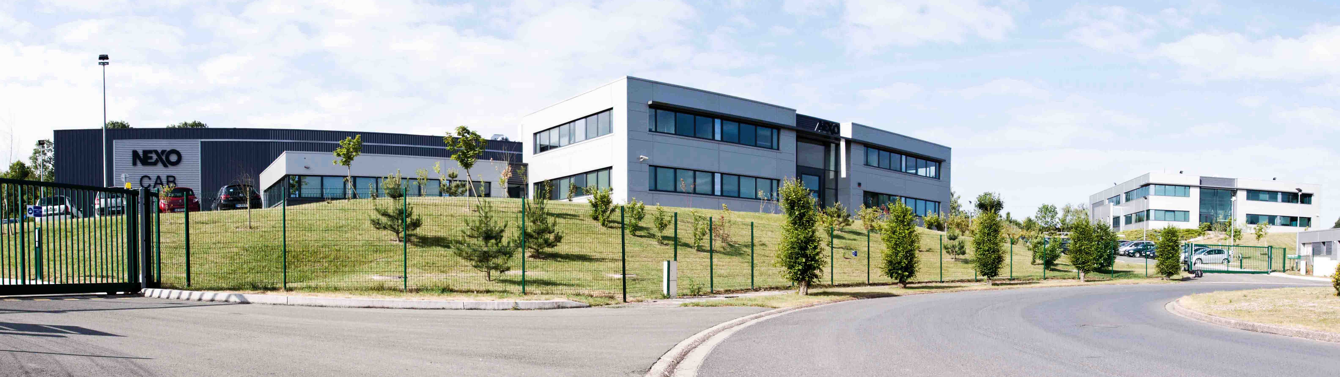
GLOBAL SOLUTIONS
The home of
Precision Sound.
NEXO has been designing ground-breaking sound reinforcement solutions at its French headquarters since 1979.
The company’s pioneering technology, innovative designs and sonic excellence have enhanced live events and venue sound across the globe for decades, gaining the respect and trust of sound professionals everywhere.

Slide 3

GLOBAL SOLUTIONS
Advanced manufacturing processes
Each and every one of NEXO’s loudspeaker cabinets is designed and manufactured in France. Since 2007, the company’s headquarters have been located in modern purpose-built facilities, just 30 km north of Paris and close to Charles de Gaulle International Airport. NEXO has also a manufacturing plant in Saint-Pierre-de-Côle.
Highly-automated
manufacturing plant
2 optimized production lines
5000 Sqm/each
Rigorous processes /
Quality management system

Slide 4
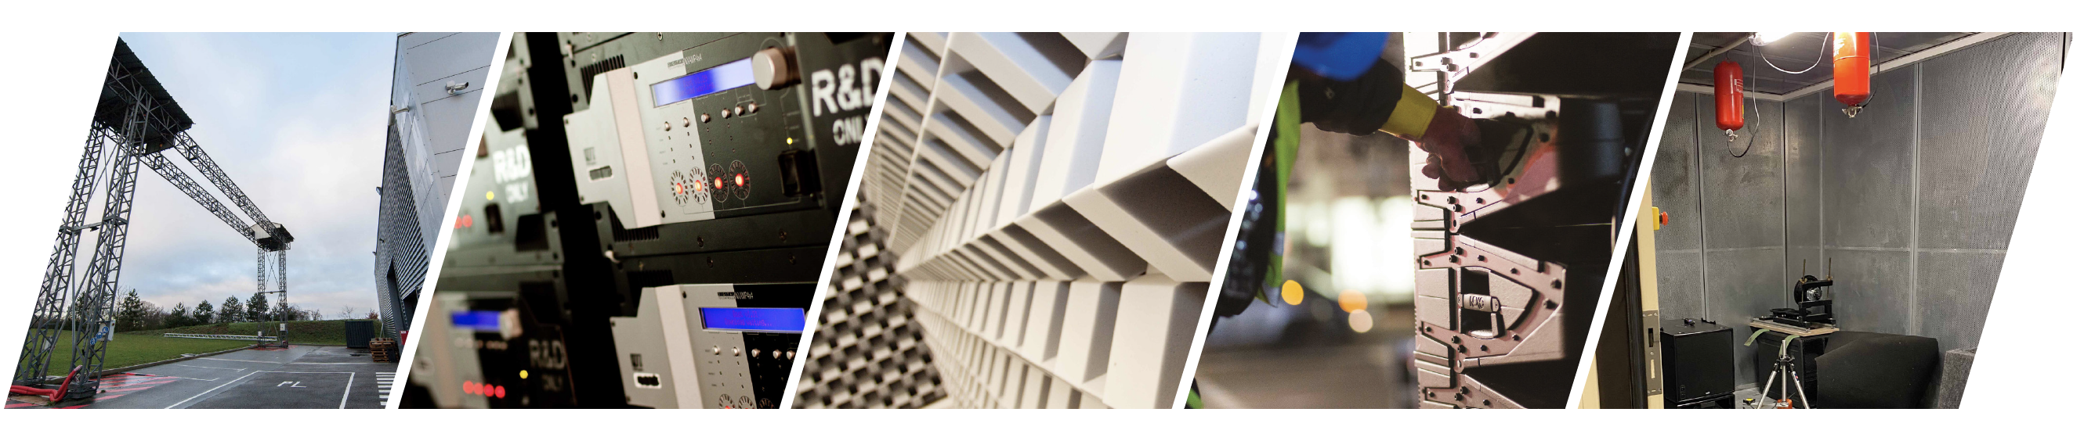
GLOBAL SOLUTIONS
Modern purpose-built facilities
Each new system begins with sophisticated computer simulations, executed by specialised proprietary software. The entire electro-acoustic signal chain is thoroughly modelled and product performance rigorously evaluated to maximise system performance.
R&D centre : 2000m2 dedicated
State of the art facilities
Anechoic chamber : 12m x 8m x 6.5m, this chamber allows the R&D team to measure down to 28Hz.
Passionate, rigorous and high level engineers

Slide 5
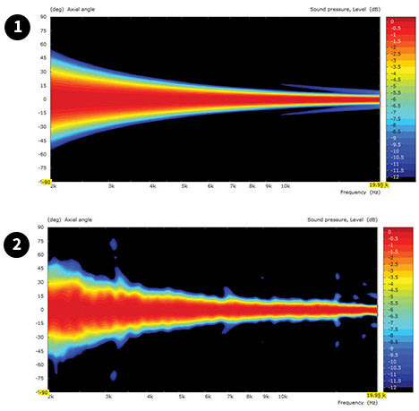
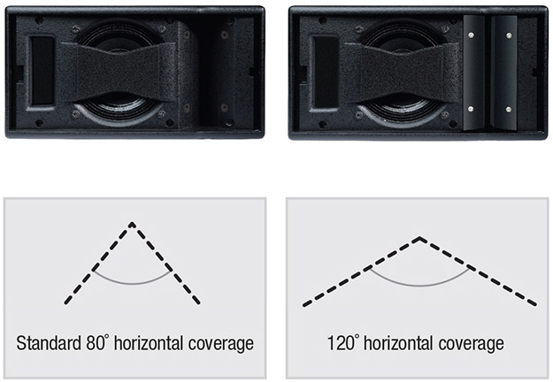
GLOBAL SOLUTIONS
Thinking. Inside the box.
What separates NEXO from its competition is its innovative, integrated systems approach to loudspeaker research and development. The company’s R&D mission to innovate is acknowledged in the form of numerous patents, some of which are included here.
THE HRW HYPERBOLIC
REFLECTOR WAVEGUIDE
THE CDD CONFIGURABLE
DIRECTIVITY DEVICE
&
THE PDD PHASE
DIRECTIVITY DEVICE
Conventional speakers cannot be coupled in the high frequency range if not generating a continuous wavefront along the height or the width of the enclosure.
HRW waveguide converts the spherical wave front generated by a high frequency compression driver into a flat or convex wavefront by means of an acoustic reflector.
It allows speaker cabinet acoustical coupling without interference up to 20 kHz, with inter-cabinet angle sequences ranging from 0° up to 30° or more.
Used in GEO M Series, GEO S1210 and S1230, STM M28 and M46 cabinets.
CDD flanges are superposed to a horn or a waveguide to modify its dispersion characteristics.
The same speaker cabinet reference can therefore produce a wide range of directivity features, from 80° or (narrow coverage needed at long distances) less to 120° or more (wider coverage needed at short distances).
PDD : Coupled direct radiation drivers will interfere when the distance between them exceeds half a wavelength, which sets a strong constraint on cross-over frequency to high frequency drivers (these are very likely to distort below 1 kHz). The Phase Directivity device splits the radiating surface of the driver in 2, thus dividing by 2 the acoustic distance between coupled devices.
Used in GEO M Series, GEO S1210 and S1230, STM M28 cabinets.

Slide 6
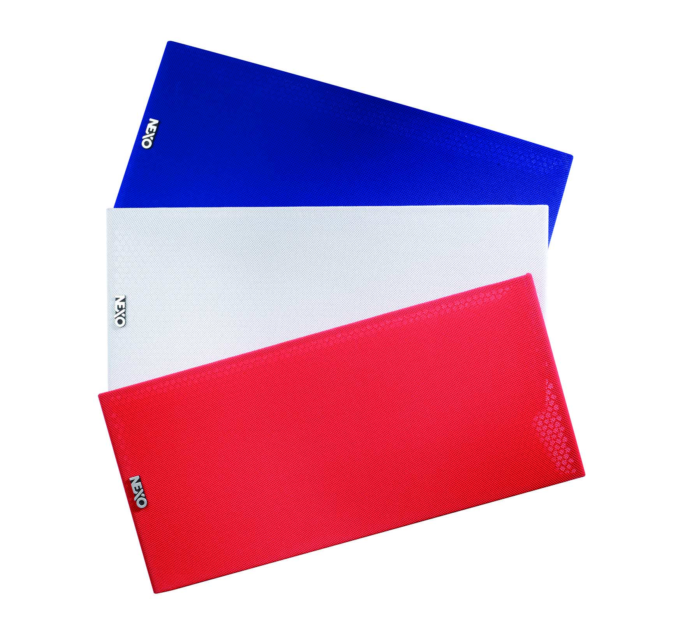
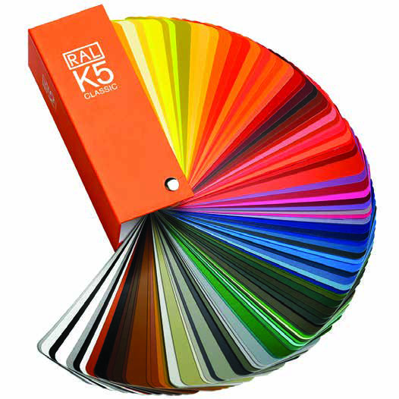


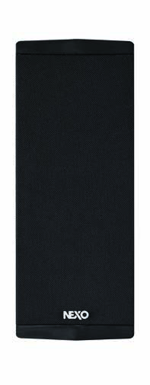
GLOBAL SOLUTIONS
Custom solutions
Our installation versions cabinets and accessories can be specified in black, white or any RAL colour for projects that require the greatest degree of customization.

Slide 7
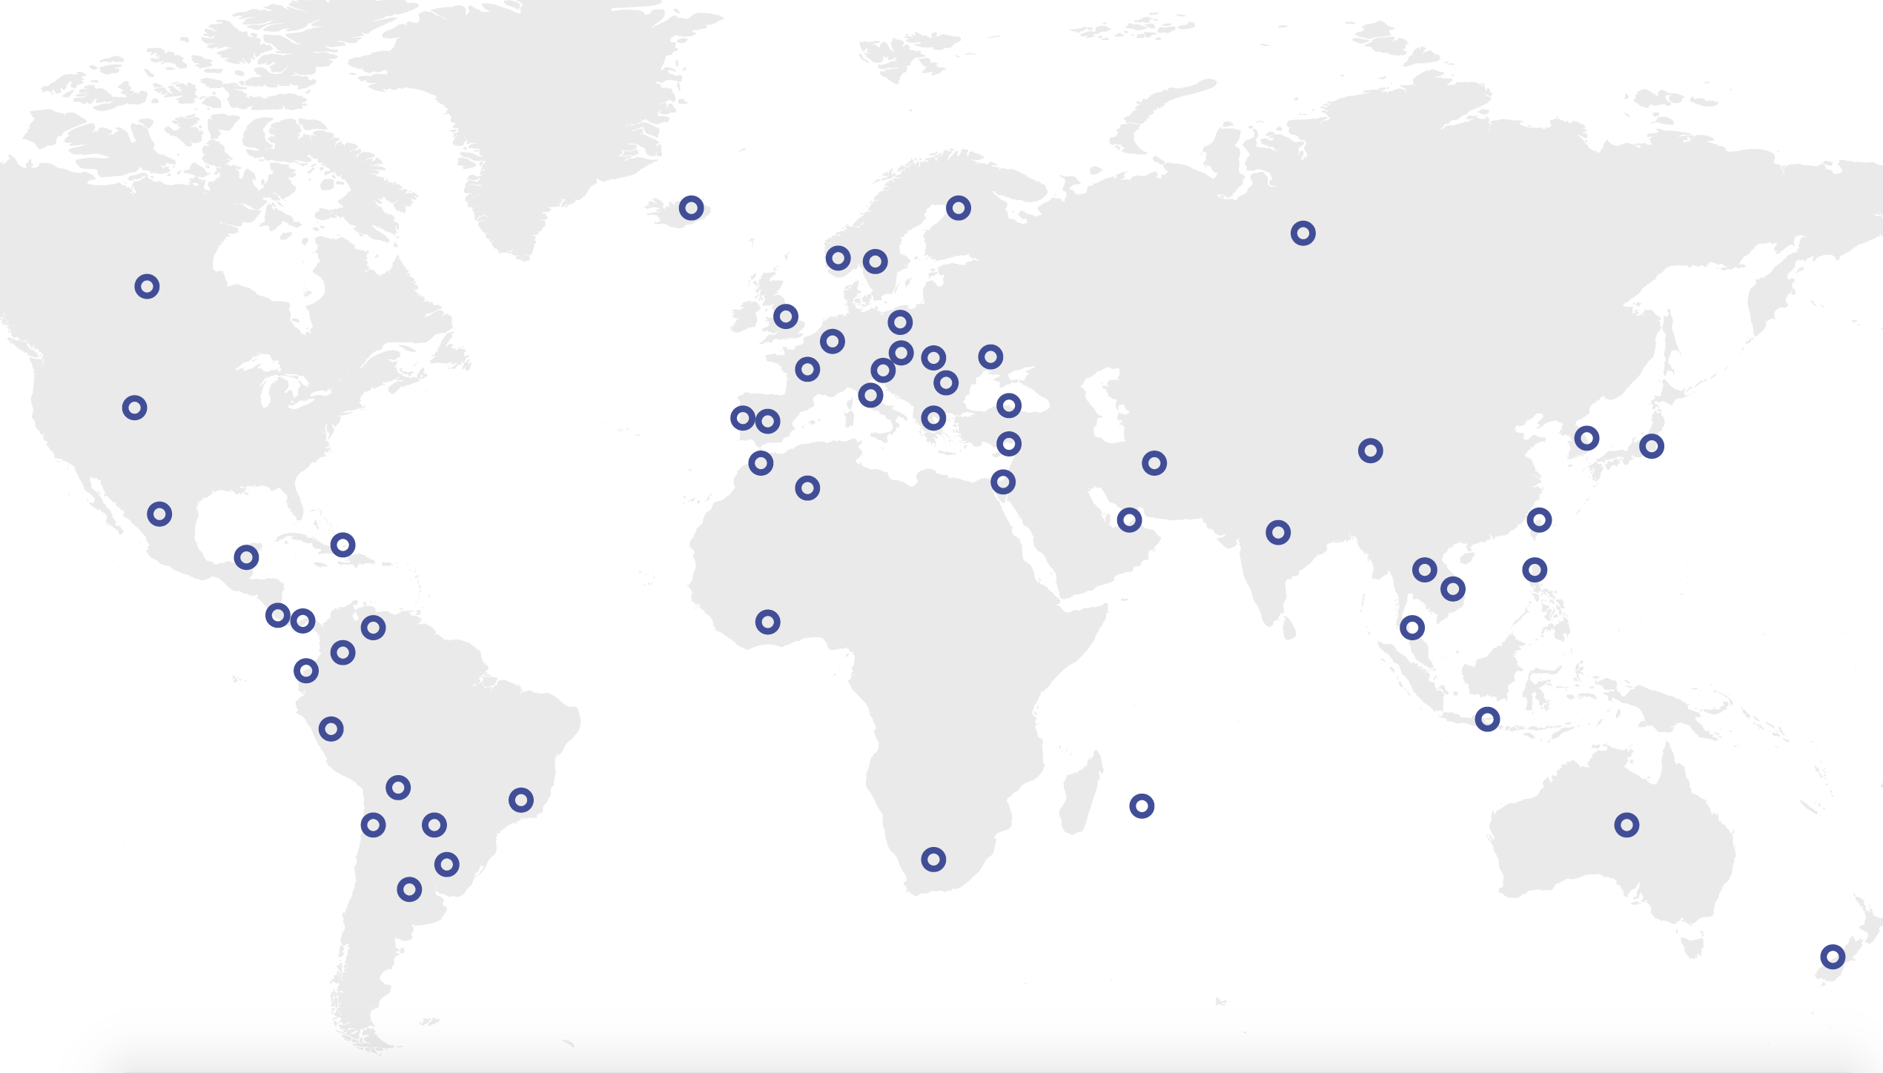
GLOBAL SOLUTIONS
A global sales & support network
NEXO systems are distributed by a network of 50 independent distributors worldwide, each chosen carefully for their expertise and provision of high-level technical and customer support.

Slide 8
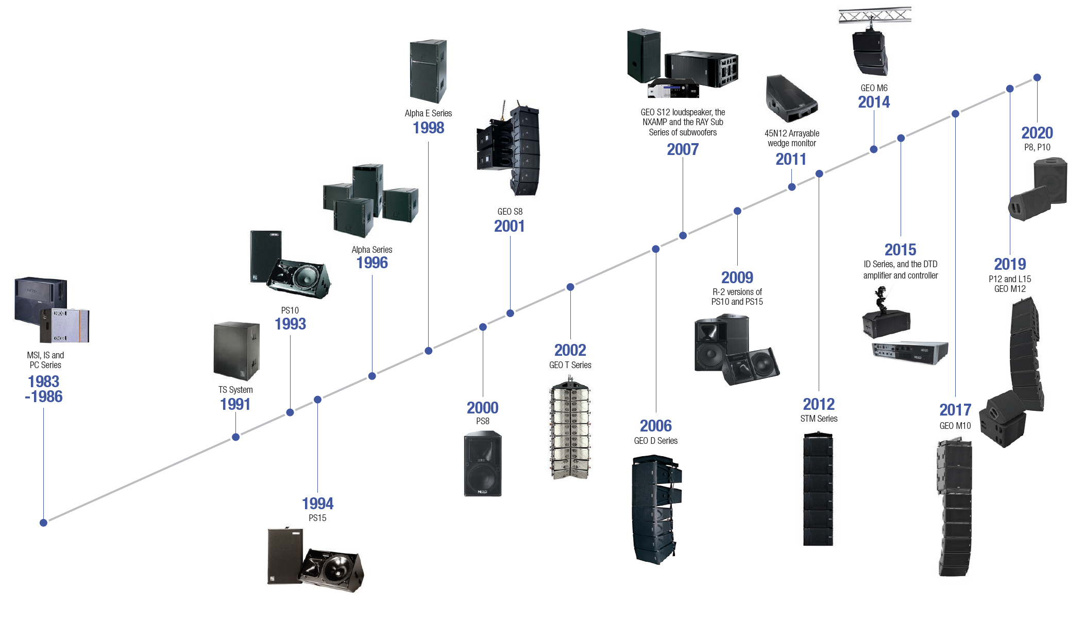
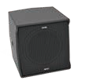
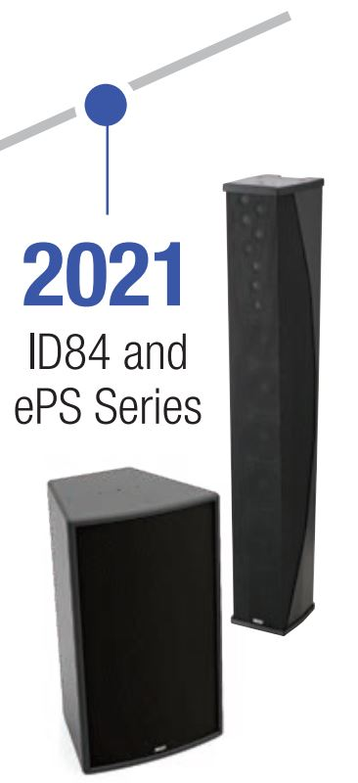
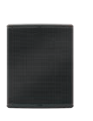

GLOBAL SOLUTIONS
Product Legacy
and Timeline.
ID14
P15, L18

Slide 9





GLOBAL SOLUTIONS
Quality & Certifications
In order to meet our customers’ requirements and enhance their satisfaction, NEXO is continually identifying the best options necessary to set an exceptional standard of products and services. The high quality of our products and services is endorsed through certification and a commitment to recognised methodical processes.
EC Declaration of Conformity
IP 54 Rating
ISO 9001
TÜV Certification

Slide 10
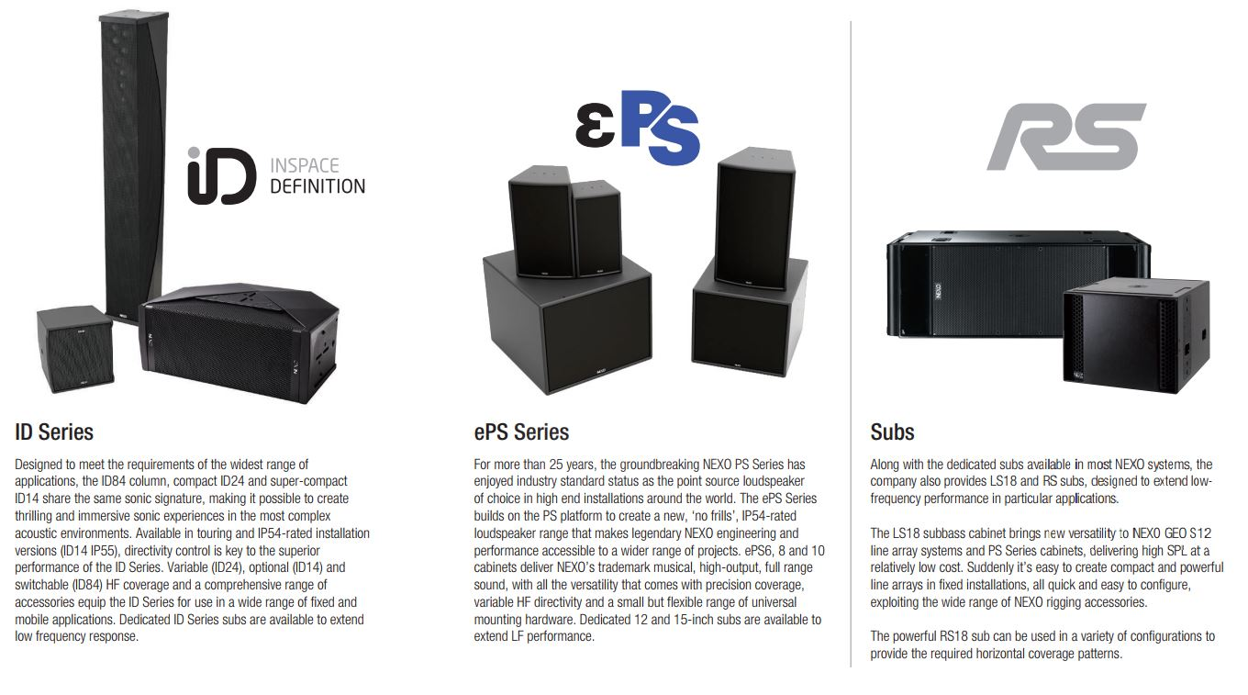
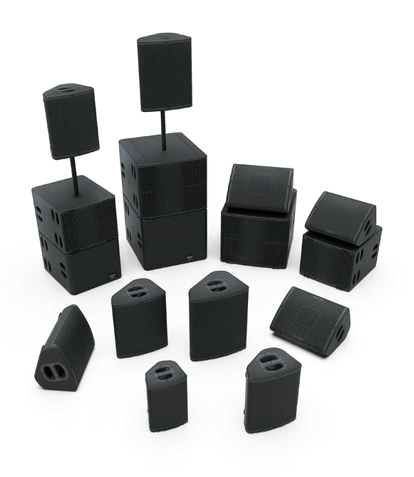


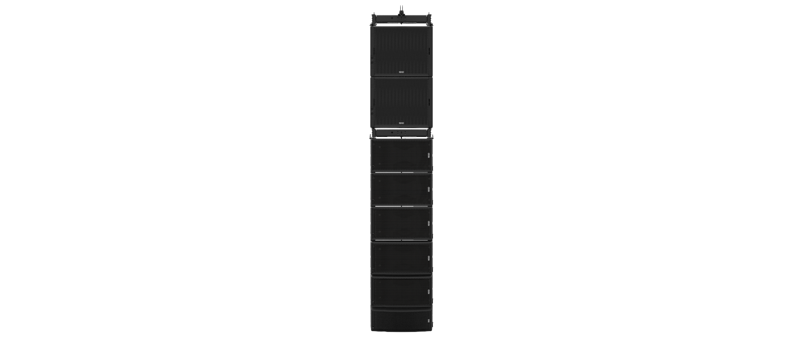
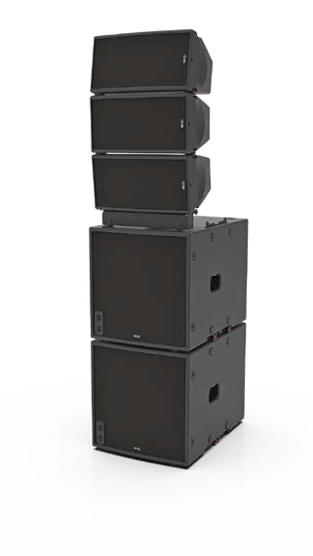
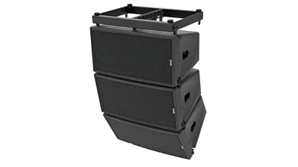
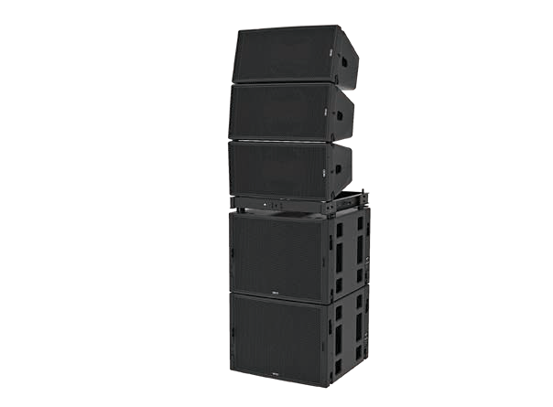
The perfect system for every venue
GLOBAL SOLUTIONS
From the ultra-compact ID Series to the mighty STM, NEXO loudspeaker systems provide designers and installers with the ultimate toolkit from which configure a high-performance sound reinforcement solution for applications of every size and scale.
Every system is compatible with a comprehensive and flexible range of mounting hardware and a range of networkable ‘Plug & Play’ power and DSP control solutions, with remote management features. And all NEXO systems can be custom finished in any RAL paint colour.
GEO M6
GEO M10
GEO M12
Available in mobile and install versions, the curved, low profile
P8, P10, P12 and P15 cabinets can deployed both vertically or
horizontally (as a wedge monitor). Dispersion angles can be changed
quickly to match precisely the application, and versatility is further
expanded by a comprehensive range of accessories. Matching
the footprint of the P12 and P15, the L15 and L18 are the perfect
partner sub-bass cabinets for the P+ Series cabinets, extending LF
performance down to 40Hz and 32Hz respectively.
Small, medium and large systems, each with a dedicated sub, share the same sonic signature and flexible, cost-efficient power and processing solution.

Slide 11
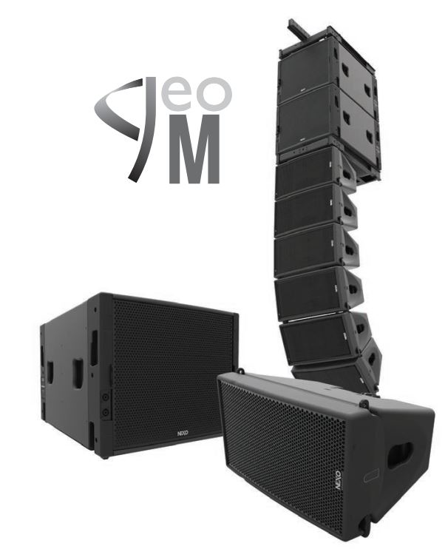
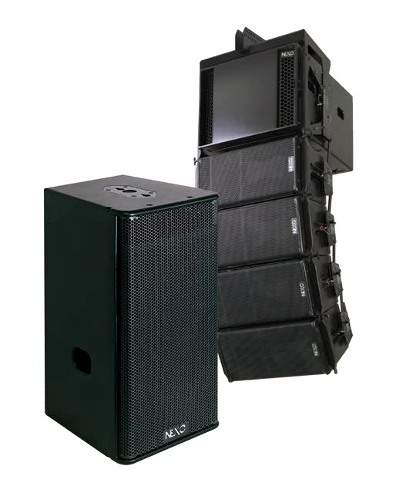
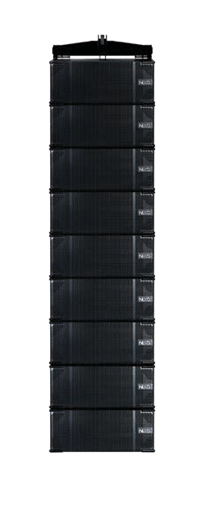









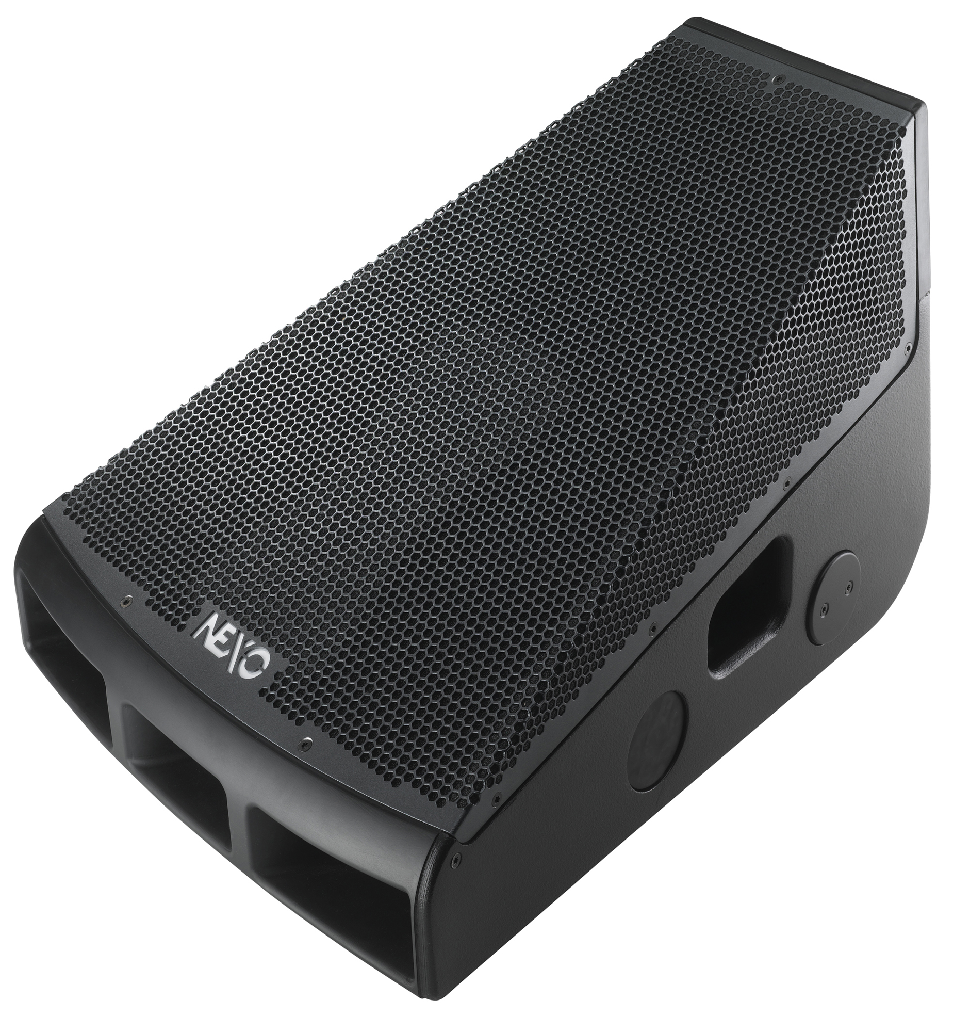
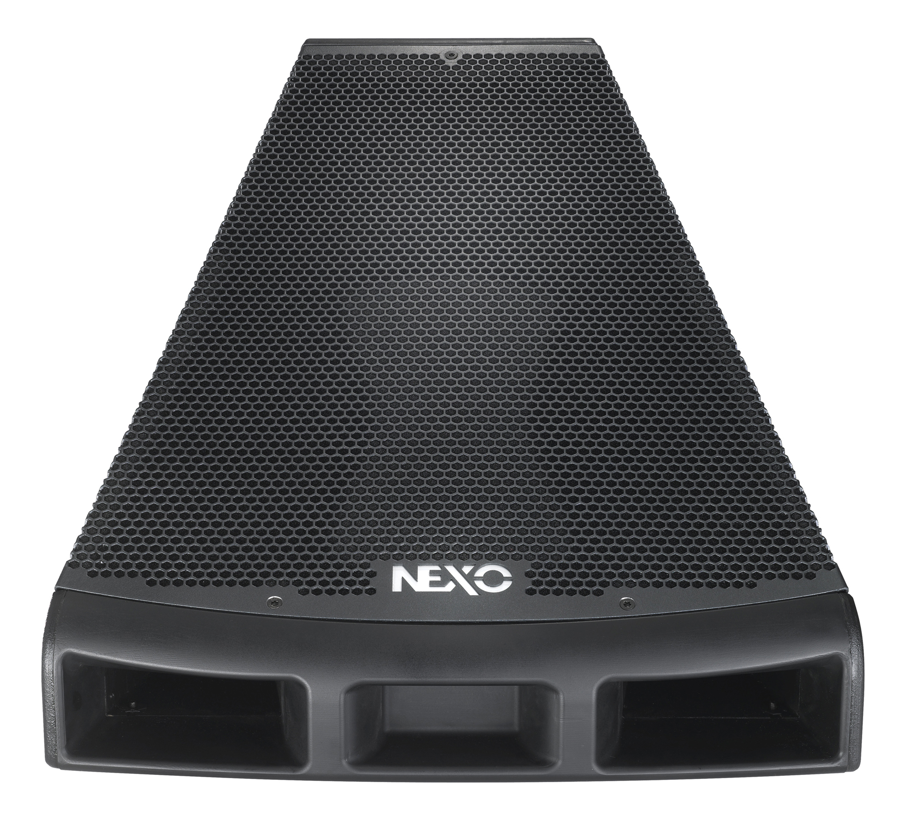
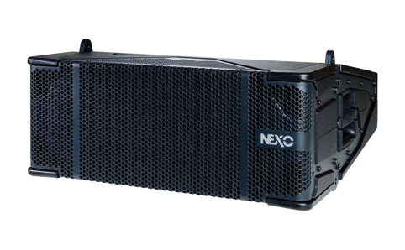
The perfect system for every venue
GLOBAL SOLUTIONS
The most powerful of the NEXO systems, STM embraces the concept
of Scale Through Modularity, empowering designers to configure
systems from four compact and proportionally-sized Main, Bass,
Sub and Omni modules. STM represents an important achievement
in line array technology and incorporates a number of patented
developments including a 3D Hyperbolic Reflector for HF summing
without interference, an acoustic nozzle to ensure smooth airflow
in the Sub venting, a new vent design for improved efficiency in the
Omni and Main modules, and CCD patented technology for variable
horizontal dispersion in the Omni module, along with innovative
PistonRig™, REDLock™ and CompassRig™ rigging, allowing the
technical aspects of system rigging to be safely carried out by one
person.
The GEO M Series comprises three systems: GEO M6, M10 and M12
– each with variable horizontal dispersion and each with a dedicated
and proportionally-sized sub bass cabinet. Because all three systems
share the same sonic signature, it’s easy to mix and match GEO M
systems in a single application, for instance GEO M12 for the main
PA and GEO M10 for the delays. Dedicated MSUB12, MSUB15 and
MSUB18 sub-bass cabinets extend system response down to 45Hz,
40Hz and 32Hz respectively and NEXO NXAMPMK2 powered TD
controllers provide a flexible and cost effective power and processing
solution. A single 4 channel amplifier can power up to 16 boxes and
presets are instantly available for all NEXO cabinets
The GEO S12-ST Series expands NEXO’s global reputation for
advanced vertical array design into horizontal arrays. Both the
S1210-ST (with shallow tapering to the cabinet rear) and S1230-ST
modules (with steeper tapering, allowing for larger array angles) are
characterised by an exceptionally ‘long-throw’, making the system
a popular choice for sports stadium installations. A comprehensive
accessories package precisely rigs S12-ST arrays, both horizontally
and vertically, with unrivalled flexibility, and without sonic compromise
to venue architecture or acoustics
.
Volume without feedback is the defining characteristic of the
revolutionary NEXO 45N12, bringing all the benefits of line
array technology to stage monitoring. Incorporating a number of
groundbreaking technologies, the 45N12 provides musicians,
contractors and rental companies with a single, scalable solution to
all their monitoring requirements.

Slide 12
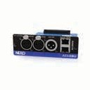
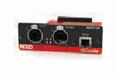
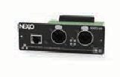
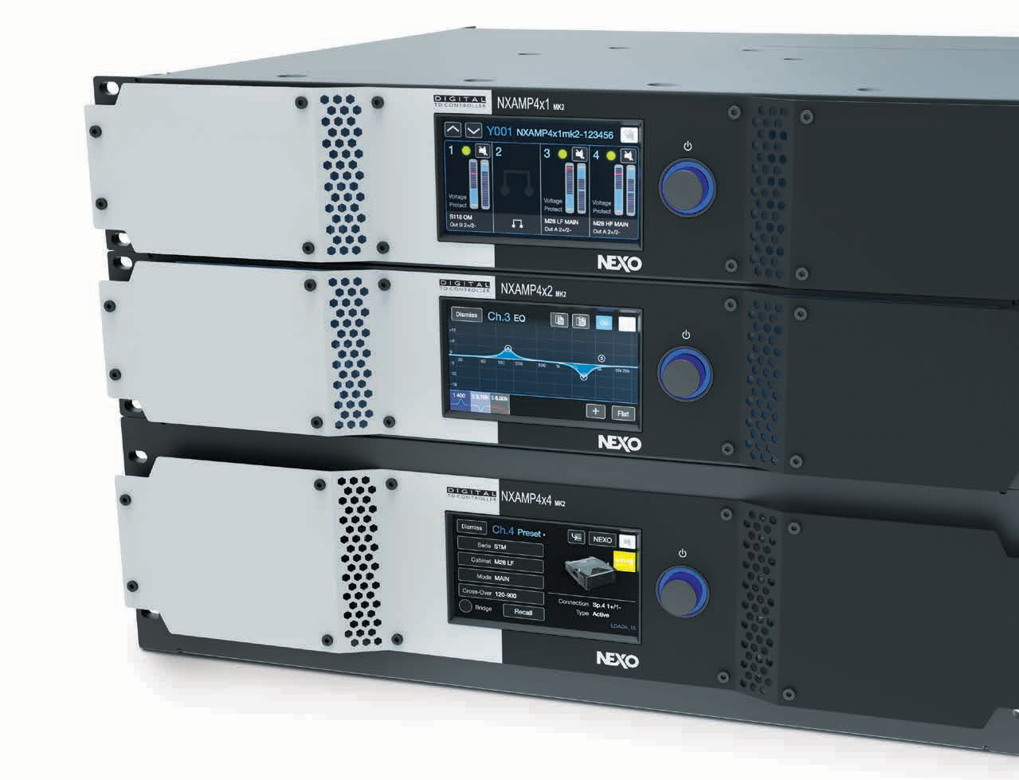
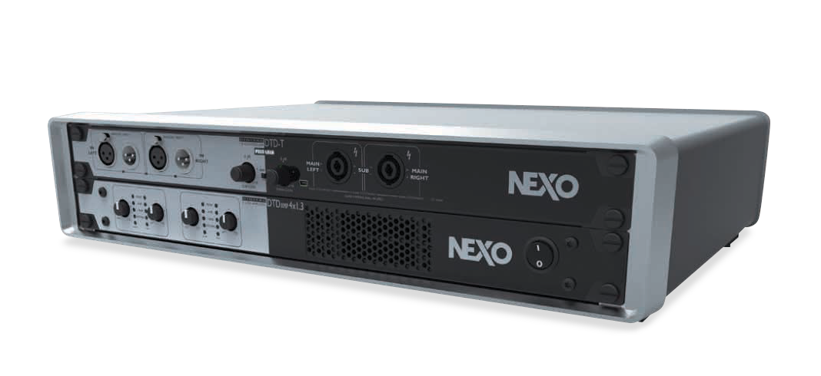

GLOBAL SOLUTIONS
Power & Processing
Plug & Play Solutions for NEXO Systems
NEXO’s range of powered controllers combines high performance, 4-channel amplification with advanced, preset DSP control to provide compact, elegant and easy-to-configure power solutions for NEXO installations.
NXAMPMK2
Available in 4 X 1300 Watts, 4 X 2500 Watts and 4 X 4500 Watts versions, the NXAMPMK2 combines advanced signal processing with state-of-the-art four channel Class D amplifiers to create a flexible, light-weight powering and control solution for NEXO loudspeaker systems.
DTD/DTDAMP
Ideal for powering fixed installations of NEXO ID and P+ Series systems, the 4-channel, 1U rack-mounting DTDAMP is available in two versions: 4 x 700 Watts and 4 x 1300 Watts. The DTDAMP partners perfectly with NEXO’s DTD Controller to create a compact, light-weight, intelligent powering and control solution that’s easy to configure and operate.
AES/EBU *
Class
D
P|F|C
*optional

Slide 13
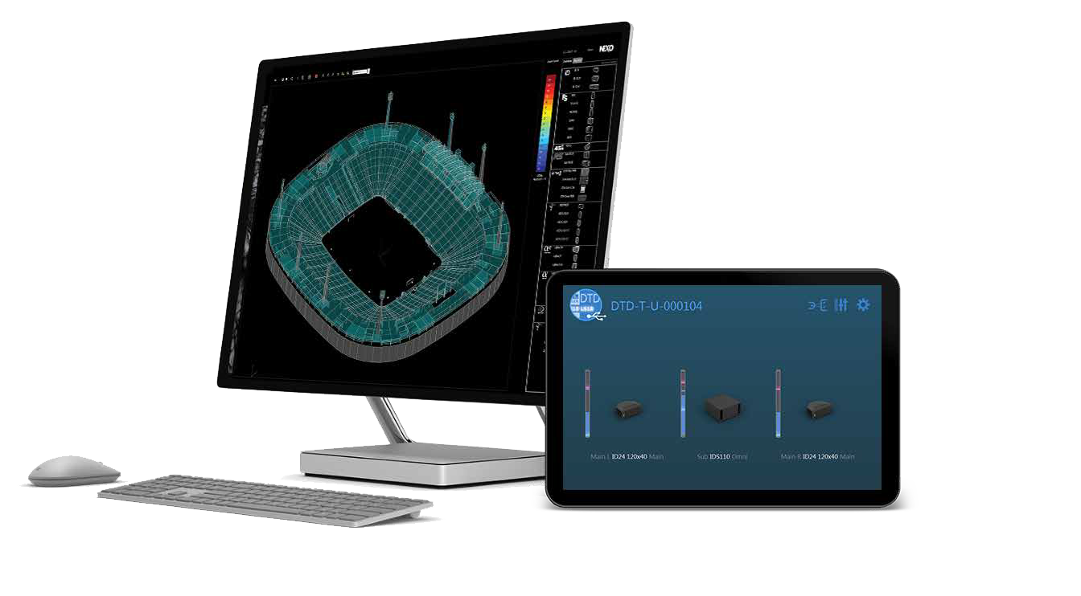


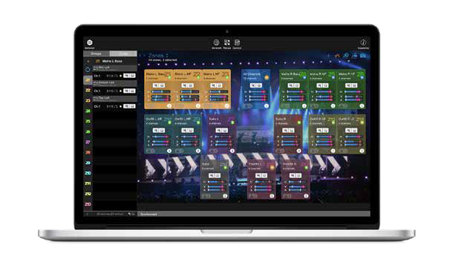
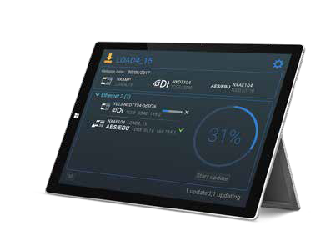


GLOBAL SOLUTIONS
NS-1
Powerful and intuitive System Configuration and Simulation tool ensuring uniform SPL coverage in any venue with any NEXO System. Windows only.
Dory
A highly intuitive Remote Control Solution for NEXO Digital TD Controller (DTD) over USB. Windows and Android.
With you at every stage
A powerful set of free software tools for every step of your workflow, from sound design to final event monitoring.
NeMo
A complete System Management and Remote Control solution for networked NEXO Powered TD Controllers (NXAMP) and Digital TD Controllers (DTD). macOS and iOS.
NeFu
With NeFu, updating your NXAMPmk2s is easy; when networked together, NEXO devices can be updated in parallel in a very short time.

Slide 14
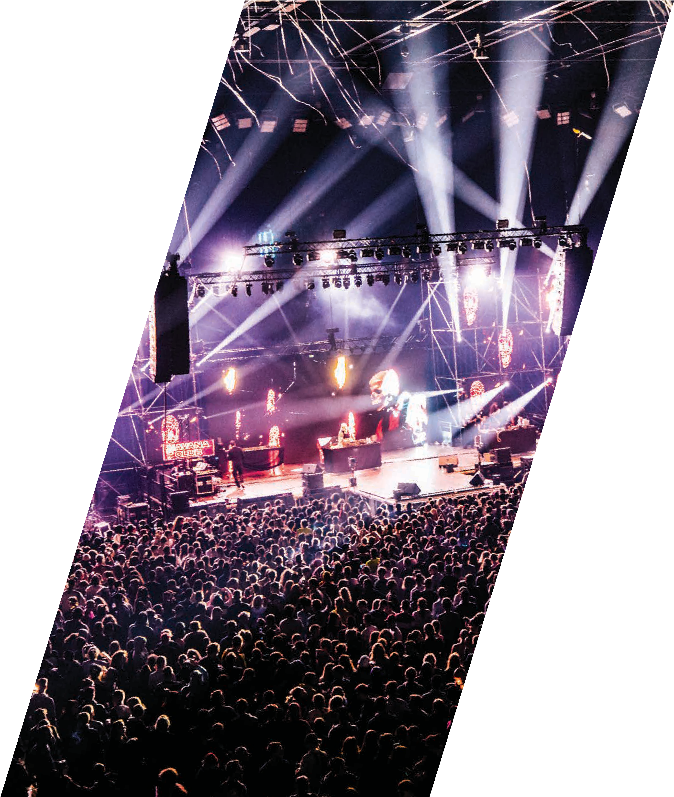
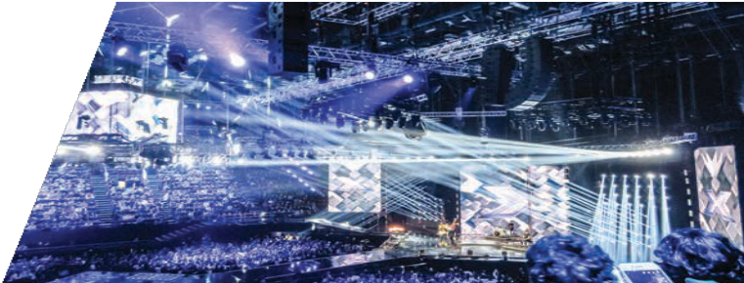
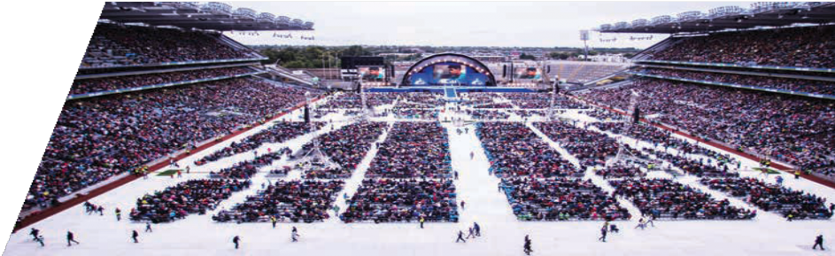
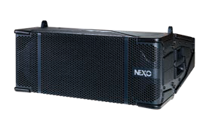

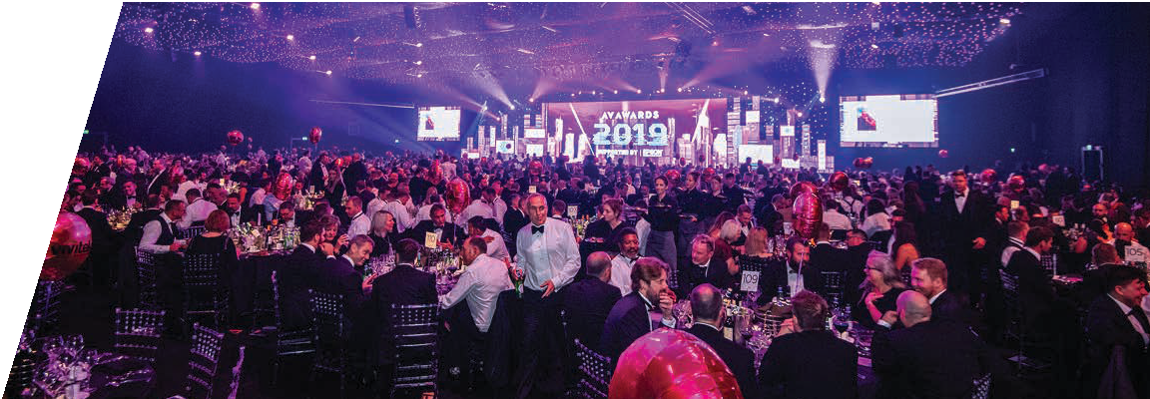
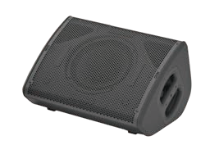
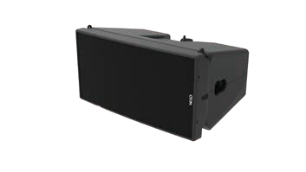
Live Events
Global Solutions
GLOBAL SOLUTIONS
X Factor Finale, Italy
STM and GEO M10 were deployed for the Italian X Factor’s 2018 nationwide live tour.
For shows that stand out from the crowd
For more than four decades, the Live and Touring Events industries have looked to NEXO to provide the ultimate in sound reinforcement technology. Today, NEXO’s loudspeaker systems, plug & play amplification solutions and NS-1 configuration tools deliver significant performance benefits to artists and audiences alike, and important valuable commercial benefits to rental companies and sound contractors.
Recommended Systems
Comprising Main, Bass, Sub and Omni modules of consistent width and with true modularity at the heart of its philosophy, STM combines with plug and play networkable powering solutions to make configuring and installing the perfect sound system easy any scale of event.
Croke Park, Dublin
In the hands of Sound Design Ireland, the STM Series modular line array has scored a high-profile success for the Festival of Families event in Dublin gathering an audience of more than 82,000, addressed by the Pope himself.
The versatility of the P+ Series really pays dividends at live events where cabinets can be quickly and easily configured to create compact and powerful wedge monitors and drum fills.
The GEO M Series of three line array systems, each with a dedicated sub, delivers systems of perfect scale for small to medium sized events. Compact and powerful, GEO M systems share the same sonic signature and easy rigging characteristics.
AV Awards, UK
For the 2019 AV Awards ceremony, the hosts asked NEXO to provide the audio systems for the event (GEO M12), which is attended by nearly 2000 leading professionals from the AV business.
26
©Axel Thijssen, Agoratech, FCKNYE Festival
27

Slide 15
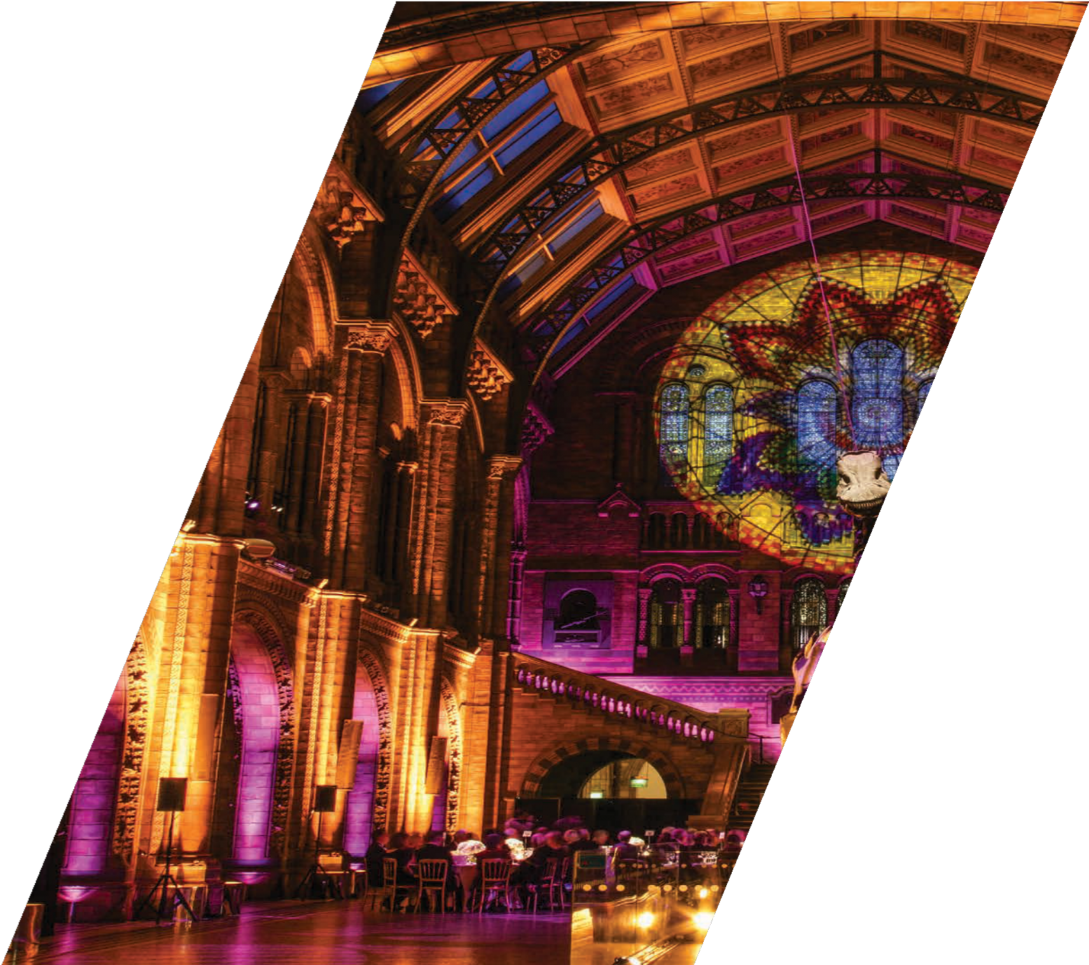
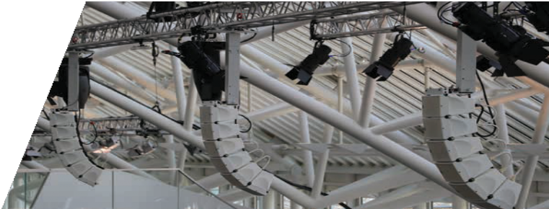
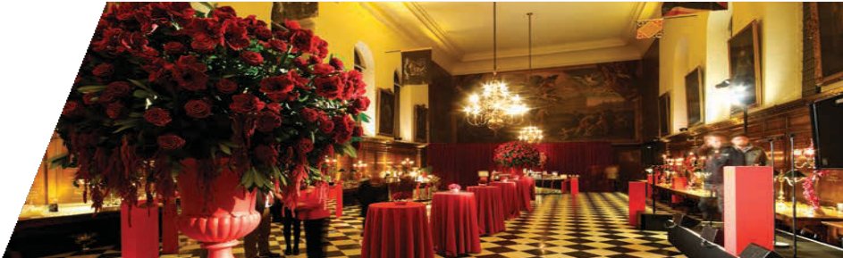
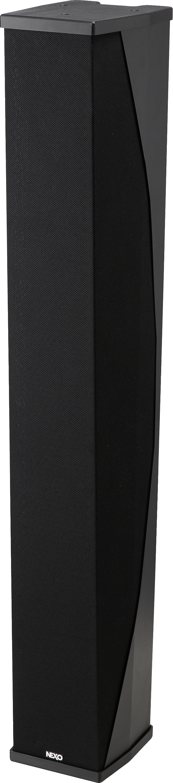

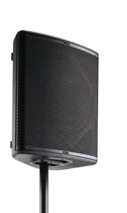
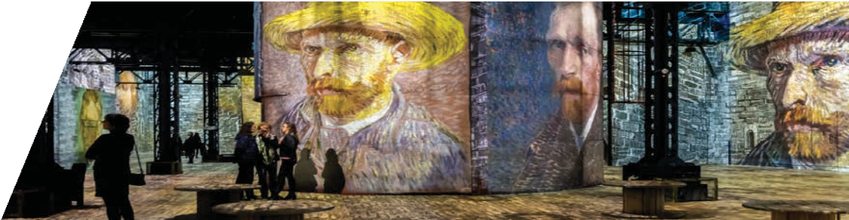
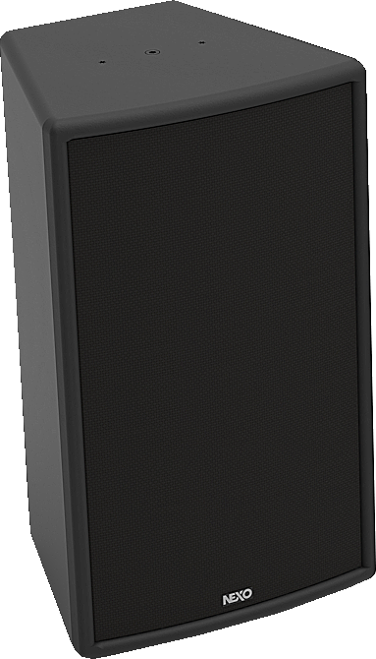

Corporate & Public Spaces
Global Solutions
GLOBAL SOLUTIONS
Precision sound, heard but not seen
From product launches and corporate events through to fixed installations in major public buildings, NEXO sound reinforcement systems offer sound contractors, architects and installers a perfect balance of powerful, full-range performance, compact design for low visual impact, flexible and convenient mounting
accessories for fixed and mobile applications, precision directivity for consistent coverage and ‘Plug & Play’, networkable power and control solutions.
Audi HQ, Germany
Arrays of GEO M6 in the press centre theatre at Audi’s HQ in Ingolstadt.
Recommended Systems
NEXO’s super-compact ID14, compact ID24 and ID84 column speakers are available in touring and fixed installation versions and feature variable HF dispersion options and a comprehensive range of mounting accessories.
Chelsea Royal Hospital, UK
A compact form-factor and low visibility are key factors in sound system design for prestigious events in landmark buildings.
With a choice of three main cabinet sizes, an extensive range of mounting accessories and the facility to change HF dispersion characteristics quickly and easily, the P+ Series is as flexible as it is powerful and compact.
Based on the legendary NEXO PS Series point source speakers, the ePS Series of three main cabinets and two subs is a versatile, ‘no frills’, IP54-rated loudspeaker range that makes legendary NEXO engineering and performance accessible in cost-critical applications.
The GEO M Series of three line array systems, each with a dedicated sub, delivers systems of perfect scale for small to medium sized events. Compact and powerful, GEO M systems share the same sonic signature and easy rigging characteristics.
Atelier des Lumières, Paris, France
NEXO’s high-performance super-compact ID Series loudspeakers are playing a key role in a new digital exhibition in Paris, which offers a spectacular immersive AV experience with the paintings of Vincent Van Gogh.
28
29

Slide 16
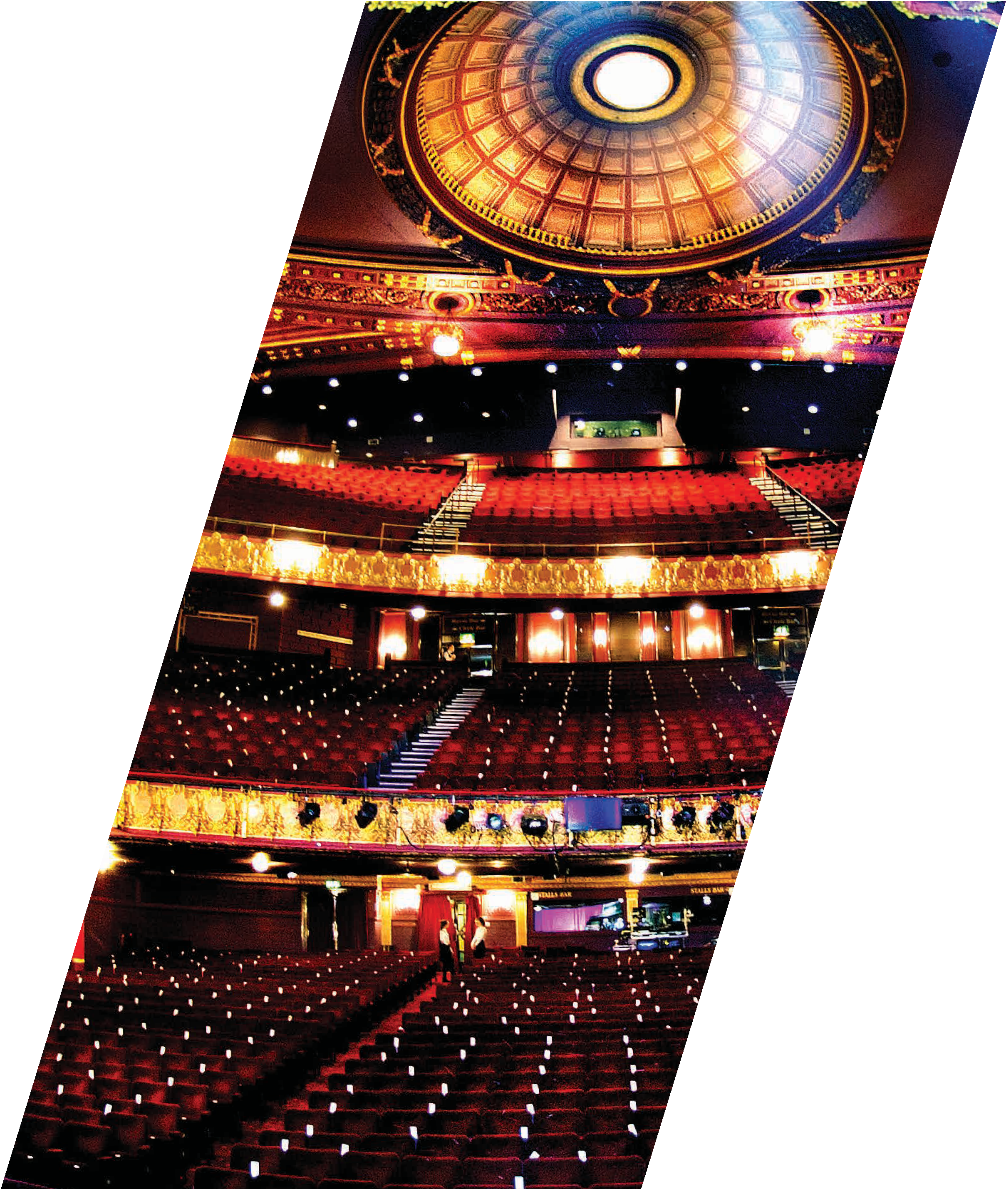

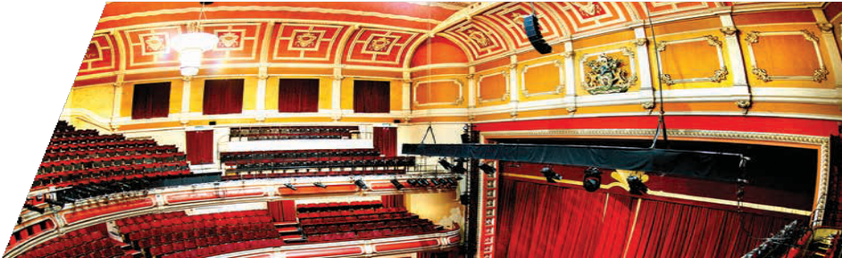
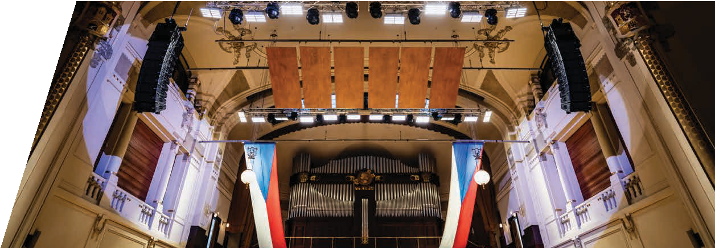
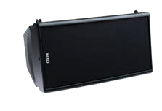
Theatres
Global Solutions
GLOBAL SOLUTIONS
Dramatic sound for every seat in the house
Theatres come in all shapes and sizes and can be challenging spaces in which to achieve consistently even sound coverage across the entire audience, without restricting lines of sight from any seats in the house. Thankfully, NEXO systems present installers with the perfect ‘toolkit’ of loudspeakers for main line arrays of appropriate scale, front stage fills and under-balcony fills, and for ‘beaming’ sound into any other tricky corners of the venue. And because NEXO’s combined amplification and control solutions feature phase-aligned presets for every NEXO cabinet, it’s no problem to combine speakers from different NEXO ranges to
achieve a perfectly balanced system.
Stadsgehoorzaal, Holland
L/R olive green GEO M6 arrays combine with a centre M6 cluster and ID24s in the wings and two boxes to deliver even audience coverage this Dutch theatre.
Recommended Systems
The ultra-compact ID Series is perfect for ‘beaming’ sound into tricky places like under balconies. And because cabinets are so small, audience lines of sight remain uninterrupted. Also perfect as stage front fills, a comprehensive hardware range makes ID Series quick and easy to install in a variety of configurations.
Victoria Theatre, United Kingdom
NEXO’s compact GEO M6 line array system has been installed as the main house PA system in the Victoria Theatre, Halifax, to provide high quality audio reproduction during its diverse programme of live shows and events.
Powerful, versatile and compact, variable HF dispersion makes it easy to configure P+ series systems with consistent audience coverage in challenging spaces.
The GEO M Series of three line array systems, each with a dedicated sub, delivers systems of perfect scale for any theatre. Compact, powerful and visually unobtrusive, GEO M systems share the same sonic signature and are complemented by a comprehensive and versatile range of mounting accessories.
Comprising Main, Bass, Sub and Omni modules of consistent width and with true modularity at the heart of its philosophy, STM combines with plug and play networkable powering solutions to make configuring and installing the perfect sound system easy any scale of event.
Municipal House, Prague, Czech Republic
The supremely elegant Municipal House in Prague, considered to be the finest example of modernist art in the Czech Republic, has completed the permanent installation of a NEXO STM Series line array system in the renowned 2,000- capacity Sala Smetana.
30
31

Slide 17






Clubs
Global Solutions
GLOBAL SOLUTIONS
Thrilling the dancefloor
It’s no surprise that NEXO systems can be found rocking dancefloors in every corner of the globe. Full frequency performance and high power levels from typically compact cabinets make high-quality sound available to clubs both large and small, with NEXO’s enhanced directivity characteristics always proving beneficial in license applications.
V Livehouse, China
LS18 subs complement an STM main system with PS Series cabinets used as front fills and stage monitors in this Shanghai club.
Recommended Systems
Compact, powerful and uniquely versatile – thanks to an ingenious system for varying HF dispersion, the P+ Series is ideal for configuring club systems with high quality sound throughout the venue.
NEXO’s original PS Series point-source loudspeakers were a huge hit in the clubs. The ePS Series of three main cabinets and two subs builds on that success with a ‘no frills’ approach that makes legendary NEXO engineering and performance accessible to a wider range of venues.
Crobar, Argentina
John Digweed uses triple-wide STM groundstacks to create a stunning sound at a gig in Argentina.
.
The first choice of many high-profile DJs, this truly modular system can be configured in compact groundstacks or flown in arrays to create the ultimate in high-powered sound systems.
Compact and powerful, NEXO subs combine directional control with high levels of versatility. NEXO power and processing solutions feature phase-linear presets for all NEXO subs, and flexible rigging makes deployment easy in ground-stacked or flown systems.
NEXO Subs
Jolly Joker Vadistanbul, Turkey
One of Istanbul’s largest nightclubs, the latest in the group of Jolly Joker venues, is making a big impact on the city’s entertainment scene, thanks to a high-specification NEXO STM Series modular line array.
32
33

Slide 18









Bars & Restaurants
Global Solutions
GLOBAL SOLUTIONS
Creating the perfect vibe
NEXO’s patented technologies help to ensure that NEXO loudspeakers are typically more compact than others in their class – perfect for bars and restaurants in which low visual impact is important. And it also helps that many NEXO speakers can be specified in custom RAL colours to blend in seamlessly with the interior design. Clarity at low volume is also a NEXO characteristic, with the ability to perform effortlessly at higher volume levels once the dining is over and the DJ starts. And with such a comprehensive range to choose from, installers can easily create systems with totally even coverage throughout the venue, eliminating the ‘hot’ and ‘dead’ spots that can kill the vibe.
Custom RAL colours
Lightweight polyurethane composite cabinets, fabric grilles and
accessories can be specified in any RAL colour.
Recommended Systems
Chic, elegant and compact, NEXO’s ID14 and ID24 cabinets are available in a range of custom colours and supported by a comprehensive range of vertical and horizontal mounting hardware. Dedicated subs are equally discreet.
Monsieur Bleu, Paris
NEXO speakers and a spectacular view create the perfect outdoor dining experience at this Paris restaurant.
With its elegant, curved cabinet designs, variable HF coverage and comprehensive range of mounting accessories, the P+ Series provides the building blocks for a system that looks as good as it sounds.
A range of three main cabinets and two subs combine with a small but
flexible range of mounting hardware to create a ‘no-frills’ solution for
high-quality bar and restaurant sound.
With its compact form factor, integral rigging, elegant hardware, and custom RAL colours, GEO M6 delivers advanced NEXO line array technology in a TÜV-certified system measuring just 373mm in width.
Typhoon Shelter, Mumbai, India
The design of the restaurant features an immersive sound experience with GEO M6 cabinets, that of sitting in the middle of an approaching typhoon.
34
35

Slide 19




Houses of Worship
Global Solutions
GLOBAL SOLUTIONS
Spreading the word
An optimised balance of high performance and discreet visual impact make NEXO systems an ideal choice for installations in houses of worship. The facility to mix cabinets from different systems – all powered by NEXO’s combined amplification and DSP control solutions makes it possible to configure systems that deliver consistently even coverage across the congregation, even in difficult acoustic environments, while compact form factor and custom colour options help cabinets blend discreetly into the space.
Willebadessn’s Baptist Church, Germany
GEO M6 line arrays complement the calm and elegant interior of this 1500-seat church, delivering smooth and even coverage to the whole congregation.
Recommended Systems
Chic, elegant and compact, NEXO’s ID Series cabinets are available in a range of custom colours and supported by a comprehensive range of mounting hardware. Dedicated subs are equally discreet.
Bethany Community Church (BCC), USA
The 100-year old Bethany Community Church (BCC) Green Lake in Seattle, Washington has invested in a new STM modular line array, teamed with a Yamaha CL5 digital audio console.
With its elegant, curved cabinet designs, variable HF coverage and comprehensive range of mounting accessories, the P+ Series provides the building blocks for a system that looks as good as it sounds.
The GEO M Series of three line array systems, each with a dedicated sub, delivers systems of perfect scale for any installation. Compact, powerful and visually unobtrusive, GEO M systems share the same sonic signature and are complemented by a comprehensive and versatile range of mounting accessories.
Comprising Main, Bass, Sub and Omni modules of consistent width and with true modularity at the heart of its philosophy, STM provides building blocks for the ideal sound reinforcement system.
Enjoy Church, Australia
In order to keep up with its expanding congregation, Enjoy Church asked Forefront productions to implement a purposeful main speaker system upgrade. They’ve chosen the STM Series to apply more modern sound reinforcement technology to the venue’s geometry, and better cater for future changes presentation as well as capacity.
36
37

Slide 20










Sports Arenas
Global Solutions
GLOBAL SOLUTIONS
Stade de France
Almost 300 NEXO cabinets are installed in our local sports stadium, the legendary Stade de France!
Pitch perfect sound
Sound systems have many roles at a major sporting event, from helping to build the atmosphere and excitement through to ensuring crowd safety in the event of an emergency. Central to all of these roles is a requirement for clear, powerful, full-range reproduction and consistent crowd coverage, all of which NEXO systems deliver alongside the benefits of flexible audio networking.
Recommended Systems
Optus Stadium, Perth, Australia
Nearly 500 NEXO loudspeaker cabinets, line array and point-source, have been installed in the prestigious Optus Stadium in Perth, Western Australia, in a state-of-the-art AV system.
Designed specifically for stadium sound installations and widely used in sports arenas the world over, NEXO has created dedicated long-throw ST versions of its standard GEOS1210/S1230 cabinets, delivering the highest audio quality standards, combined with controlled directivity, in operationally-flexible networked solutions.
NEXO’s ultra-compact and visually unobtrusive ID Series cabinets are ideal for use in VIP areas and corporate boxes.
Toyota Stadium Toyota, Japan
As one of Japan’s host venues for the Rugby World Cup, the Toyota Stadium in Toyota City is gaining a very high international profile for its newly-installed NEXO GEO S12-ST line array sound system.
Comprising Main, Bass, Sub and Omni modules of consistent width and with true modularity at the heart of its philosophy, STM combines with plug and play networkable powering solutions to make configuring and installing the perfect sound system easy for sports arena of all sizes.
With its elegant, curved cabinet designs, variable HF coverage and comprehensive range of mounting accessories, the P+ Series provides the building blocks for a system that looks as good as it sounds.
Molineux Stadium,UK
The entertainment experience for Wolverhampton Wanderers football fans has been transformed with a new NEXO PA/VA system making ‘a massive difference’ without blowing the budget.
38
39

Slide 21

STADIA & ARENAS - Sound Solutions
Parc d’Activité du Pré de la Dame Jeanne, B.P. 5
60128 Plailly
France
Tel: +33 (0) 3 44 99 00 70
Email: info@nexo.fr
nexo-sa.com

