Slide 1
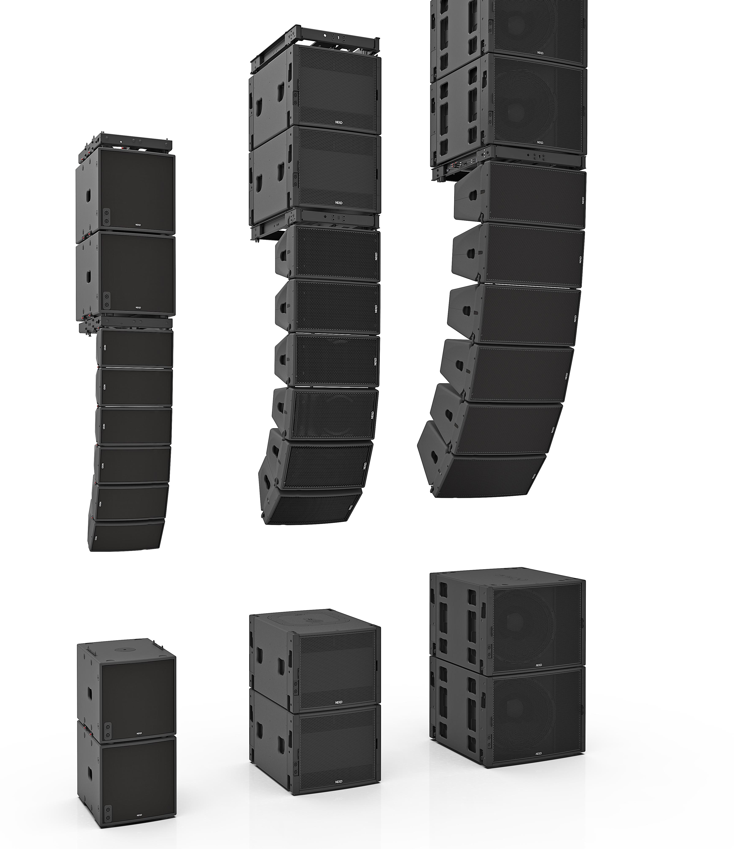
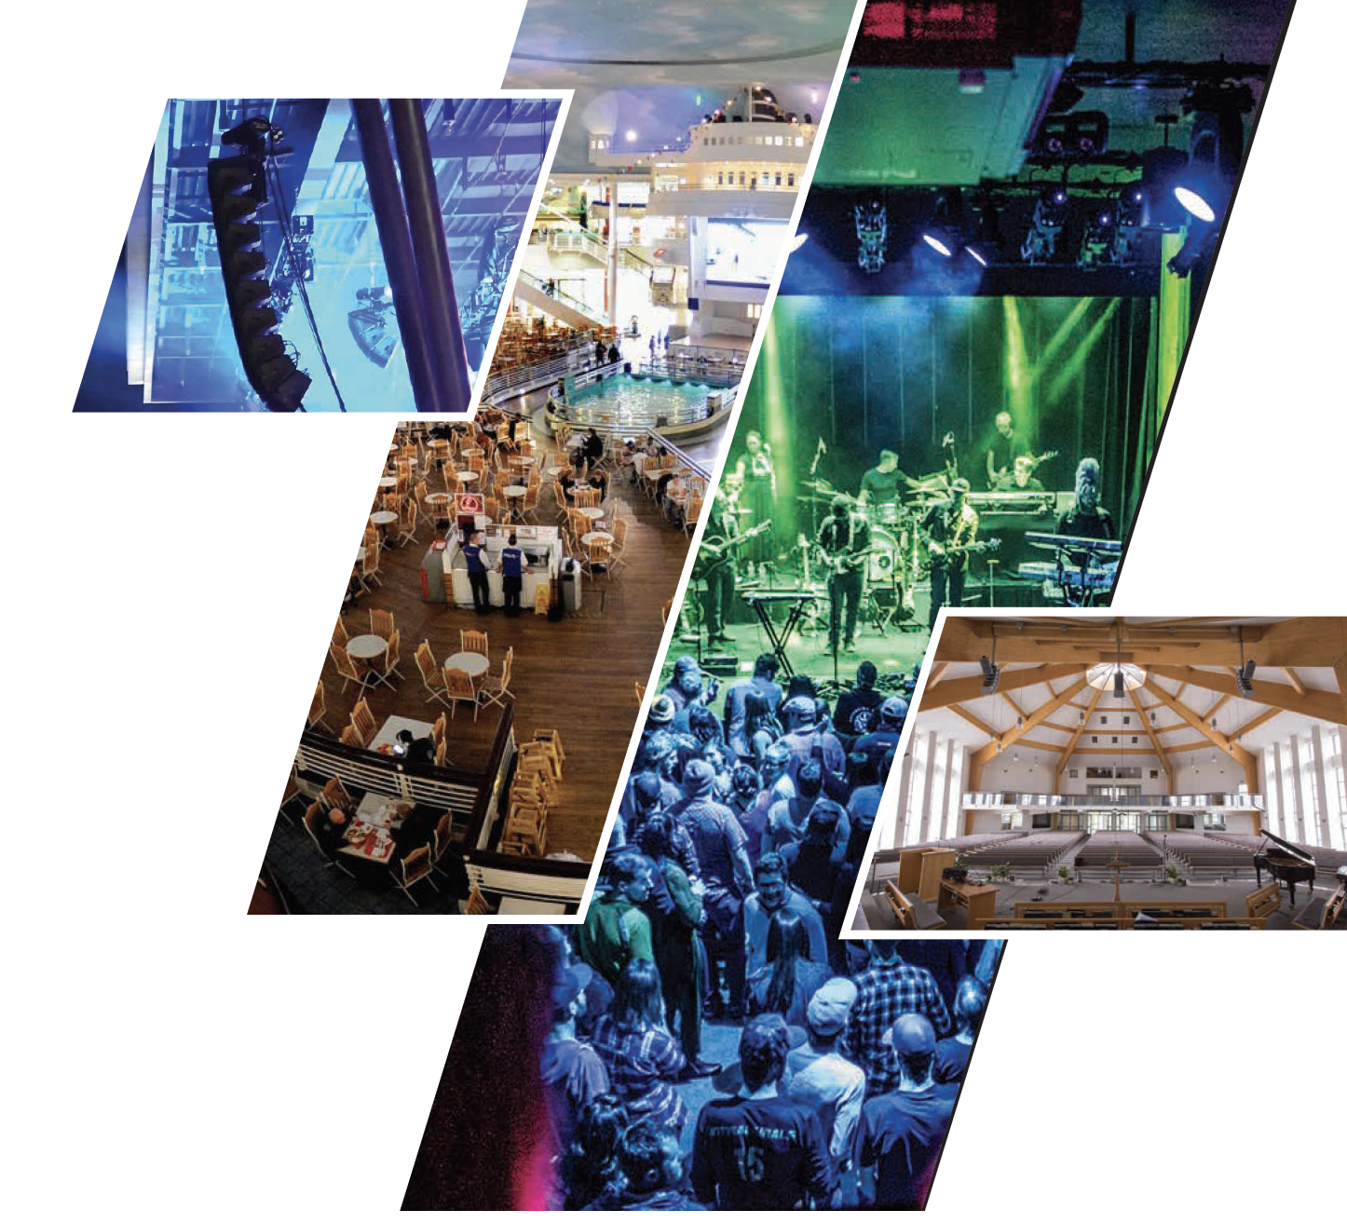

One voice.
No limits.

Slide 2

Main Modules

Slide 3
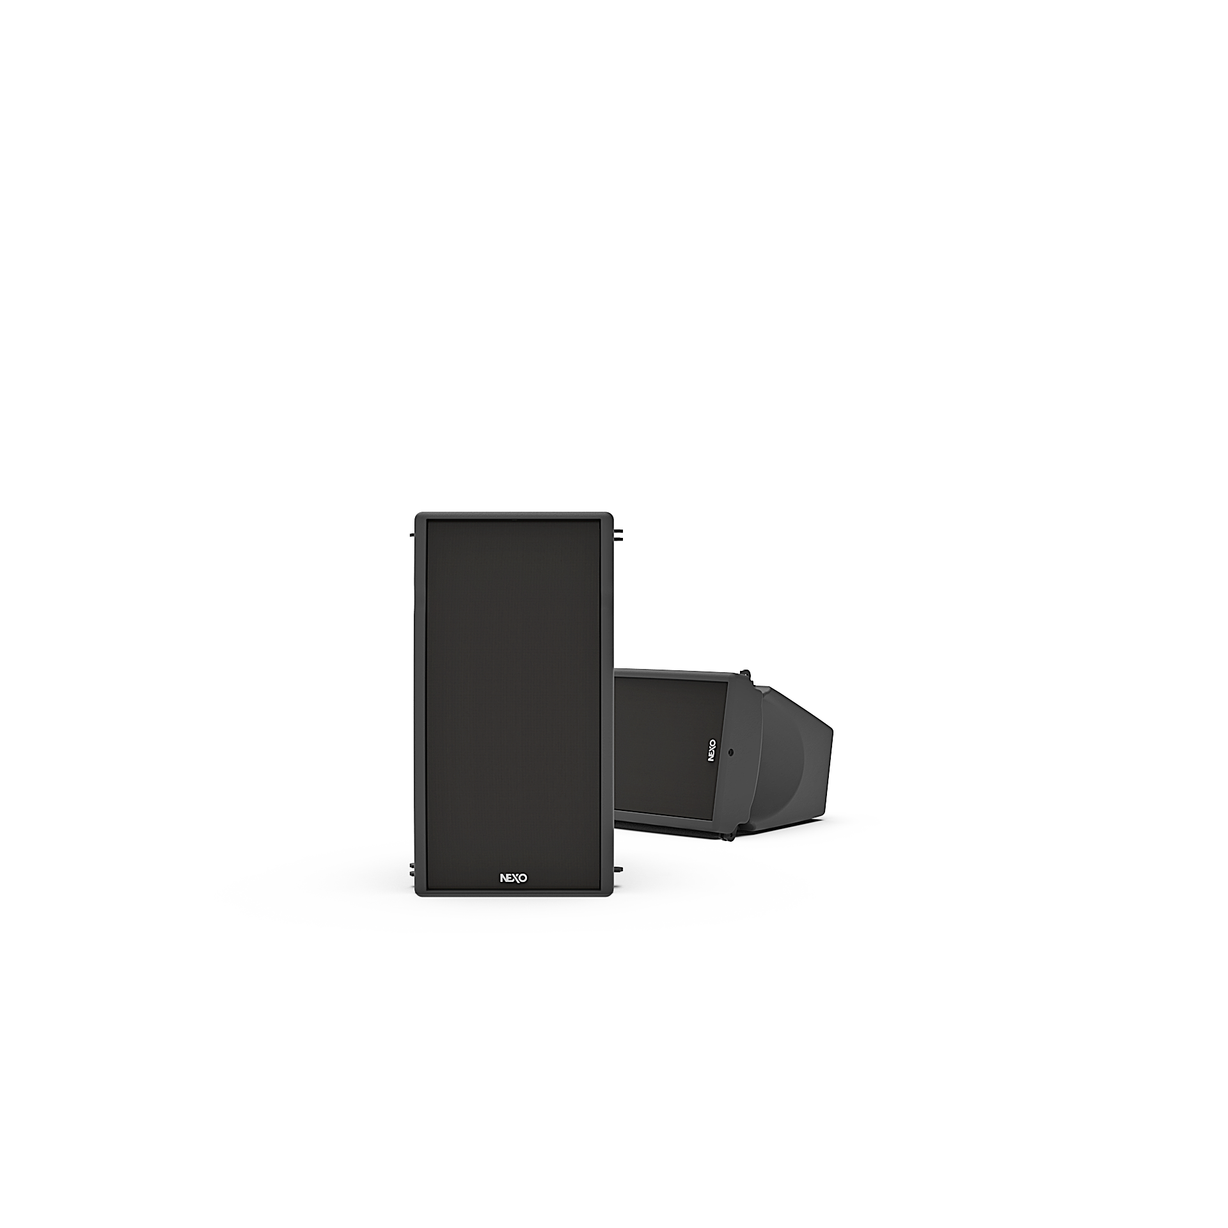




The visual impact of GEO M6 is subtle, thanks to compact design, an elegant internal rigging system and custom colour options. Comprising two identically-sized cabinets – the GEO M620 main and GEO M6B bass extension – and complemented by a comprehensive range of mounting accessories, GEO M6 offers installation contractors and sound rental companies a dependable, TÜV-certified system with an important difference: legendary NEXO performance.
127dB SPL
6-inch Bass/Mid Driver
20° Vertical Dispersion
Versions
Variable 80°/120° Horizontal
Dispersion

Slide 4
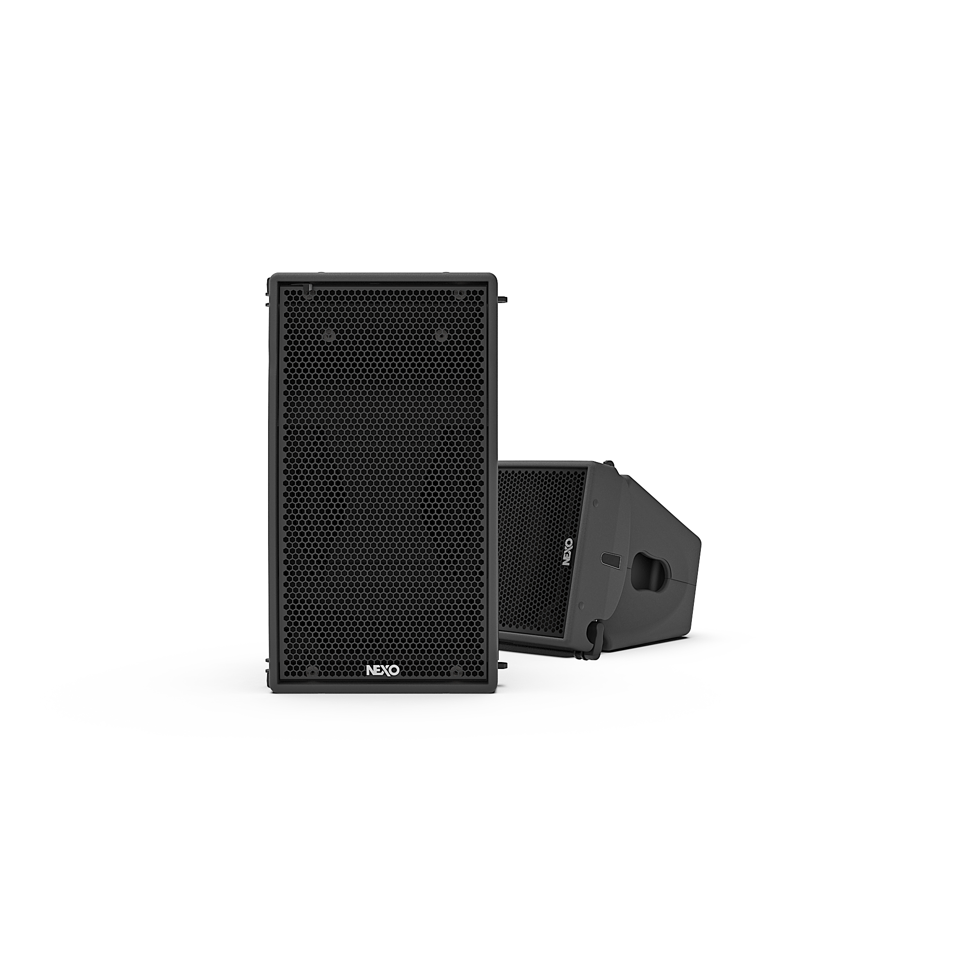

NEXO’s extraordinary GEO M10 combines a number of patented technologies with advanced DSP control and integral, ‘no loose parts’ rigging to create a compact, powerful, wide-bandwidth module that’s quick and easy to deploy in flown arrays or groundstacks.
GEO M6 | GEO M10
127dB SPL | 136dB SPL
6-inch Bass/Mid Driver | 10-inch Bass/Mid Driver
20° Vertical Dispersion Versions | 12.5°/25° Vertical Dispersion Versions
Variable 80°/120° Horizontal Dispersion | Variable 80°/120° Horizontal Dispersion

Slide 5

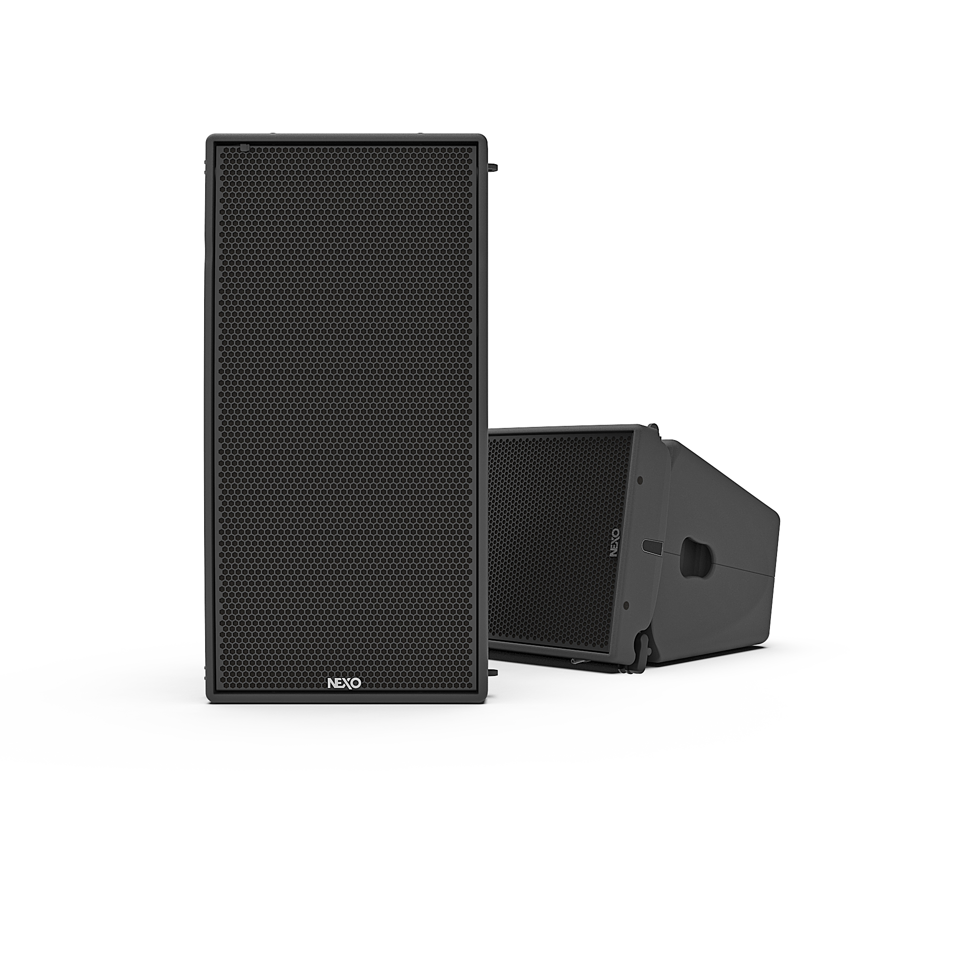
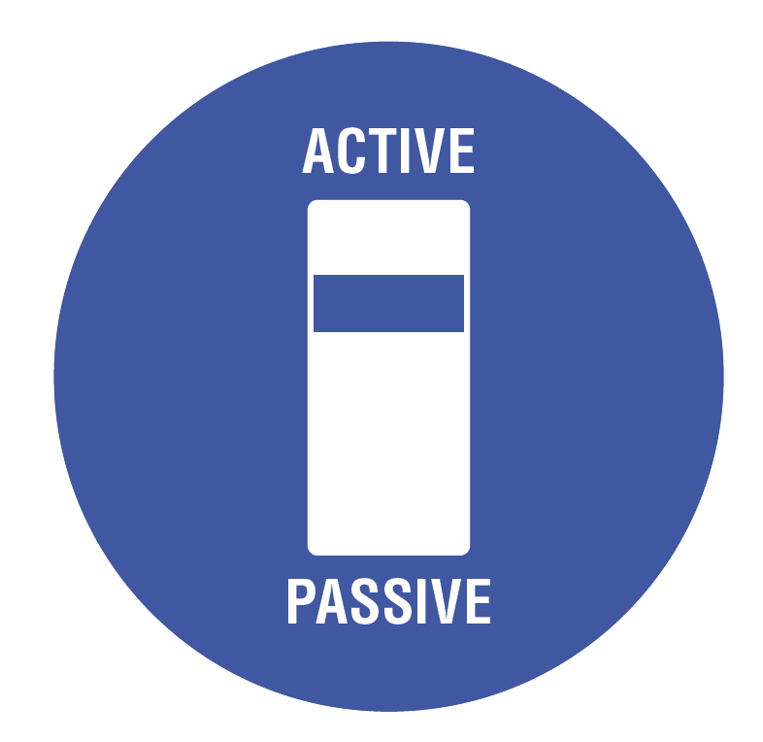
Aimed primarily at the mid-size rental company, the GEO M12’s competitive price tag will make it a popular investment in a range of applications from corporate presentation to live performance venues and houses of worship.
GEO M6 | GEO M10 | GEO M12
127dB SPL | 136dB SPL | 140dB SPL
6-inch Bass/Mid Driver | 10-inch Bass/Mid Driver | 12-inch Bass/Mid Driver
20° Vertical Dispersion Versions | 12.5°/25° Vertical Dispersion Versions | 10°/20° Vertical Dispersion Versions
Variable 80°/120° Horizontal Dispersion | Variable 80°/120° Horizontal Dispersion | Variable 80°/120° Horizontal Dispersion
- | - | Passive / Active modes

Slide 6
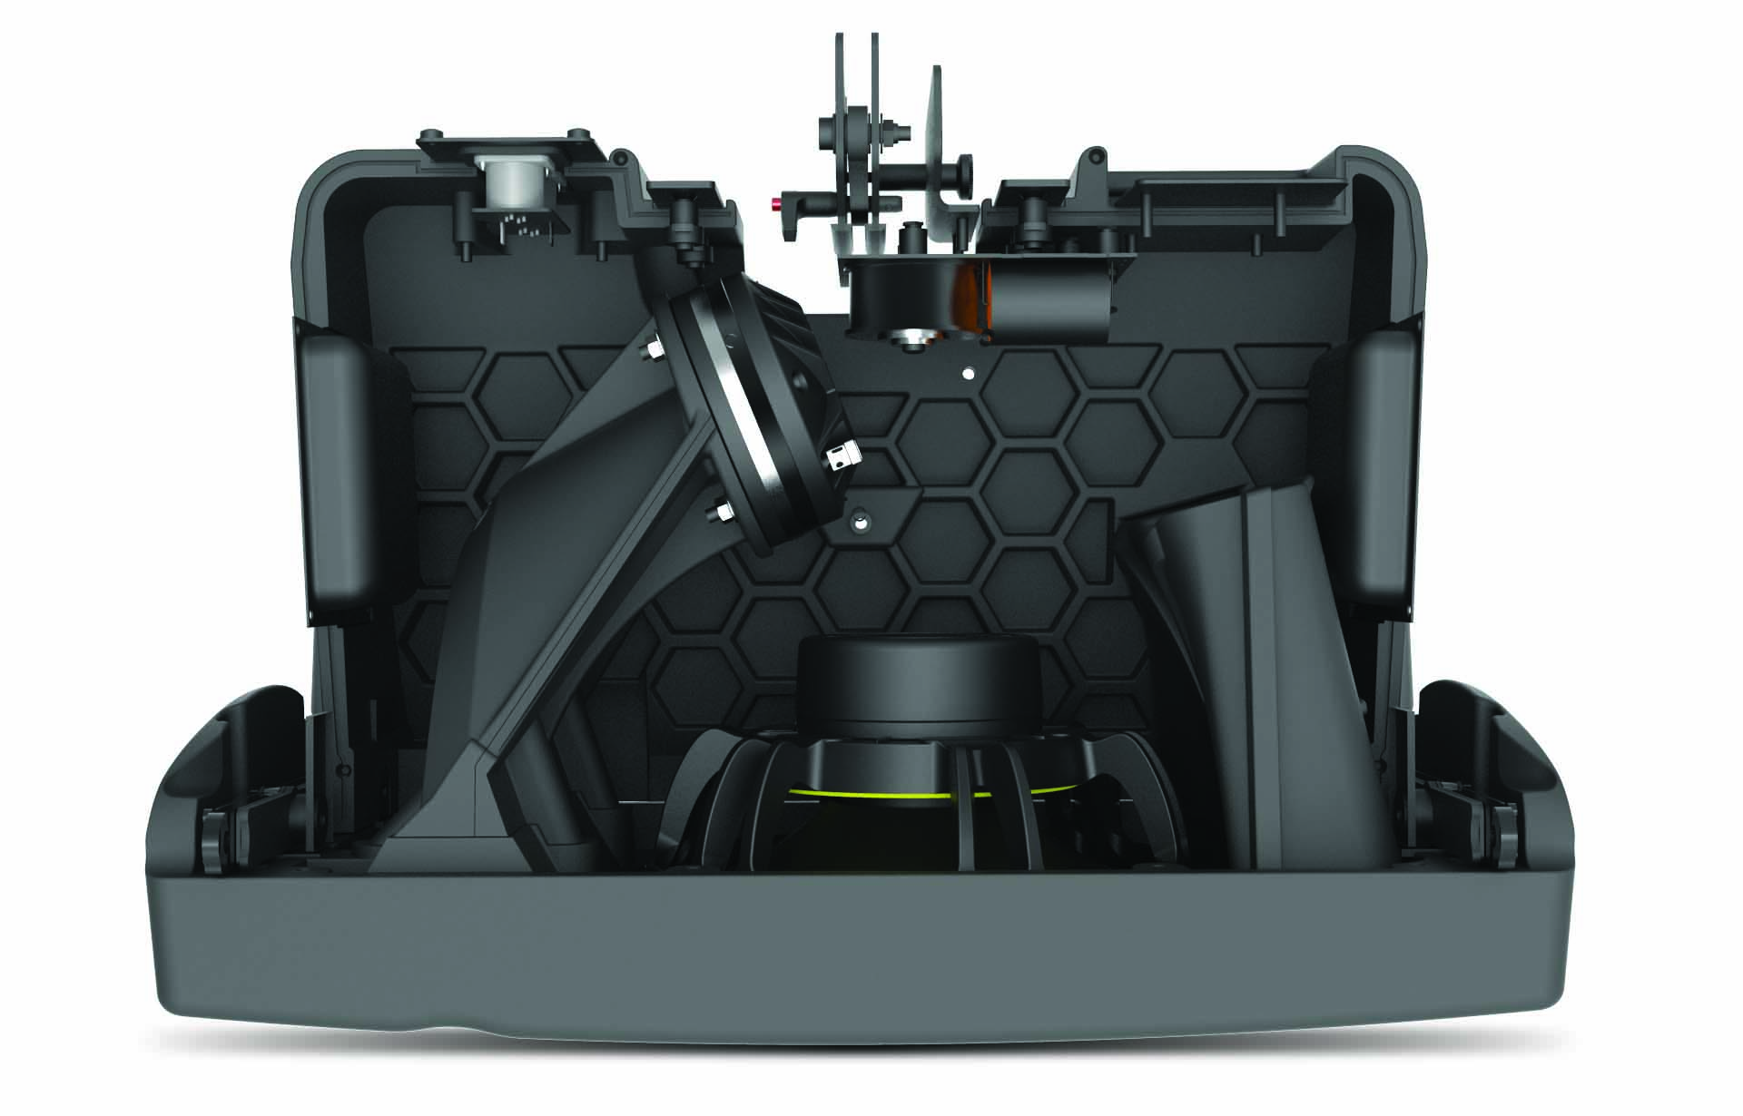
Our patented technology,
makes the difference
Central to the advanced performance and versatility of the GEO M Series is the deployment of a number of patented technologies, thinking ‘inside the box’ with a focus on the delivery of high-output, full-range sound and consistently even venue coverage from cabinets that are typically more compact than others in their class.

Slide 7
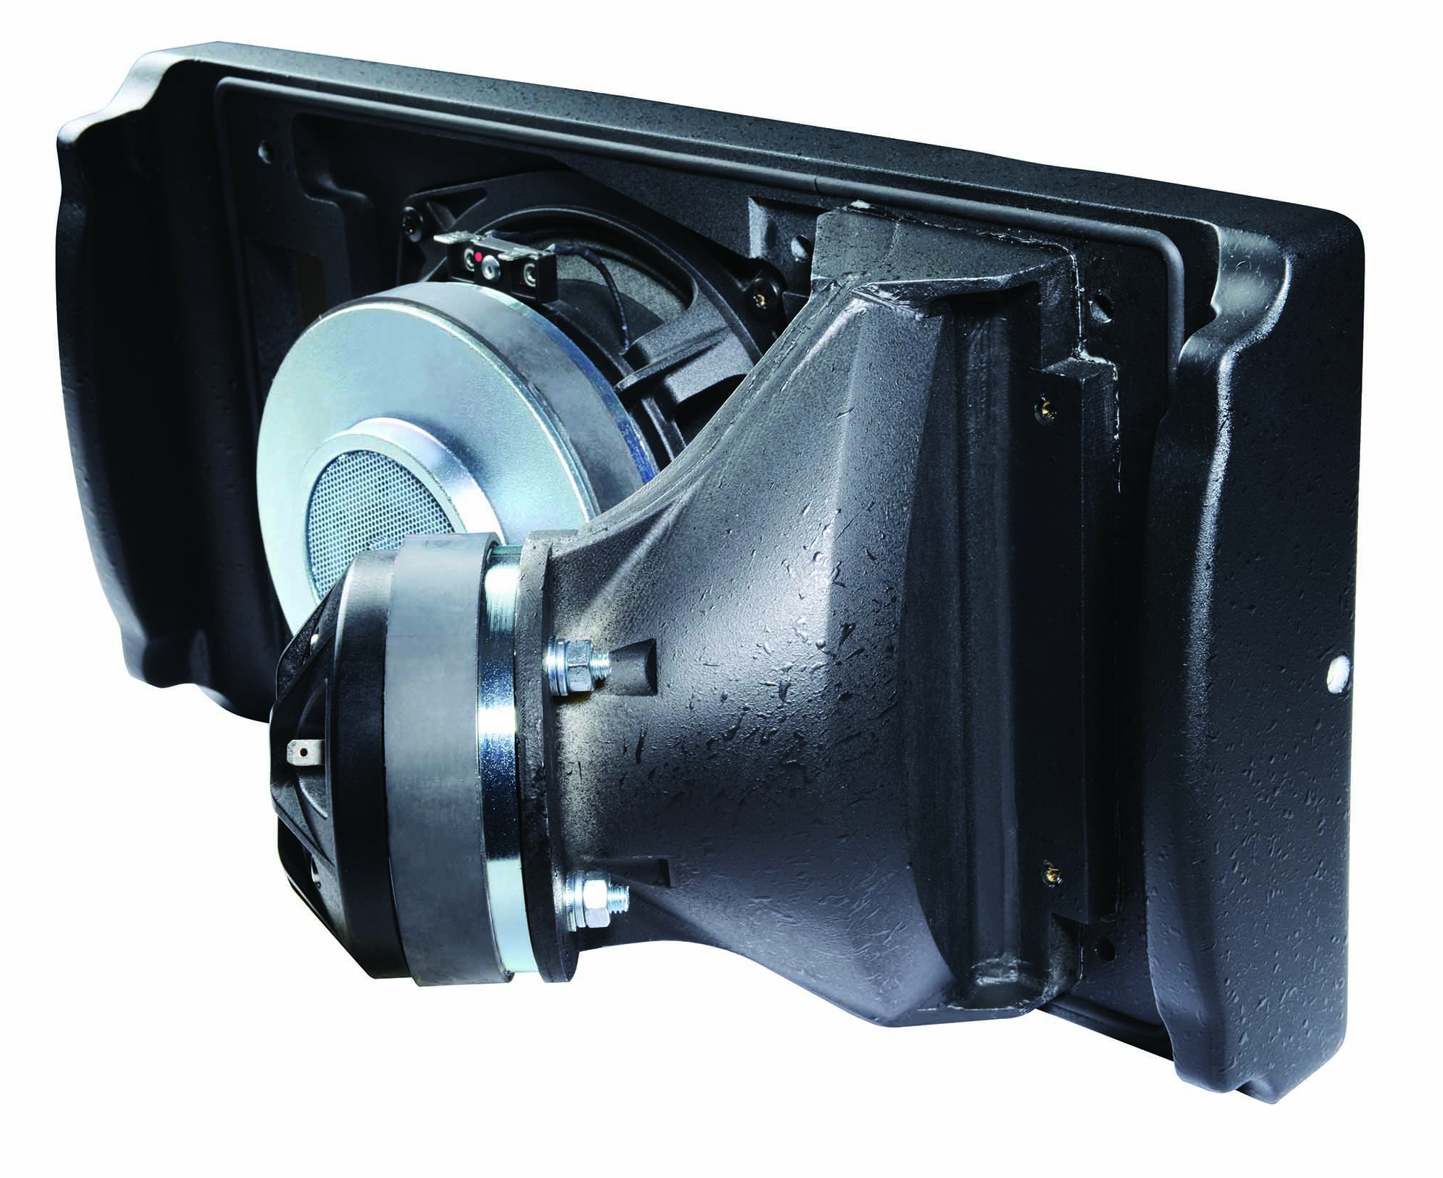
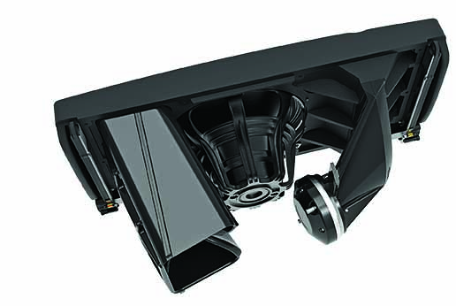
NEXO patented technology
Acoustic coupling of cabinets
up to 20kHz without interference
with the Hyperbolic Reflector Waveguide
GEO M6
NEXO’s patented Hyperbolic Reflector Waveguide converts the spherical wavefront generated by a high frequency compression driver into a flat or convex wavefront using an acoustic reflector, allowing speaker cabinet acoustical coupling without interference up to 20kHz.
GEO M12

Slide 8
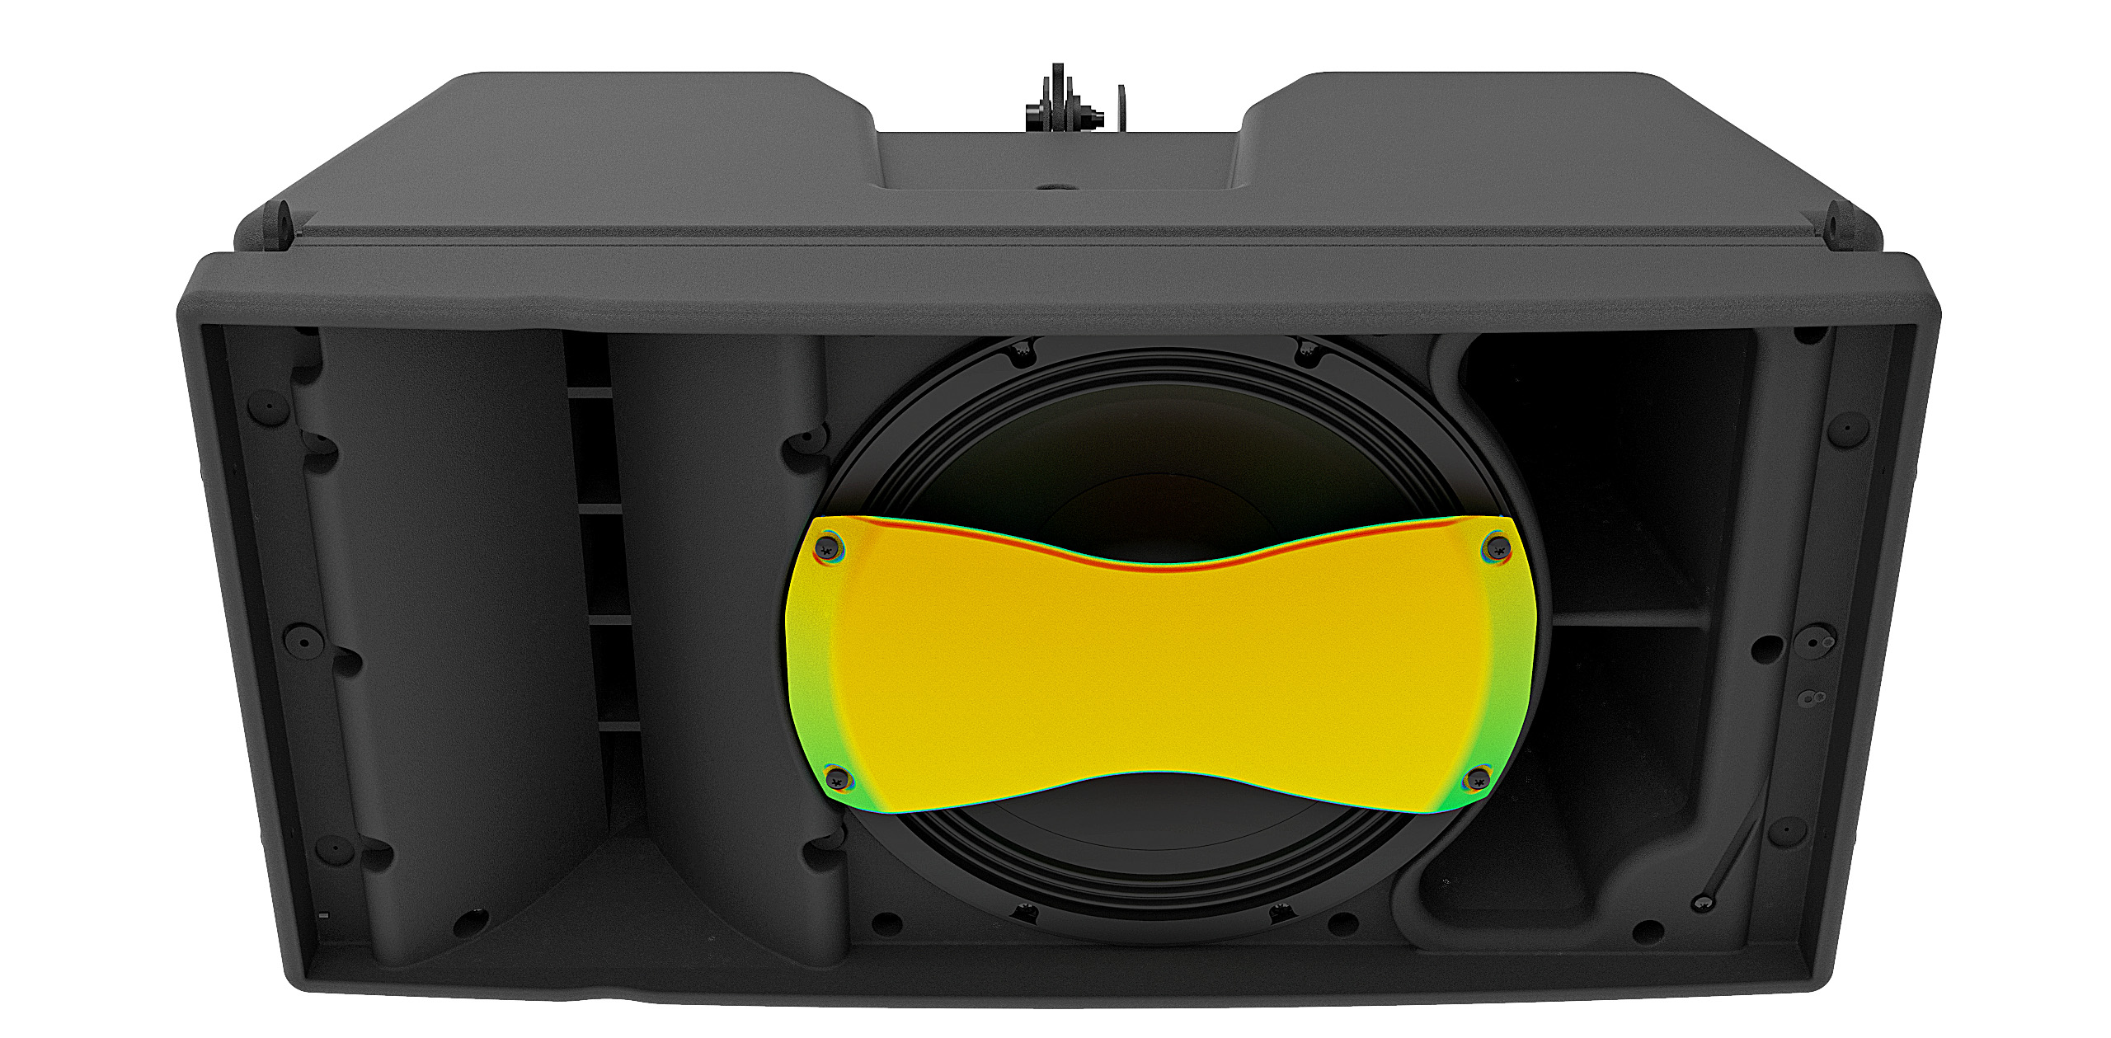
NEXO patented technology
Reduced mid-band distortion
with the Phase Directivity Device
Another NEXO innovation, the Phase Directivity Device (PDD) splits the radiating surfaces of an LF driver into two, essentially halving the acoustic distance between coupled devices, enabling crossover points with high frequency drivers to be increased by one octave which significantly reduces mid-band distortion.

Slide 9
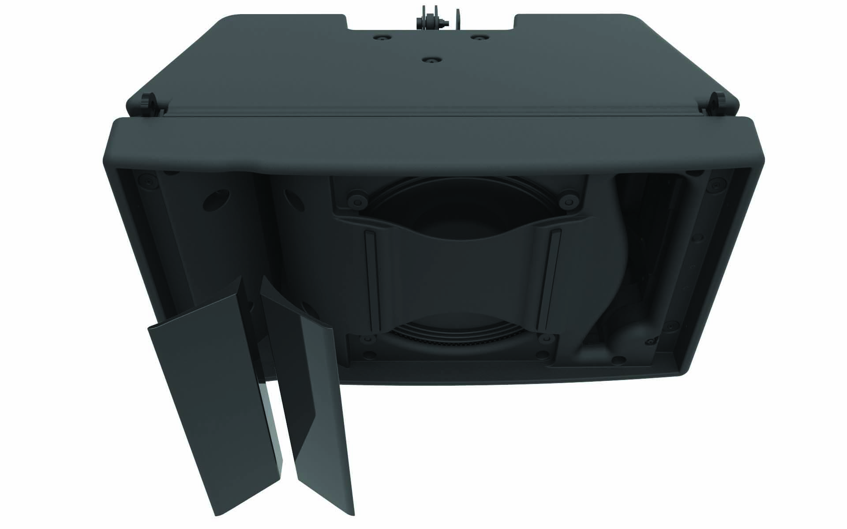
NEXO patented technology
Variable directivity options
with the Configurable Directivity Device
Simple but extremely effective, the Configurable Directivity Device (CDD) superimposes flanges to a horn or waveguide to modify its dispersion, providing installers with a choice of 80° or 120° horizontal coverage.

Slide 10
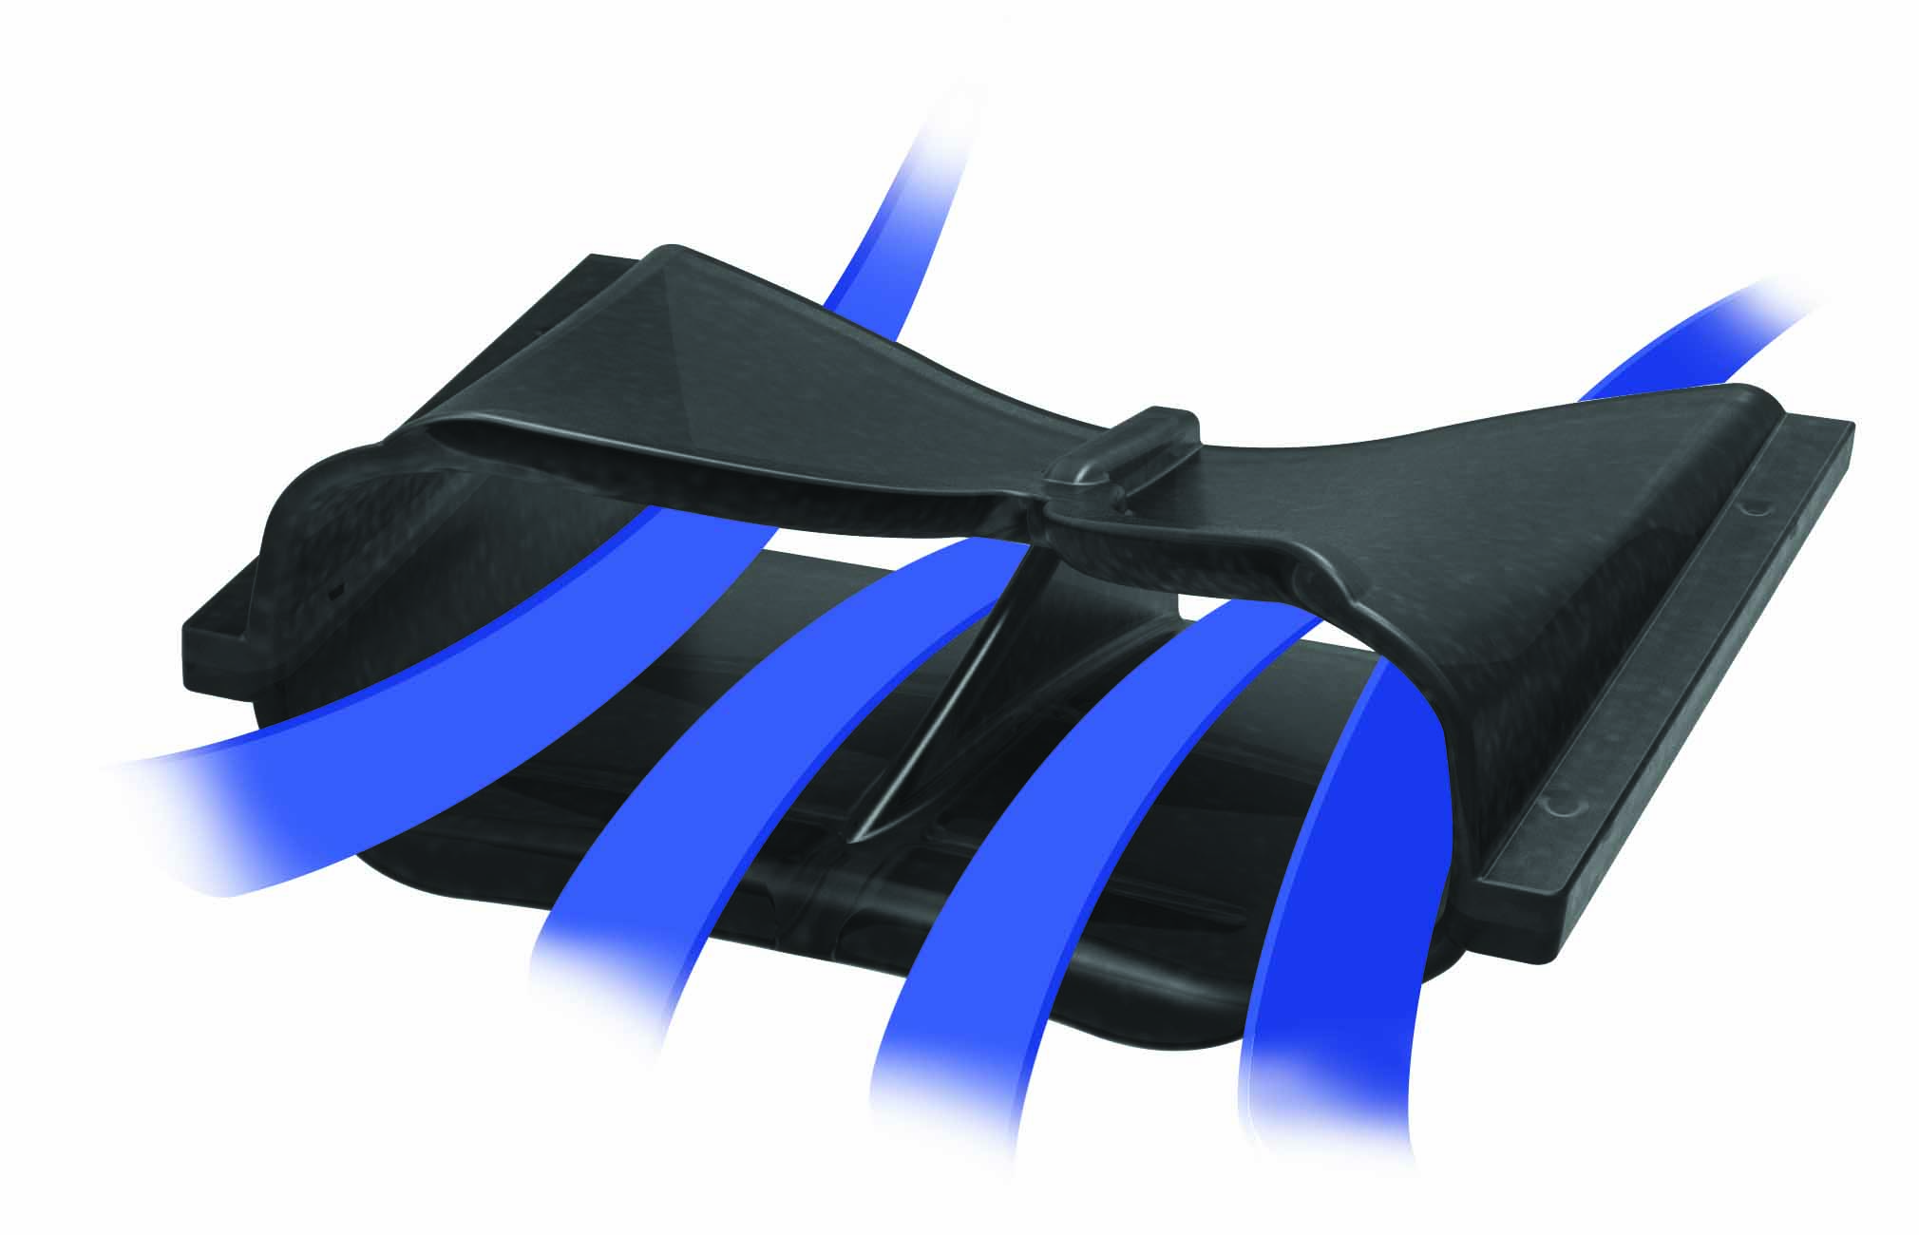
NEXO patented technology
Patented Port Profile
NEXO’s patented cabinet vent profiling absorbs the radiated higher order harmonics that are detrimental to on-axis frequency response and consistent directivity (GEO M10 and M12 only).

Slide 11
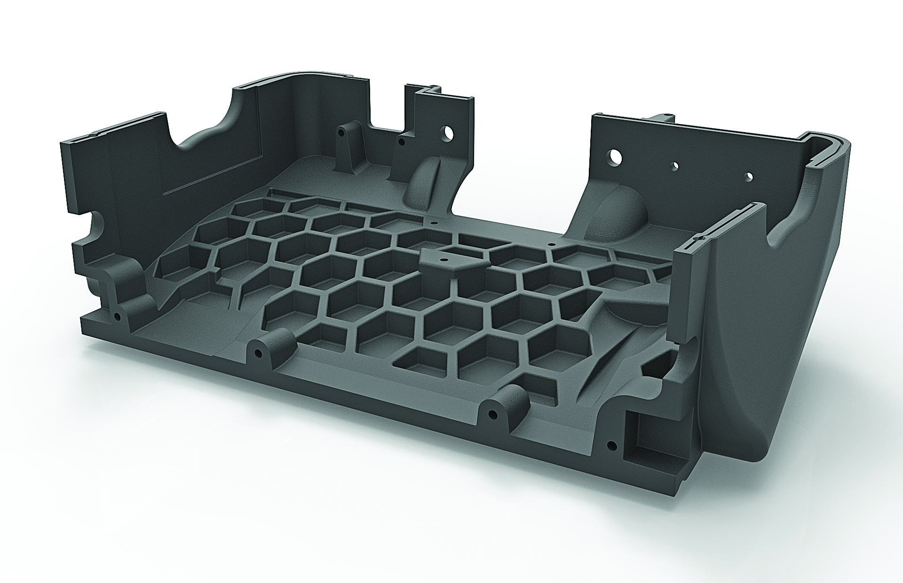
Lightweight Polyurethane
Composite Cabinets
Polyurethane composite cabinets moulded in a honeycomb configuration ensure that GEO M modules are exceptionally rigid and strong, while also being light in weight.

Slide 12
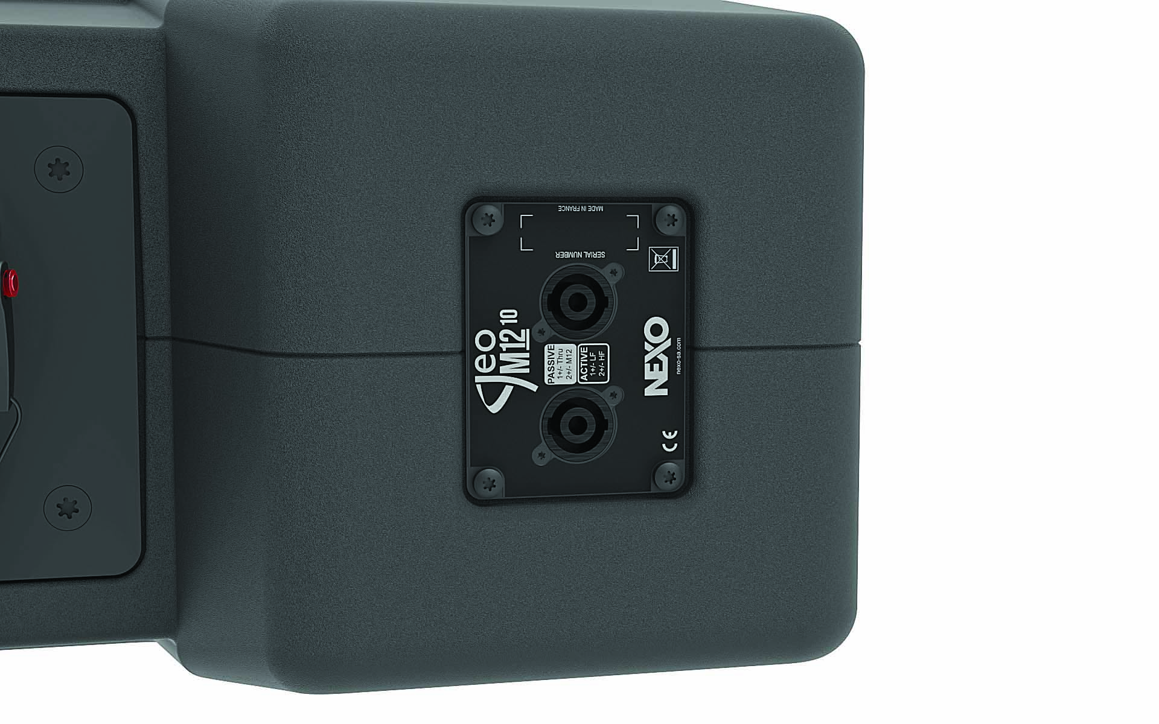
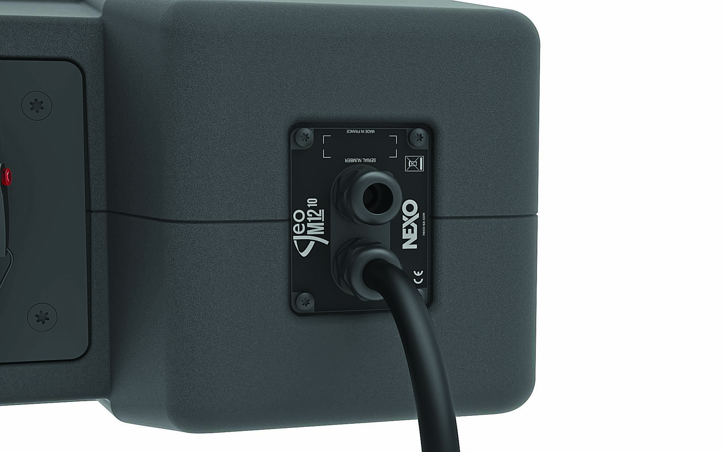
Touring and Installation Versions
Touring version
Installation version
GEO M10 and M12 modules are available in touring and installation versions.
The Touring versions use a magnetically fixed front steel grill with a back mesh and the connection plate features NL4 connectors.
The Installation versions keeps the same acoustic design but come with a fixed front steel grid covered by an acoustic cloth. IP54 rated connectivity is made through cable gland and captive four core cables.

Slide 13
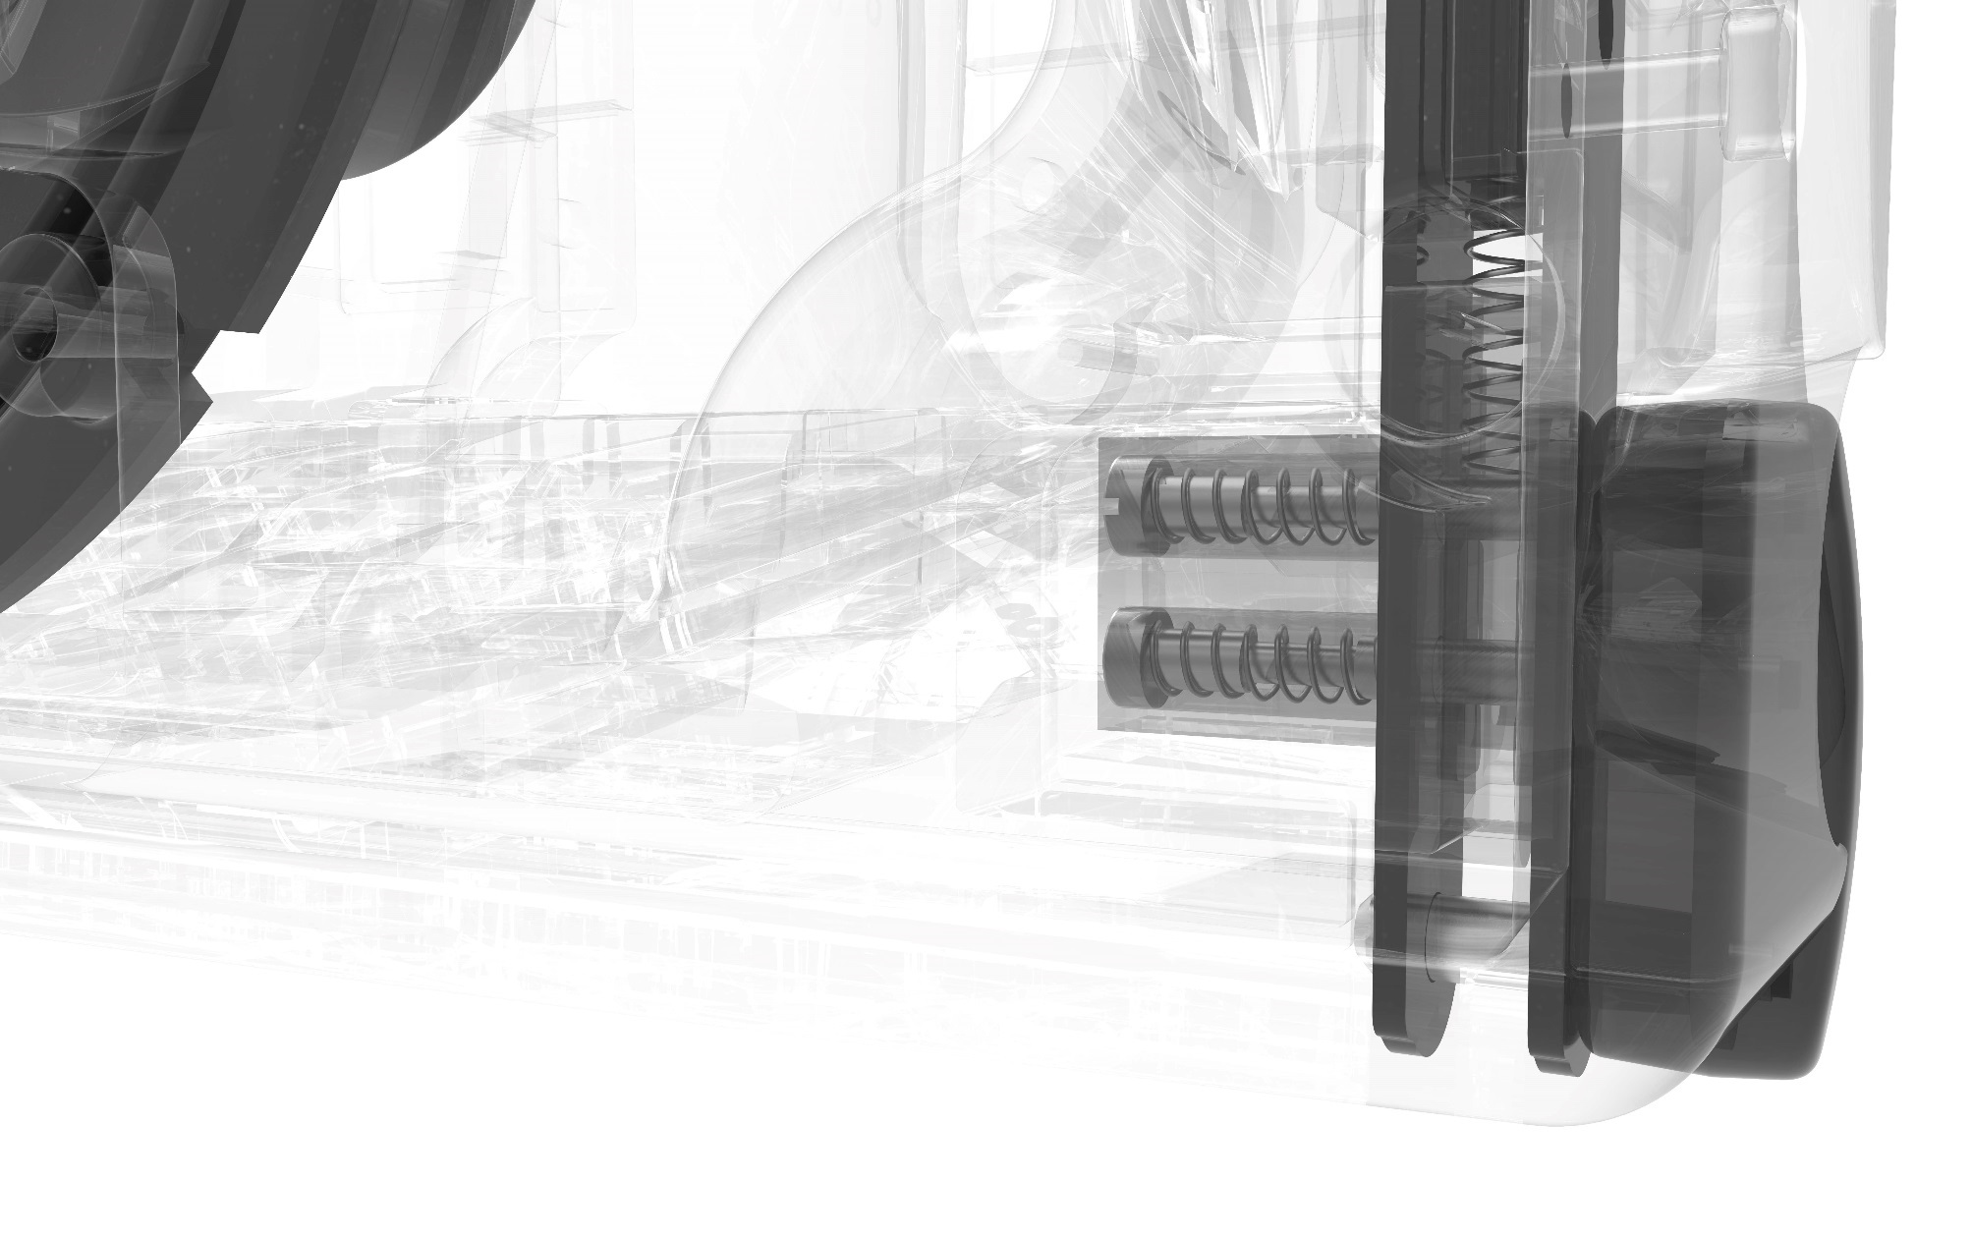
AutoRigTM
Fly or stack.
Just click to deploy.
GEO M10 and M12 cabinets feature the TÜV-compliant, AutoRig™ integral rigging system.
The rigging can held in the ‘open’ position, locking closed when the next box is located, making it easy for one pair of hands to configure systems straight out of the flightcases.

Slide 14
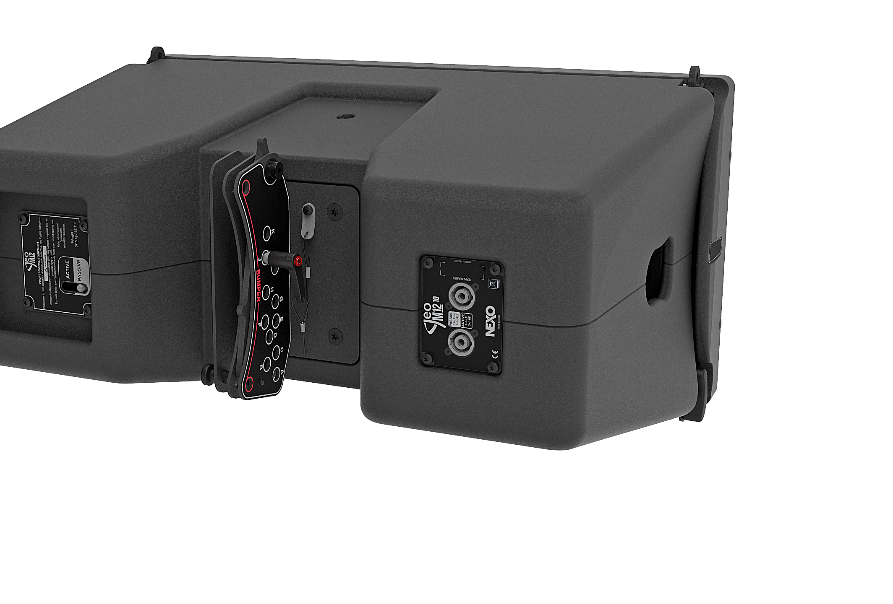
AutoRigTM
Fly or stack.
Just click to deploy.
In addition, rigging angles can be set quickly and easily from the rear of the cabinet using a single, integrated ball lock and cable tie, and a guide to hole alignment..

Slide 15
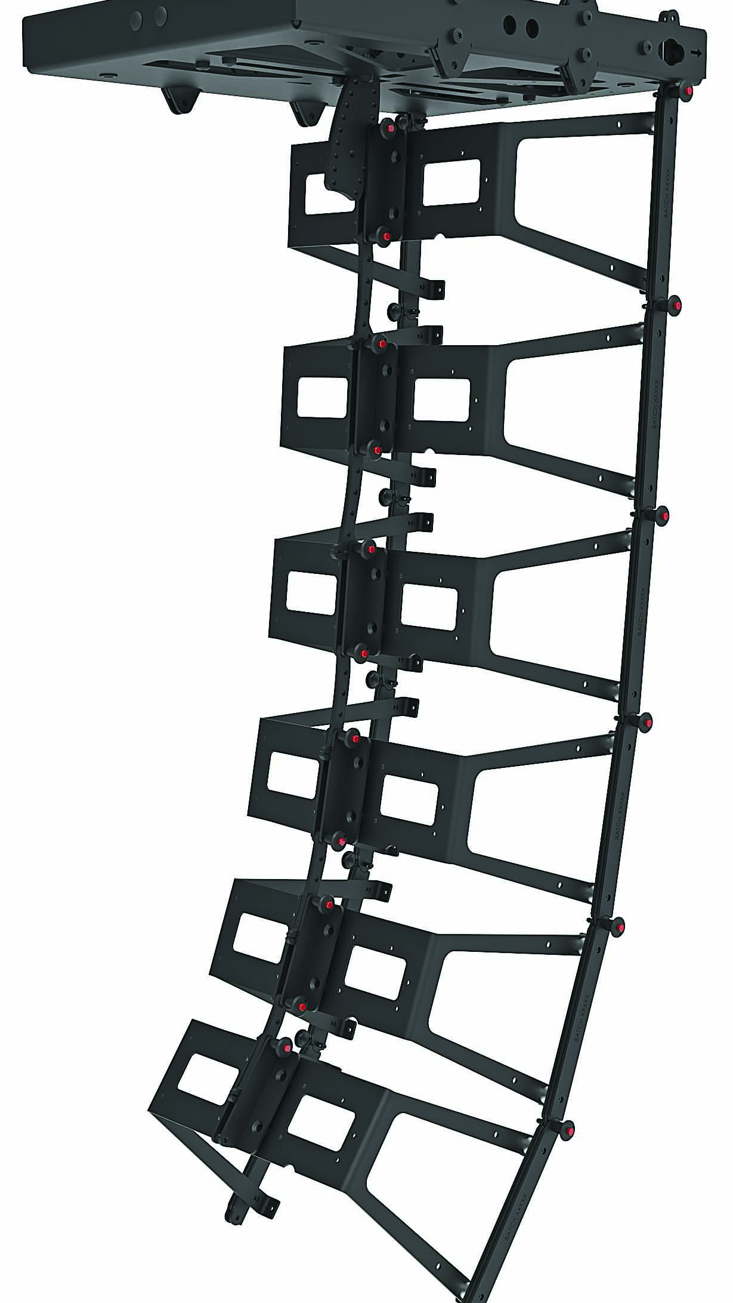
NEXO Skeleton
The most ingenious rigging
system you’ve never seen.
As impressive as th mechanical performance is similarly impressive. All structural forces acting on a GEO M Series cluster are born by the groundbreaking NEXOSkeleton™ integral rigging system, rather than the cabinets.
Fully TÜV certified, any configuration of cabinets can be safety-checked, using NEXO NS-1 system configuration software.

Slide 16
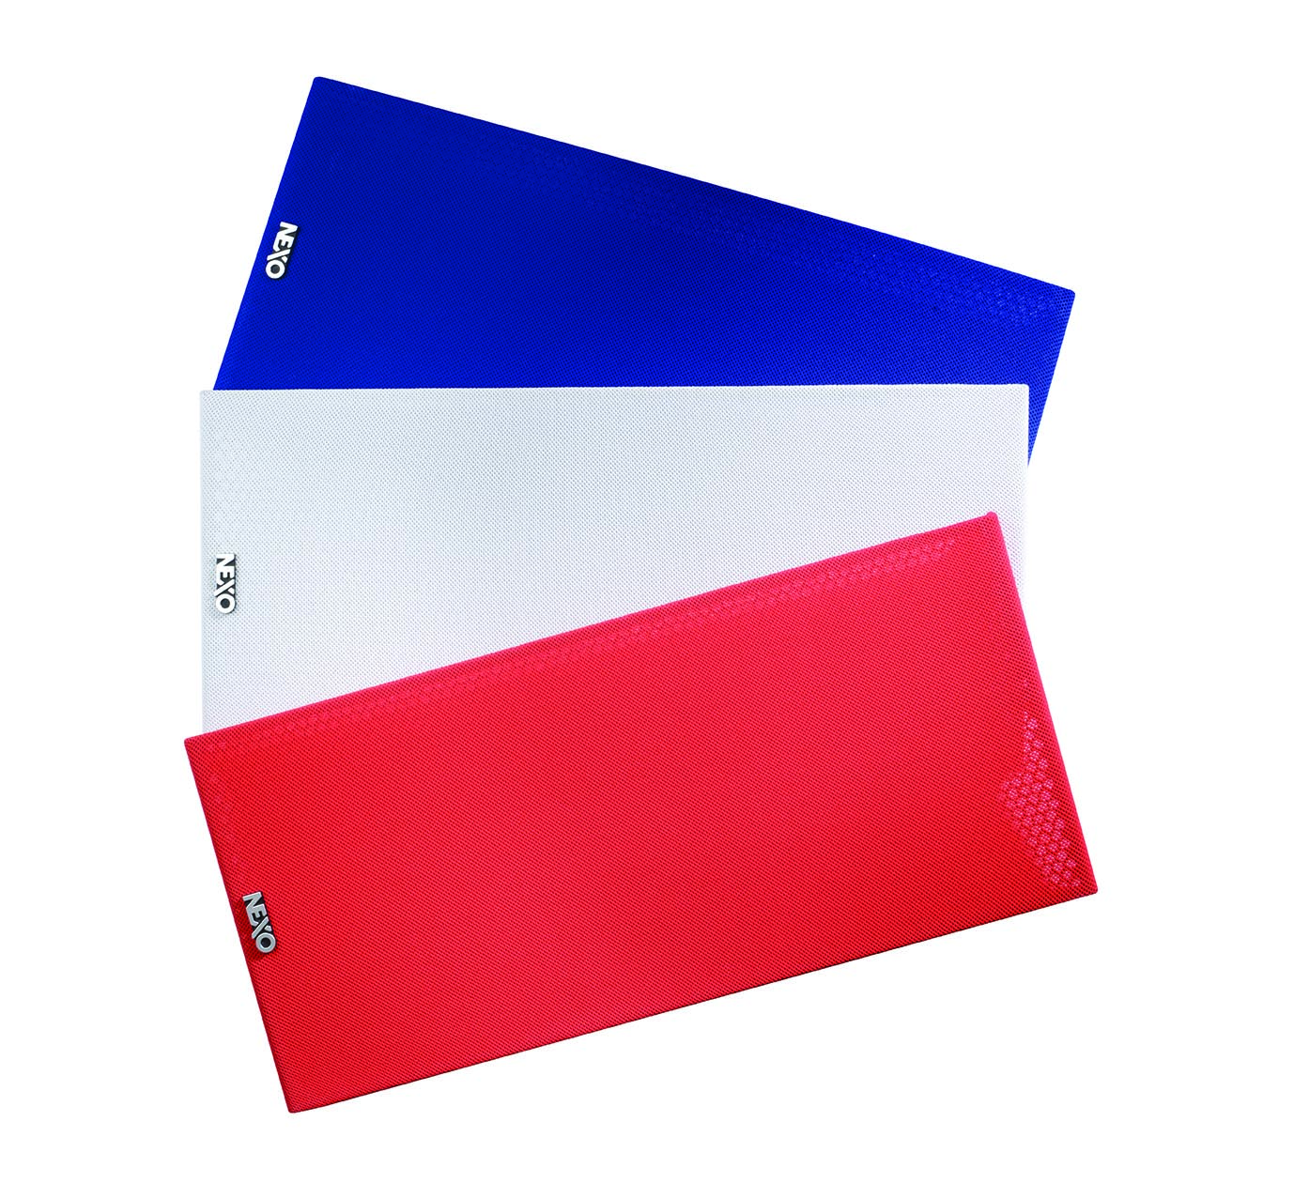
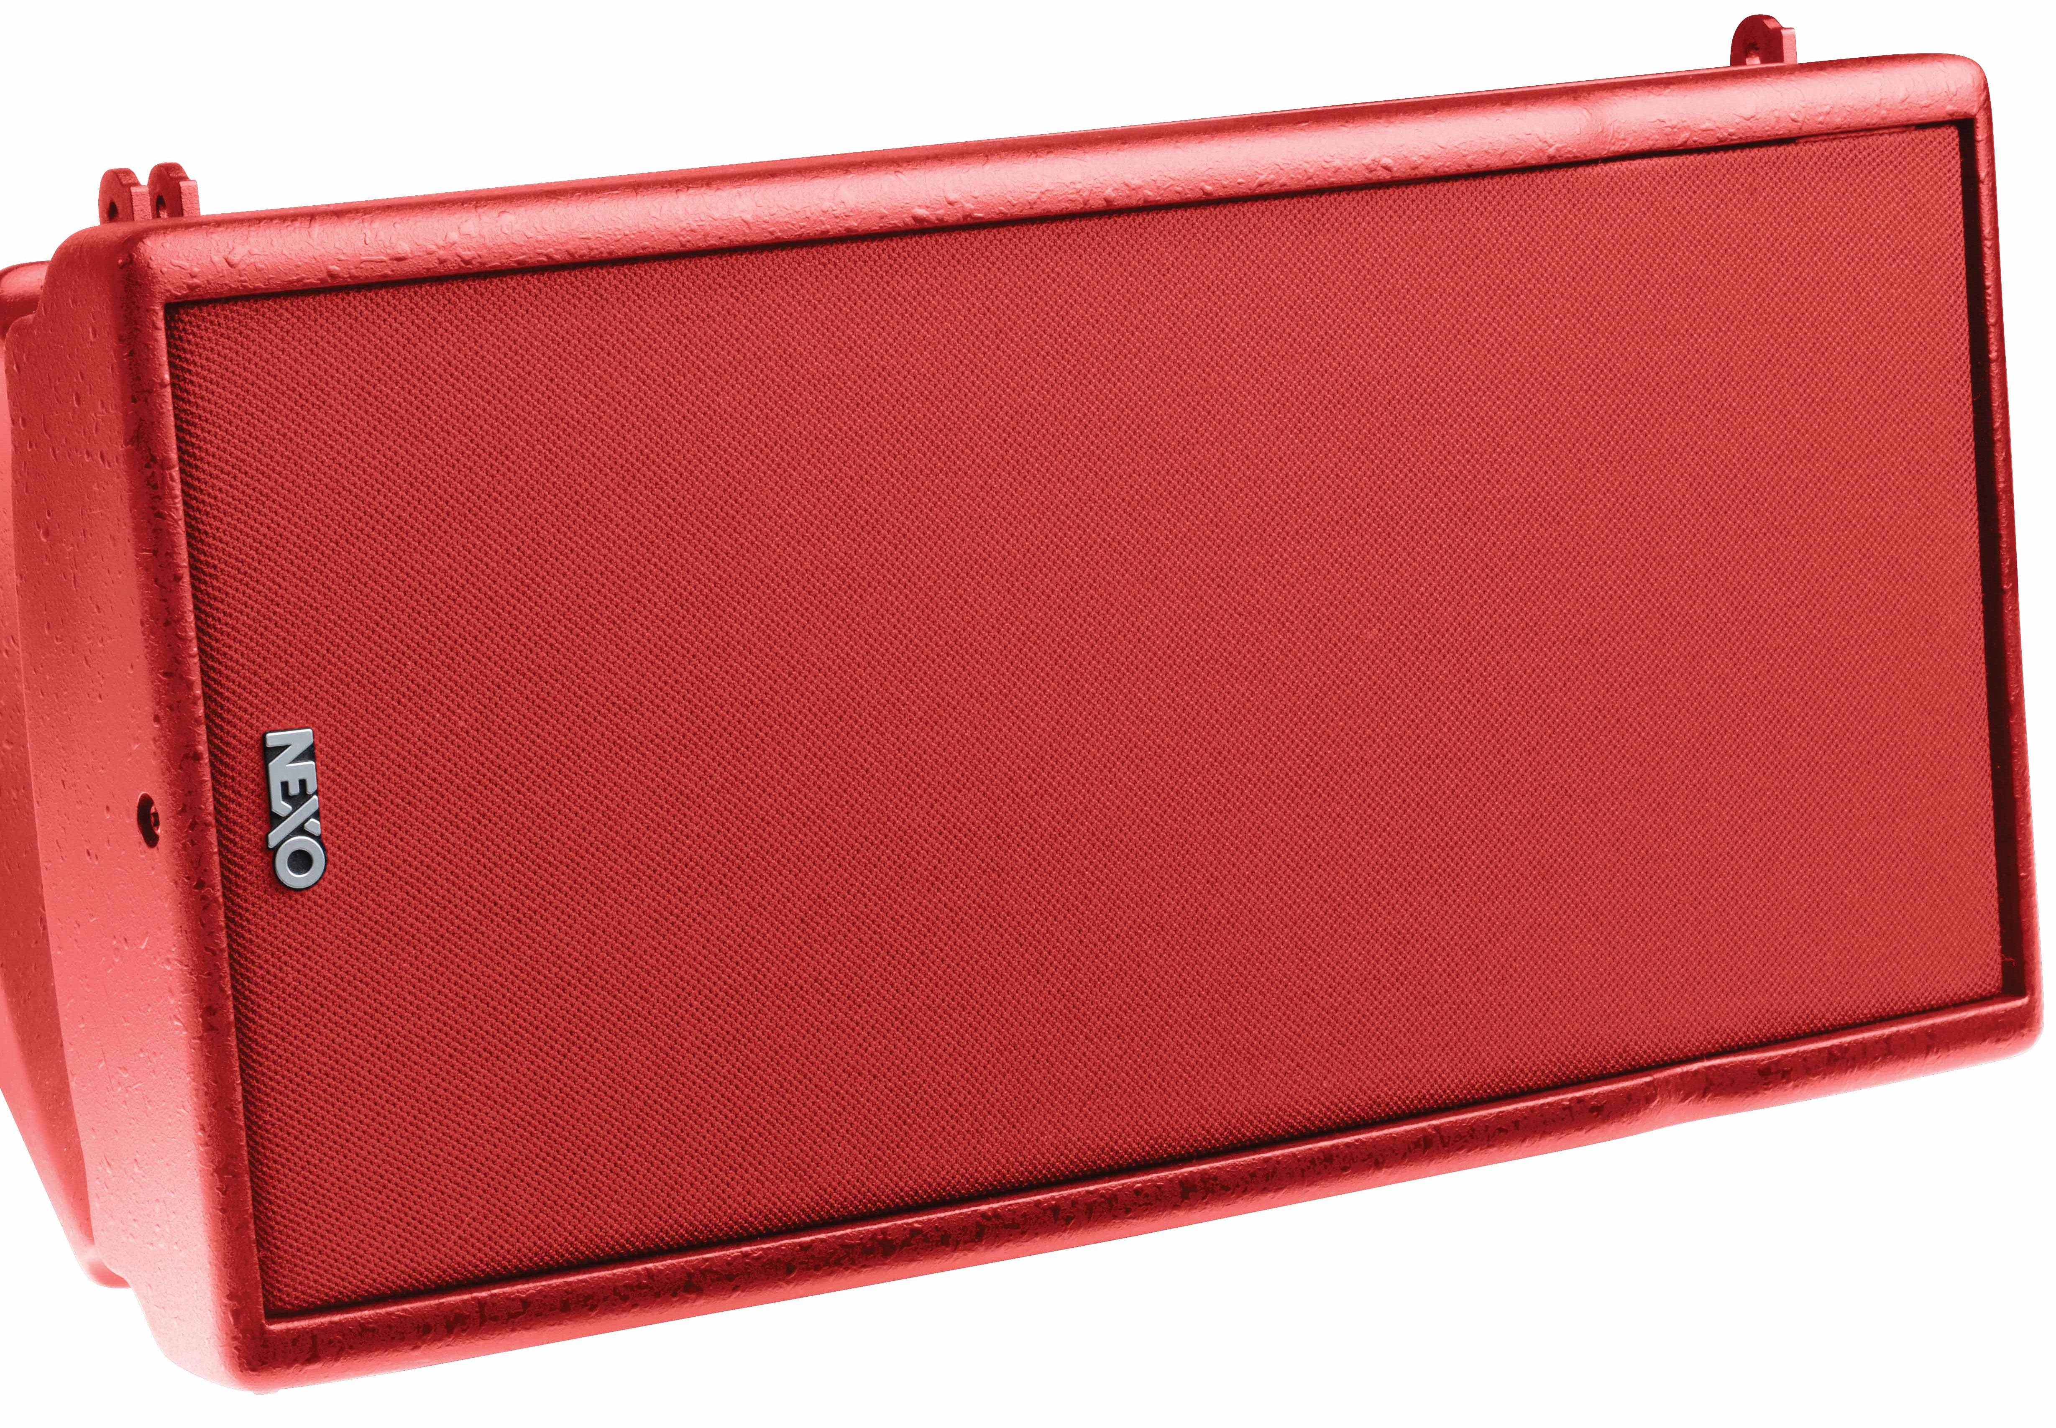
Custom Solutions
Installation versions are available in any RAL colour ensuring a low visual impact in any venue.

Slide 17

Sub Bass Modules

Slide 18
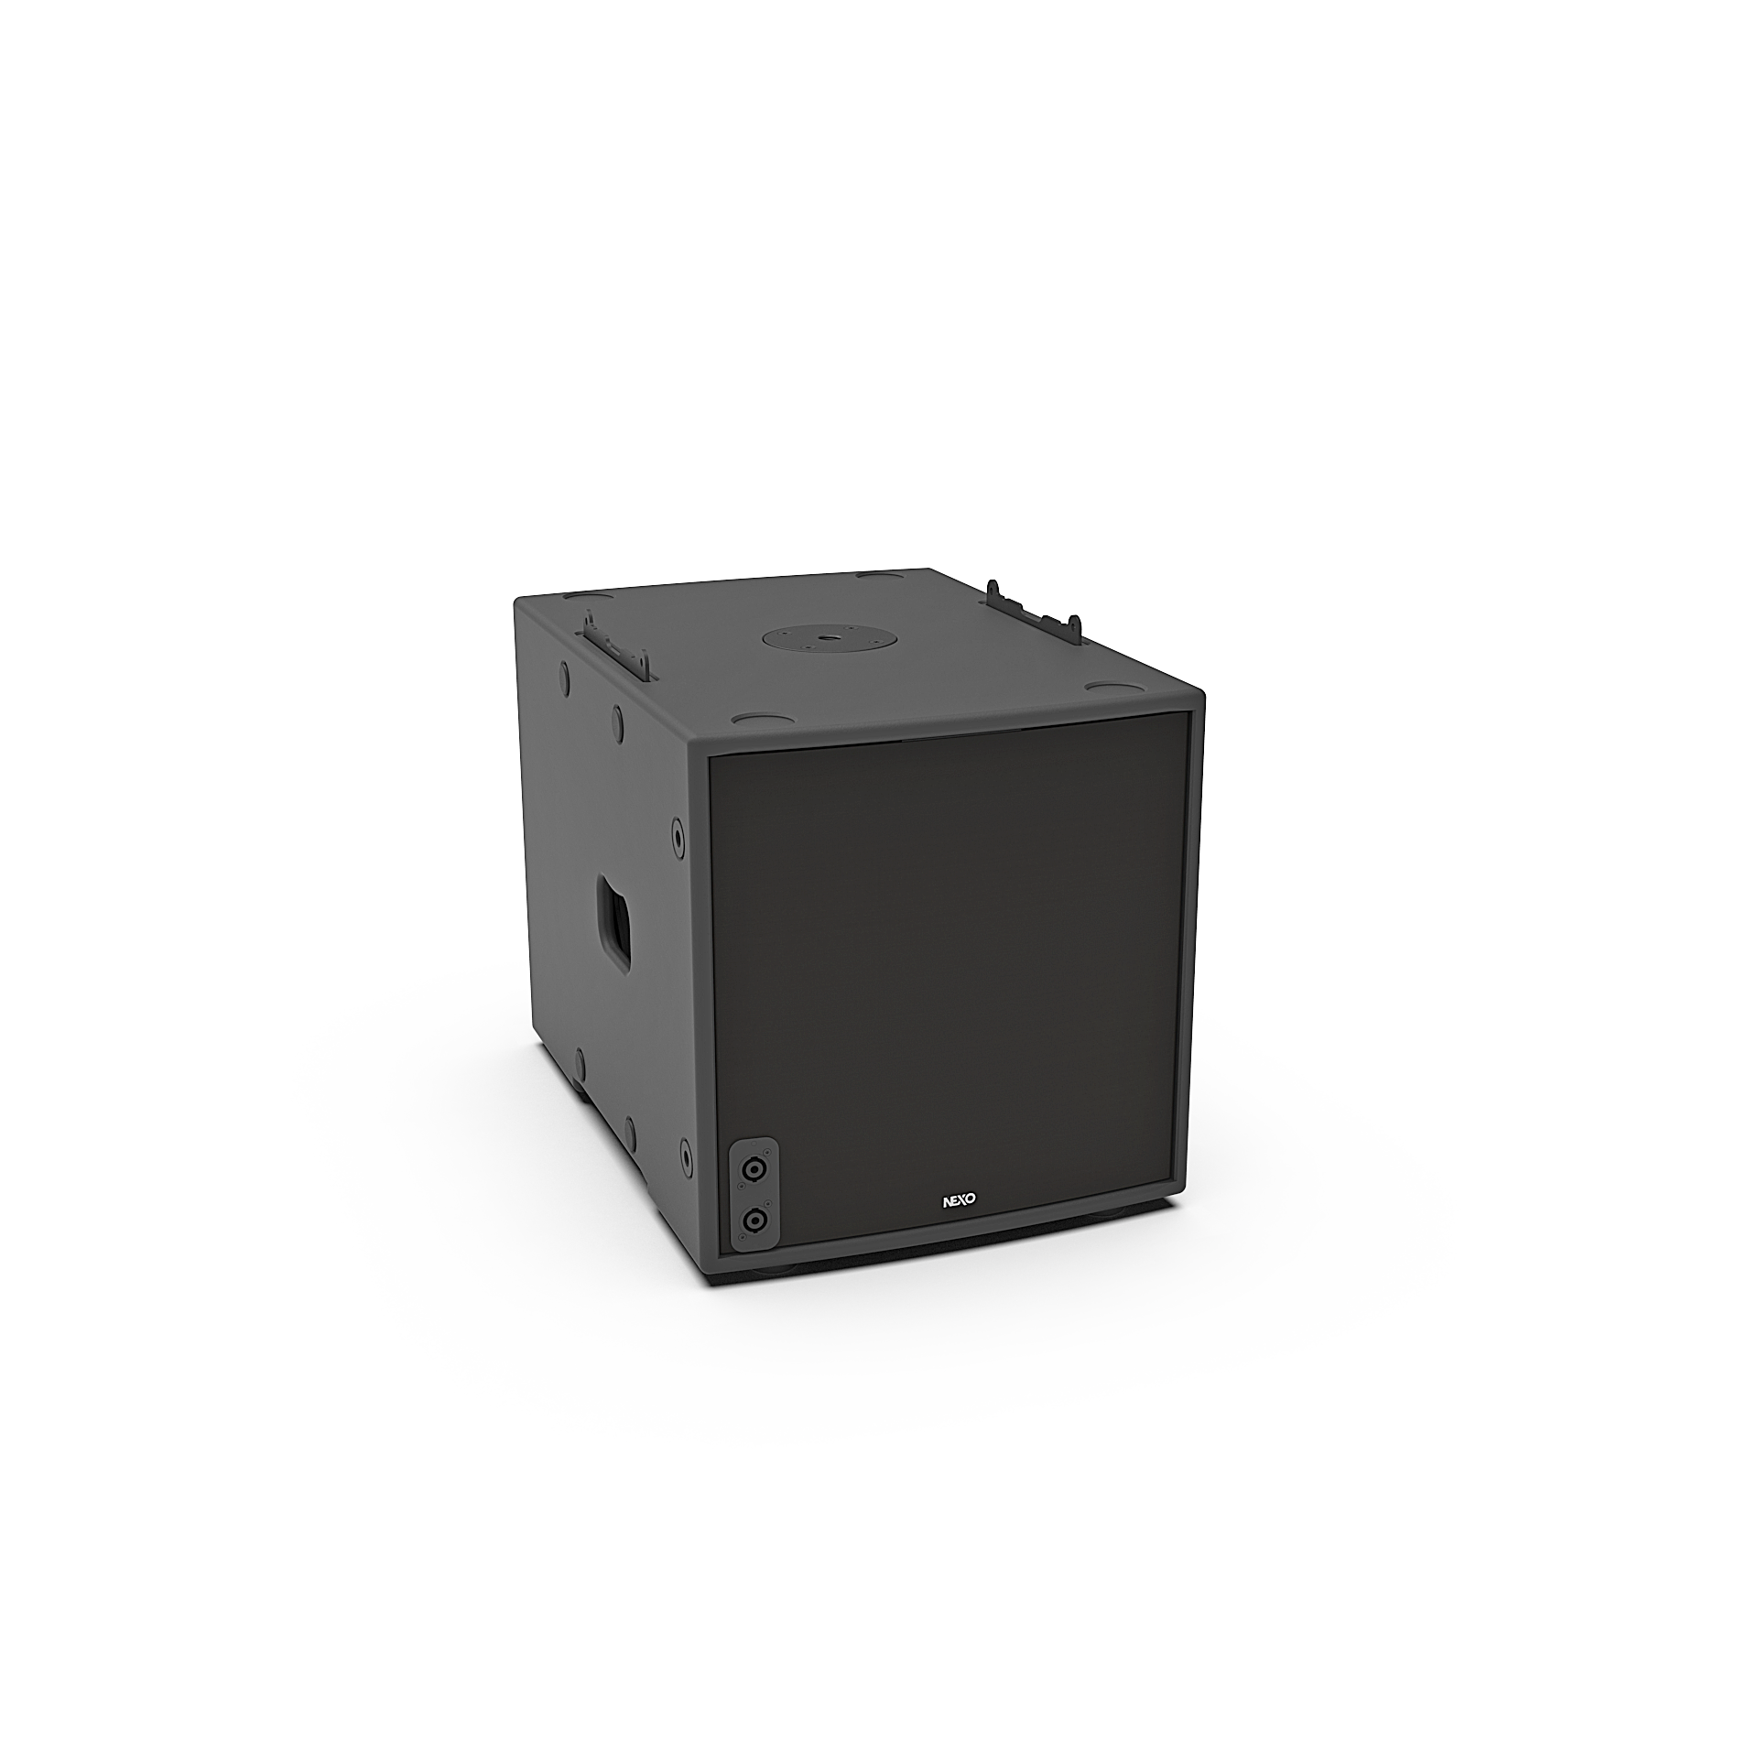


Using a high efficiency bass-reflex design, the NEXO MSUB12 features a long excursion 12 inch Neodymium driver precisely tuned to match the frequency response of the GEO M6.
130dB SPL
12-inch Driver
55 HZ

Slide 19
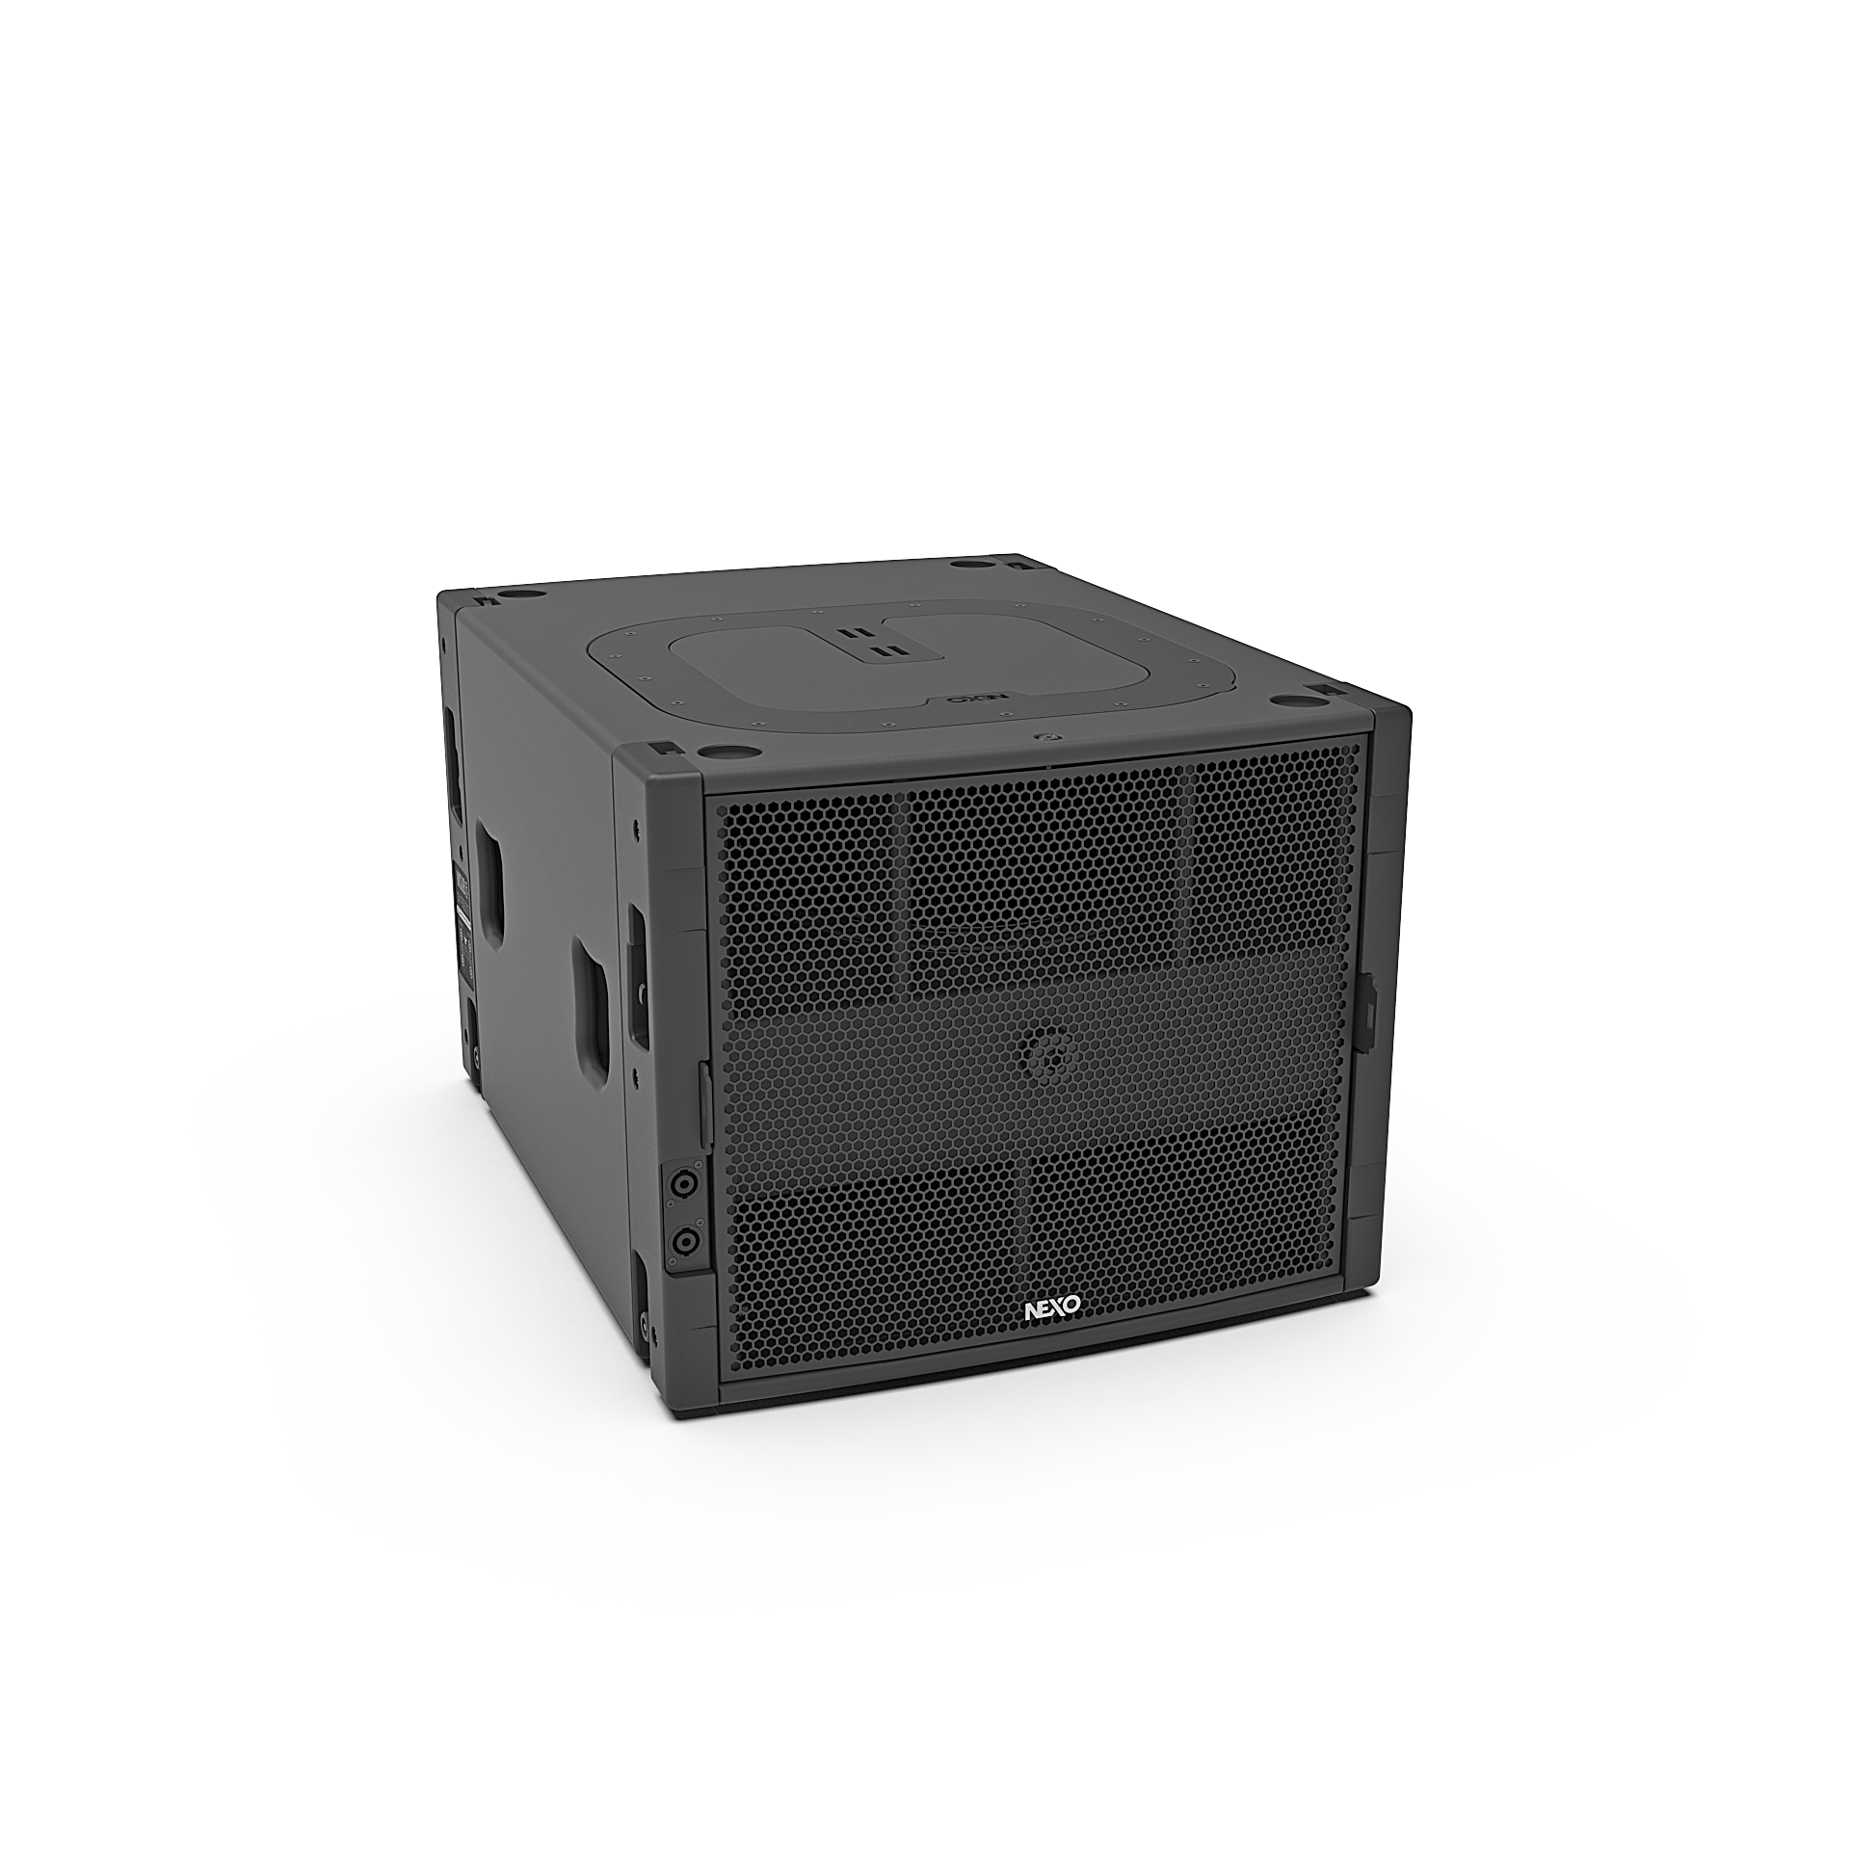

Building on a tradition of very high efficiency band pass sub design, the NEXO MSUB15 features a new long excursion lightweight 15 inch Neodymium driver coupled with a new quadratic-shaped low frequency port expansion, limiting the port compression to a very low level.
MSUB12 | MSUB15
130dB SPL | 136dB SPL
12-inch Driver | 15-inch Driver
55 HZ | 40 HZ

Slide 20

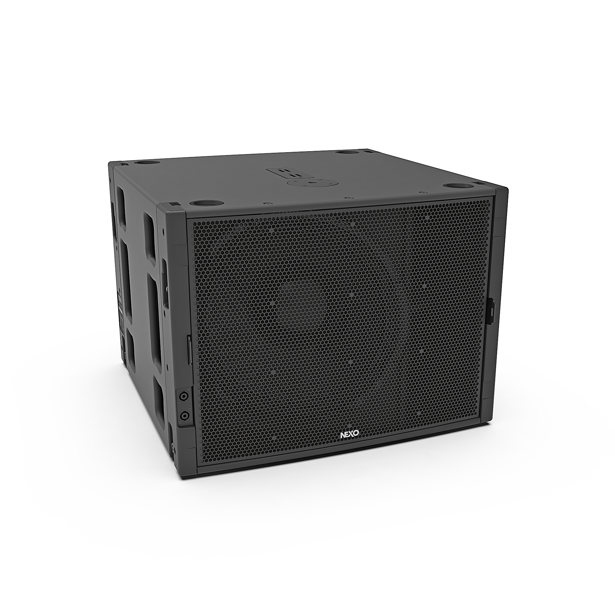
Using a new very high efficiency hybrid band pass sub design, the NEXO MSUB18 features a new long excursion 18 inch Neodymium driver coupled with a new quadratic-shaped low frequency port expansion, limiting the port compression to a very low level.
MSUB12 | MSUB15 | MSUB18
130dB SPL | 136dB SPL | 139dB SPL
12-inch Driver | 15-inch Driver | 18-inch Driver
55 HZ | 40 HZ | 32 HZ

Slide 21
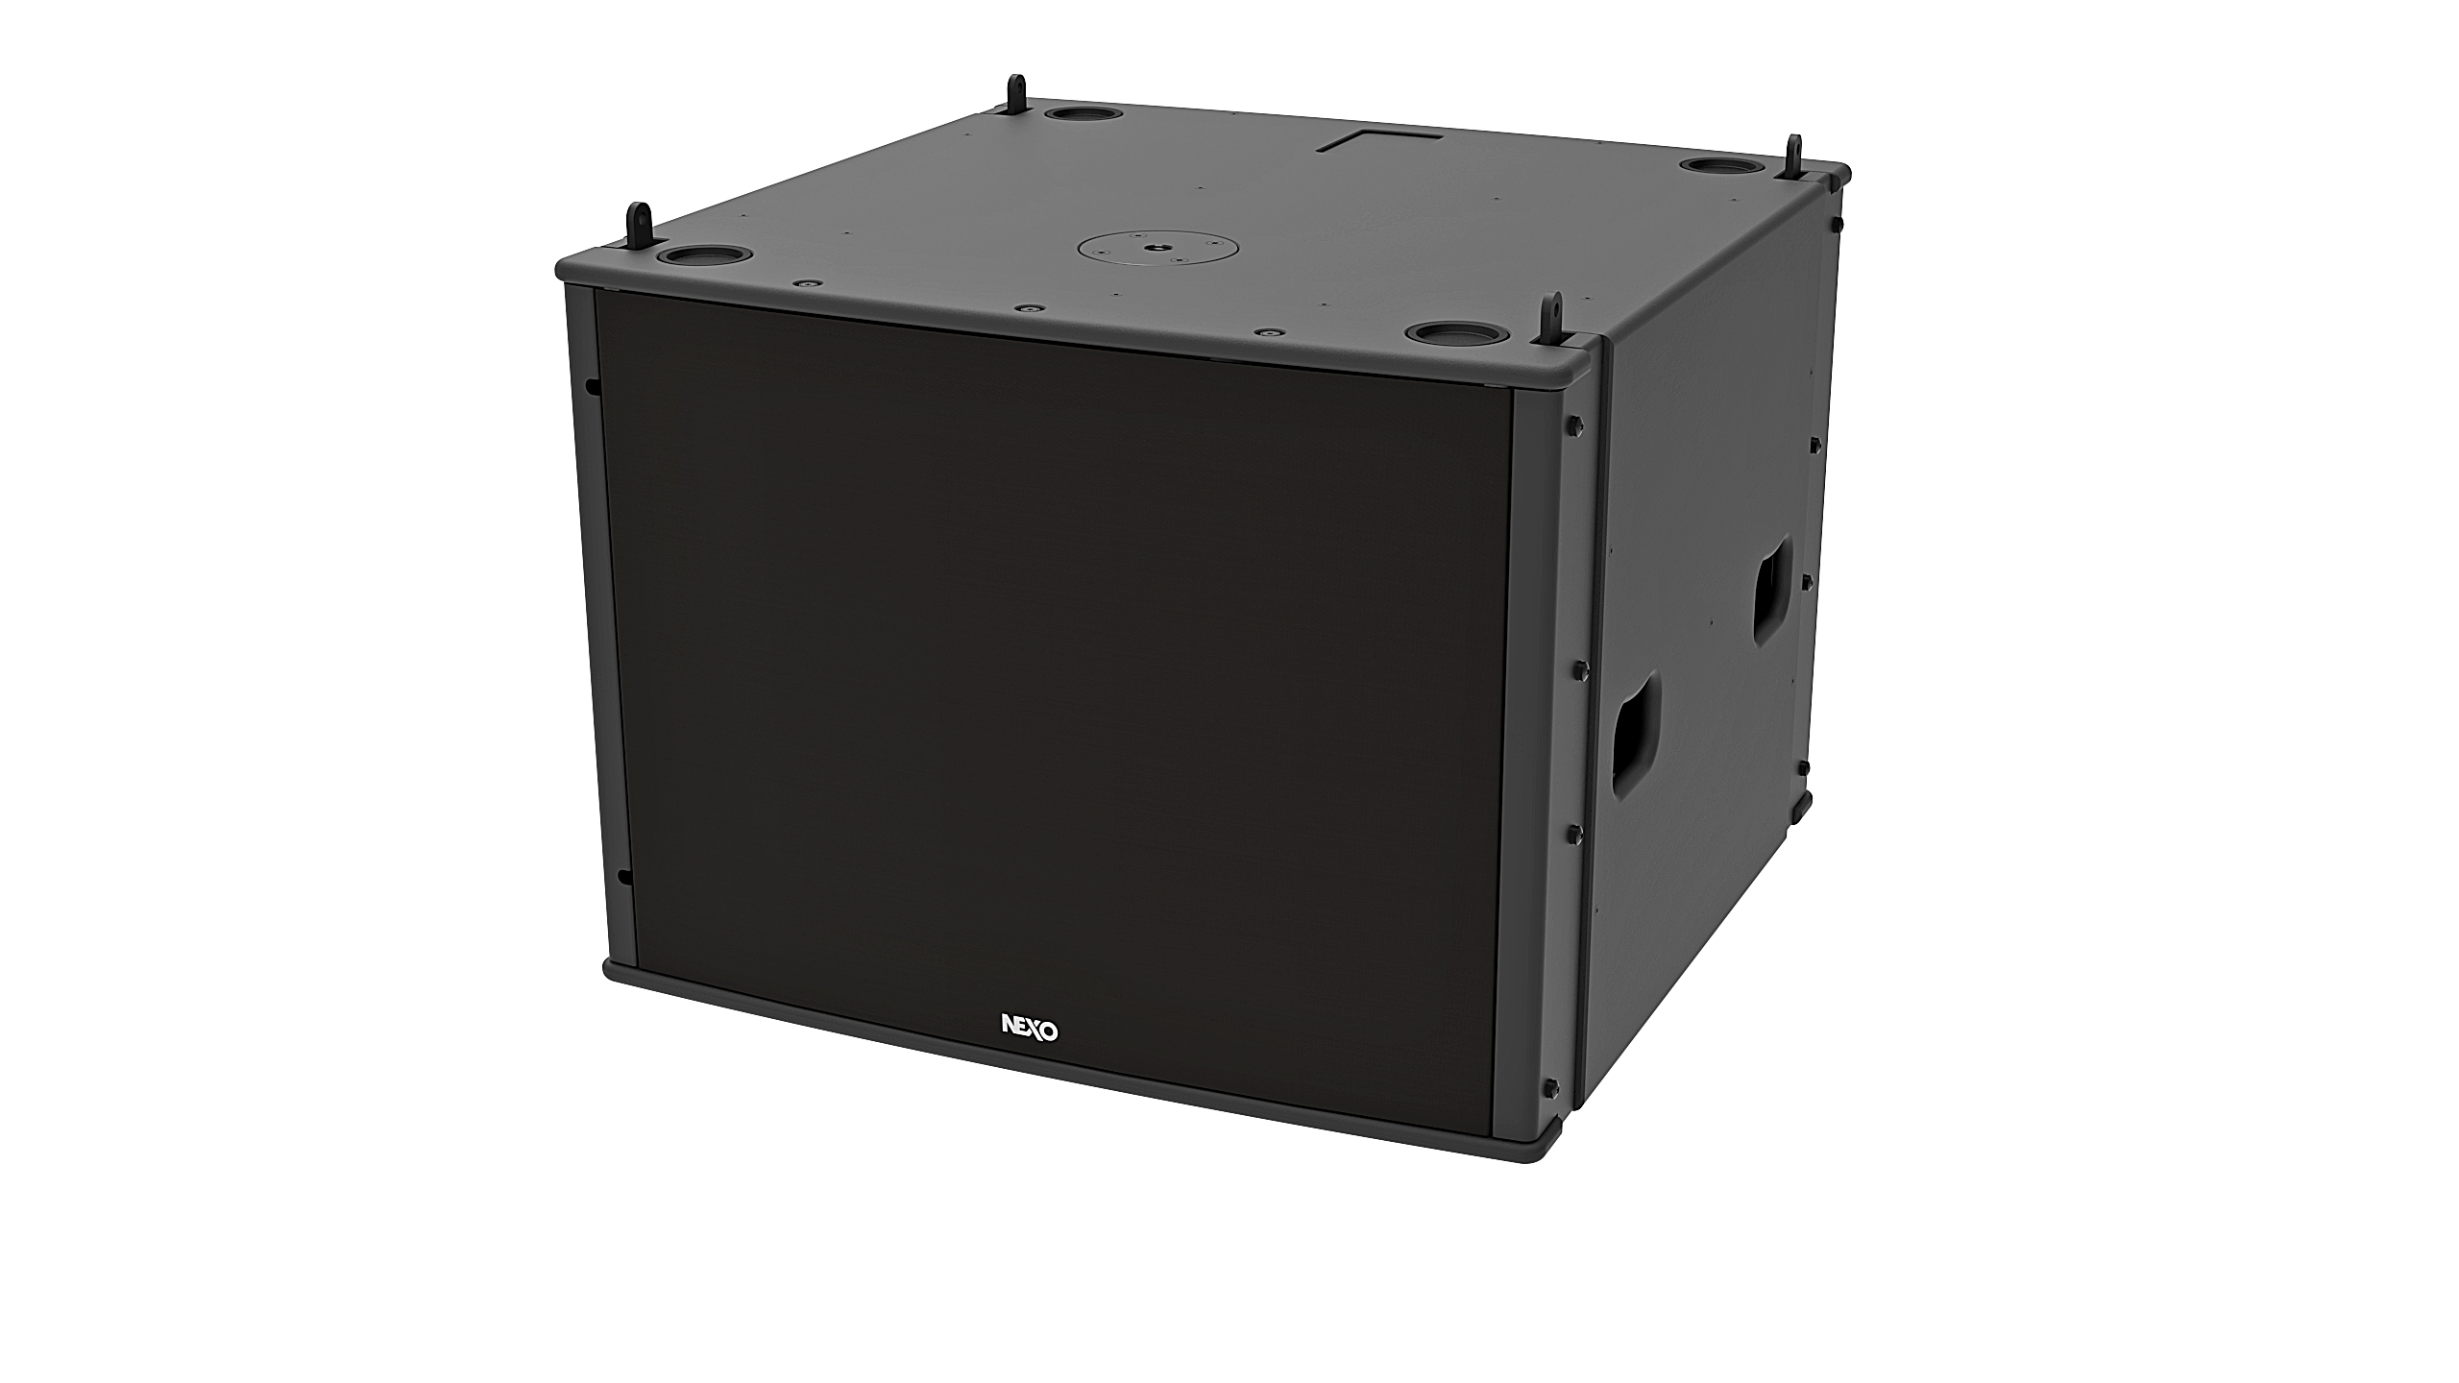
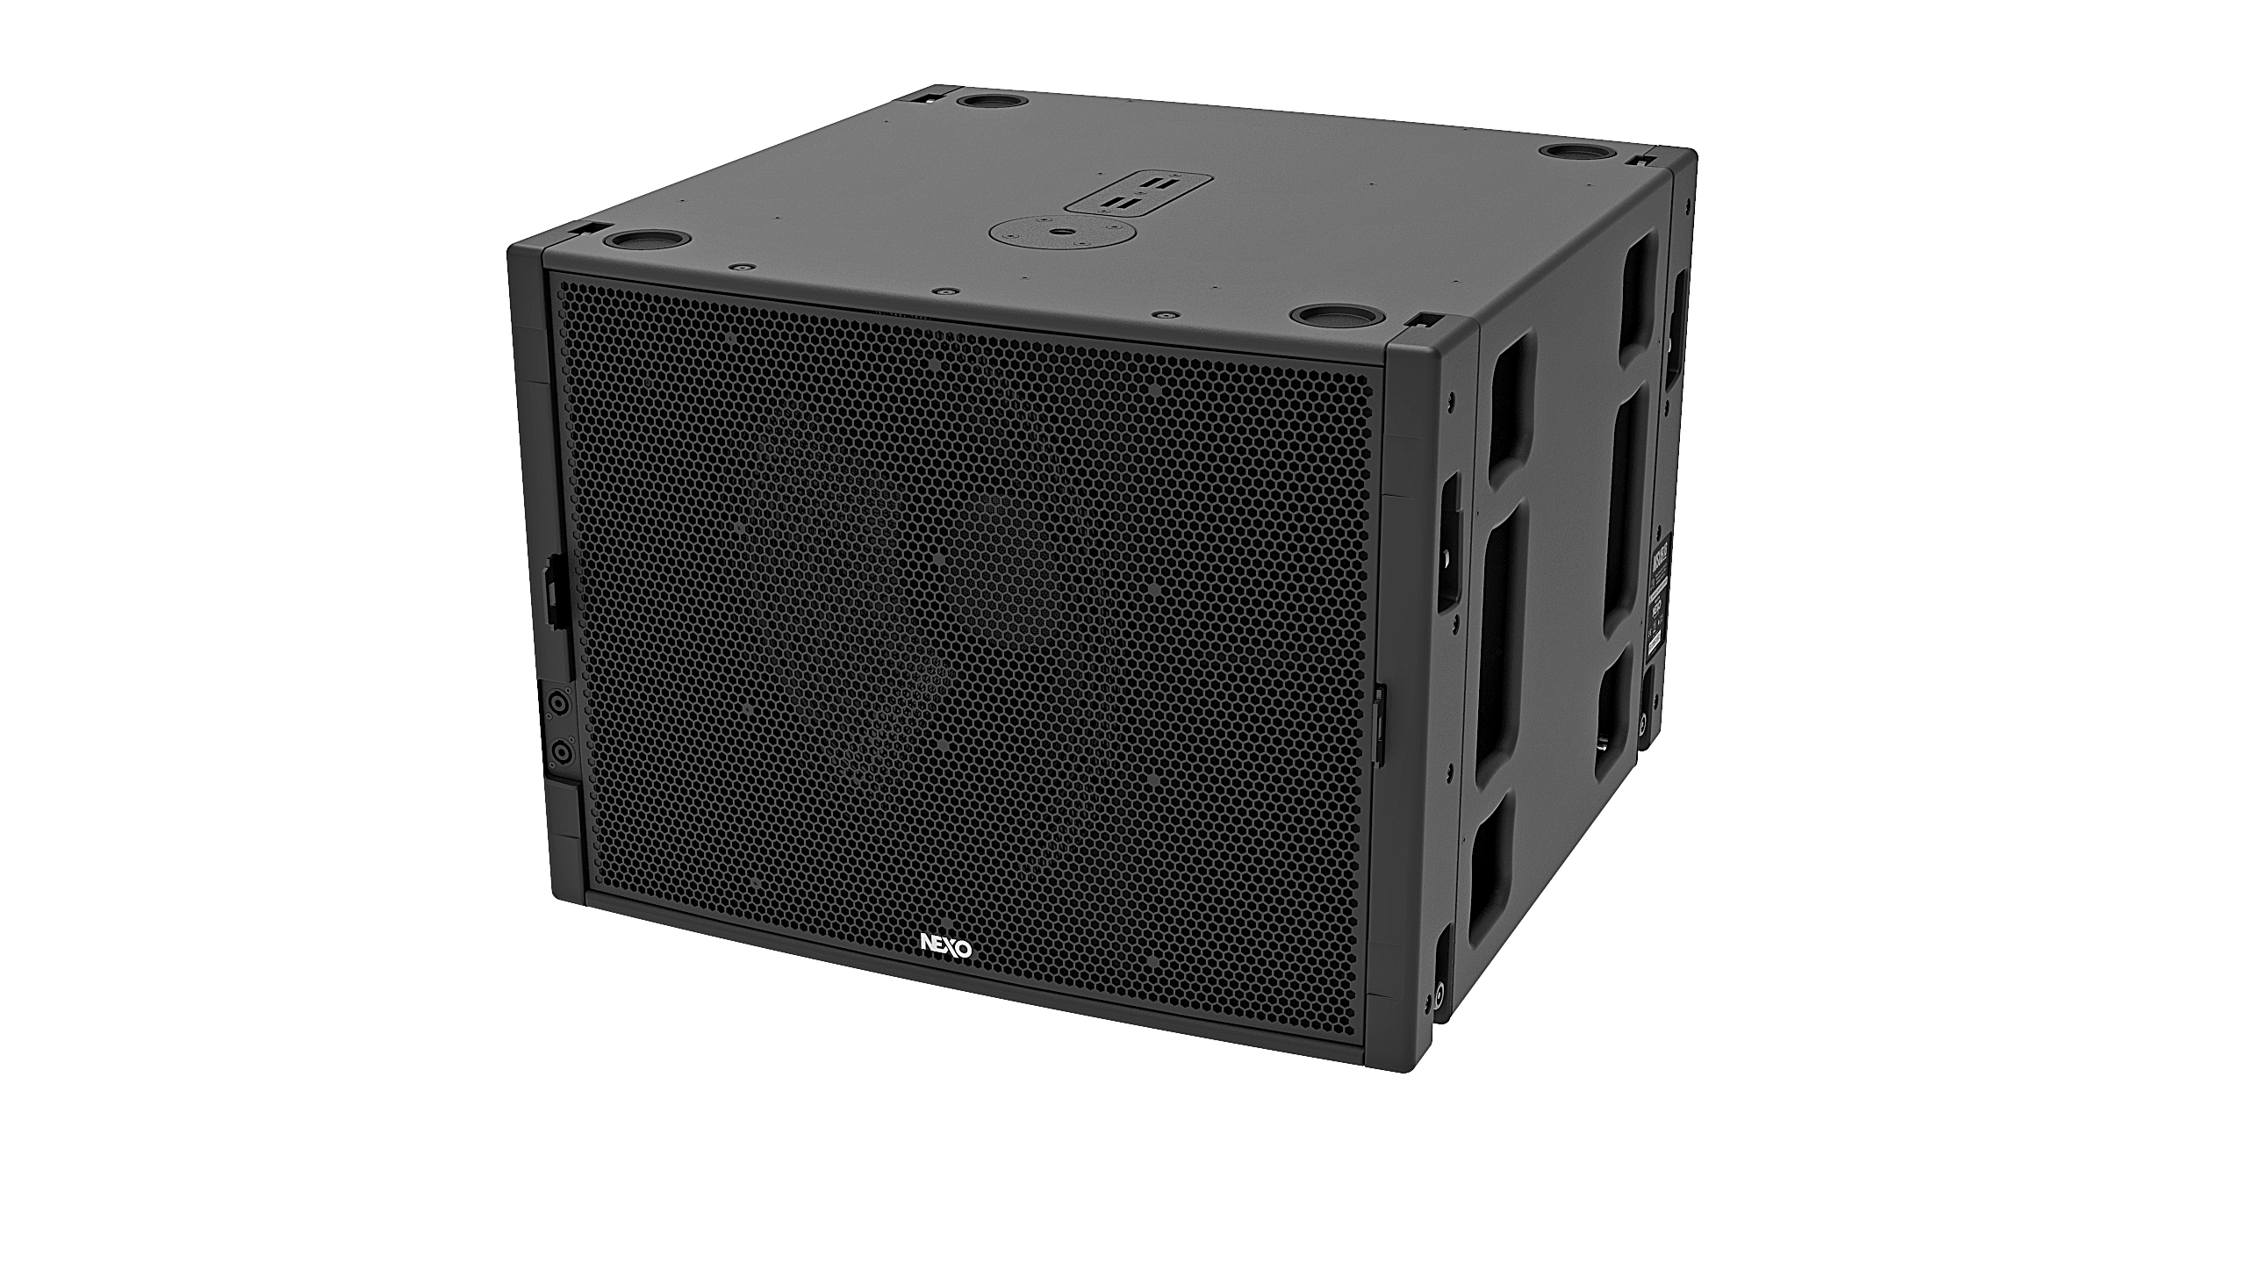
Touring and Installation Versions
MSUB18 Installation version
MSUB18 Touring version
The Installation version keeps the same acoustic design but comes with a front steel grill covered by an acoustic cloth. The rigging system uses safety nuts and connectivity is made through cable gland and captive two core cables, installed back or front.

Slide 22
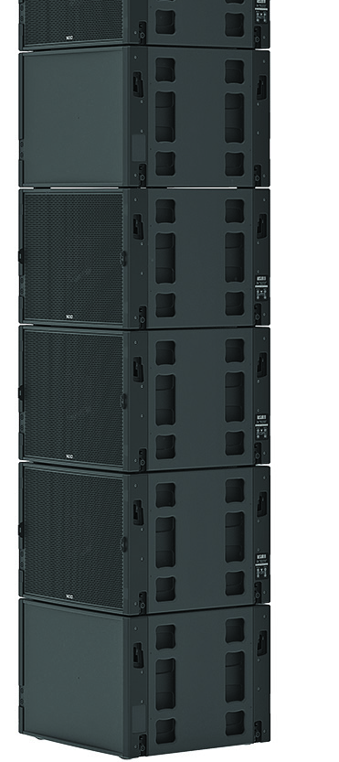
Omni and Cardioid Modes
Easy to deploy in Omni mode, the MSUB sub bass modules also accommodate cardioid implementation either in stacked or flown configurations. The front and back rigging systems are compatible so the subs can be implemented ‘front to back’.
Connectivity is repeated on each side, making it easy to remove cables from audience view. NEXO’s acclaimed simulation software NS-1 takes care of precise simulation of any sub configurations to predict audience coverage and rejection at the back.

Slide 23
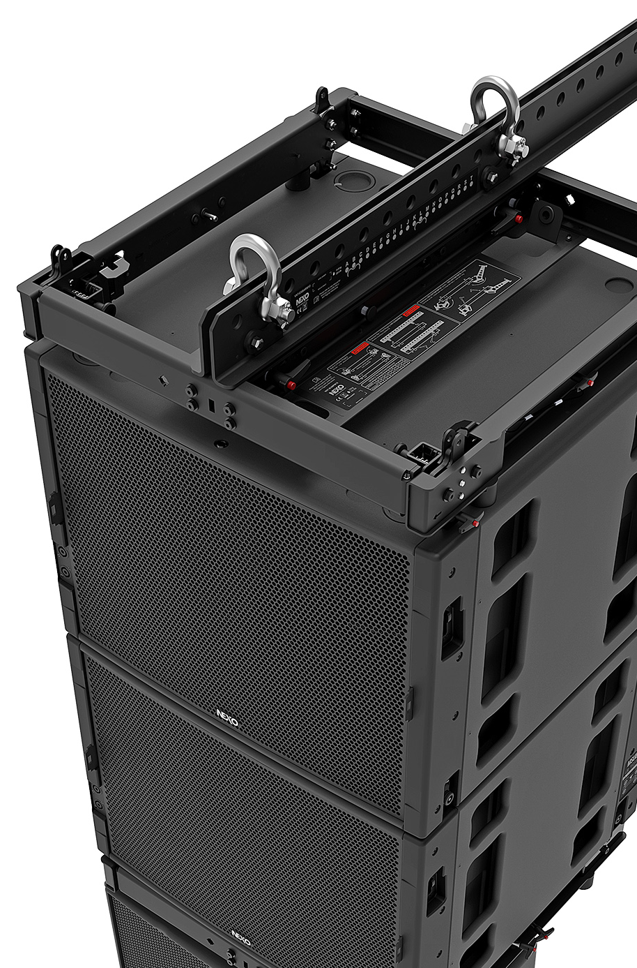
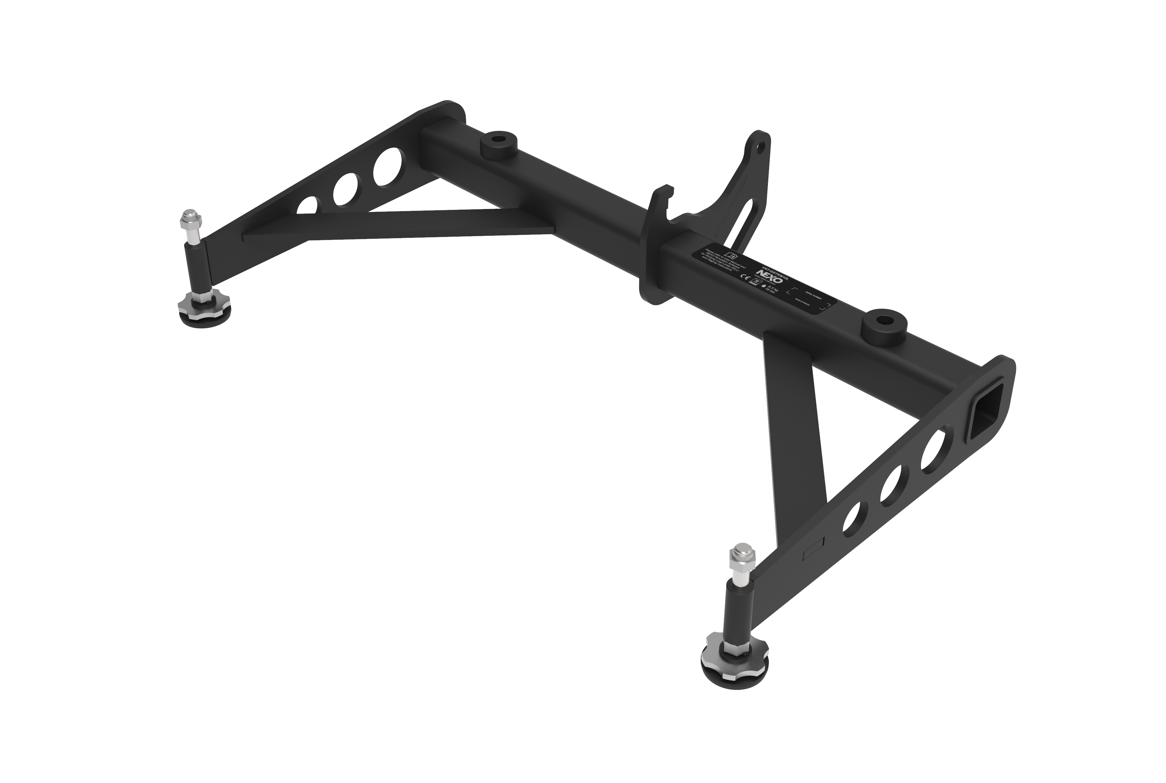
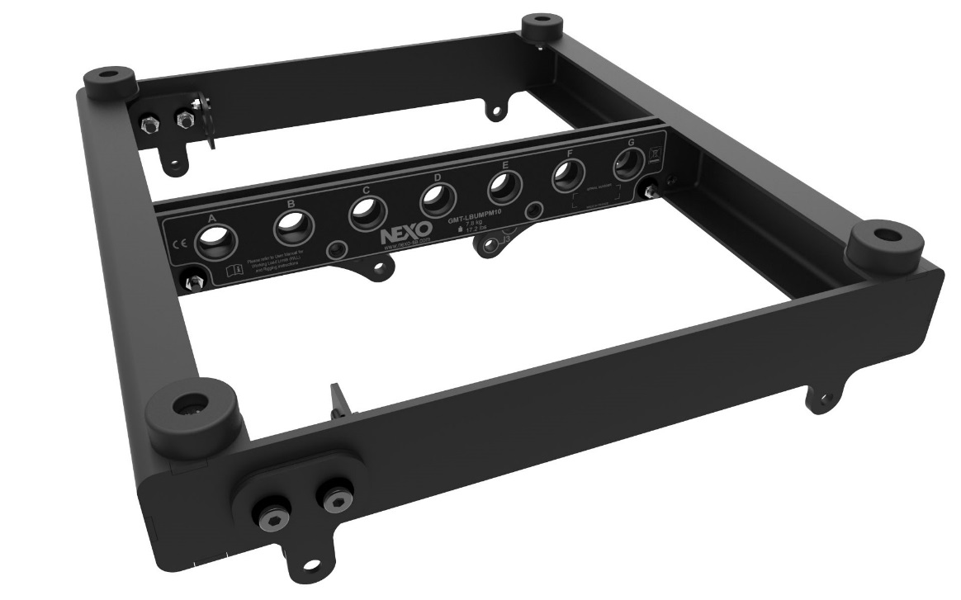
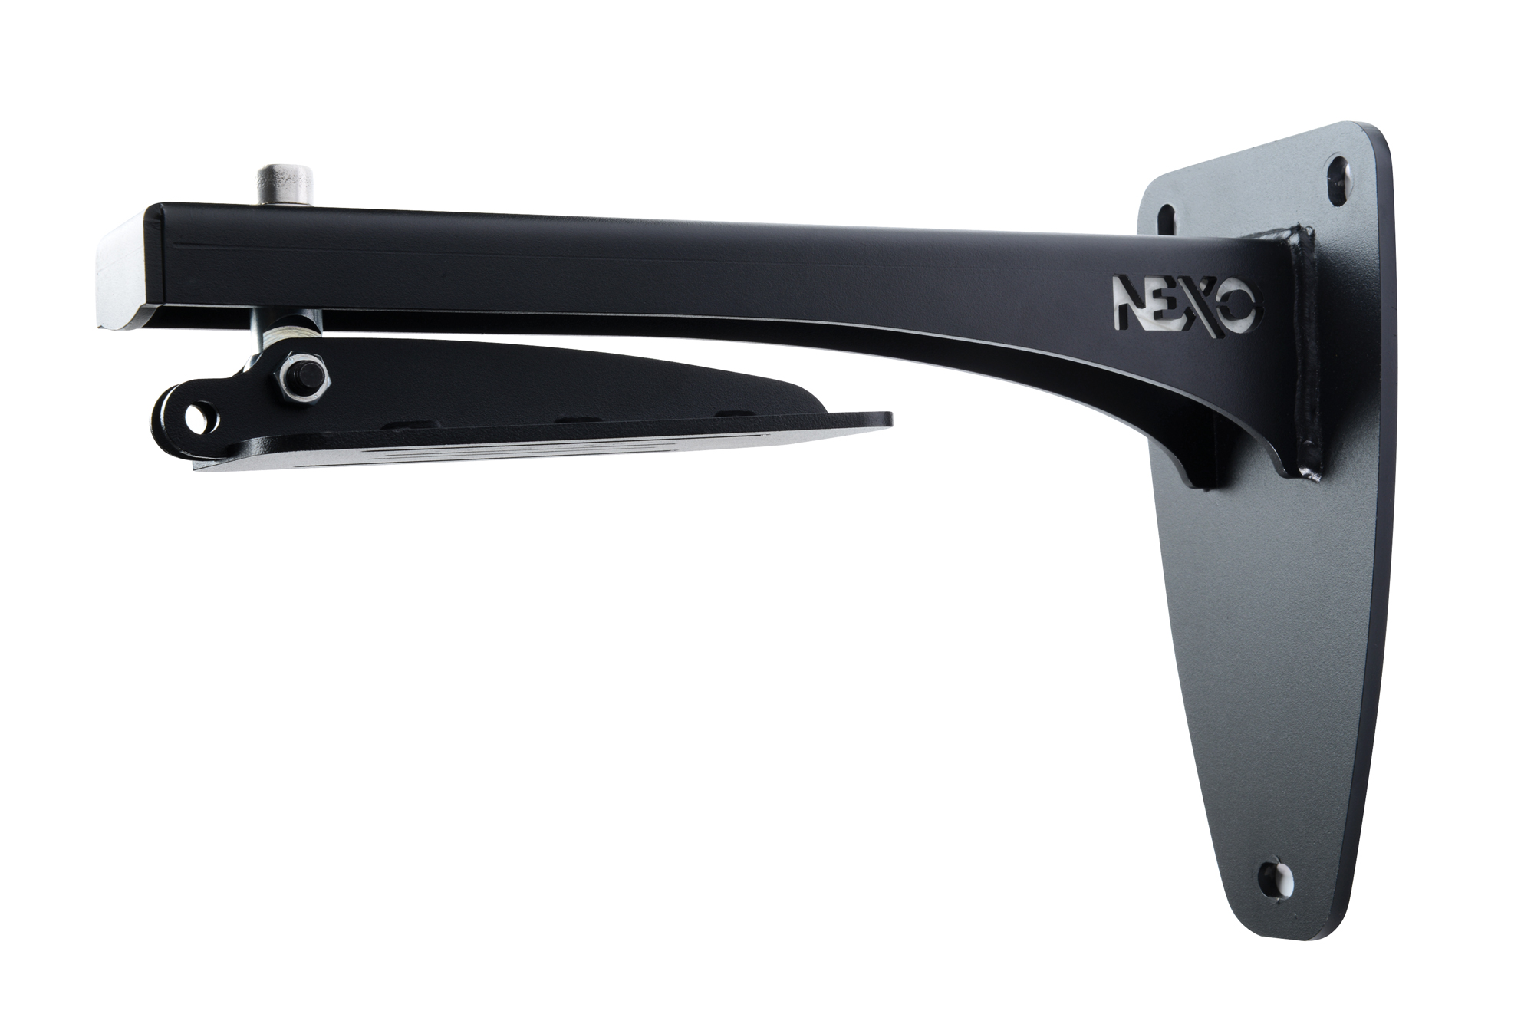
Accessories
Touring bumper
enables mixed main modules and subs flown arrays or groundstacks
A comprehensive range of accessories make it easy to deploy GEO M systems in a wide variety of fixed and mobile applications.
Here are few accessories of the GEO M range.
Full accessories list on our website and in the GEO M brochure.
Light Weight bumper
Perfect for smaller systems, can handle flown arrays or small ground stacks.
Long stacking extention
Wall mount
For installation applications

Slide 24
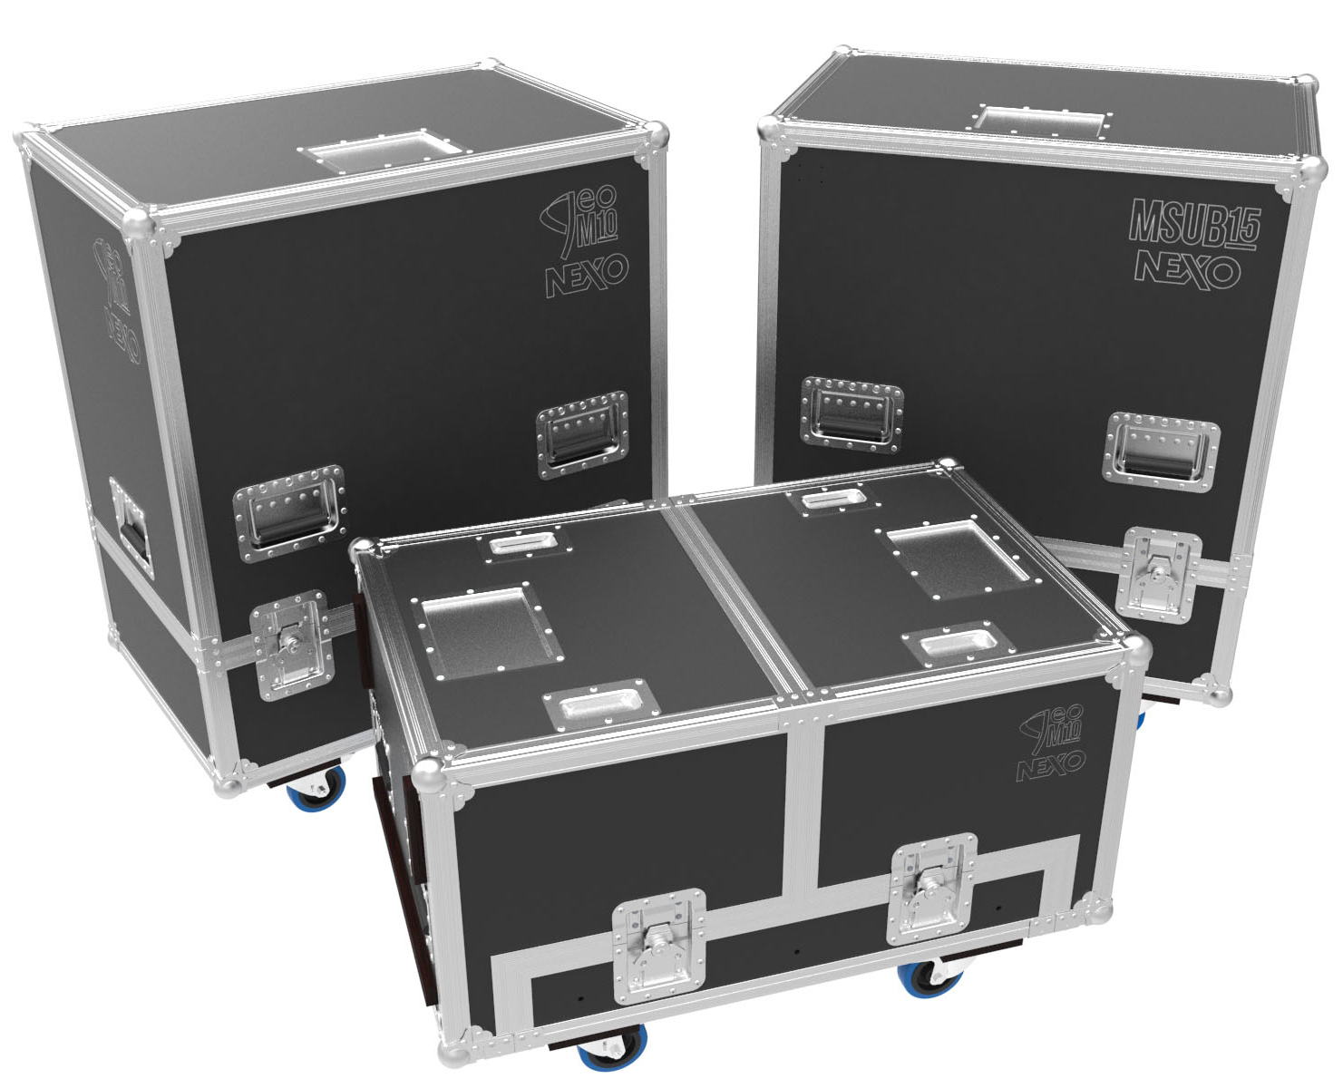
Accessories
Designed to roll.
Wheeled flightcases available to accomodate GEO M main modules and subs.

Slide 25
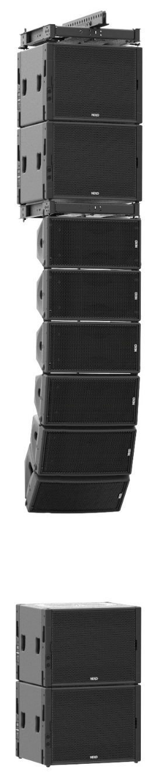
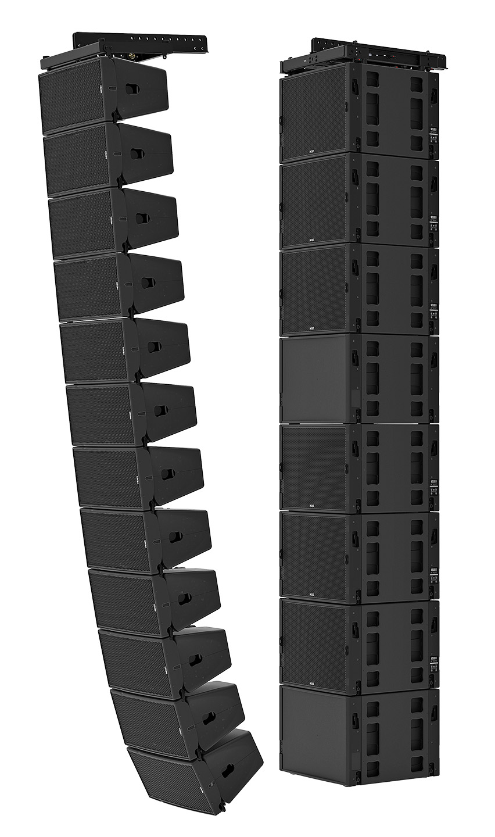
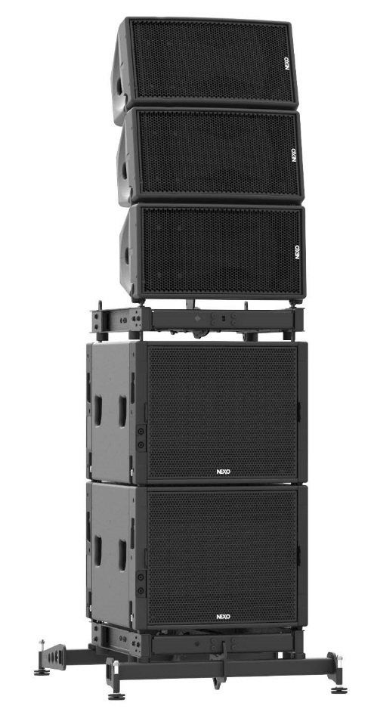
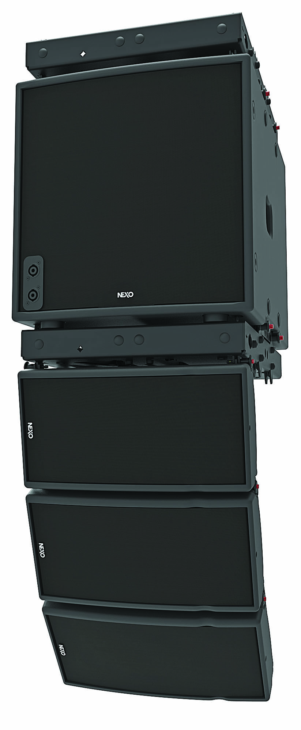
Mix. Match.
Build the perfect system.

Slide 26

Concerts and Festivals

Slide 27
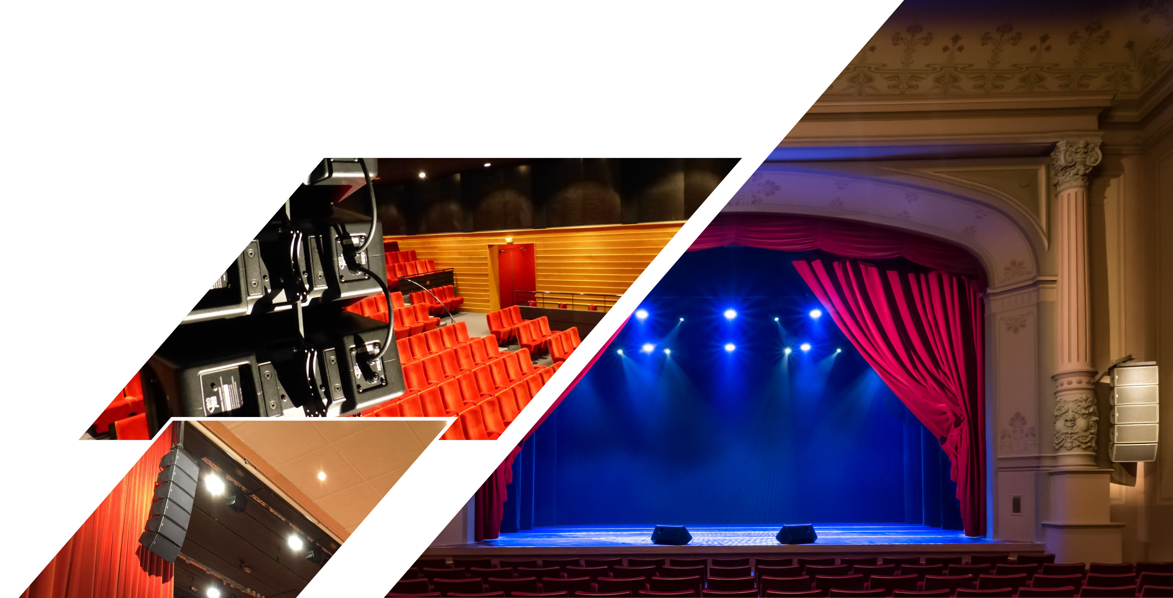
Theatres

Slide 28
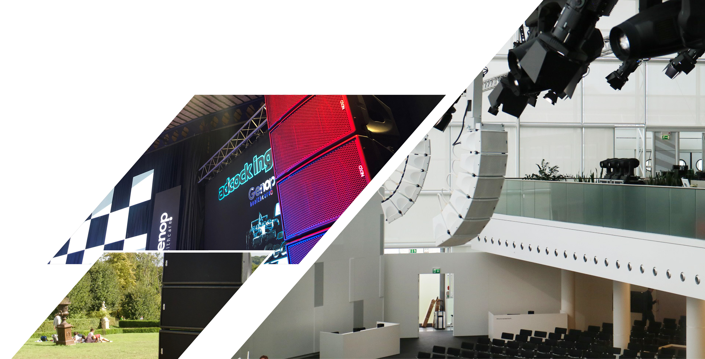
Corporate AV

Slide 29
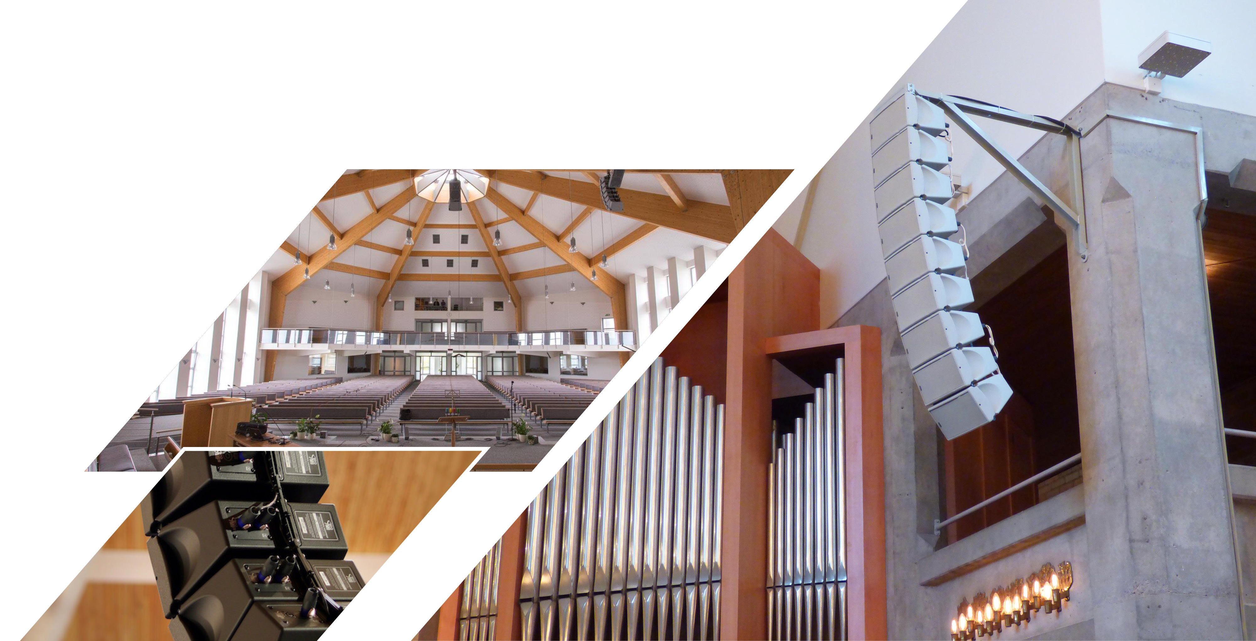
Houses of Worship

Slide 30
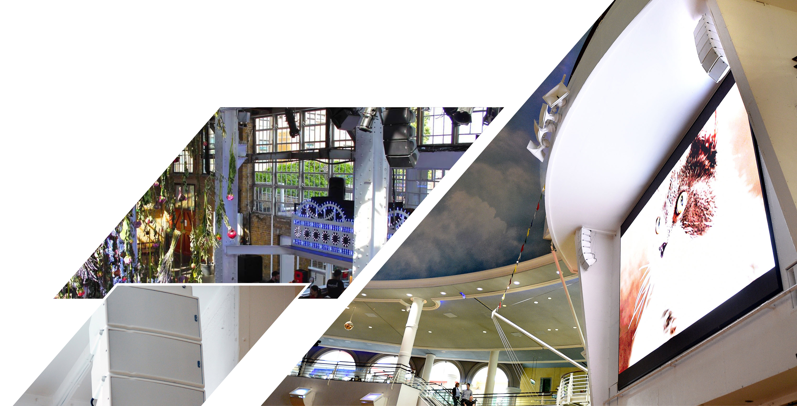
Public spaces

Slide 31
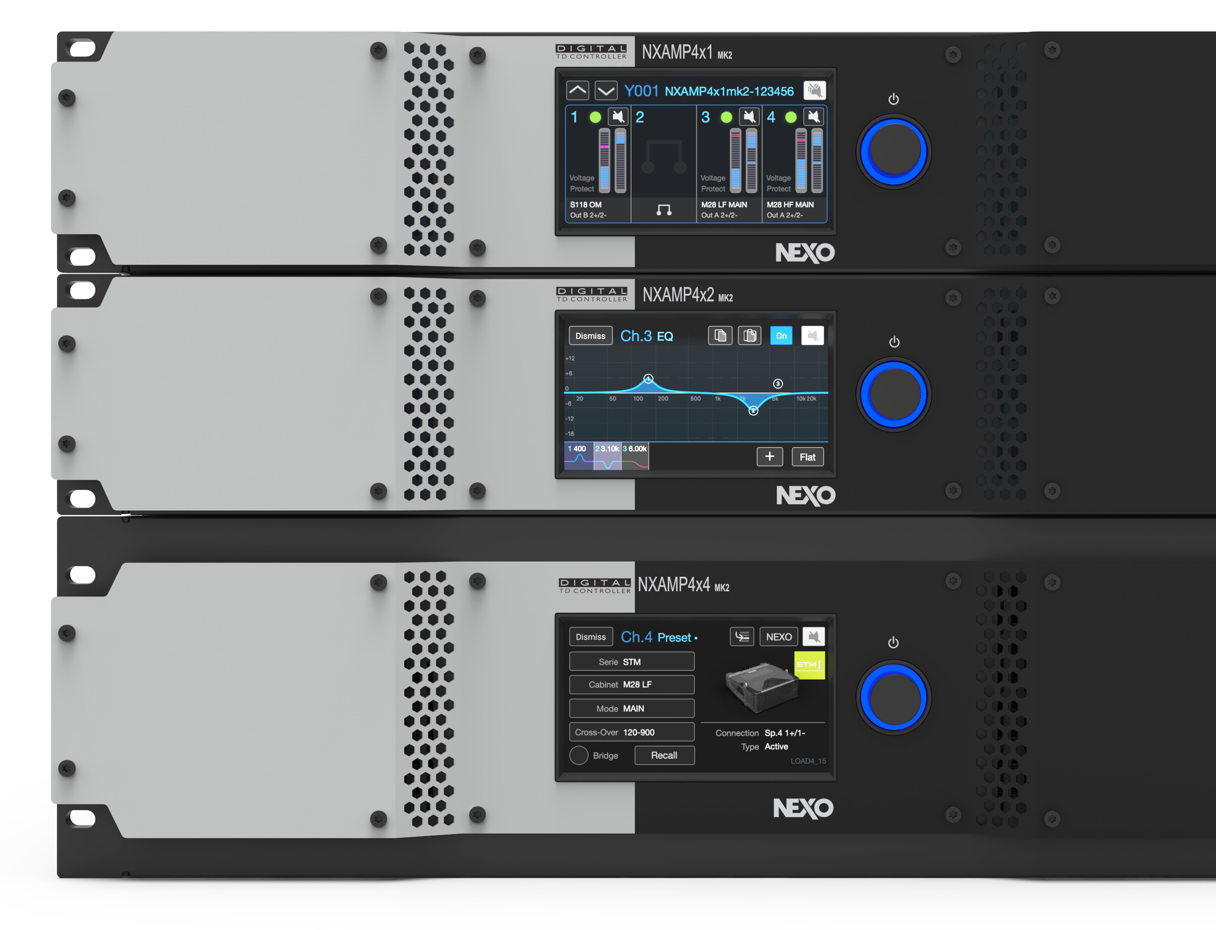
Plug & Play power and processing
With phase linear presets for every cabinet, NEXO NXAMPMK2 provides a smart, compact and cost-effective amplification solution for any GEO M system.
A single NXAMP4X1MK2 powers up to
16 x GEO M6 Cabinets
A single NXAMP4X2MK2 powers up to
16 x GEO M10 Cabinets
A single NXAMP4X4MK2 powers up to
16 x GEO M12 Cabinets

Slide 32
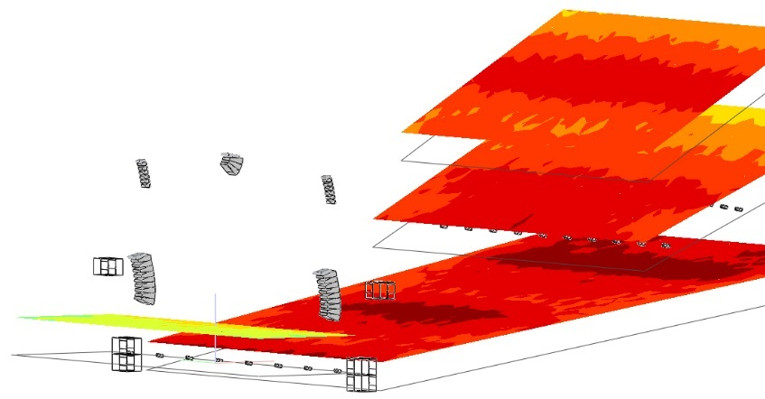
Software
Available to download free of charge, NS-1 is a powerful and intuitive system configuration and simulation tool enabling NEXO users to configure and optimise the performance of any NEXO system by predicting its behaviour in any venue to ensure uniform SPL coverage.
Go on our website nexo-sa.com to download NS-1.

Slide 33

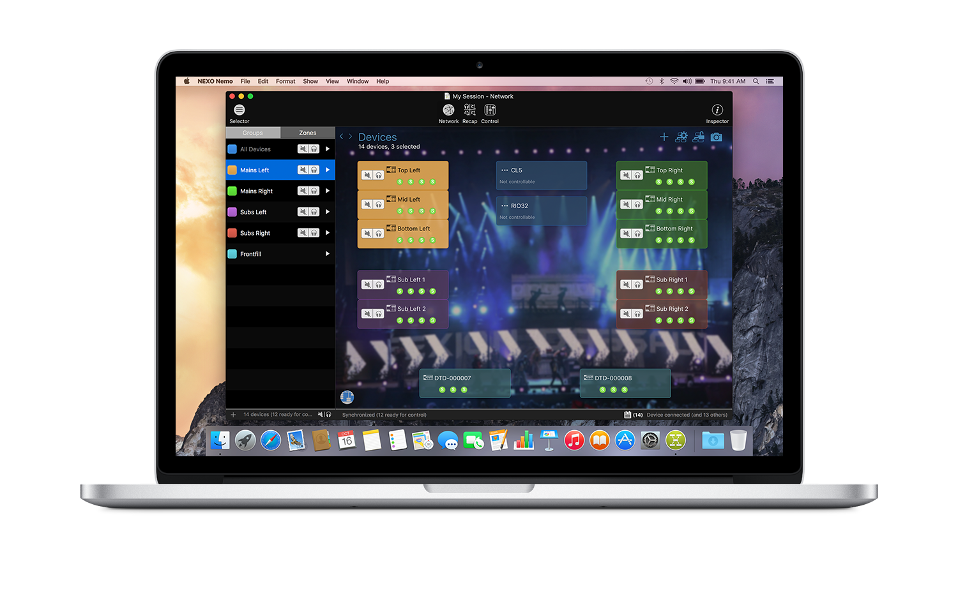
Software
NEXO NeMo is our system management software.
It allows you to control from an Apple iPad, iPhone, iPod Touch through a Wi-Fi network and from a Mac through a wired or Wi-Fi network one or many NEXO Devices (NXAMP Powered TD-controllers, DTD Digital TD-controllers).
Managing and positioning devices, monitoring their parameters (levels, etc.), and setting new values (preset, volume, delay, EQ, etc.) is made possible thanks to an attractive and intuitive user interface. NEXO NeMo also comes with a powerful engine for logging and alerting.
Available on the App Store.

Slide 34


