Slide 1


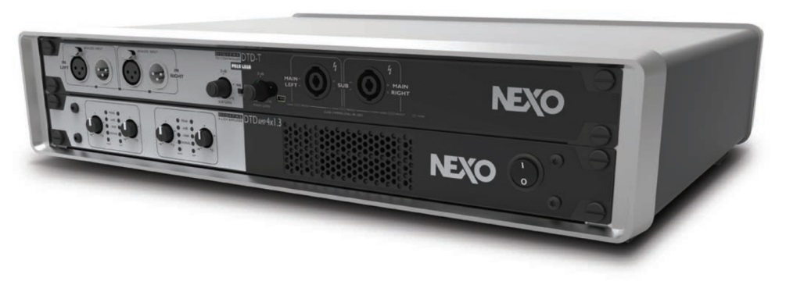


Slide 2

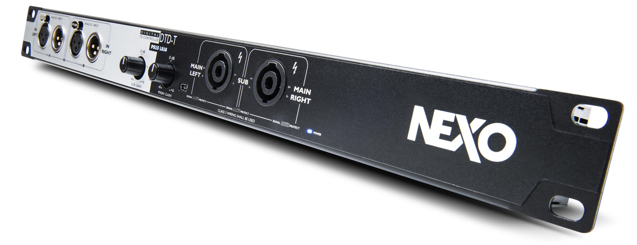
More performance
in more applications
Speaker controller for PS and LS series, providing digital processing from the NXAMP technology.
High-end Balanced Stereo Analog inputs, AES input, USB input and optionally Dante ™.
Simple control from the front panel (Sub Gain, Main Gain, Crossover mode) or advanced control using USB port.

Slide 3
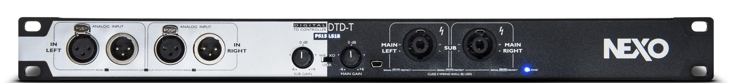
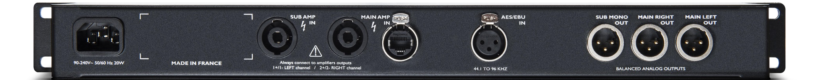
DTD-T Touring Version
Analog input and output connectors on the front panel (XLR and Speakons) :
Flexible inputs : Stereo balanced analog inputs, an AES input, a USB port…
Two hardware knobs for Sub/Main output gain.
A switch for selecting Wideband, Crossover or User mode.

Slide 4
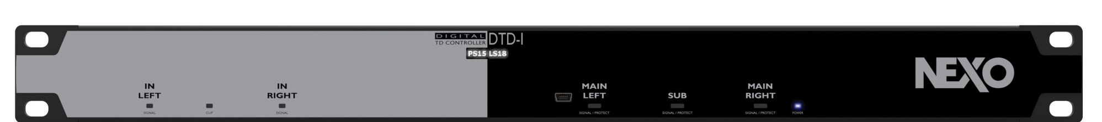
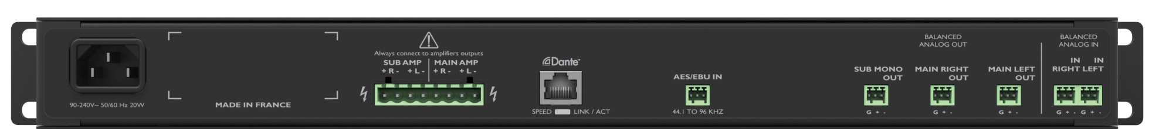
DTD-I Install Version
All connectors (except mini-USB) at the back on the barrier strip.
No hardware control.
Set up from a PC/Mac computer connected on the USB port.

Slide 5
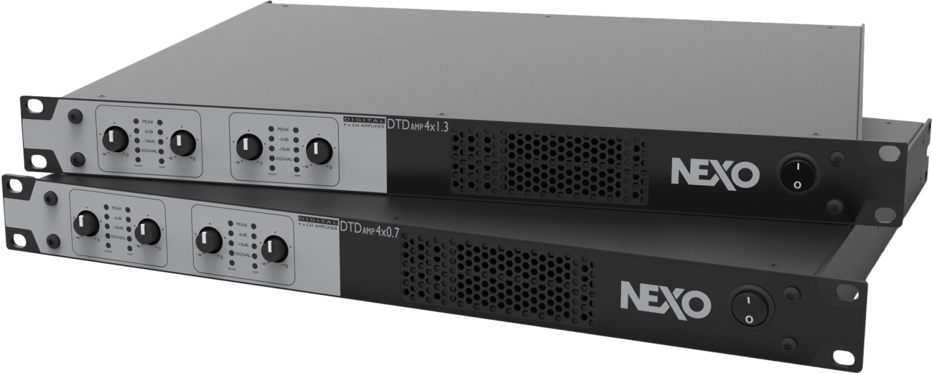
Ideal 4 channel amplifiers perfectly matching NEXO DTD Controller
Two models of high-power, lightweight 4 channel amplifiers.
High-efficiency Switch Mode power supply and Amplifier channel design.
Channels can be independently bridged 2 by 2.

Slide 6
DTDAMP4x0.7
DTDAMP4x1.3
Same rear for both versions
Available in two versions: 4 x 700 Watts and 4 x 1300 Watts.
x4 Inputs on XLR connectors and four Outputs on SP-4 connectors.
Extensive protection (Mains over/ undervoltage, temperature, DC outputs, current and voltage peak limiters, variable speed cooling system).

Slide 7
DTD + DTDAMP :
The perfect combo
A compact, light-weight, intelligent powering solution that’s easy to configure
A pair of DTD + DTDAMP will :
-weigh together less than 10 Kg
-be able to process and power system composed of 2 x NEXO Speakers + 2 x subs

Slide 8
