Slide 1
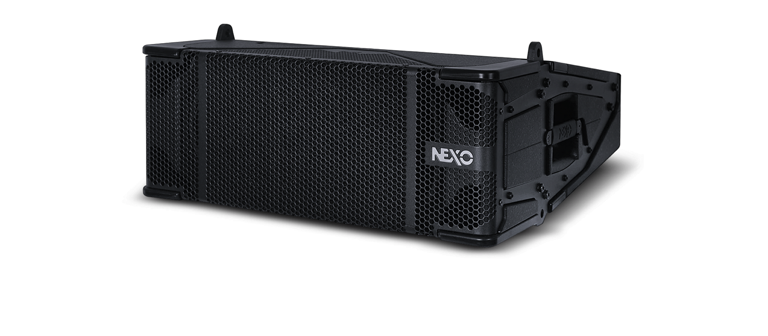
M28 Omni-Purpose Module

Slide 2
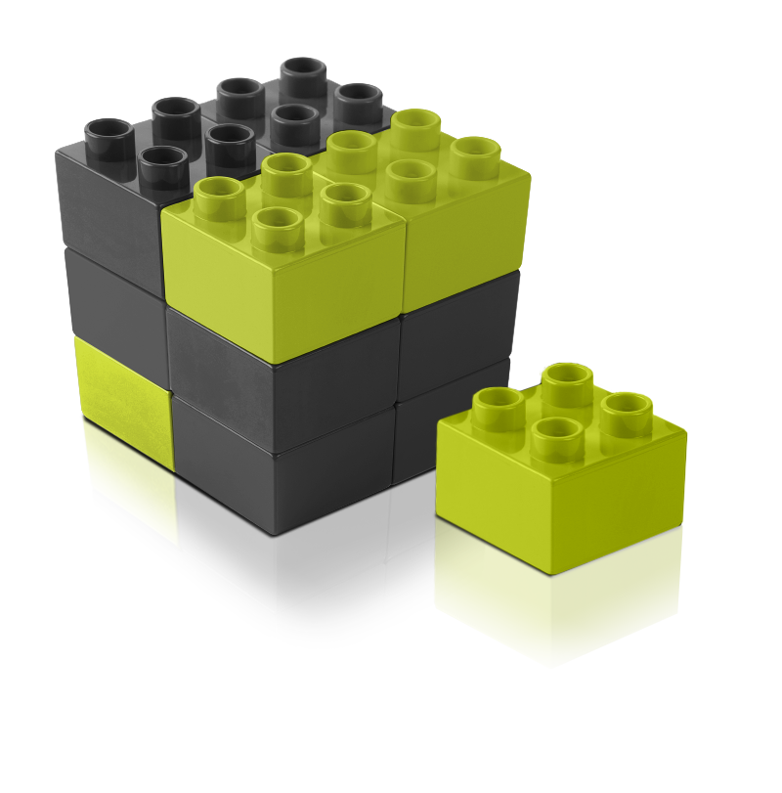
M28
The final STM building block

Slide 3
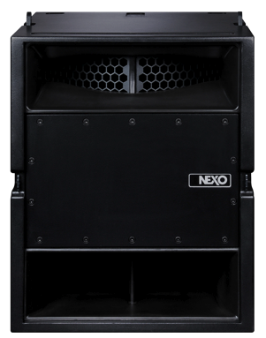
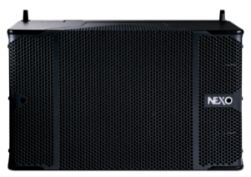
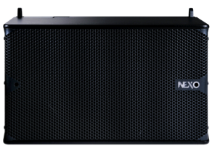
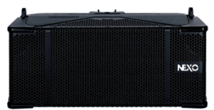

The four STM modules
M46
Main Module
B112
Bass Module
S118
Sub Module
M28
Omni-Purpose Module

Slide 4
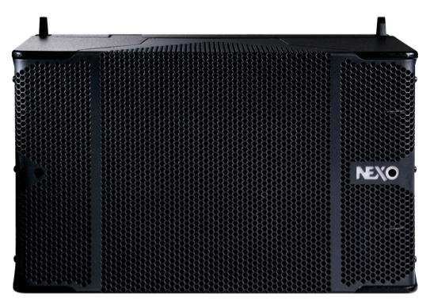

M46 Main Module
4 x 6.5 inch LF/MF Flat Membrane Drivers
4 x HF Ketone Polymer Compression Drivers
Frequency response: 85Hz–20kHz
145dB peak SPL
H350mm/W575mm/D715mm
Dispersion 90˚ H x 0-10˚V

Slide 5

B112 Bass Module
1 x 3000W +/- 3cm excursion 12 inch LF Driver
143dB peak SPL
Frequency response: 55Hz-200Hz
H350mm/W575mm/D715mm

Slide 6
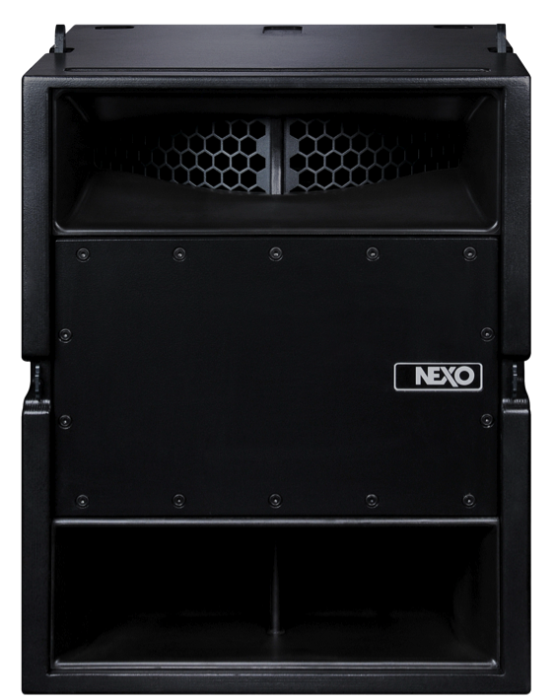

S118 Sub Module
1 x 3000W 18 inch LF Driver
143dB peak SPL
Frequency response: 25Hz-120Hz
H700mm/W575mm/D715mm
Flown or groundstacked
Omni or CD/RS cardioid modes

Slide 7
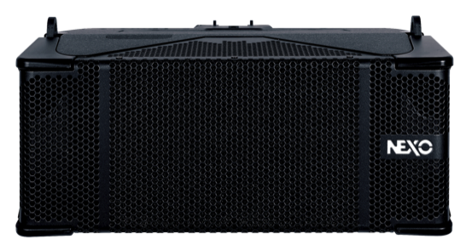
M28 Omni-Purpose Module
2 x 8 inch long excursion LF Drivers
2 x HF Ketone Polymer Compression Drivers
141dB peak SPL @ 1m
Frequency response: 60Hz-19kHz
H234mm/W575mm/D653mm

Slide 8
M28 in detail

Slide 9




Same polyurethane composite weatherproof construction as M46 and B112

Slide 10
Horizontal dispersion user-configurable
90 or 120 degrees
90º
120º

Slide 11
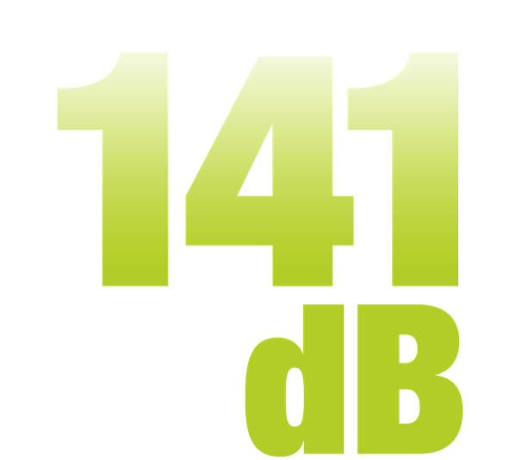
Peak output of 141dB @ 1m in 90 degree dispersion mode
2dB louder than GEO T!
Possibly the most powerful cabinet in its class

Slide 12
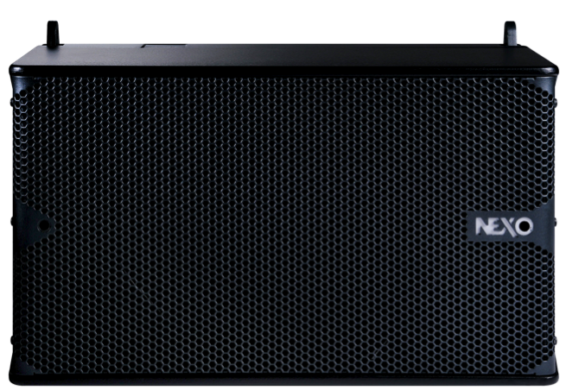
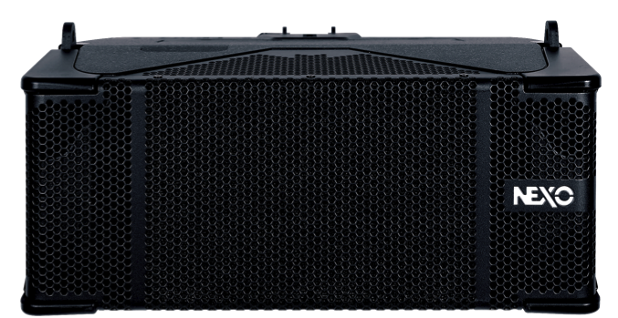
Same width as all STM modules

Slide 13
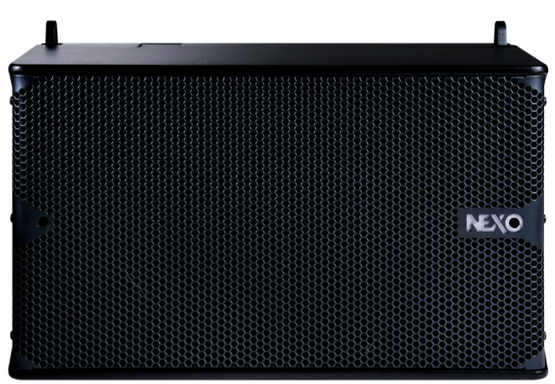
Two-thirds the height of M46 and B112

Slide 14
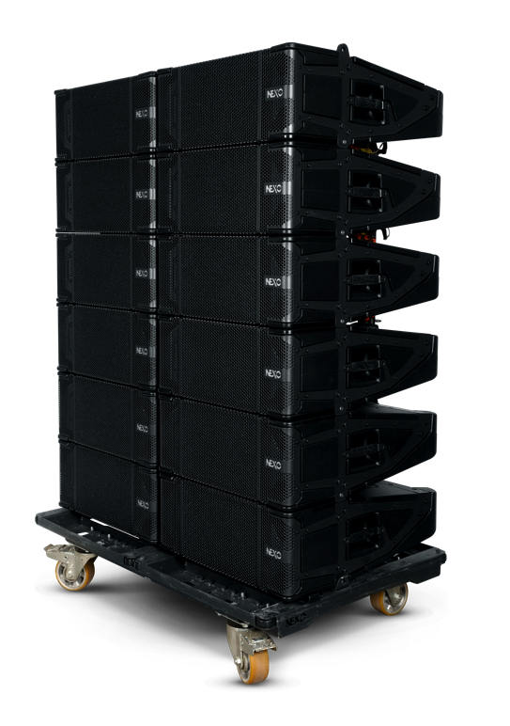
Compatible with all STM dollies and rigging

Slide 15
Omni-purpose capability

Slide 16
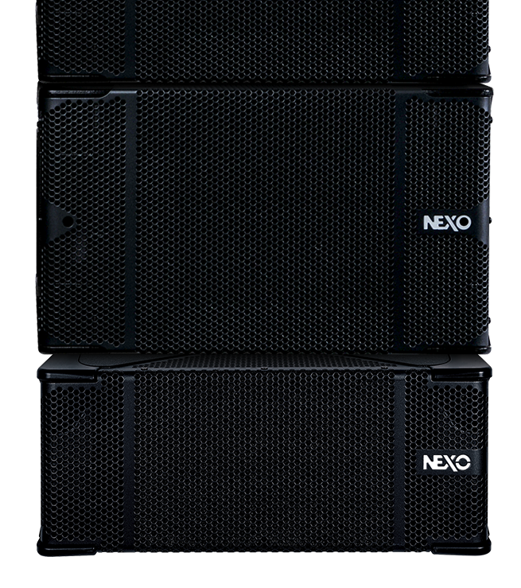

M46 Downfill

Slide 17
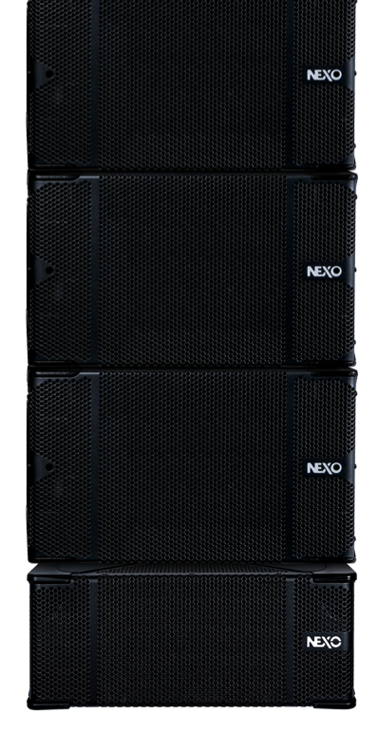

When used as M46 downfill, M28 is attached below the STM bottom bumper in tension (gravity) mode

Slide 18
Available angles in downfill mode are 10, 12.5, 15 degrees

Slide 19
M28 as a Main PA

Slide 20
M28 as a Main PA
Fully compatible with all STM modules and rigging

Slide 21
1 x S118 : 1 x B112 : 2 x M28
Recommended starting ratio

Slide 22
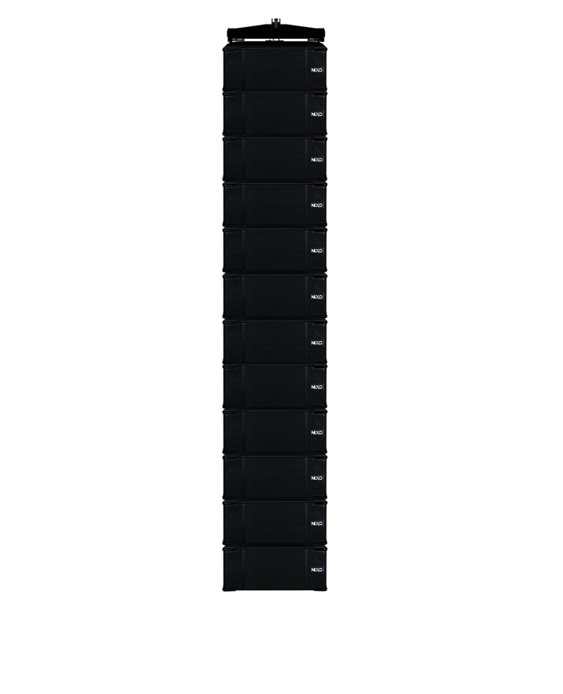


M28 is flown using compression mode

Slide 23
60Hz – 20KHz
Usable alone for speech and light music events

Slide 24
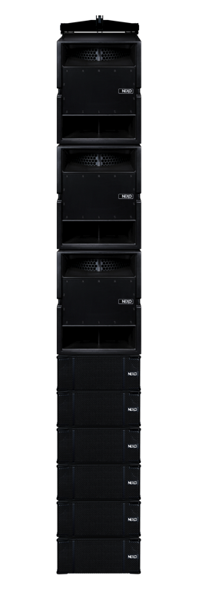
Full-range flown system
(30Hz to 20 kHz)
3 x S118 and 6 x M28

Slide 25
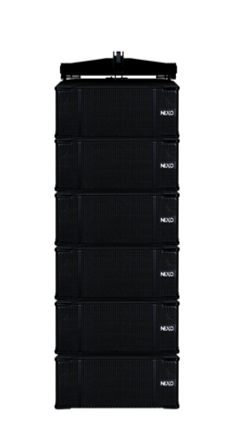
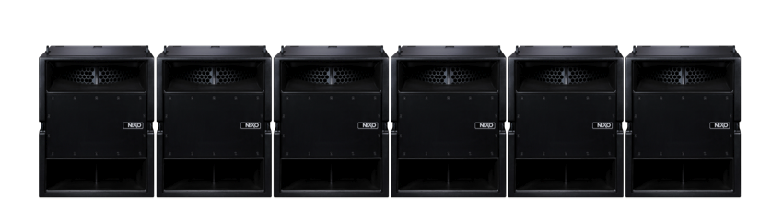
Or with subs on the floor
6 x M28
6 x S118 groundstacked

Slide 26
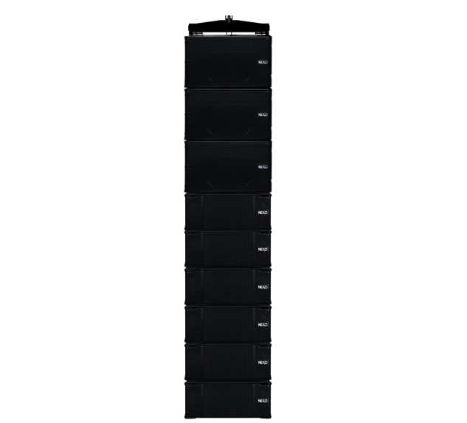
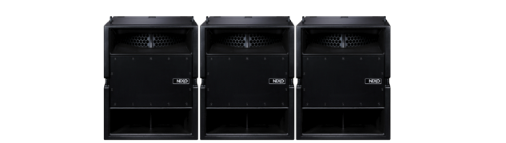

Full-range system with extra “punch”
3 x B112, 6 x M28
3 x S118 groundstacked

Slide 27
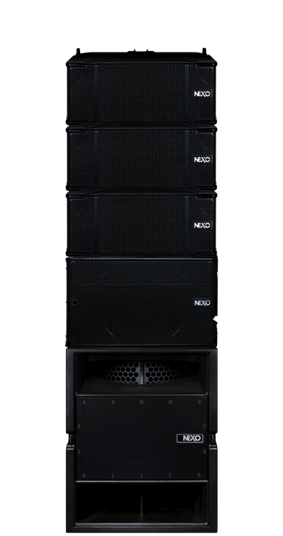
Groundstacked
Powerful, full-range system with extremely small footprint
1 x S118, 1 x B112
3 x M28

Slide 28
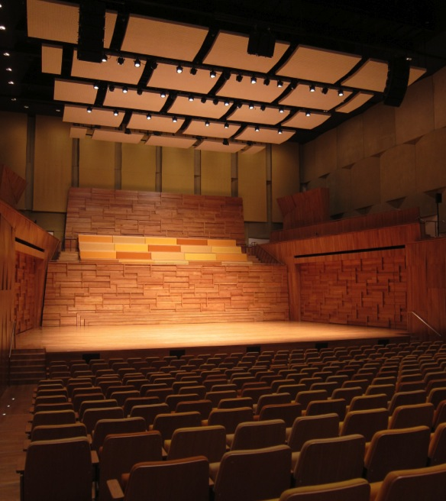
Venues with rigging weight limitations

Slide 29
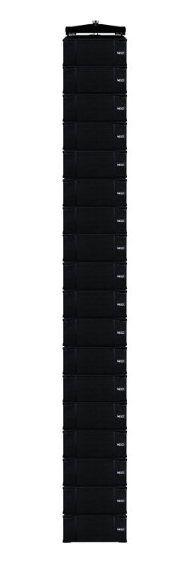
1 tonne point restriction
18 x M28 single column. Total cabinet weight = 666kg

Slide 30
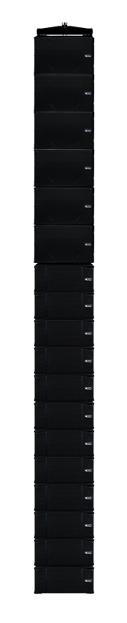
1 tonne point restriction
6 x B112 + 12 x M28
Total cabinet weight = 798kg

Slide 31
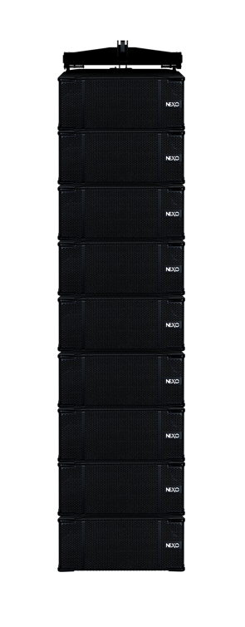
500kg point restriction
9 x M28
Total cabinet weight = 333kg

Slide 32
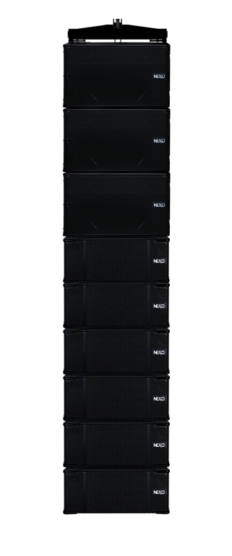
500kg point restriction
3 x B112 + 6 x M28
Total cabinet weight = 399kg

Slide 33
Amplification

Slide 34
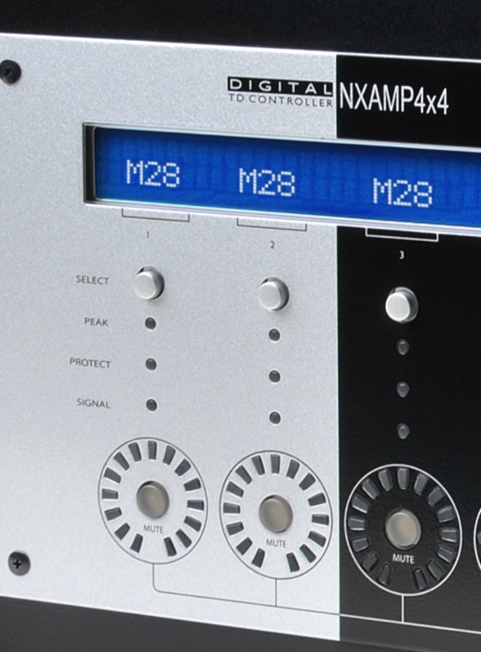
M28 active
2 NUAR channels powers up to 3 cabinets

Slide 35
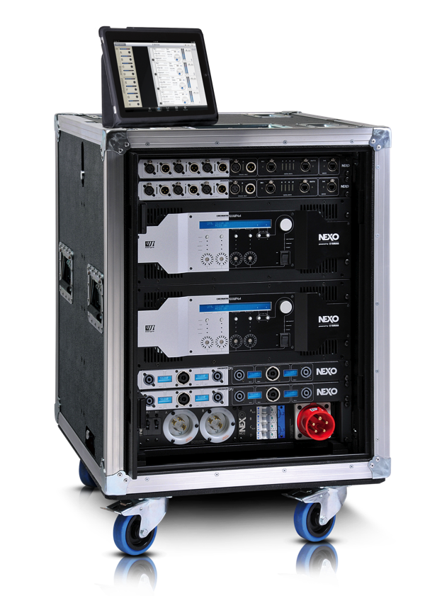
8 ohm cabinet
Up to 12 M28 cabinets on one NUAR rack (STM standard)

Slide 36
Packaging

Slide 37
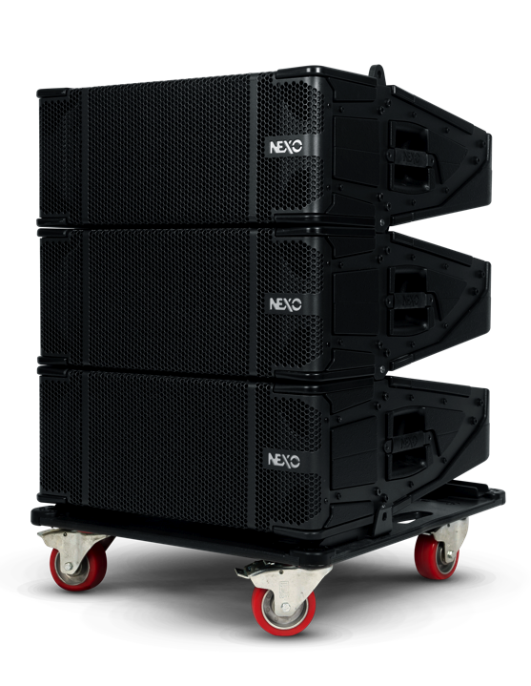
Lightweight dolly for smaller applications

Slide 38
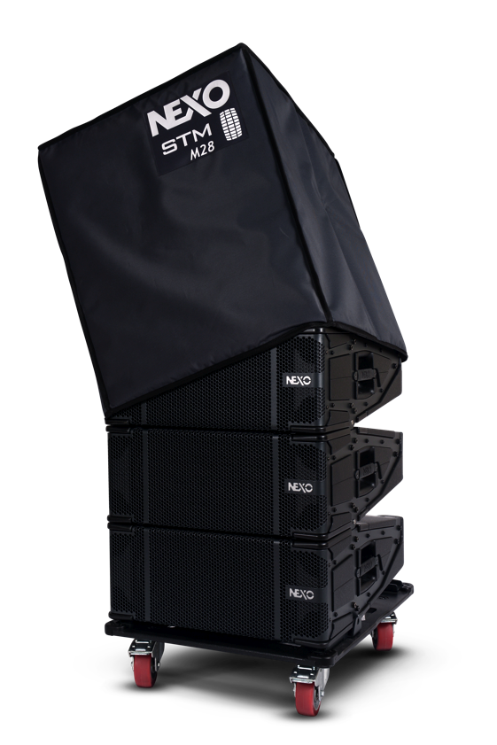
Compatible with STM dollies, roofs and covers

Slide 39
12 x M28 on a STM double dolly

Slide 40
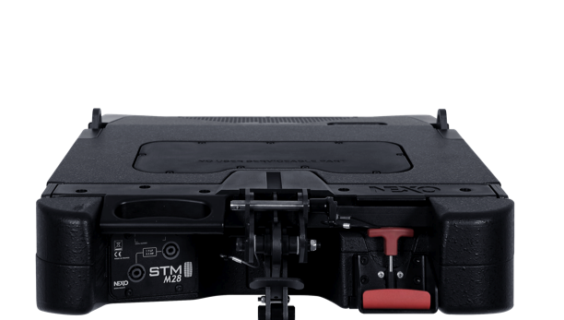
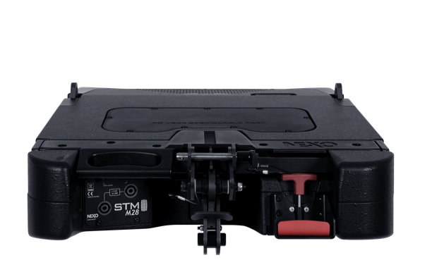
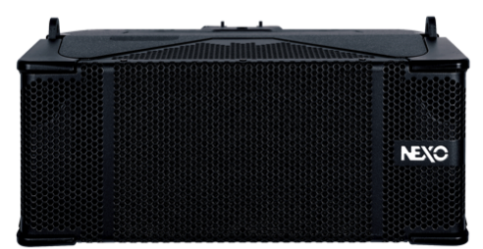


Designed and built from the ground up as an STM module, M28 is a “future-proof” solution for smaller companies with plans to grow

Slide 41
Thank you

