Slide 2
Our mission.
To build a sound system that makes you money.

Slide 3
A sound system that fits your model
Not one that dictates it

Slide 4
A scalable system for every application.

Slide 5
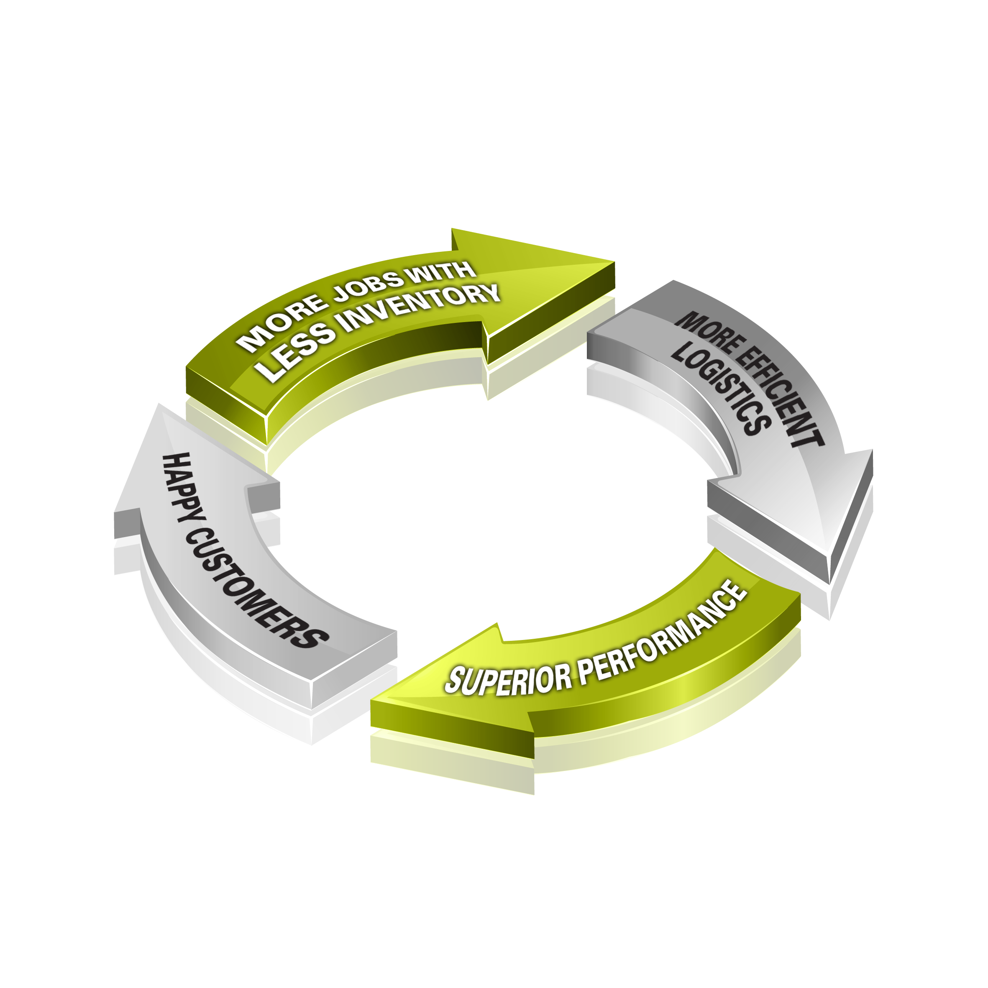
Where good things flow naturally from a new way of thinking.

Slide 6
Introducing

Slide 7
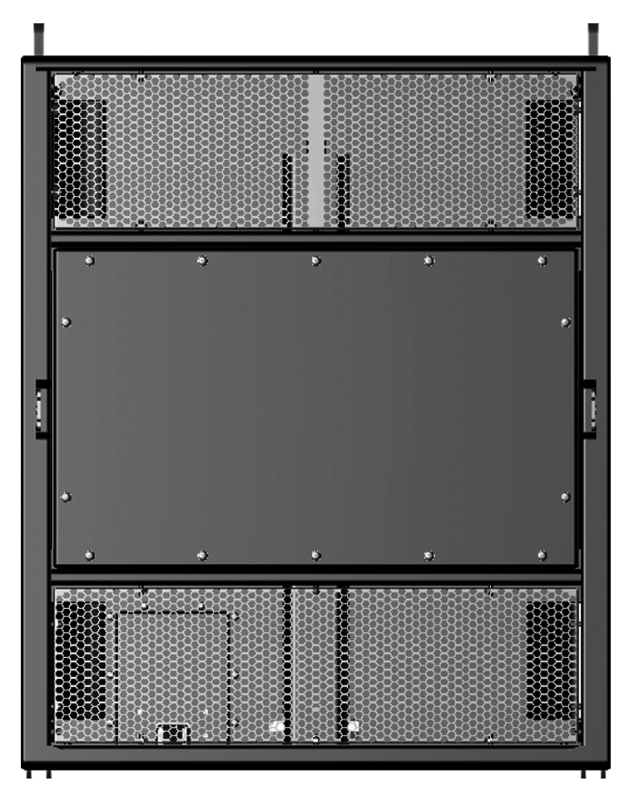
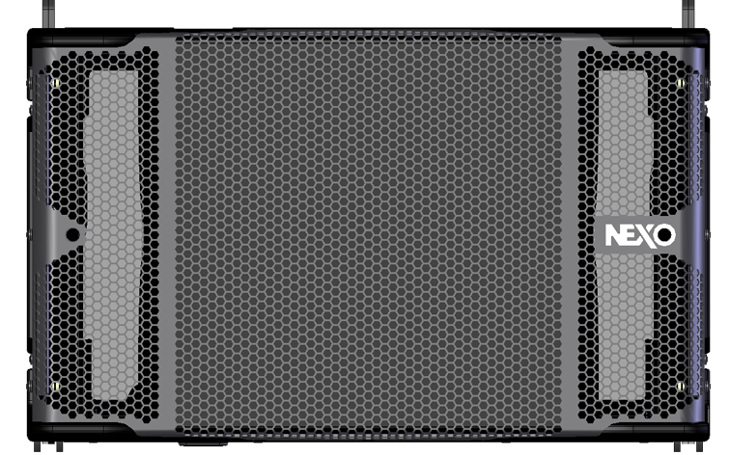
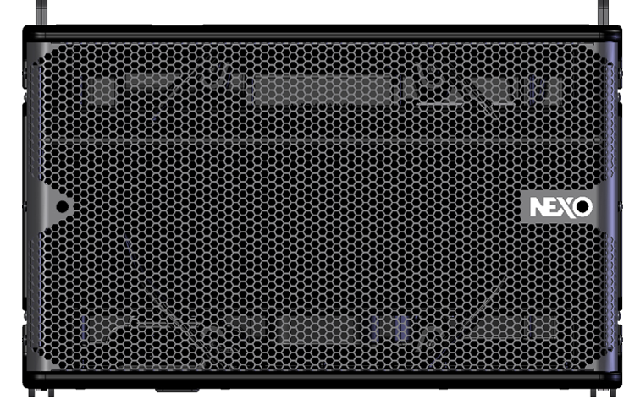
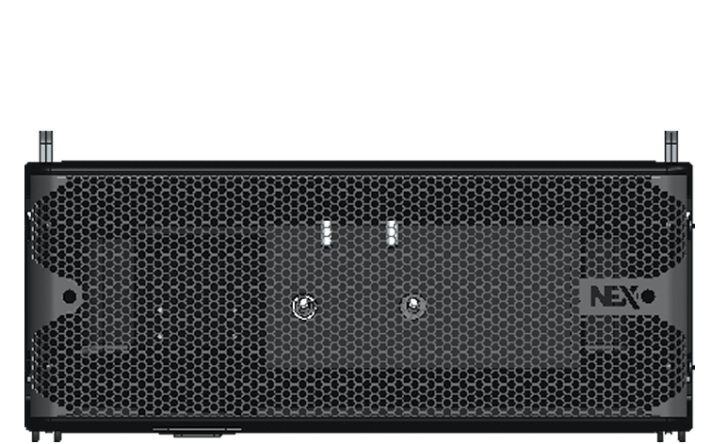
STM comprises 4 modules.
M46
B112
S118
M28
The STM Main Module.
The STM Bass Module.
The STM Sub.
And the STM ‘Omni’.

Slide 8
Let’s take a look
at each STM module in turn.

Slide 9
M46 Main Module
4 x 6.5 inch LF/MF Drivers
4 x HF Compression Drivers
Frequency response: 85Hz–20kHz
145dB peak SPL
H350mm/W575mm/D715mm
55Kg/121lb
Dispersion 90˚ H x 0-10˚V

Slide 10
B112 Bass Module
1 x 3000W +/- 3cm excursion 12 inch LF Driver
141dB peak SPL
Frequency response: 63Hz-200Hz
H350mm/W575mm/D715mm
55Kg/121lb

Slide 11
S118 Sub Module
1 x 18 inch LF Driver
143dB peak SPL
Frequency response: 25Hz-85Hz
H700mm/W575mm/D715mm
85Kg/187lb
Omni or cardioid modes

Slide 12
M28 ‘Omni’ Module
2 x 8 inch LF Drivers
4 x 4 inch MF Drivers
1 x HF Compression Driver
140dB peak SPL
Frequency response: 60Hz-20kHz
H233mm/W575mm/D715mm
38Kg/84lb
Dispersion 120˚ H x 0-15˚V

Slide 13
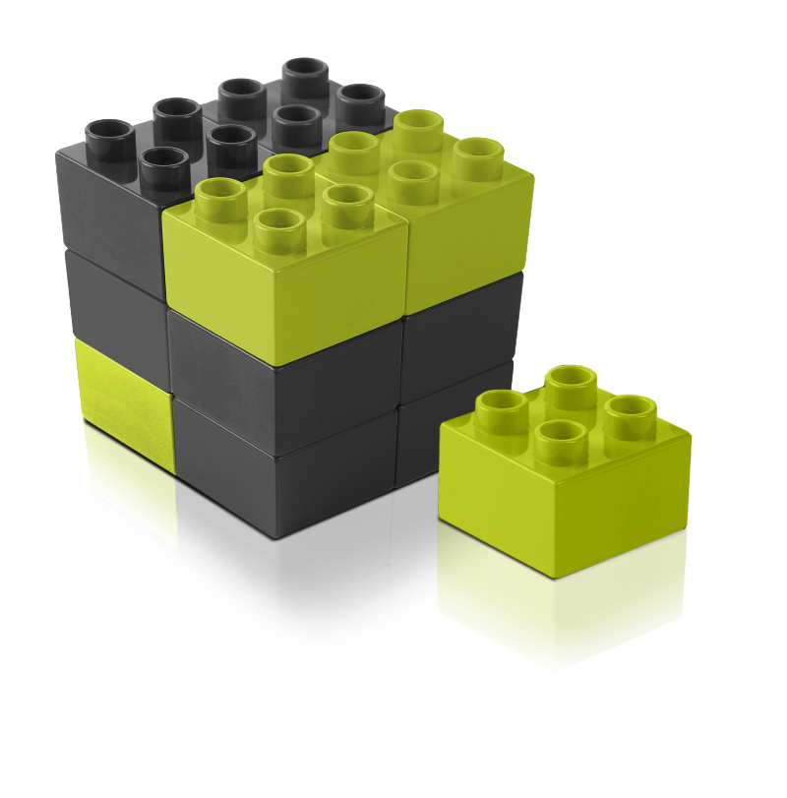
Think of them as blocks from which you can build any system you need, any time – quickly and easily.

Slide 14
Main
It could be a single column.
Main
Main
Main
Main

Slide 15
Bass
It could be a single column.
Bass
Main
Main
Main

Slide 16
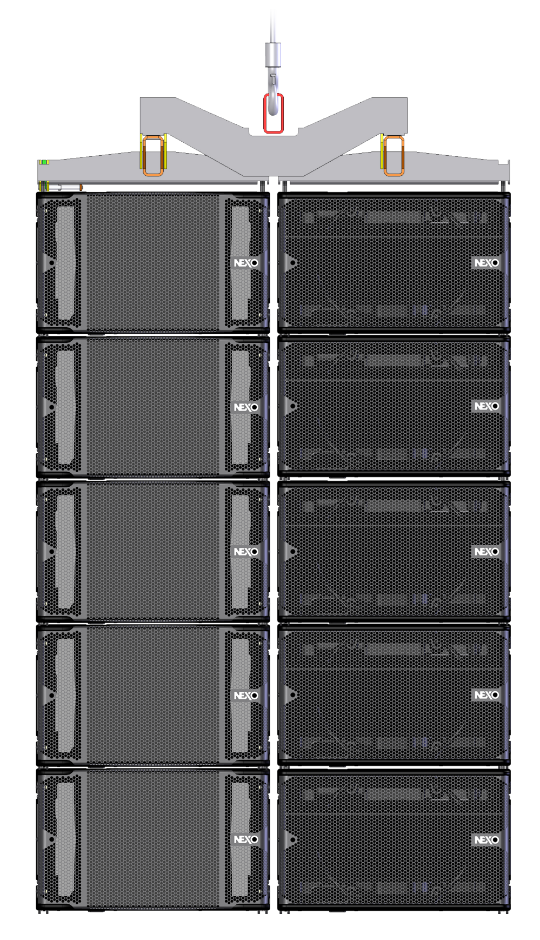
Main
Bass
Or a double column system for performance levels equivalent with existing line arrays.
Main
Bass
Main
Bass
Main
Bass
Main
Bass

Slide 17
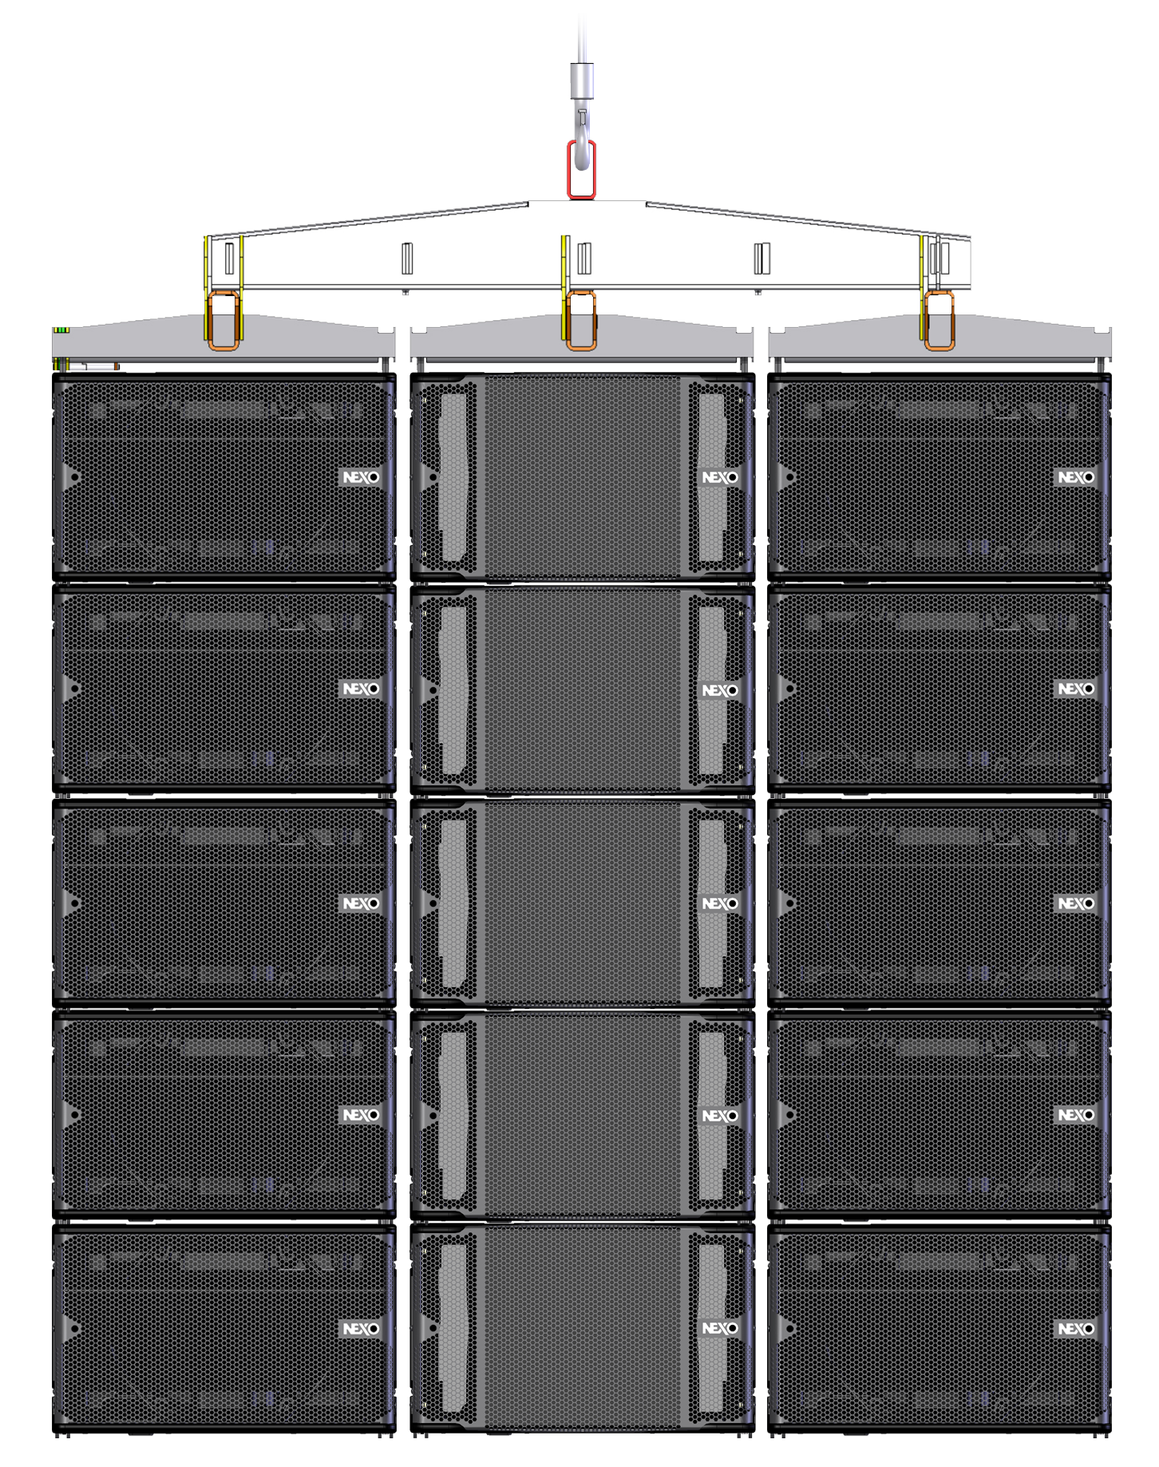
Bass
Main
Bass
Or a triple column for previously unattainable levels of LF output.
Bass
Main
Bass
Bass
Main
Bass
Bass
Main
Bass
Bass
Main
Bass

Slide 18
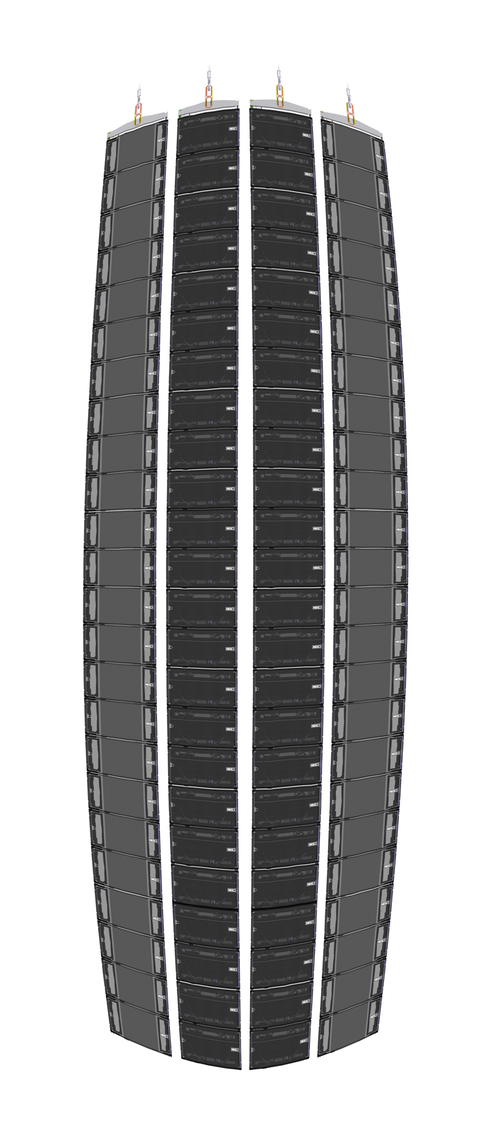
Subs
Main
Bass
Bass
Main
Right up to a
large-scale stadium configuration that no other system can match.

Slide 19
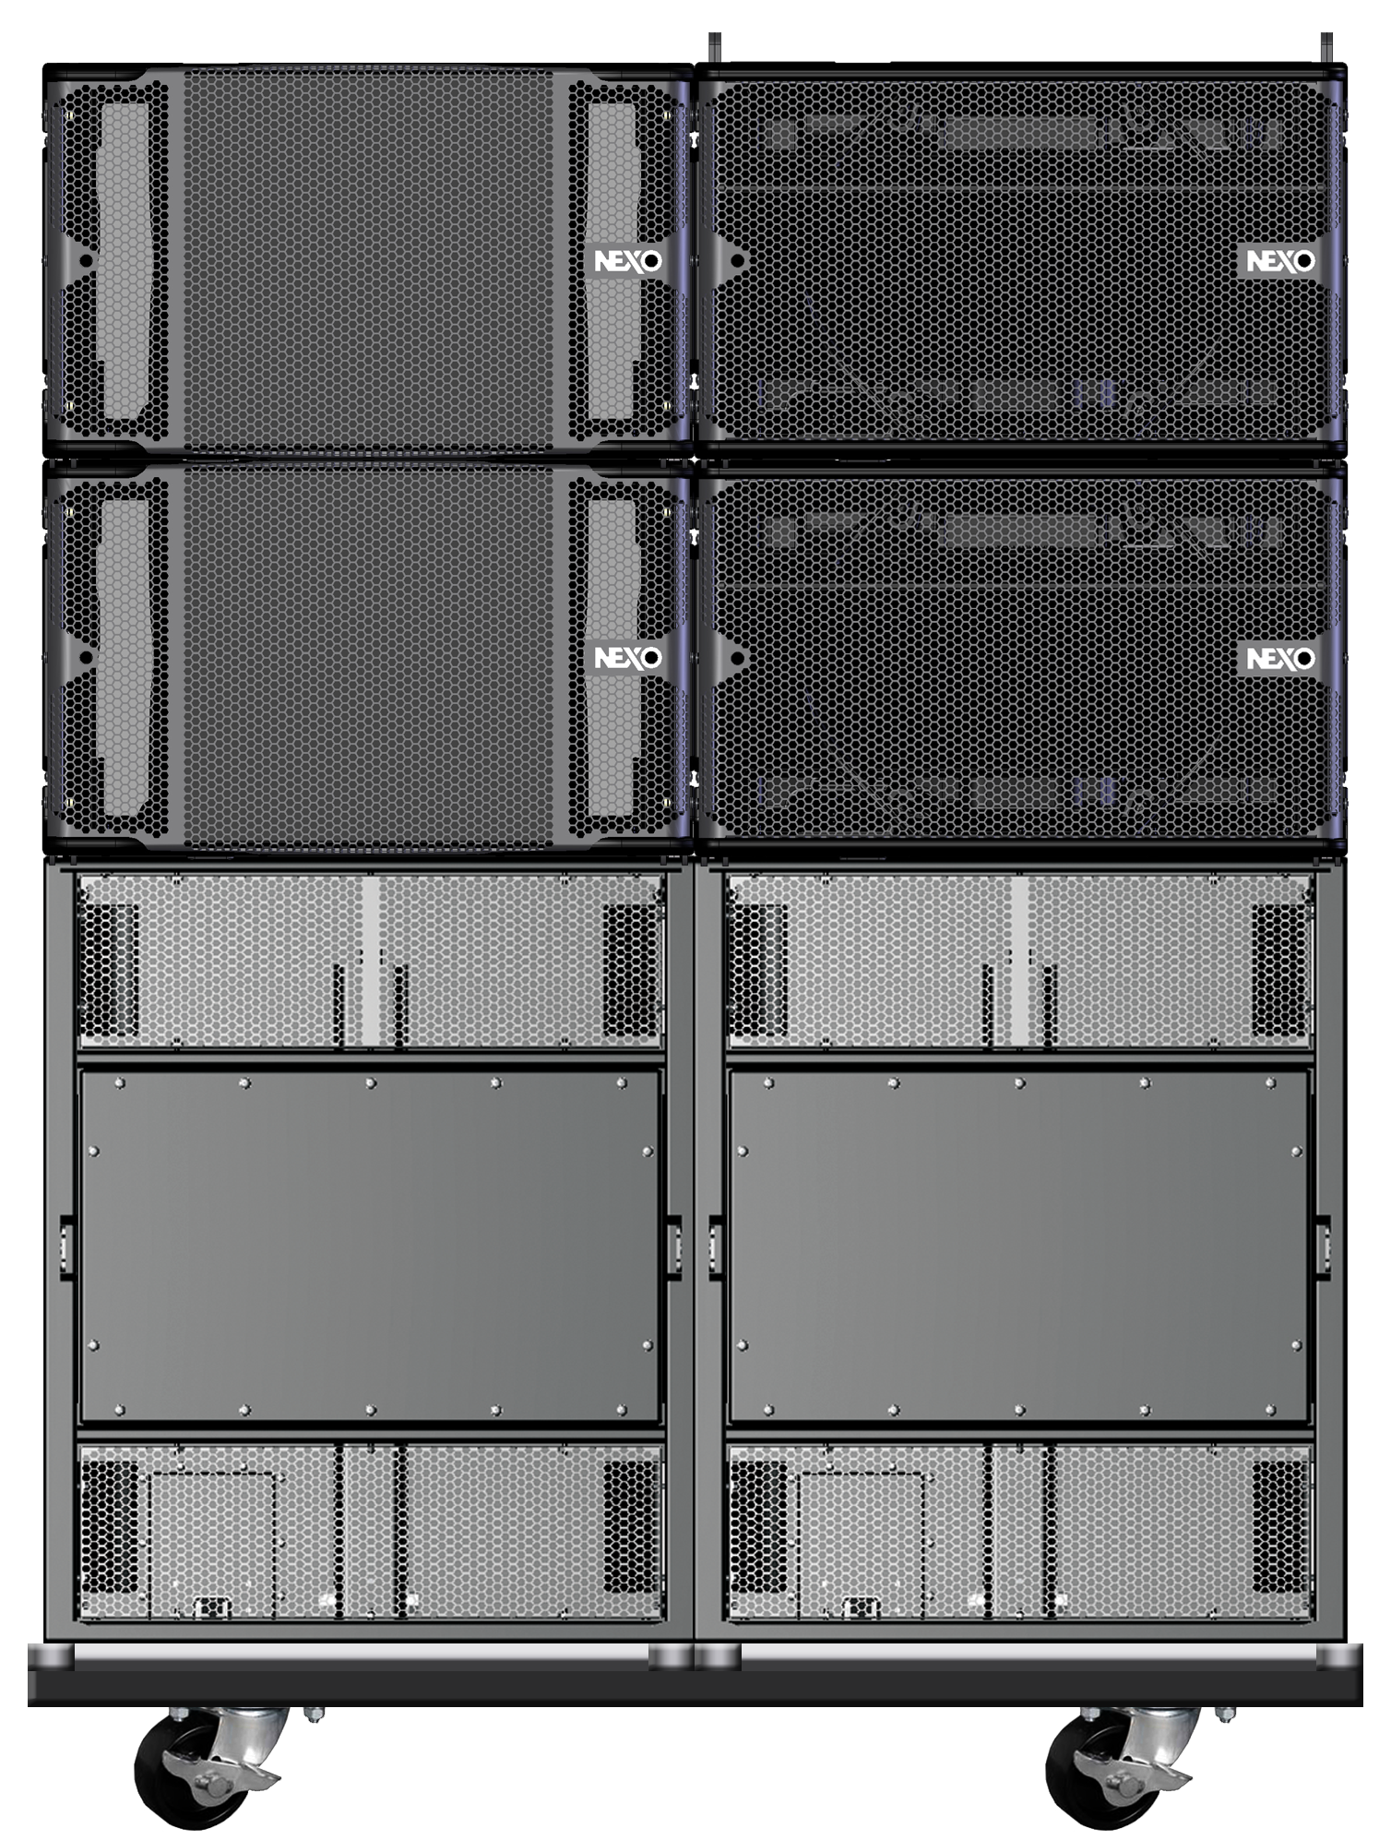
Main
Bass
Main
Bass
Sub
Sub
Or just a simple ground stack.

Slide 20
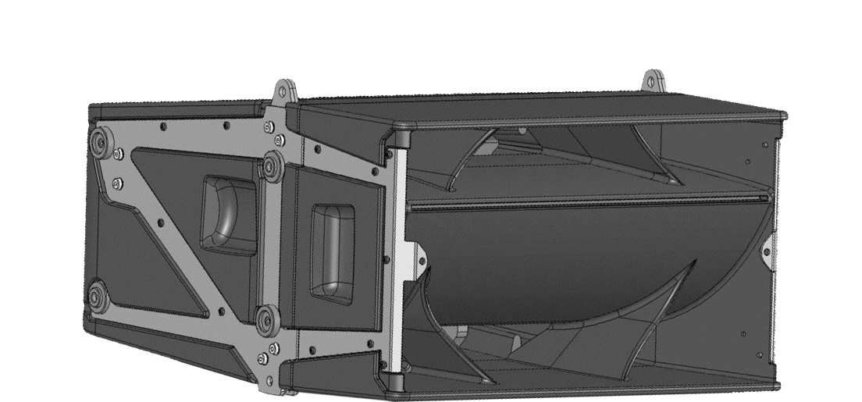
Main, Bass and ‘Omni’ cabinets are injection-moulded for increased durability and rigidity.

Slide 21
Did we say quick and easy to build?

Slide 22
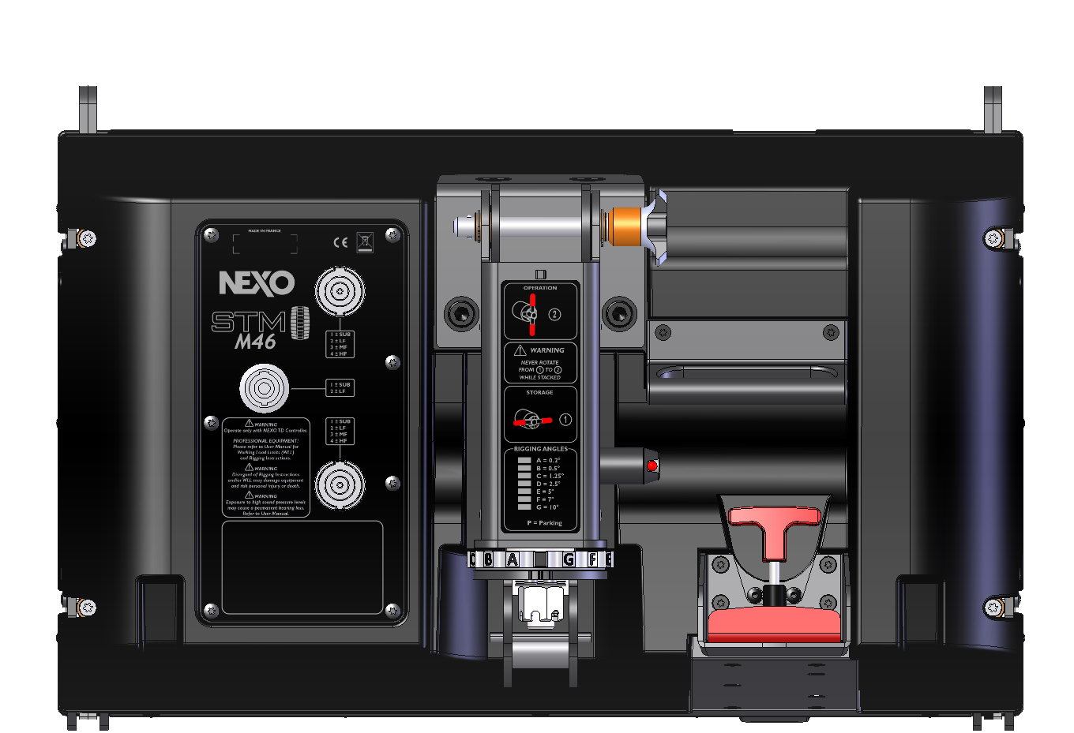
Innovative PistonRig™ and REDLock™ rigging enables any size of systems to be flown safely by one person.

Slide 23
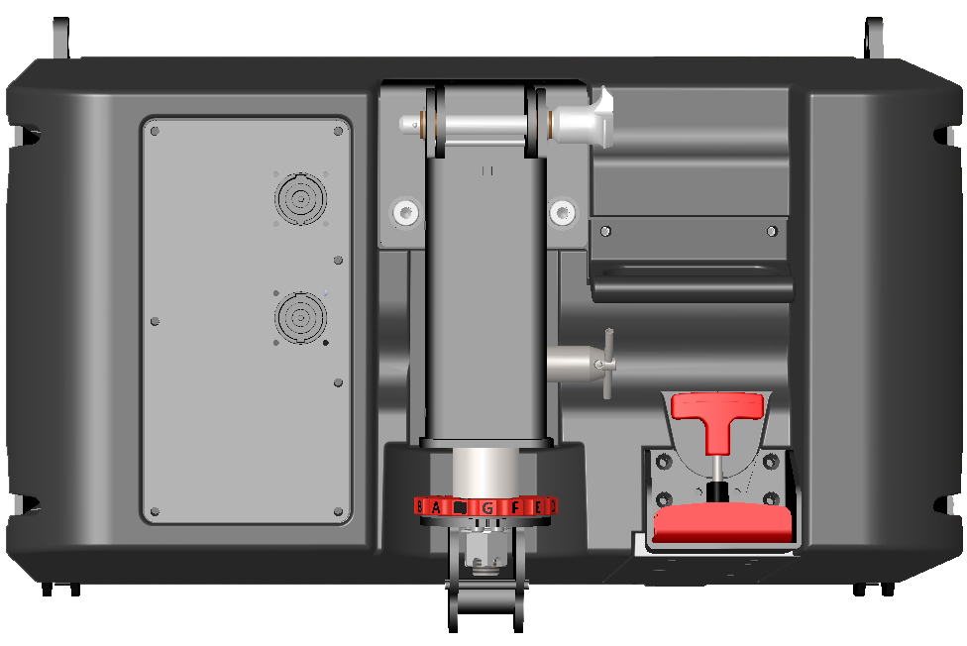
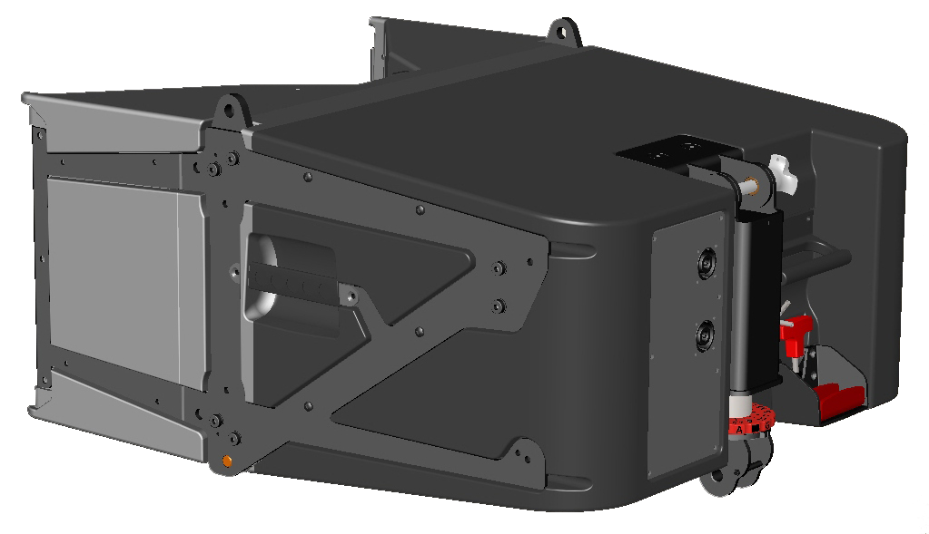
• PistonRig™ allows pre-setting of inter-cabinet angle values
• REDLock™ handle locks front rigging points from rear of cabinet
• All adjustments made from one position at rear of cluster

Slide 24
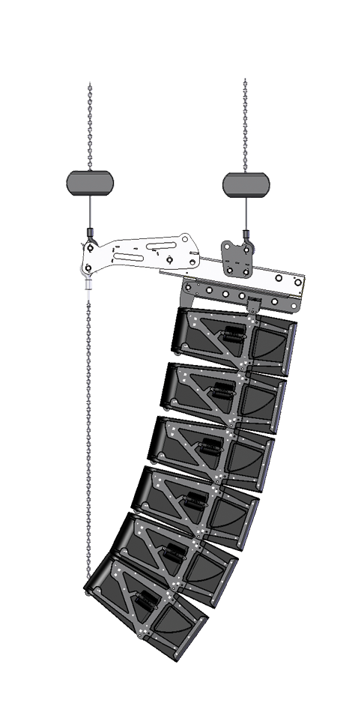
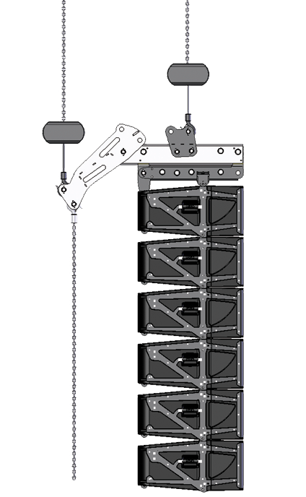
﻿System stays flat during set-up
﻿Bumper and array angles realised after lifting

Slide 25
And the efficiency gains start in the warehouse.

Slide 26
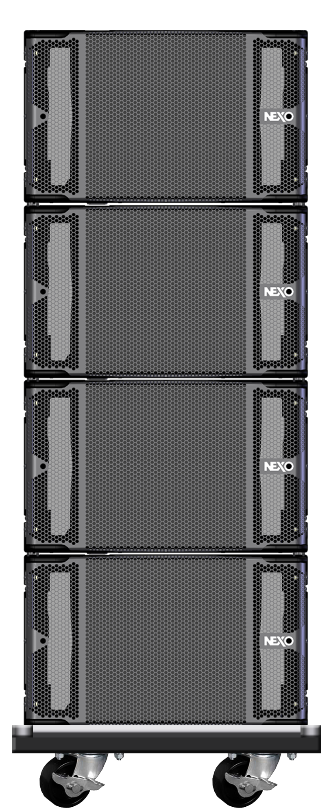
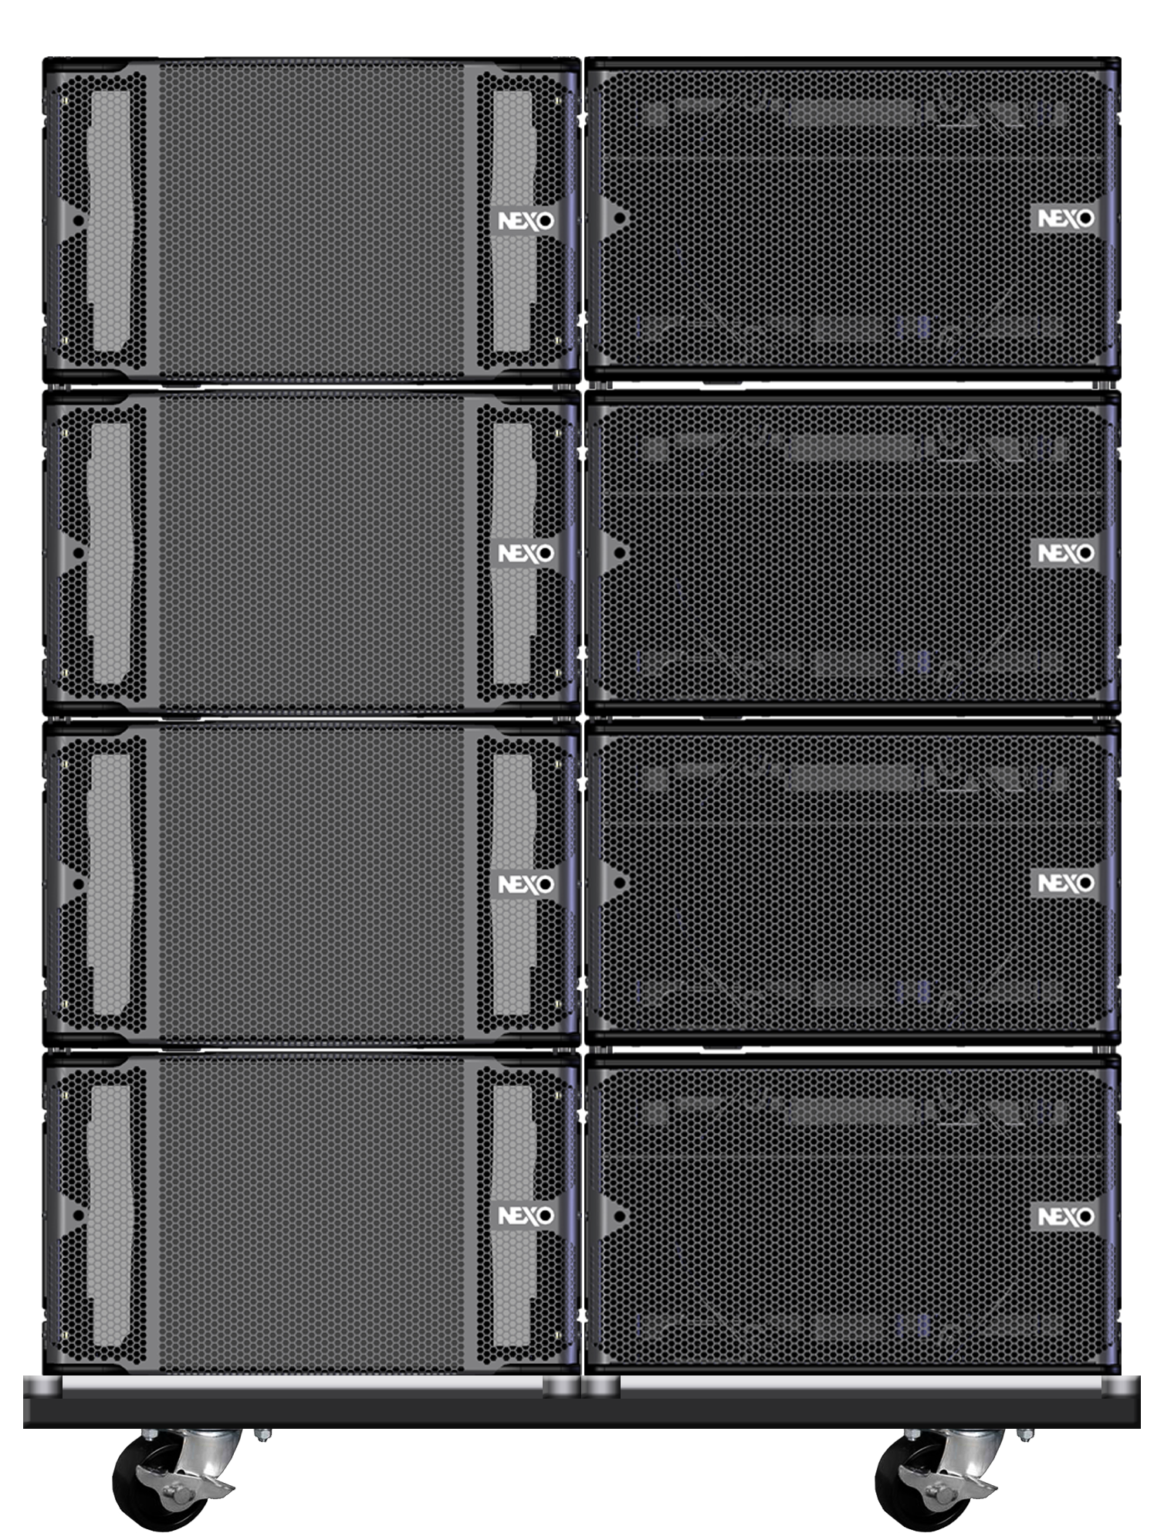
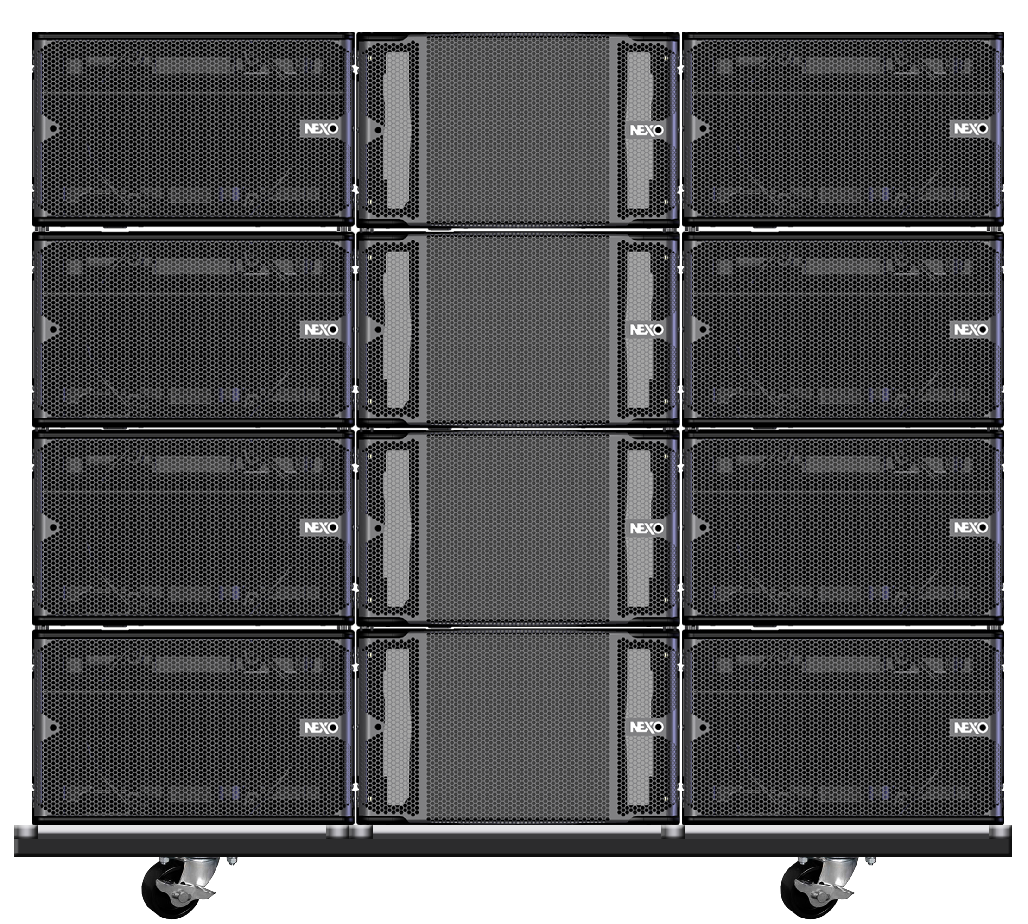
Modular dollies make it easy to organise and move systems of any size.

Slide 27
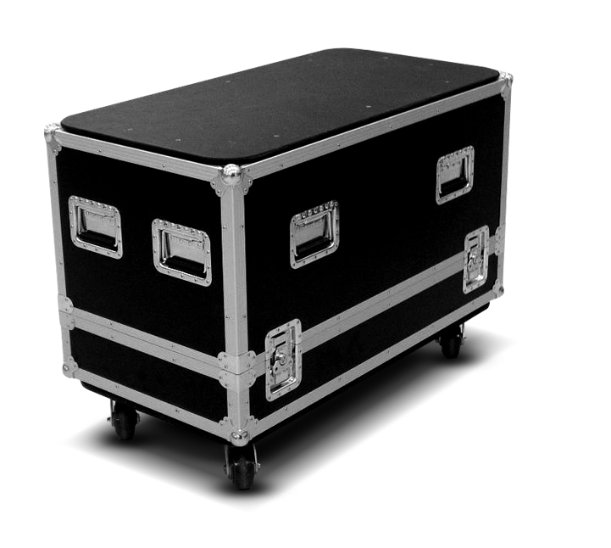
And systems are supplied ‘road ready’, with cases, covers, cables and amp racks.

Slide 28
Introducing NUAR
Because a truly versatile system needs truly versatile amplification.

Slide 29
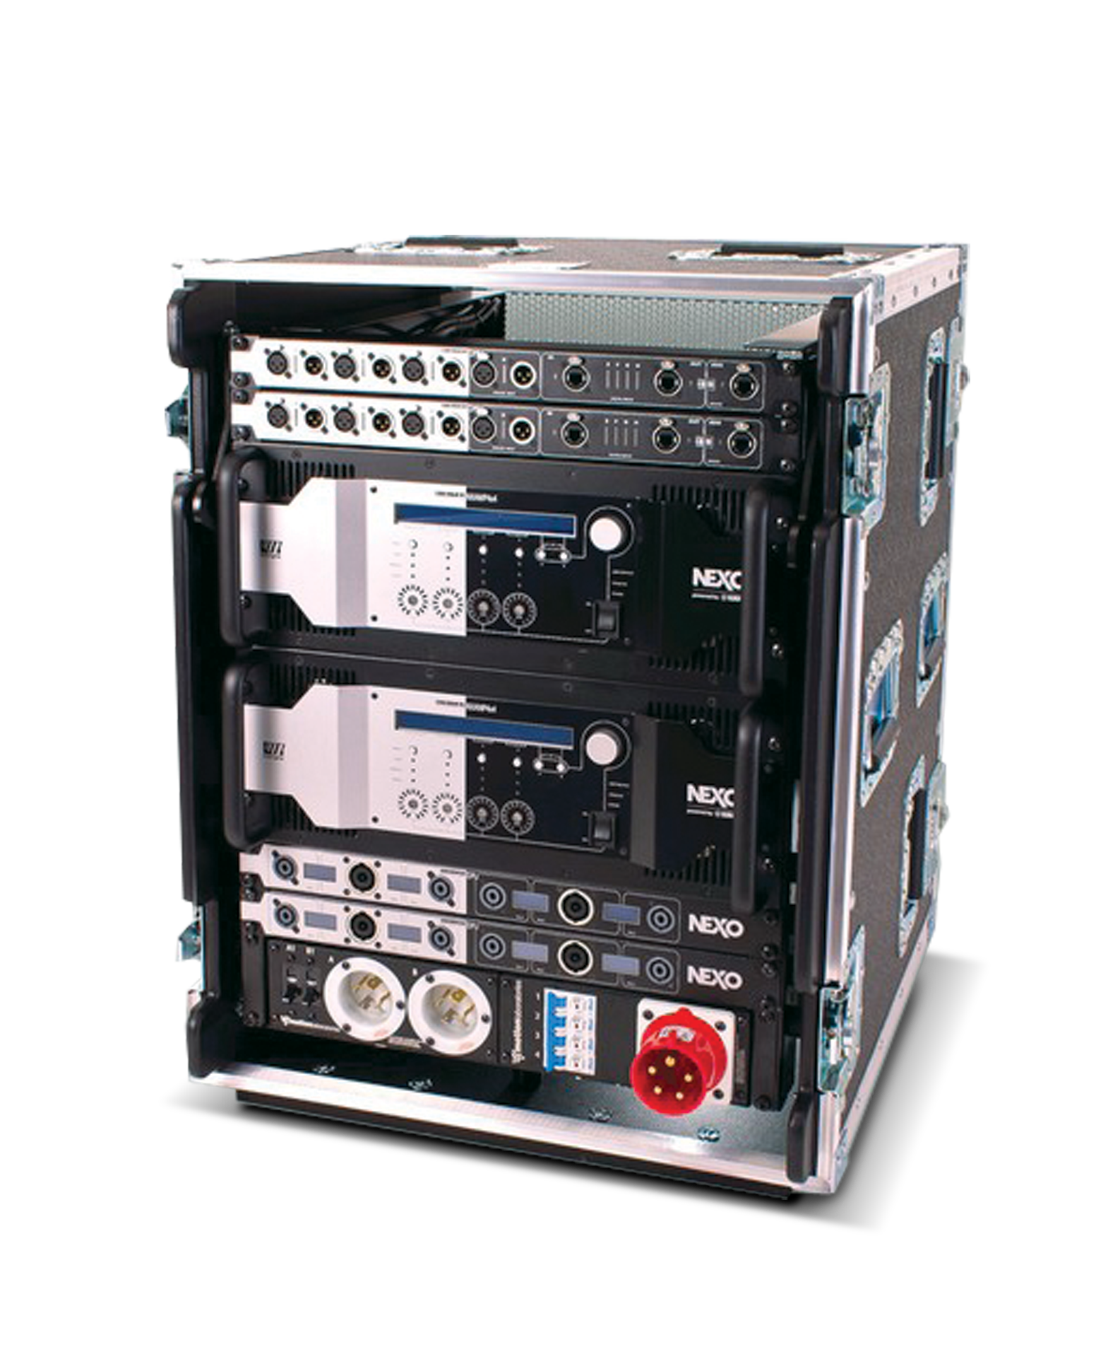
NUAR
The NEXO Universal Amp Rack
Feeds 12 x STM modules in any combination in groups of 3
Comprises 2 NXAMP 4X4, 2 Digital Output Patch, 2 Input Patch, 1 Network Module (Fiber) and 1 Power Module

Slide 30
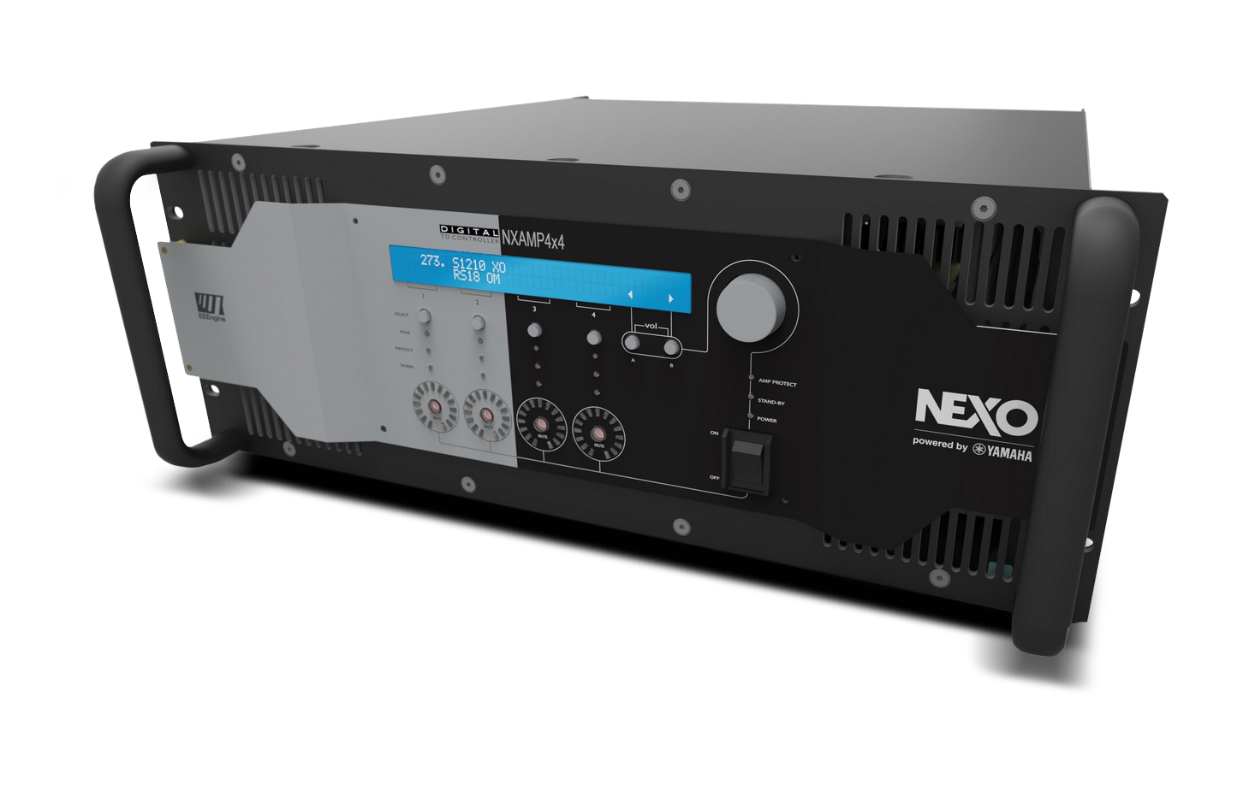
﻿NXAMP 4x4
Powered TDController
New features
New dual-voltage version
Optional Dante™ and EtherSound™ network cards
Set up selection per channel
Linear phase on all set-ups
All systems compatible 20Hz-20kHz

Slide 31
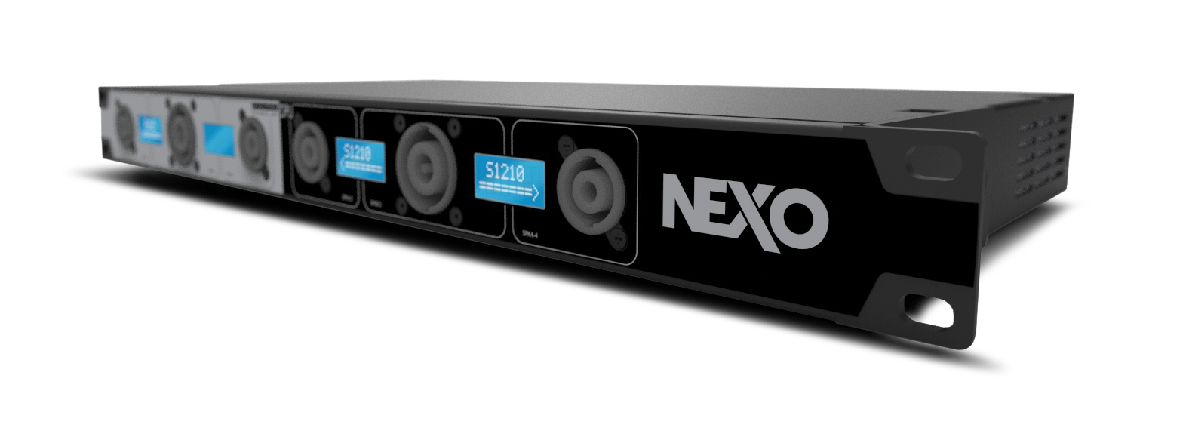
﻿DPU
Digital Patch Unit
﻿ Intelligent output patch panel offering digital communication with NXAMPs
Four individual LCD displays for easy labelling of the output speakons
Fully redundant design for maximum safety
Plug and play operation, entirely driven by the host NXAMP

Slide 32
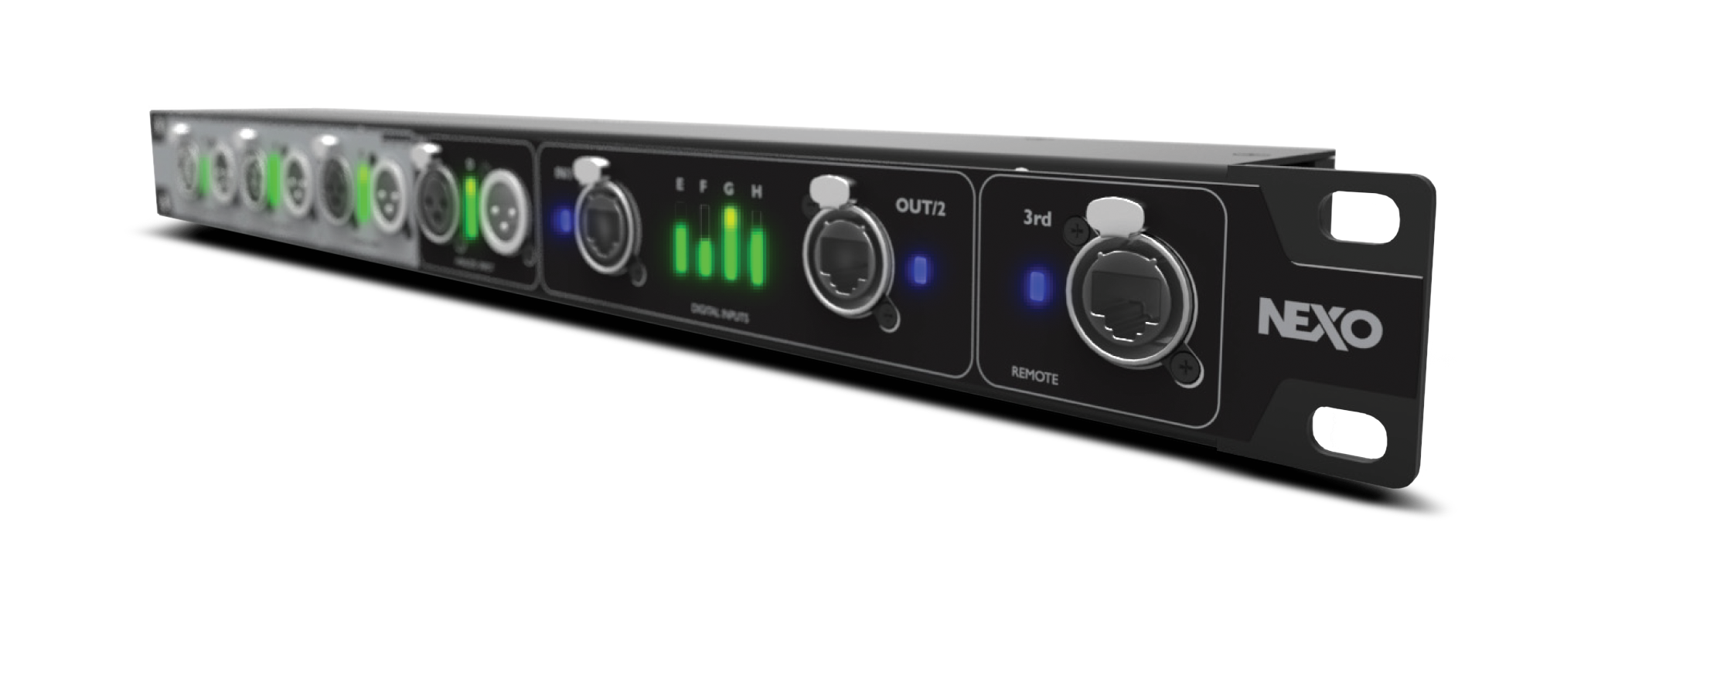
﻿DMU
Digital Meter Unit
﻿ Intelligent input patch panel offering digital communication with NXAMPs
Provides input level meters on all analog and network inputs
Fully passive design on the audio and network paths
Powered through the host NXAMP, no need for mains supply

Slide 33
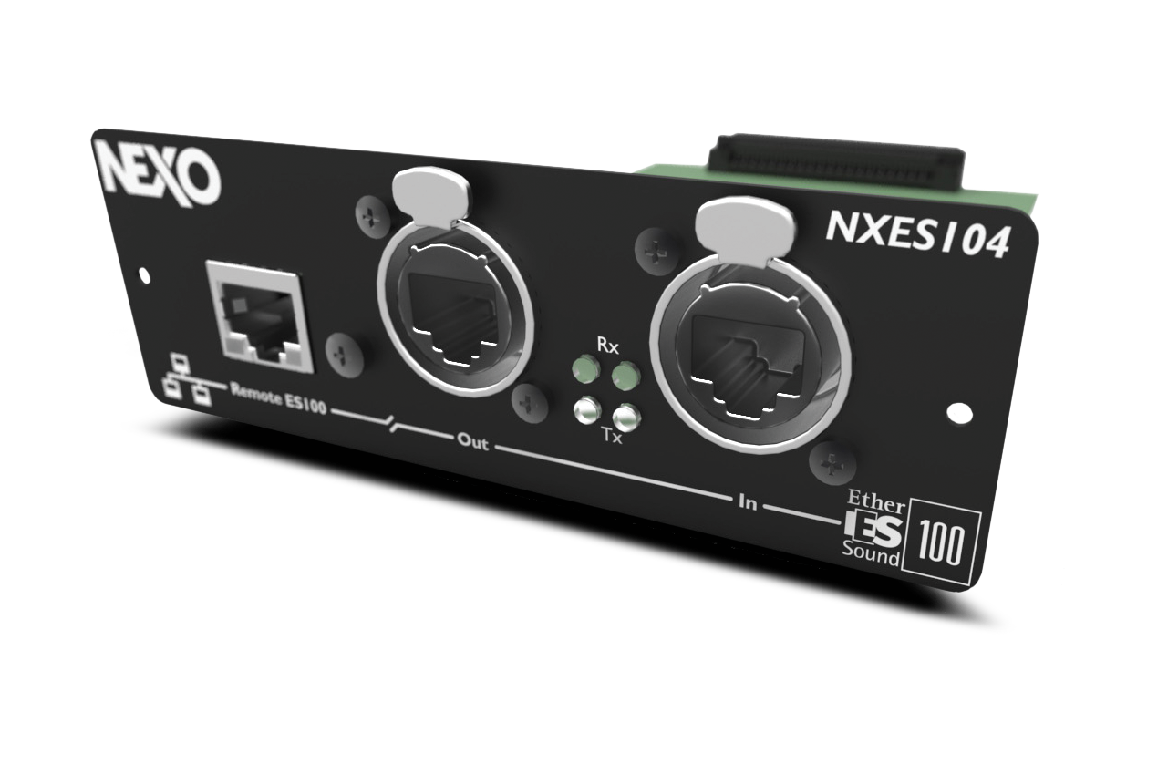
﻿NXES104
EtherSoundTM Network Card
﻿ Extracts 4 audio streams (24 bits / 48 KHz) among the 2 x 64 channels of a ES100 EthersoundTM stream
IN and OUT port for simple daisy chain without any need for an external switch
3rd Ethernet port for remote control of the whole network from any NXES104 card and ASIO streaming

Slide 34
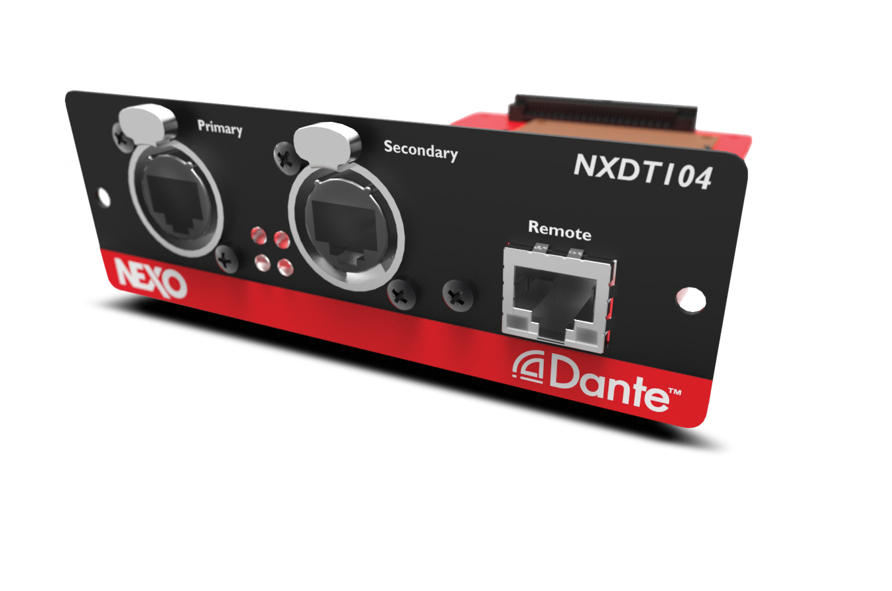
﻿NXDT104
DanteTM Network Card
﻿ Receives 4 audio streams (24 bits / 48 KHz) in Dante™ format
Dual port for redundancy and 3rd port for additional remote control
Direct connection to PC using the ASIO format

Slide 35
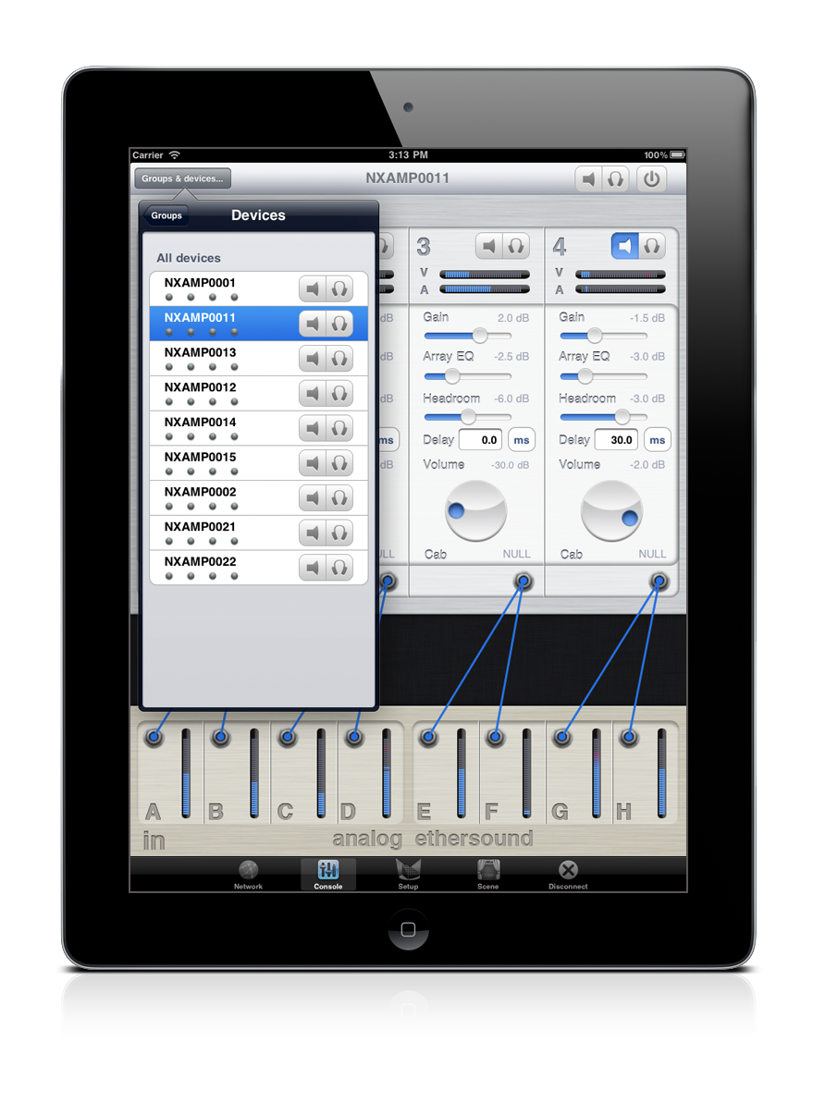
﻿NeMo
Remote Monitoring App
﻿Available free for iPad and iPhone, NEXO’s NeMo Remote Monitoring app provides remote control over a NXAMP network from anywhere in the venue.

Slide 36
It all adds up to total operational efficiency.

Slide 37
Finally, a system that works the way you work.
It’s a system we call STM.

