Slide 1
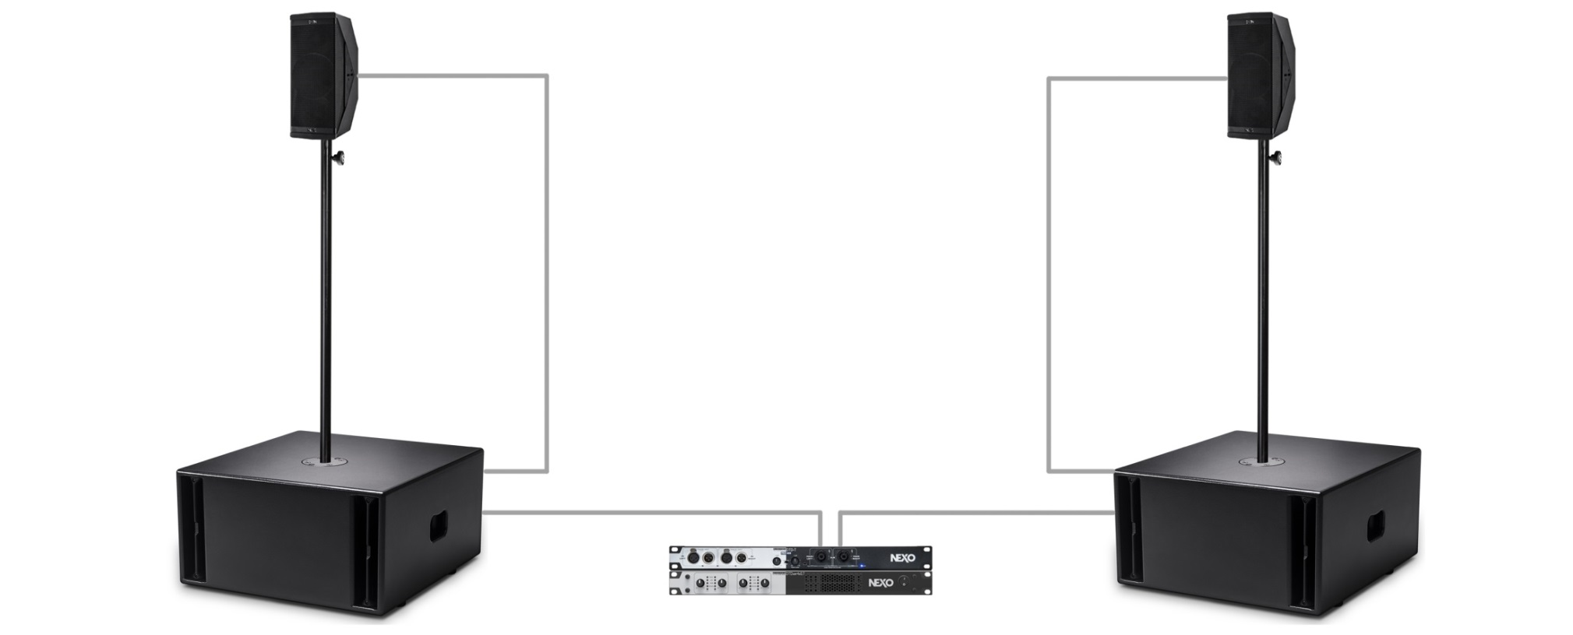

Slide 2
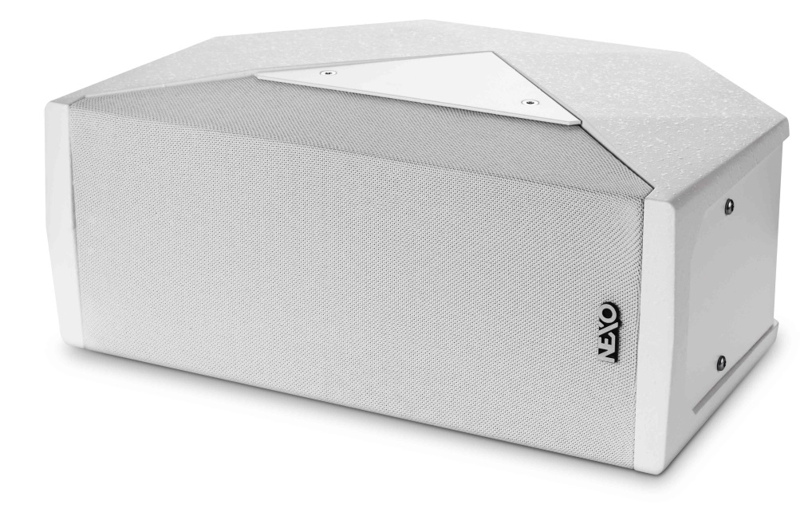
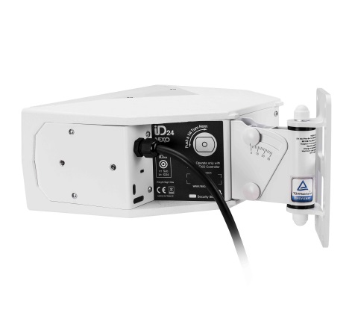
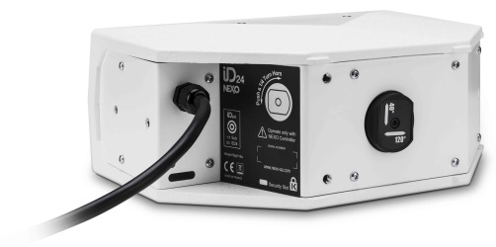
ID24i
(Installation version)
Available in black or white
Captive cable for fast and secure connectivity
Threaded holes for mounting accessories

Slide 3
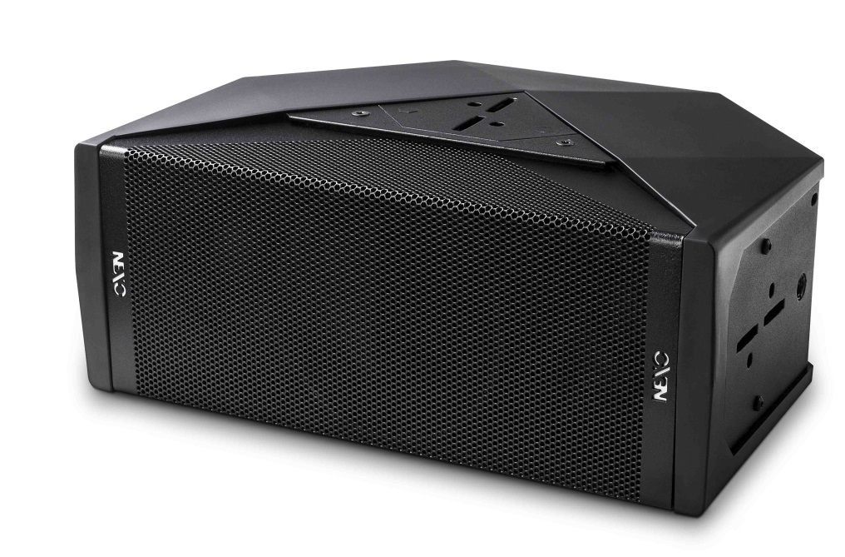
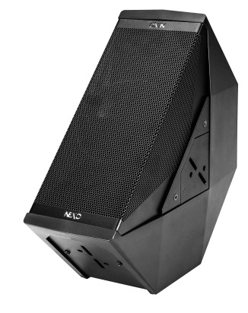
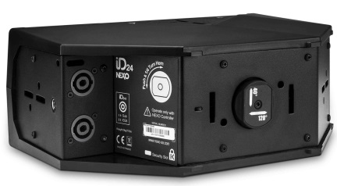
ID24t
(Touring version)
Available in black or white
Speakon connectors
Quick release rigging points
Compatible with a range of NEXO touring accessories

Slide 4
ID24c - A la Carte
Colour : Black, white or custom RAL
Directivity
120° x 40°
90° x 40°
60° x 60°
120° x 60°
Connectivity
Captive cable
Speakon
Grille
Steel
Fabric
Foam
Mounting Options
Quick release rigging points
Threaded holes

Slide 5
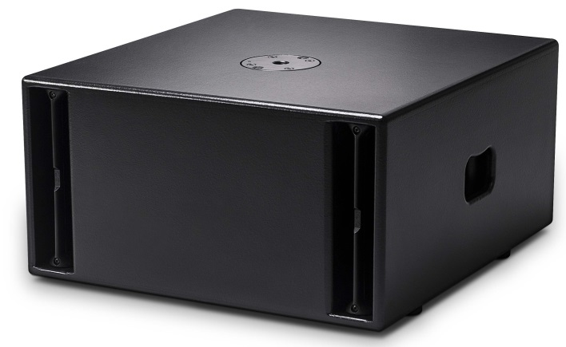
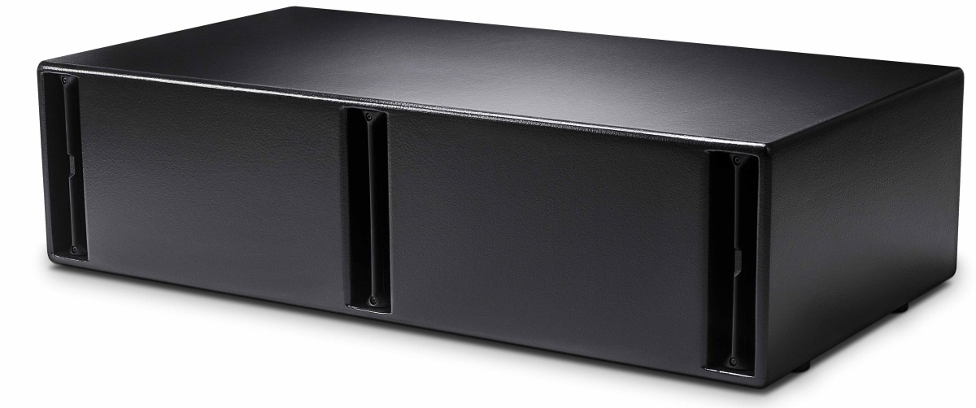
ID Series Subs
IDS110
(1x10″ sub)
IDS210
(2x10″ sub)
Compact and powerful subs, both available in install and touring versions.

Slide 7
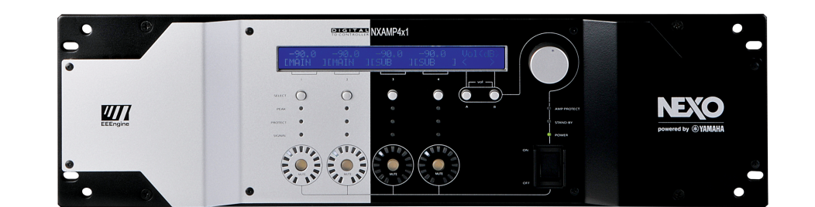
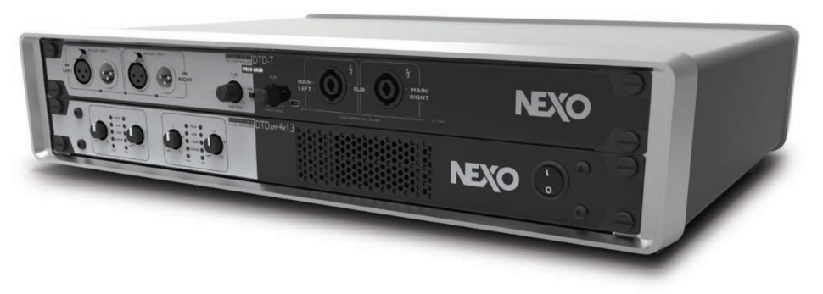
Powering options
DTD Controller and DTDAMP
NXAMP4x1
Up to 16 cabinets from a single NXAMP 4x1
Two ultra-lightweight, high-power and compact DTDAMP 4-channel amplifiers are perfectly matched to NEXO’s DTD Controller.

Slide 8
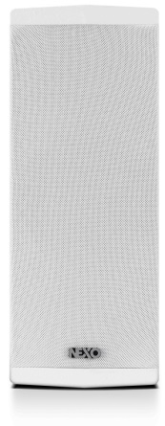
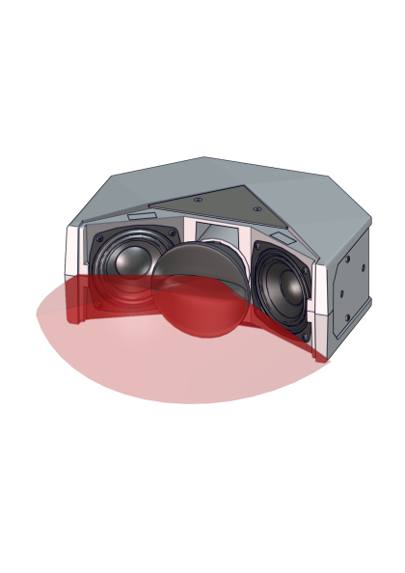
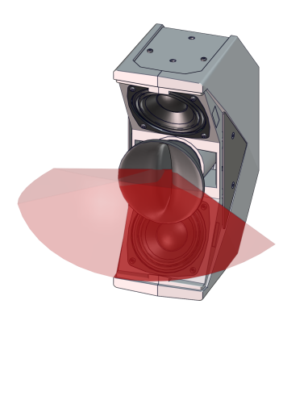
Application-focused design
User- Rotatable horn
(All HF coverages are reversible)
Horizontal
mounting
Vertical
mounting
Example : Directivity 120° x 40°

Slide 9
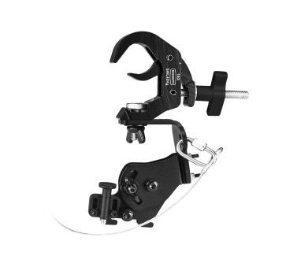
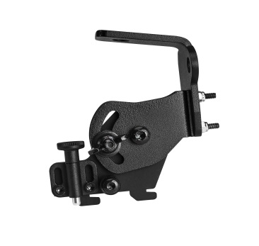
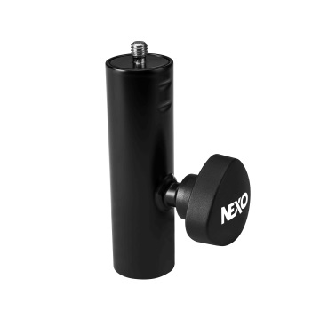
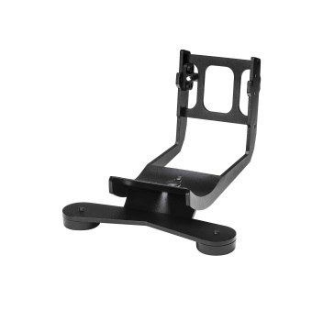
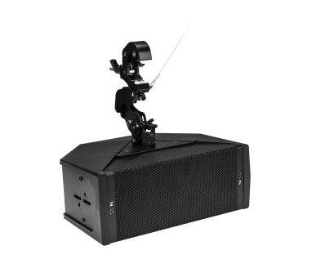
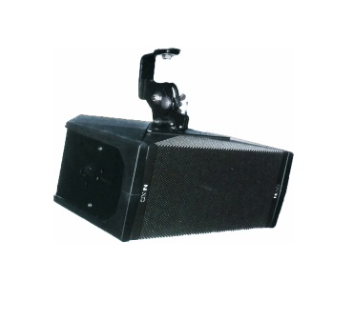
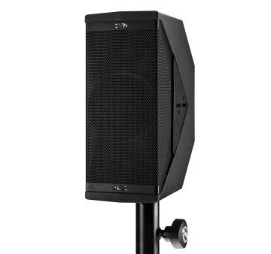
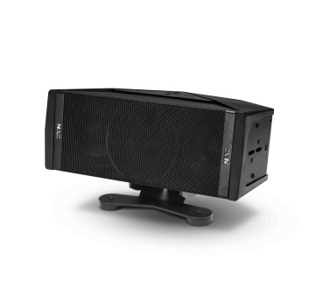
Touring Accessories
IDT-TCBRK2538
IDT-TCBRK3851
IDT-QRA
IDT-TVP
IDT-GSTK
Under-balcony
/ Flown
Truss clamp
fitting
Pole-mounting
Stage front-fill

Slide 10
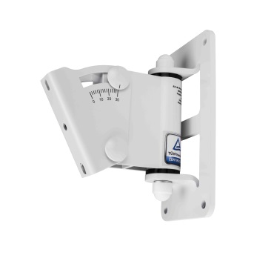
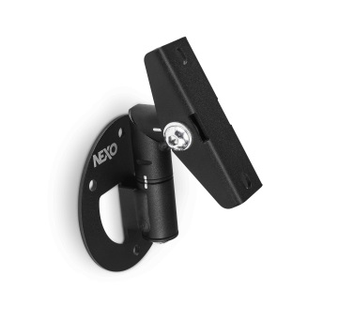
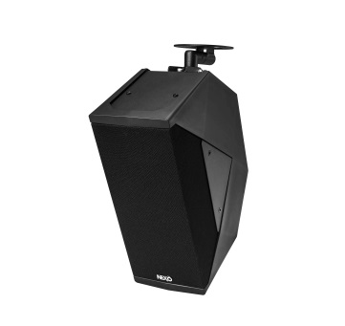
Installation Accessories
IDI-WM01
IDI-WB02
Wall-mounting
Wall-mounting

Slide 11
Sample systems
x2 ID24T
x2 IDS110T
X1 DTD-T-U
X1 DTDAMP4x0.7

